Slide 1
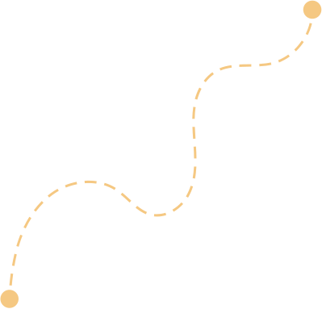
Hi Humaniser! Moment
A quick reminder to stay curious and look beyond our immediate view.
Join the Dots
Small habits shape how teams work together.

Slide 2
Pause for Clarity
(3-5 minutes)
When to use it
How it works
At the start of a meeting where teams are exploring ideas, solving problems, or reviewing progress.
It helps bring a wider perspective before diving into the conversation.
Share the reminder about connecting perspectives and information.
Invite people to briefly consider what might sit outside their immediate view.
Continue the meeting with that curiosity in mind.
Why it helps
Tips
When teams stay focused only on their own part of the work, important connections can be missed. A moment of curiosity helps reveal patterns, risks or opportunities that might otherwise stay hidden.
Curiosity often starts with one simple question.
Sometimes the most useful prompt is:
“What might we be missing?”

Slide 3

Join the Dots
In complex environments, the full picture is rarely visible from one perspective. Sometimes the most valuable insights appear when someone connects pieces others didn’t see.
A question worth asking
A few ways to look again
What might we be missing?
Is there another perspective we haven’t heard yet?
Does this connect to something happening elsewhere?
What assumptions are we making?
What would someone outside this conversation notice?

