Slide 1
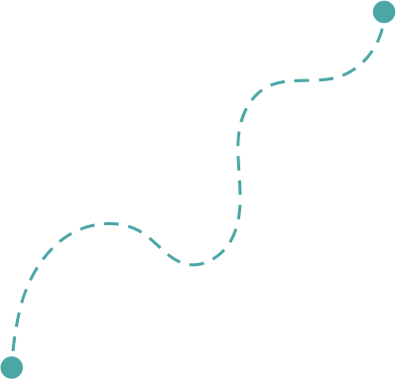
Hi Humaniser! Moment
A small insight about how the brain works and why it matters at work.
Did You Know?
Your Brain on Autopilot
Small habits shape how teams work together.

Slide 2
Pause for Clarity
(3-5 minutes)
When to use it
How it works
At the start of a meeting or learning session, especially when introducing a behavioural habit or team ritual.
It works best as a short curiosity moment, not a deep discussion.
Share the brain insight.
Invite the team to briefly reflect on where they see it in their work.
Connect the insight to a small behavioural shift.
Why it helps
Tips
When people understand how the brain naturally works, they are more open to adjusting their habits. Bringing awareness turns behaviour change from “should” into “that makes sense.”
A short insight is often enough to spark reflection.
Let the team notice where it shows up in their day-to-day work.

Slide 3

Did you know?
Your brain runs on autopilot much of the time.
This helps us move fast and handle complexity, but it also means we react before we fully think.
Under pressure, the brain tends to:
Jump to conclusions
Rely on assumptions
Respond emotionally
Small shift
Taking even a short pause helps the brain switch from reaction to reflection.
That’s why small habits like Pause for Clarity make such a difference.

