Slide 1
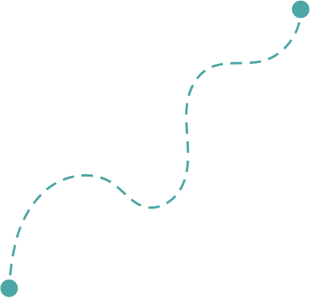
Hi Humaniser! Moment
This moment reminds us that our brains often rely on shortcuts. Those shortcuts help us move fast, but they can also influence how decisions are made in teams.
Three Biases
to Notice
Small habits shape how teams work together.

Slide 2
Pause for Clarity
(3-5 minutes)
When to use it
How it works
At the start of meetings where ideas, decisions, or plans will be discussed.
It’s a short awareness moment to help teams notice how thinking patterns can influence conversations.
Share the three common biases.
Invite the team to notice which one appears most often in your meetings.
Continue the conversation with that awareness in mind.
Why it helps
Tips
Biases are part of how the brain works. Recognising them helps teams slow down automatic thinking and stay open to different perspectives.
Often the simple act of naming the pattern helps teams notice it sooner.

Slide 3

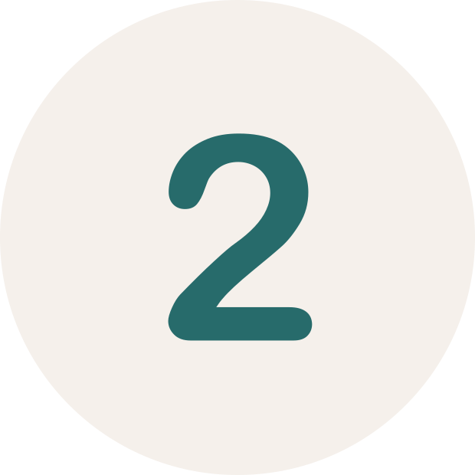
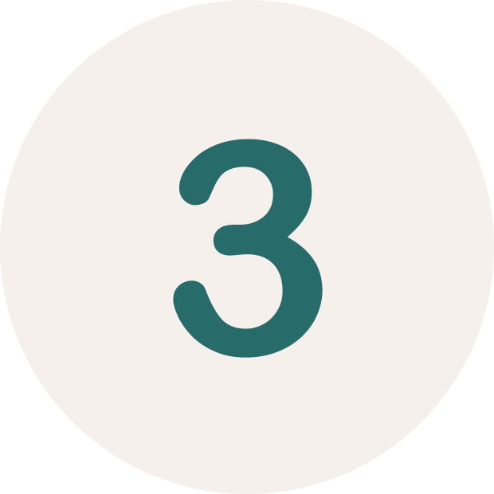
Three Biases to Notice
Which of these feels familiar?
Confidence sounds like certainty
Silence is often taken as agreement
The first idea anchors the discussion
When someone presents an idea with strong confidence, it can quickly gain traction, even before others have had time to think it through.
Sometimes the most confident voice shapes the direction of the conversation.
When a question is asked and no one responds, it’s easy to assume everyone agrees.
But silence can mean many things: people may still be thinking, unsure, or hesitant to speak.
The first idea shared in a conversation often becomes the reference point for everything that follows.
Even when better ideas appear later, the group tends to compare them to the first one.

