Slide 1
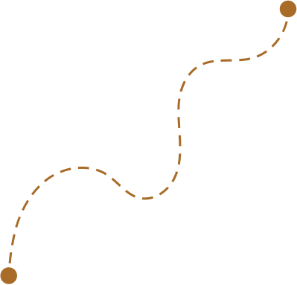
Hi Humaniser! Moment
A simple way to keep the team’s current ritual visible and alive.
What We Are Practicing
Small habits shape how teams work together.

Slide 2
How to run this HH! Moment
(1-3 minutes)
When to use it
How it works
At the start of a team meeting. It takes 2 minutes and keeps the team connected to the habit they are currently practising together.
Remind the team of the ritual currently in focus.
Read the ritual out loud or show it on the screen.
Invite the team to notice where it might show up in today’s work.
Why it helps
Tips
When habits stay visible, they are more likely to stick.
A quick reminder keeps the ritual alive and helps the team practise it in real situations.
Keep it short and natural.
This is not a discussion, it’s just a gentle reminder of the habit the team is building together.

Slide 3


What we are practicing
Practising together
Have you had a chance to try this ritual yet?
Where did you find it useful this week?
What did you notice when you used it?
Team Ritual
insert

