Slide 1
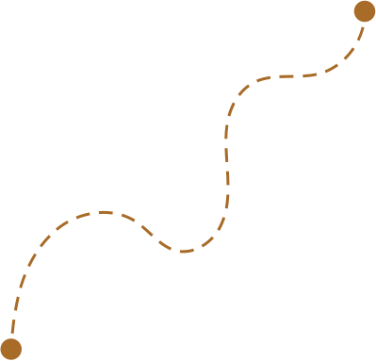
Hi Humaniser! Moment
A reflection shared by the team, captured anonymously.
From the Reflection Wall
Small habits shape how teams work together.

Slide 2
How to run this HH! Moment
(1-3 minutes)
When to use it
How it works
At the start of a team meeting. It takes 2 minutes and keeps the team connected to the habit they are currently practising together.
Select one anonymous reflection from the team Reflection Wall.
Share it with the group.
Give people a moment to read & reflect.
Why it helps
Tips
Sometimes a single reflection can highlight patterns, tensions, or small wins that many people recognise. Hearing the team’s voice can bring awareness that numbers or reports don’t capture.
Allow a short pause after sharing it. Often the reflection will resonate without needing further explanation.

Slide 3


From the Reflection Wall
Anonymous reflection from the team
insert

