Slide 1
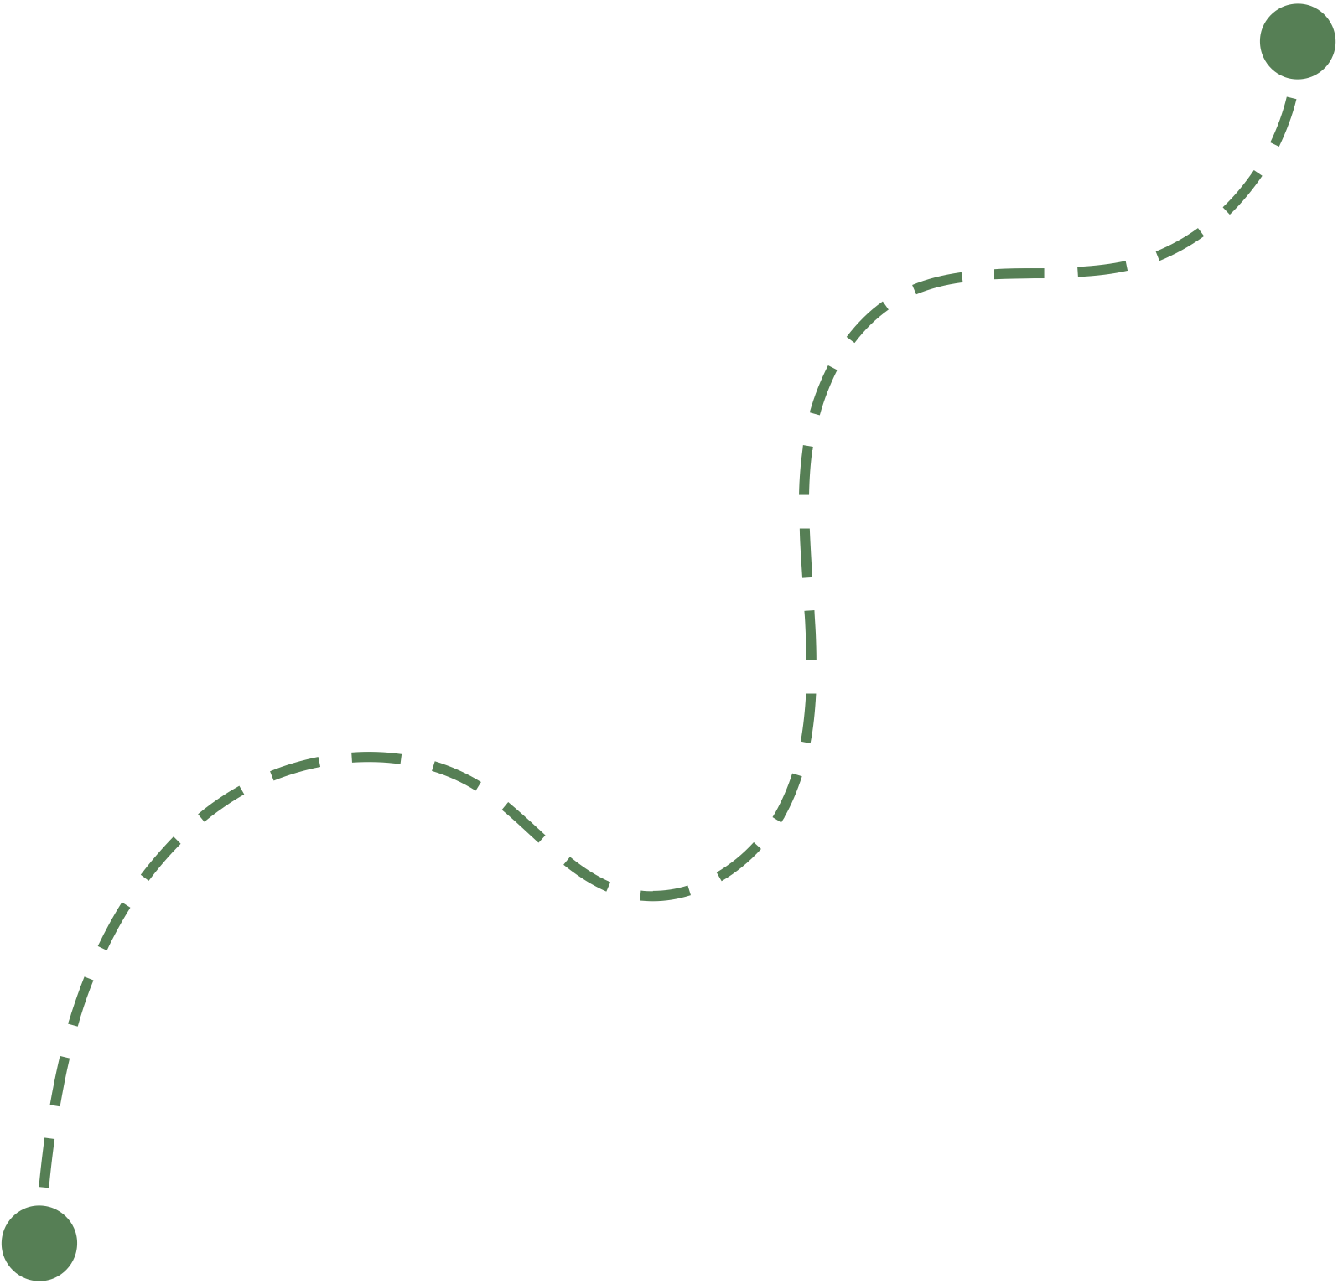
Hi Humaniser! Moment
A quick way to notice patterns that pull teams away from the habits they’re trying to build.
Common Traps to Watch For
Small habits shape how teams work together.

Slide 2
How to run this HH! Moment
(3-5 minutes)
When to use it
How it works
During a team discussion, meeting, or decision where collaboration matters.
It can also be used as a quick reminder when the team feels stuck, misaligned, or talking in circles.
Show the three common traps.
Invite the team to notice which one appears most often in your work.
Explore the small shift that could help the team catch it earlier.
Why it helps
Tips
Naming common traps helps teams spot them sooner and make small adjustments that improve how people work together.
Keep the tone curious, not critical.
The goal is not about analysing behaviours but to notice patterns and try small shifts.

Slide 3



Common traps that affect collaboration
Which of these feels familiar?
Assuming instead of checking
Listening to respond, not to understand
Silence when something feels off
We move forward based on what we think others meant, without confirming
People focus on preparing their reply rather than fully hearing the other person.
People notice misalignment but hesitate to raise it.
Small shift
Small shift
Small shift
Pause and ask: “Is this what you meant?”
Pause and summarise what you heard before adding your view.
Name the tension early, even briefly.

