Slide 1

Hi Humaniser! Moment
This moment helps teams build awareness, connection, and better collaboration, before the work even begins.
Weather Check
Small habits shape how teams work together.

Slide 2
How to run this HH! Moment
(3-5 minutes)
When to use it
How it works
At the start of a team meeting, stand-up, or check-in, especially when the team has been under pressure or moving fast.
Show the Weather Check slide.
Ask everyone to choose the weather that best reflects how they’re arriving today.
People respond through a quick anonymous poll.
No explanations required, unless someone chooses to share more.
Why it helps
Tips
A quick anonymous check-in helps teams understand the energy in the room. It gives leaders and teams a simple signal of how people are arriving, without putting anyone on the spot.
Keep it light.
The goal is awareness, not analysis.

Slide 3




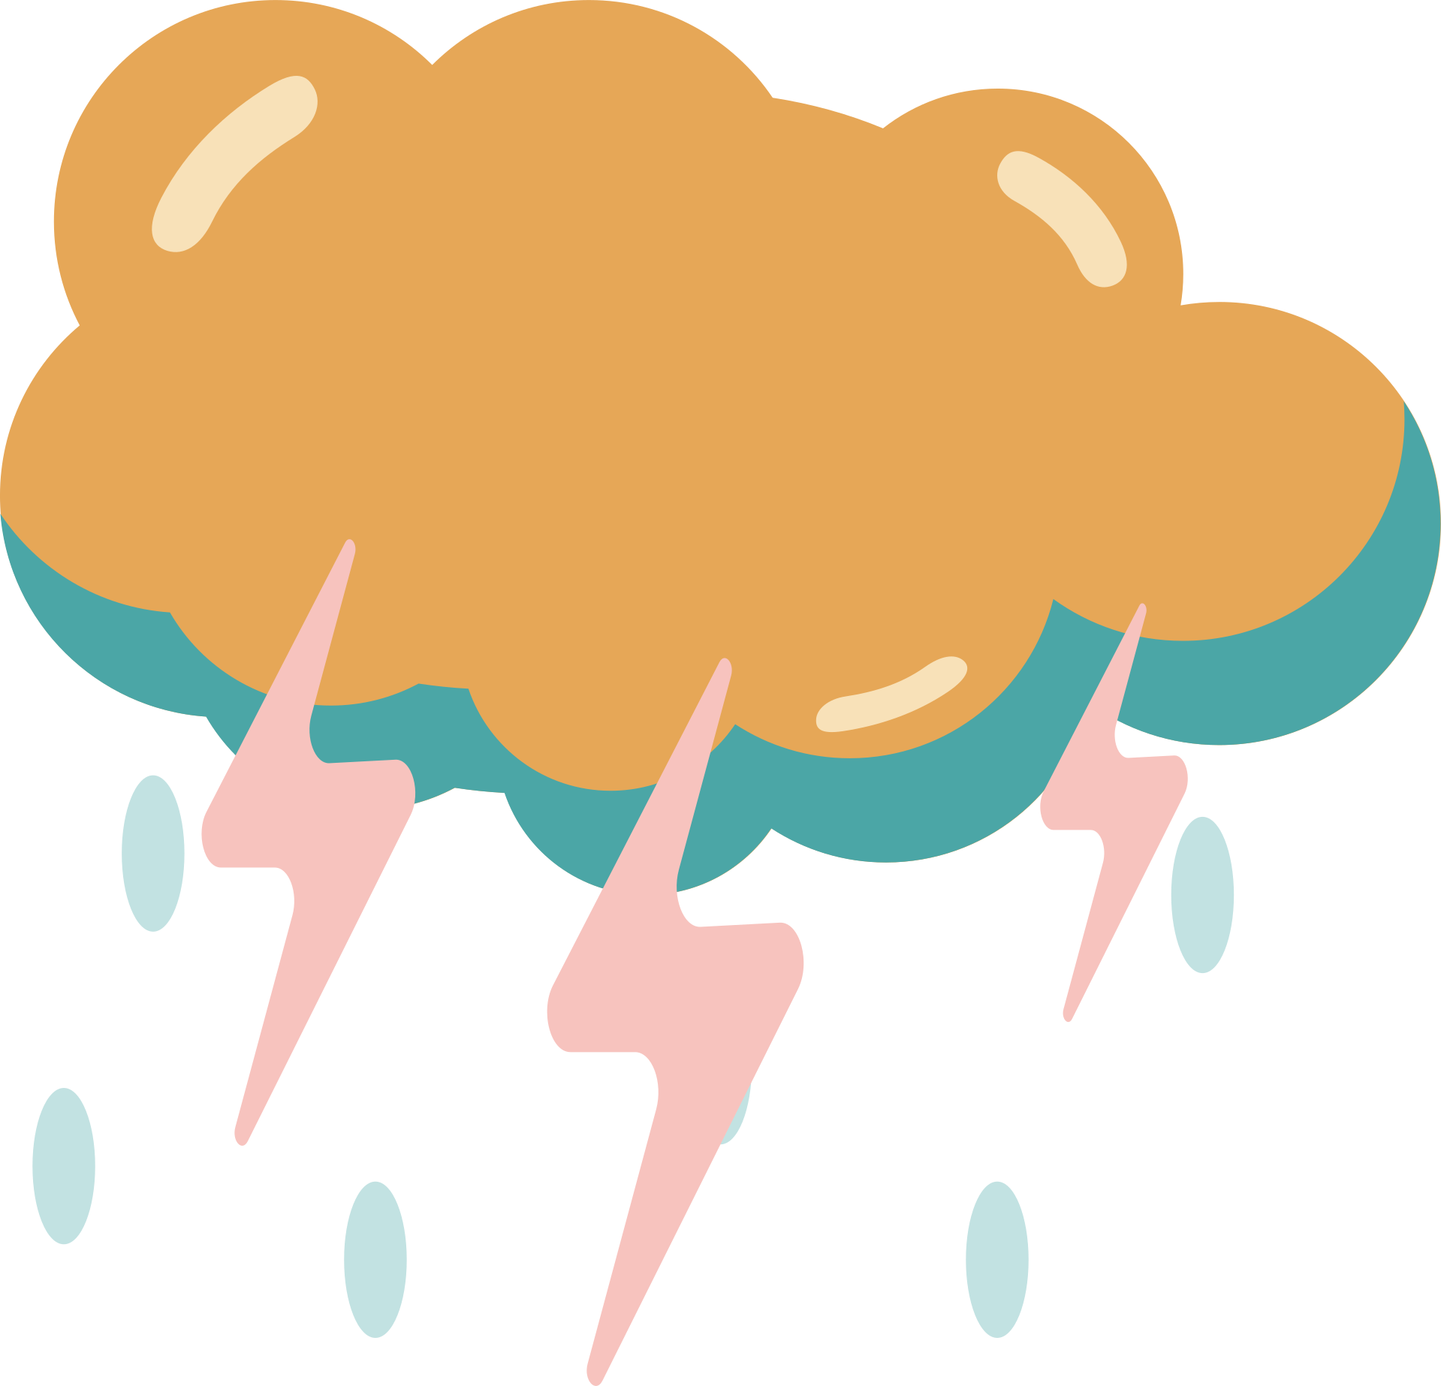
What’s your weather today?
Clear and energised
Mostly good, a few clouds
Low energy or distracted
Under pressure today
A tough day
Anonymous check-in

