Slide 1
Enterprise Application Development Lecture 2- Architecture
Vidushi Liyanaarachchi

Slide 2
TOPICS
Overview
Key Factors
Without Architecture
Types of Architectures
Layered Architecture
MVC Architecture
Component Based Architecture

Slide 3
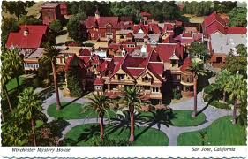
OVERVIEW
Winchester Mystery House
mansion in California
147 builders and 0 architects
The mansion contains 160 rooms, 40 bedrooms, 6 kitchens, 2 basements and 950 doors
Of there 950 doors, 65 of them open to blank walls
13 staircases were built and abandoned
24 skylights were installed into various floors

Slide 4
OVERVIEW
High
Business Architecture | Enterprise Architecture
No Architecture | Technology Architecture
Business
Return on Information
Low
Low
Technology
High
Reduction of Complexity & Cost

Slide 5
OVERVIEW
Analogy to Enterprise Architecture
The City planning and EA
City planners has to consider many unknowns such as future transportation technology, Changing work, living and commuting patterns. Because of this planning the cities are able to accommodate new technologies for transportation and communication which viable remain for hundred of years. [Nolan and Mulryan, 1987]

Slide 6
OVERVIEW
Definitions
Enterprise Architecture is about understanding all of the different elements that go to make up the enterprise and how those elements interrelate [The Open Group]
Enterprise Architecture is a strategic information asset base, which defines the business mission, the information necessary to perform the mission, and the transitional processes for implementing new technologies in response to the changing mission needs. [USA Federal CIO Council]

Slide 7
OVERVIEW
Logical Components of an Enterprise Architecture
Presentation
Business Logic
Financials
Transport
Sales & Services
Distribution
Maintenance
Projects
Engineering
Manufacturing
HR
Data

Slide 8
WITHOUT ARCHITECTURE
Unpredictable Solutions
Poor Quality and Reduced User Experience
Stunted Evolution
Rigid Systems (hard to reuse)

Slide 9
LAYERED ARCHITECTURE
Started with Client\Server
Thin Client – Web clients [Google Docs/Photo Editor web]
Fat Client – Window Clients [Word Document/Photo Editor Desktop]
Evolution
Two Tier – User Interface and Database
Three Tier – UI, Business Logic Layer, Database

Slide 10
LAYERED ARCHITECTURE
Multilayer Architecture
Presentation layer (a.k.a UI layer, view layer, presentation tier)
Application layer (a.k.a. service layer)
Business Layer(a.k.a business logic layer)
Data Access Layer (a.k.a persistence layer)

Slide 11
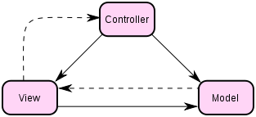
MVC ARCHITECTURE
Model, View and Controller
Model - A model represents an application’s data and contains the logic for accessing and manipulating that data
View - The presentation semantics are encapsulated within the view
Controller -The controller is responsible for intercepting and translating user input into actions to be performed by the model

Slide 12
MVC ARCHITECTURE
Web Browser and web page example
Model - Encapsulate data in the database.
View - Presentation layer, web pages, CSS, Java script
Controller - Process and respond to events

Slide 13
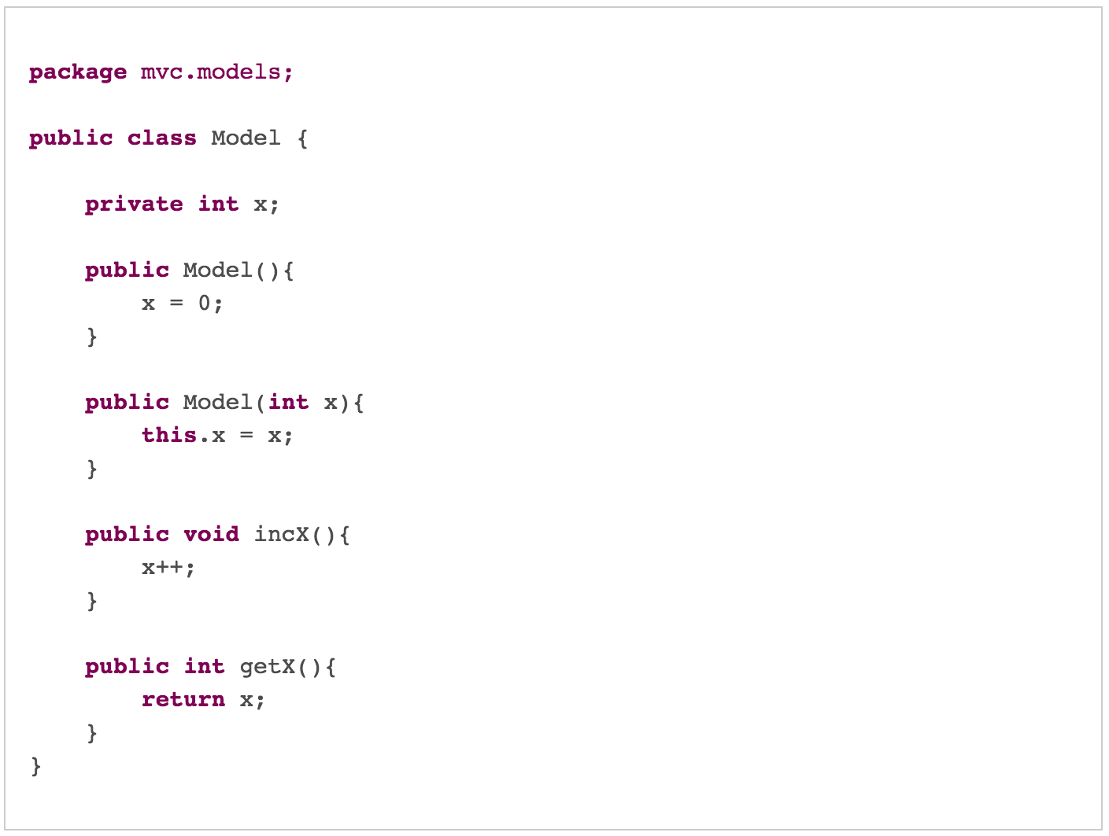
MVC ARCHITECTURE

Slide 14
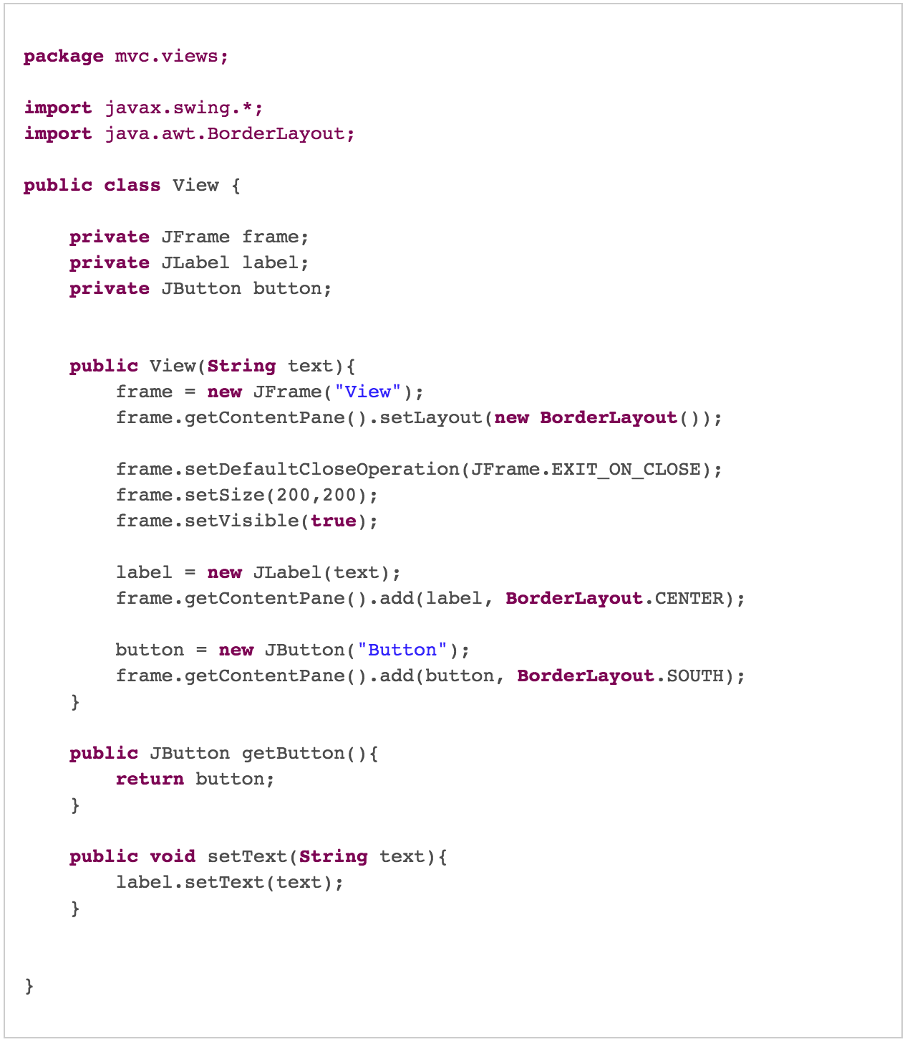
MVC ARCHITECTURE

Slide 15
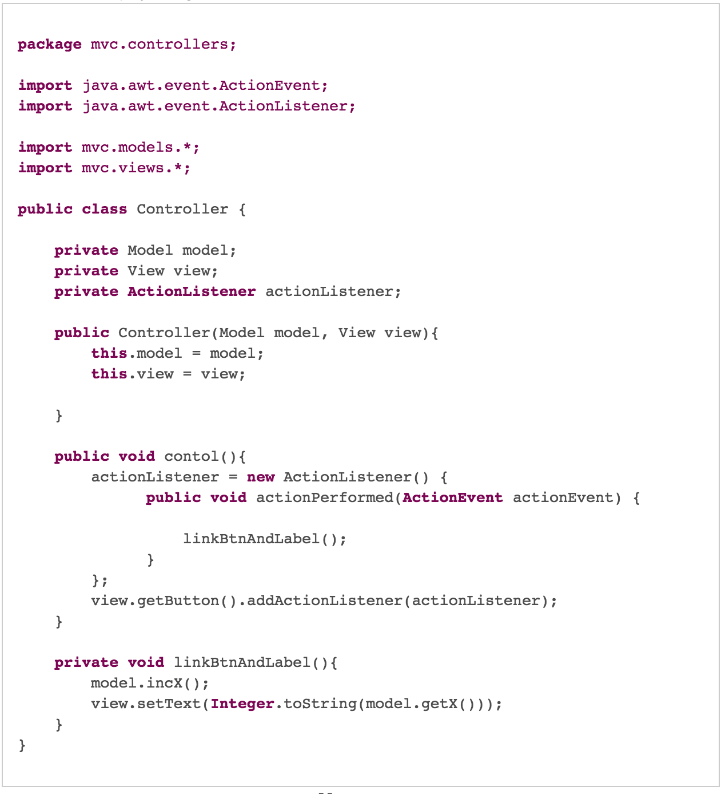
MVC ARCHITECTURE

Slide 16
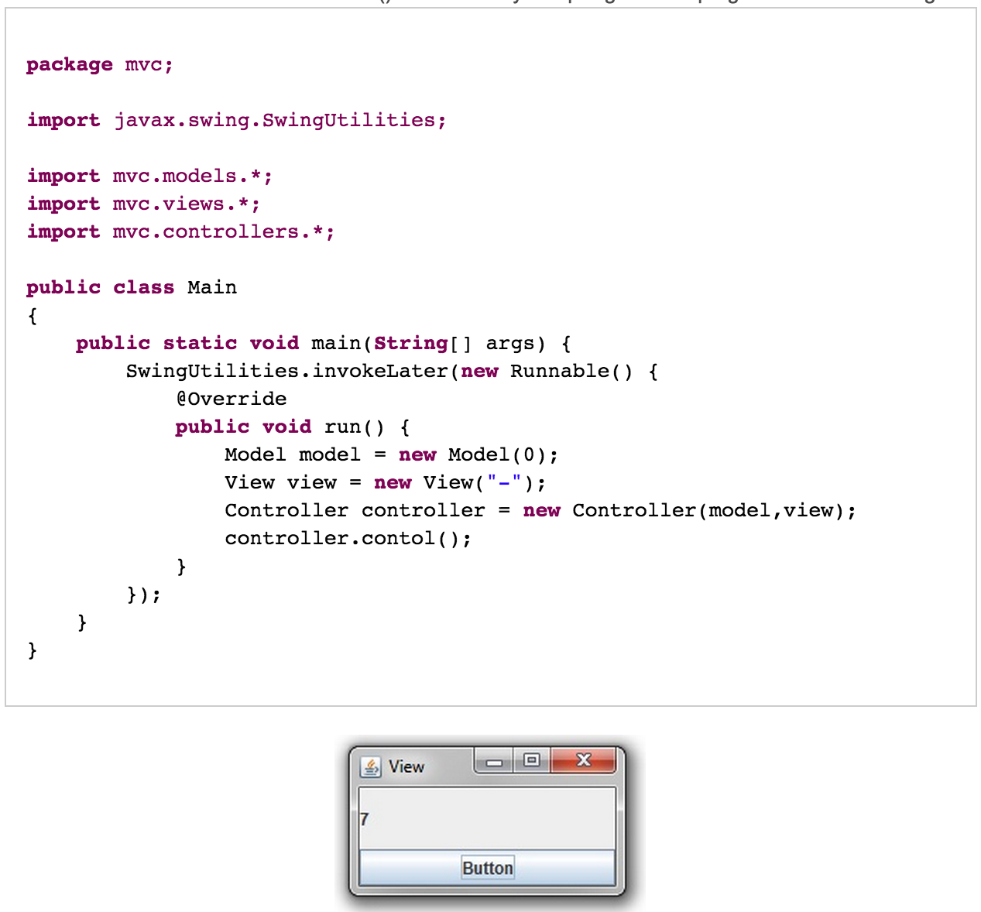
MVC ARCHITECTURE

Slide 17
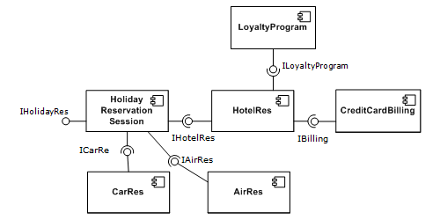
COMPONENT BASED ARCHITECTURE
Notes:
Describe Encapsulation using data retrieval via a component
Discuss the Customer and developer point of view

Slide 18
COMPONENT BASED ARCHITECTURE
Why Component architecture
EA Involved high complexity
Adopt new functionality in low cost manner
Easier for new customers to implement
Existing customer should be able to upgrade to new functionality

Slide 19
COMPONENT BASED ARCHITECTURE
What is Component
Individual module which has following attributes
Separation – All data and Functions are semantically related
Interfacing – Which can upgrade with new components
Standardization – Agreed standard interface
Example PC
Constructed by different manufacturers
Assembled very rapidly
Assembler is not an expert in internals of each component
Interface | Implementation

Slide 20
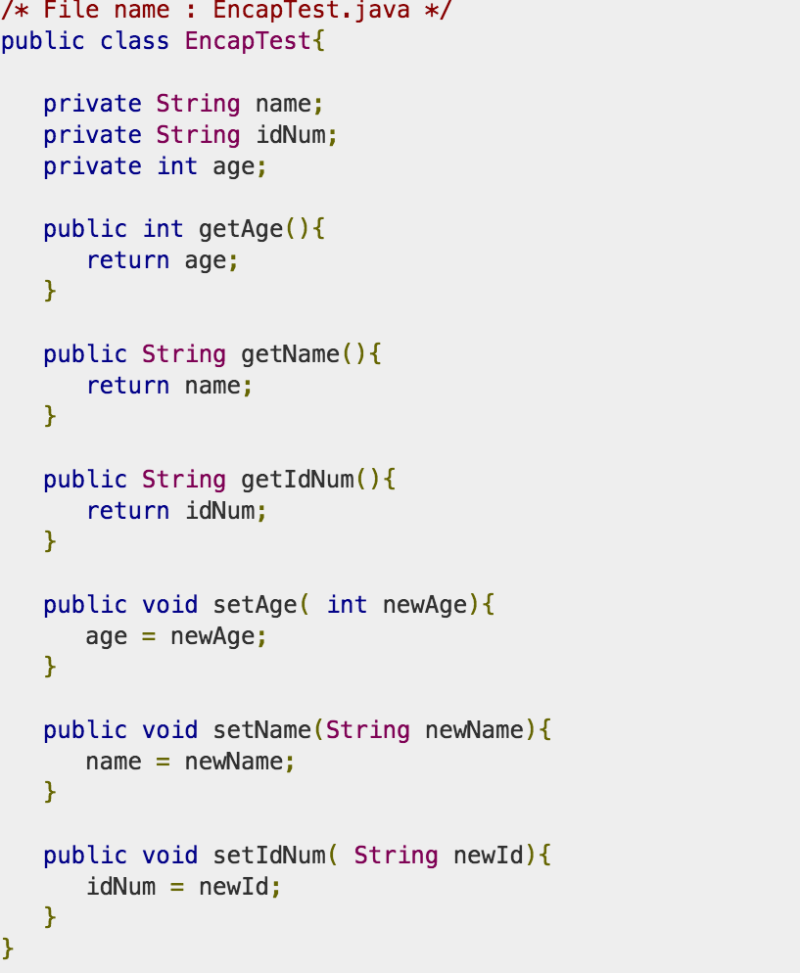
COMPONENT BASED ARCHITECTURE
Notes:
Describe Encapsulation using data retrieval via a component
Discuss the Customer and developer point of view

