Slide 1


Slide 2

Exploratory data analysis on house price project
Prepared by:- Rashmi Pradeep

Slide 3

Problem Statement:-
Objective:
Explore housing data to identify price drivers and prepare data for predictive modeling.
Analyze housing data to understand structure and patterns.
Identify key factors influencing house sale prices.
Prepare clean and transform data for modeling.

Slide 4
PROJECT PIPELINE/EDA WORKFLOW
1. Problem Understanding 2. Data Understanding 3. Data Cleaning 4. EDA | Define objective and target variable (SalePrice). Dataset Overview. Variable types (Numerical & Categorical) Missing value analysis & treatment. Handling outliers. Univariate analysis Bivariate analysis Multivariate analysis

Slide 5
Data SET OVERVIEW
TOTAL VOLUME
DIMENSIONALITY
PREDICTION GOAL
1,460 Rows/Observation
81 Total Features 36 Numerical 45 Categorical
SalePrice Target Variable

Slide 6
Data Understanding
Identified numerical and categorical variables.
Checked data types and variables meanings.
Reviewed key features influencing house prices.
Understood target-feature relationships conceptually.

Slide 7
Tools, libraries & platform used
Libraries Used
Programming Language
Platform/Environment
Python 3
Numpy-Numerical computations
Pandas-Data manipulation & cleaning
Matplotlib-Basic data validation
Seaborn-Statical & advanced
Jupyter notebook(Google colab)
Microsoft power point-Presentation & insights sharing

Slide 8
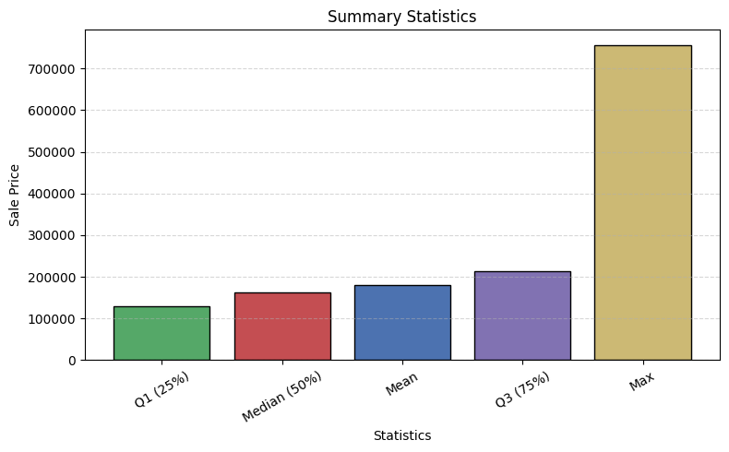
SUMMARY STATISTICS OF SALE PRICE
The dataset contains 1460 residential properties.
The average sale price is approx. Rs 180921, indicating the general market value.
The median sale price is Rs 163000, which is lower than the mean, suggesting a right skewed distribution.
Sale prices range from Rs 34900(minimum) to Rs 755000 (maximum), showing a wide variation in house prices.

Slide 9
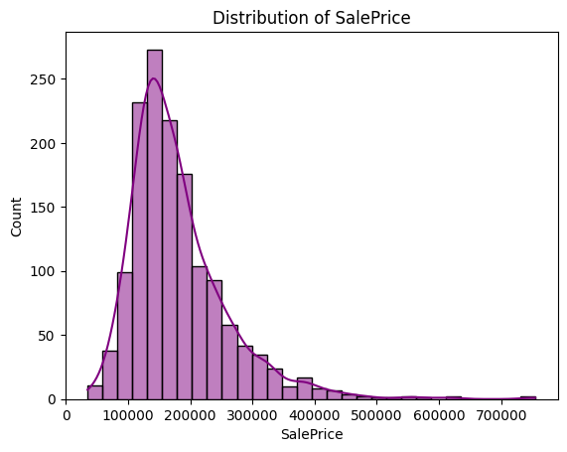
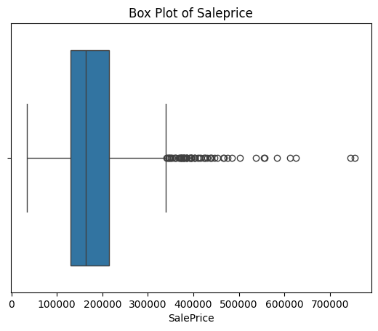
UNIVARIATE ANALYSIS (NUMERICAL)
Univariate analysis examines the distribution of individual variables independently. Here, we analyze the target variable Sale price to understand its distribution, central tendency, spread, skewness, and presence of outliers.
The Sale Price distribution is right skewed with most properties concentrated in the lower to mid price range and the box plot reveals the presence of several high value outliers.

Slide 10
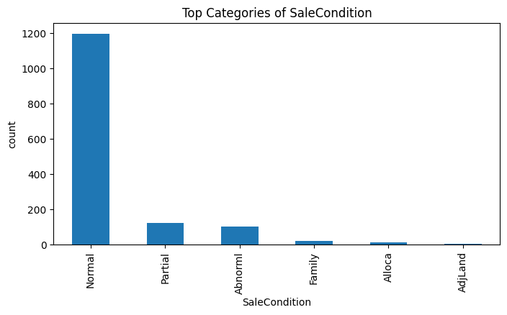
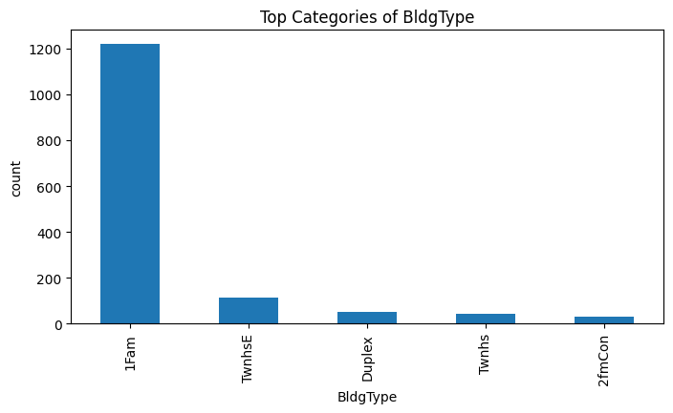
UNIVARIATE ANALYSIS (CATEGORICAL)
Most houses are sold under normal sale conditions, while other sale types occur very rarely.
The majority of properties belong to the 1Fam building type, indicating dominance of single family homes in the dataset.

Slide 11
SKEWNESS & DISTRIBUTION INSIGHTS
Sale Price shows positive(right) skewness.
Mean value is greater than the median.
Majority of houses fall in the lower to mid price range.
Presence of high value outliers stretches the distribution.
Log transformation can help improve normality for modeling.

Slide 12
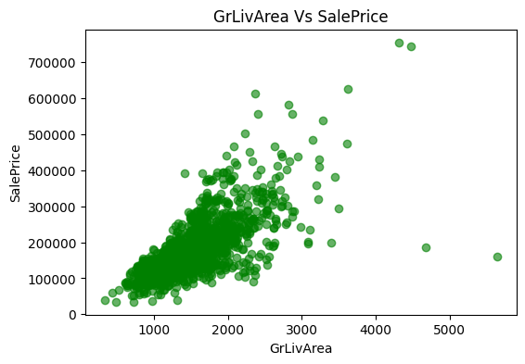
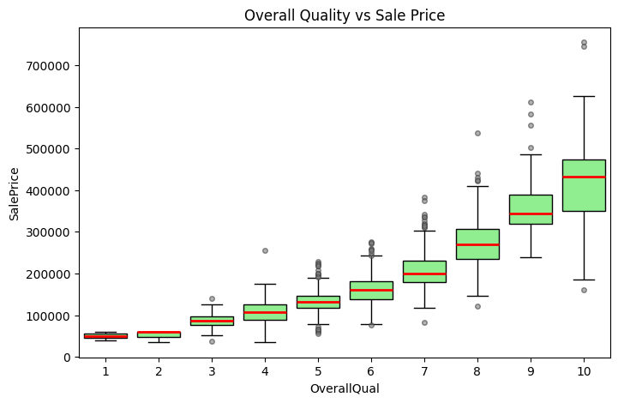
BIVARIATE ANALYSIS
A strong positive relationship is observed between GrLivArea and SalePrice, indicating that larger living areas tend to have higher house prices.
Overall Qual shows a clear increasing trend in median sale price, confirming its strong influence on house value.
Variability in sale prices increases with higher quality ratings, suggesting premium properties exhibit greater price dispersion.
A few high value outliers are visible, particularly for large houses and high quality scores.

Slide 13
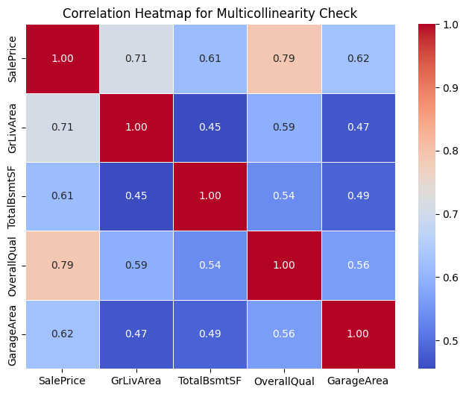
MULTIVARIATE ANALYSIS
SalePrice shows strong positive correlation with OverallQual and GrLivArea.
No severe multicollinearity observed among major predictors.
Relationships observed are consistent with bivariate results.
Selected features are suitable for further modeling.

Slide 14
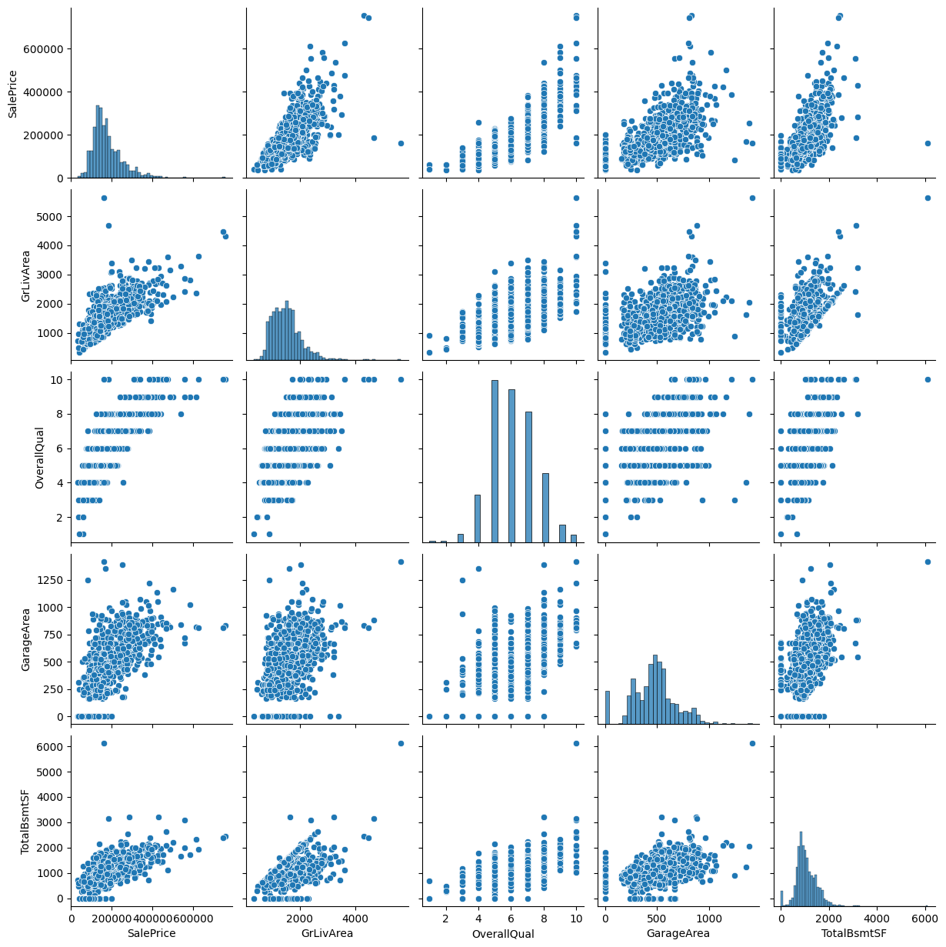
MULTIVARIATE ANALYSIS (PAIR PLOT)
Sale Price shows strong positive correlation with GrLivArea and Overall Qual.
Distribution plots confirms right skewness in Sale Price.
No severe multicollinearity observed among selected predictors.
Relationships are consistent with bivariate analysis findings.

Slide 15


PREDICTION INSIGHTS & CONCLUSION
Sale Price is strongly influenced by Overall Qual, GrLivArea, and Total BsmtSF.
Numerical features showed stronger predictive power compared to categorical features.
Right skewness in Sale Price suggest log transformation may improve model performance.
Outliers were identified but retained to preserve real world data variability.
EDA findings provide a strong foundation for accurate model building.
CHALLENGES FACED DURING EDA
Handling missing values across multiple numerical and categorical variables.
Selecting relevant features from a large numbers of variables (81 features).
Dealing with outliers without removing important high value properties.
Interpreting skewed distribution and choosing appropriate transformation.
Deciding which visualizations were meaningful.

Slide 16
THANK YOU

