Slide 1
SEIS - Special Education Information System
Individualized Education Program (IEP)

Slide 2
What is IEP?
Why IEP?
Eligibility Criteria?
Processes?

Slide 3


DYSLEXIA

Slide 4
Individualized Education Program IEP (What is IEP ?) legal document - United States law - developed for each public school child in the US who needs special education As outlined by IDEA, students can receive free appropriate education under special education law if they fall under one of 14 categories Autism Deaf-blindness Deafness Developmental delay (for children aged 3–9, varies by state) Emotional and behavioral disorders Hearing impairment Intellectual disability (formerly referred to as mental retardation) Multiple disabilities Orthopedic impairment Other health impairment Specific learning disability Speech or language impairment Traumatic brain injury Visual impairment, including blindness

Slide 5
WHY IEP? Individuals with Disabilities Education Improvement Act (IDEA 2004) - US law - equity, accountability and excellence in education for children with disabilities - 2018 ~ 7million students enrolled - keep up with the other normal child - perform at the level the child should be performing out

Slide 6
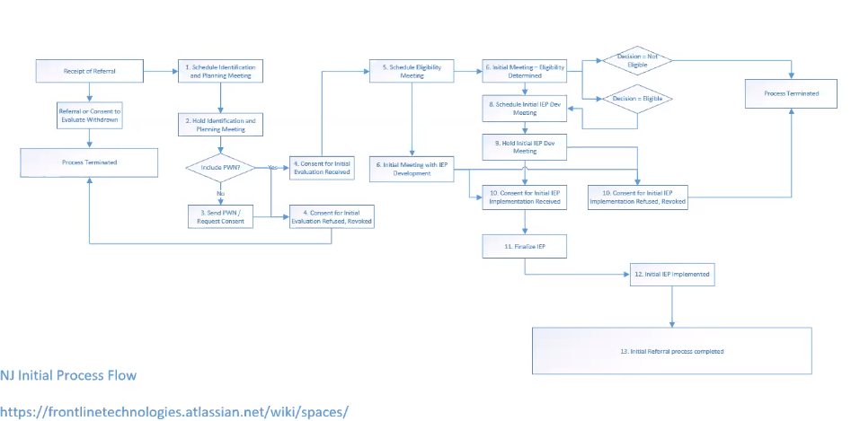

Slide 7
1. Receipt of Referral – 1st request from parents/ teacher – process begins State – School district – timeline – tracked – compliance 2. Identification and Planning Meeting – Special Ed Team – SPED Special education (special-needs education, aided education, exceptional education, special ed. or SPED) individual differences & Special needs SPED Team Parents/ Special Ed personnel/ Normal Ed personnel Hold Identification and Planning Meeting -> Evaluation – Educational/ psychological/ Speech evaluation 3. PWN – Prior written Notice – parent’s consent required – evaluation - continues 4. Eligibility meeting – findings of evaluation – determine eligibility – write IEP 5. Specific needs determined – smaller classroom/ one on one working with the child etc. 6. IEP – legal doc/ contract between school district and child’s parents – education plan – initially drafted – after consent – finalized 7. Special Ed – till they graduate or until teem meets again – decided – no longer- special Ed student

Slide 8
Annual review What is needed next year – eligibility not decided again - next plan for next IEP – Consent not required again Change in classification of disability – no annual review- > Re evaluation Every 3 years – Triennial - Re evaluation – along with annual review – still Special Ed? 1. Serious disability – outcome – continuation – child not evaluated again and again- process continues – no meet 2. Meet held – student not evaluated – info from past years taken and continued 3. Meet held – child evaluation required – still need special attention ? Re evaluation required – consent required- testing required – check eligibility – yes – IEP ; No – terminates – performance close to peers – declassification – no longer eligible – parents cant declassify – revoke

Slide 9
Every child is special and providing special attention at a very tender age can help them overcome their disability

Slide 10
Thank You

