Slide 1

Credit Card Approval Prediction
Loan Officers:
Rashmi Rekha, Andrew cowan, Kadien peart, Daneil fernandez, Drew Williams

Slide 2
Our project was based around a Kaggle dataset containing characteristics about loan. This project give us an idea of applying machine learning in a real business scenario. A basic understanding of risk analytics in banking and financial services and understand how data is used to minimize the risk of losing money while lending to customers.
Introduction

Slide 3
Credit Card RISK:
A credit card is issued to users to enable the cardholder to pay cardholder's accrued debt.
The loan providing companies find it hard to give loans to the people due to their insufficient or non-existent credit history.
Credit score cards are a common risk control method in the financial industry.
Credit scores can objectively quantify the magnitude of risk.
Logistic model is a common method for credit scoring.
Logistic is suitable for binary classification tasks and can calculate the coefficients of each feature.

Slide 4
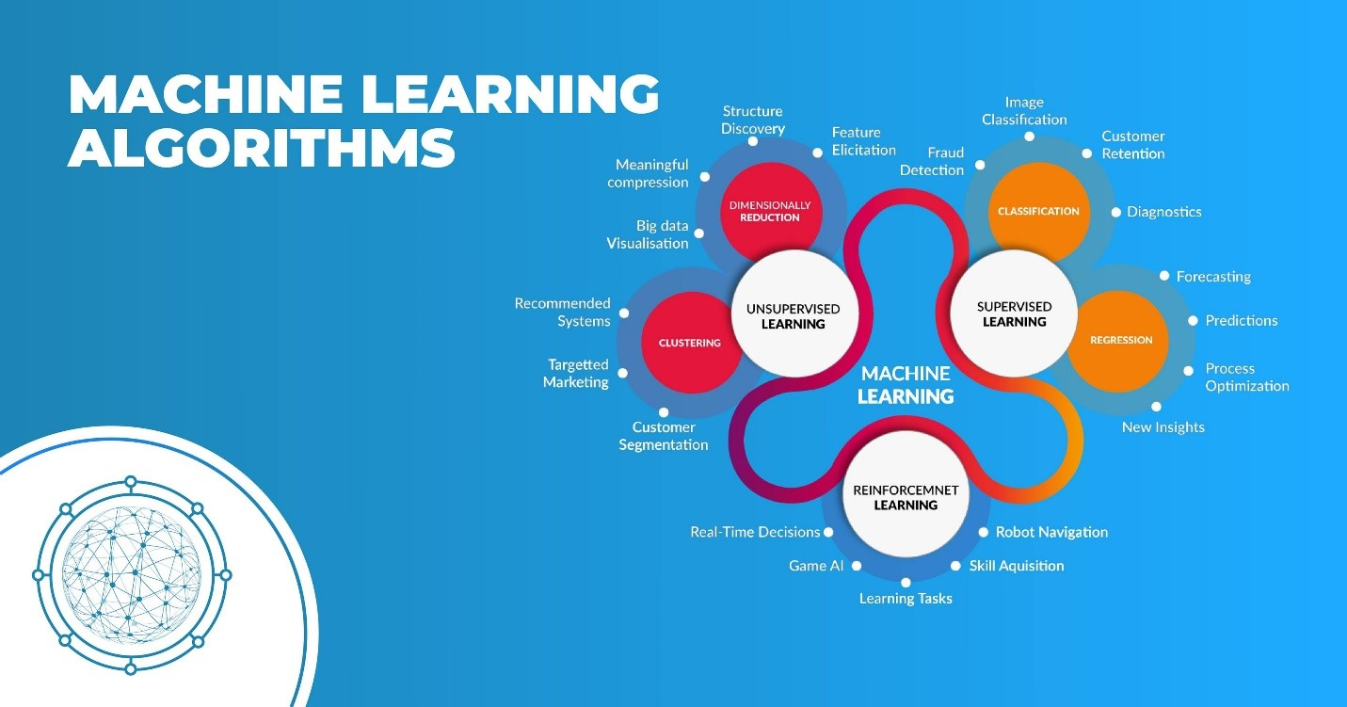

Slide 5

Machine Learning Algorithm
Predictive methods such as Boosting, Random Forest, and Support Vector Machines have been introduced into credit card scoring.
A machine learning model to predict if an applicant is 'good' or 'bad' client.

Slide 6
Project scope:
Business Understanding
Data Understanding
Data Preparation
Modeling
Evaluation
Deploy
.

Slide 7
Technical process:
Loading the CSV into a Jupyter notebook for cleanup and transformation.
.

Slide 8
Technical process:
.

Slide 10
Technical challenges

Slide 11
Any questions?

