Slide 1

Loan Approval Prediction
Loan Officers:
Rashmi Rekha, Andrew cowan, Kadien peart, Daniel fernandez, Drew Williams

Slide 2
Our project was based on a Kaggle dataset containing characteristics of loan applications. This project gives us an idea of applying machine learning in a real business scenario. A basic understanding of risk analytics in banking and financial services and an understanding of how data is used to minimize the risk of losing money while lending to customers.
Introduction

Slide 3
Loan RISK Assessment:
During the loan evaluation process, banks look at a variety of factors such as the loan annuity, the cost of the goods for which the loan is given, credit, and housing status.
It is important to determine which factors have the biggest impact on the level of risk to the business.
Logistic regression models is an effective method to predict a set of categories such as “Approved” or “Denied”.
Random Forrest Classifier is used as a method of verification.

Slide 4
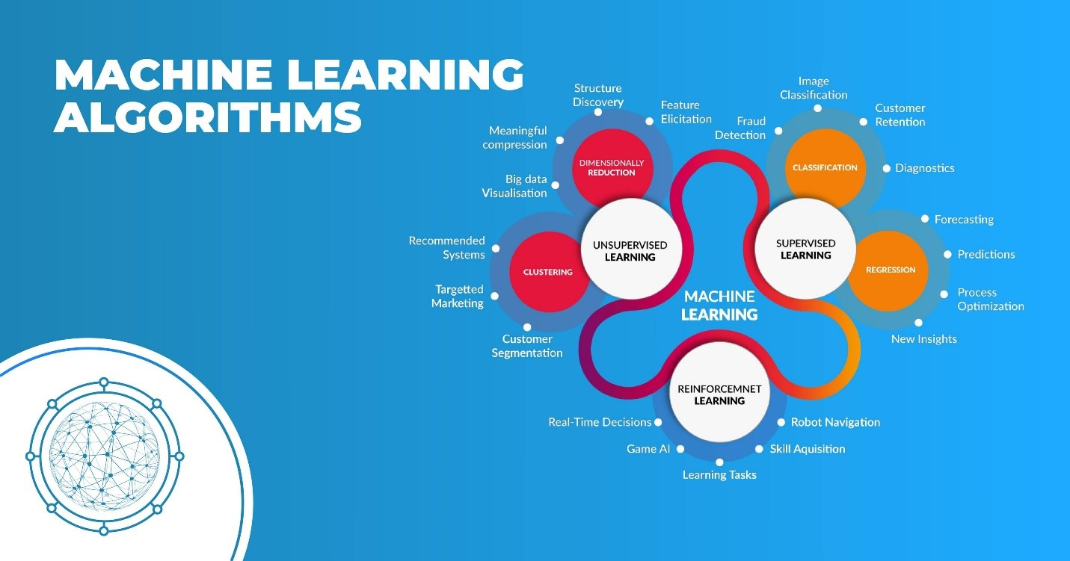

Slide 5
Project scope:
Business Understanding
Data Understanding
Data Preparation
Modeling
Evaluation
.

Slide 6
Technical process:
Data Understanding and Data preparation:
Understand, filter, and clean the data prior to generating models.
Dropping / Imputing NaNs.
One Hot Encoding - For adding the categorial values to the evaluation and predicting of the Target variable.
Model engineering.

Slide 7
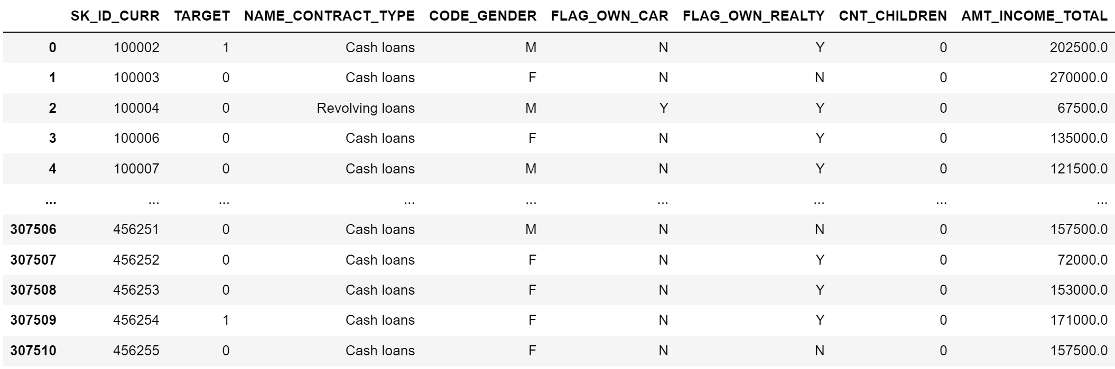
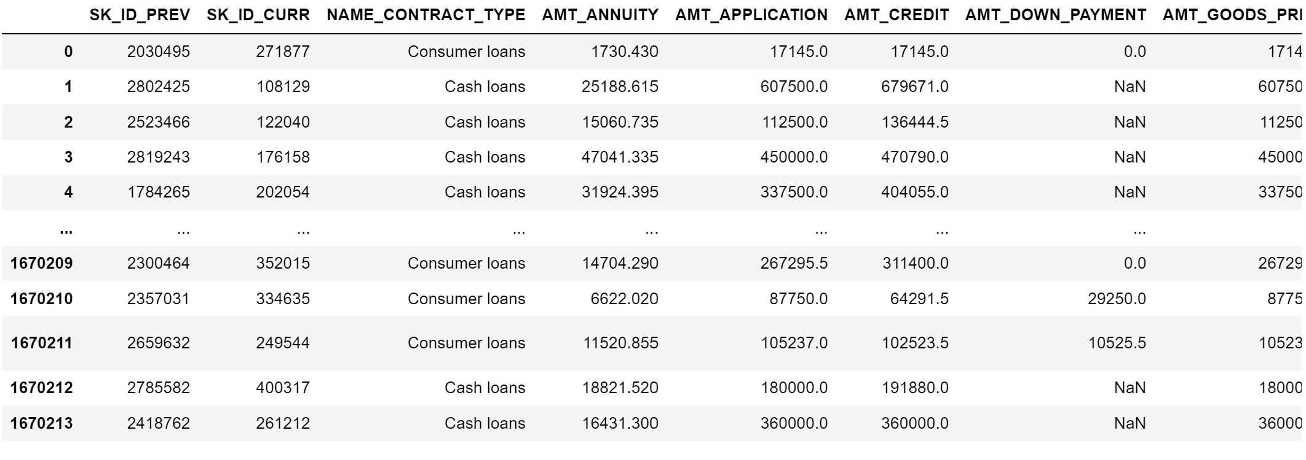
cleanup/transformation:
Loading the CSV into a Jupyter notebook.
.
Application Data
Previous Application Data

Slide 8
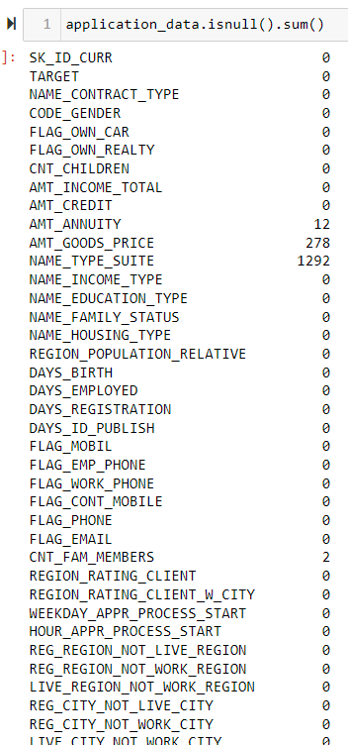
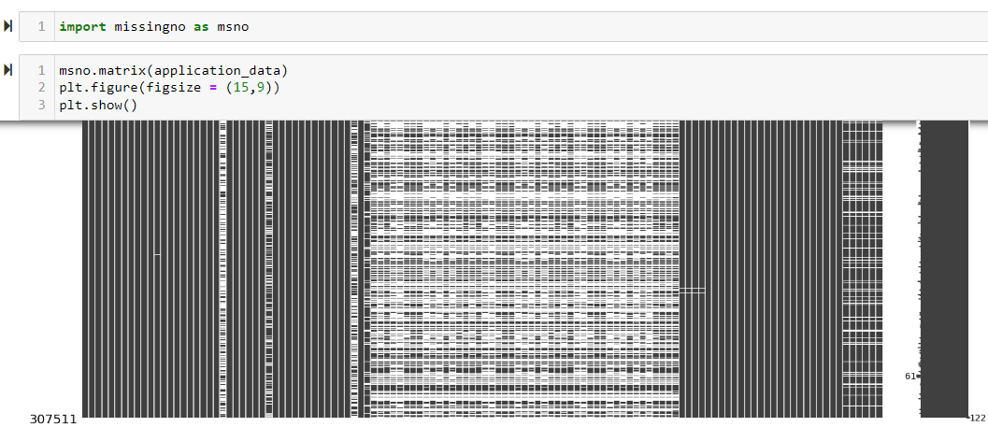
dropping Nans:
Removing the Nans.

Slide 9
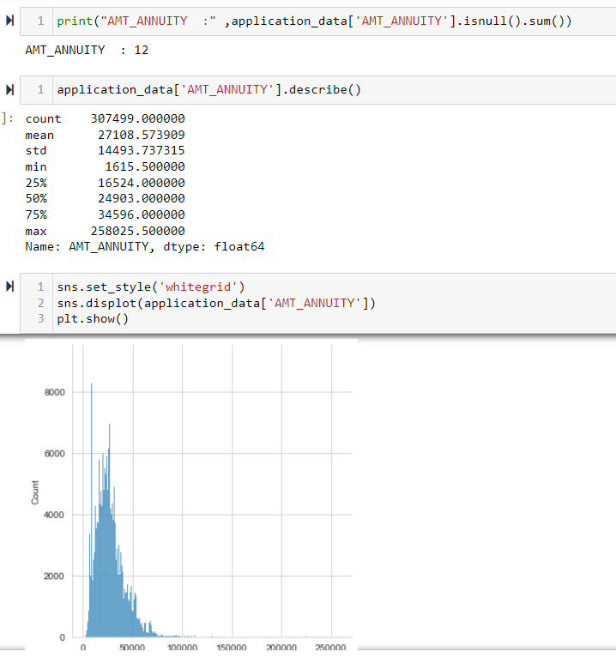
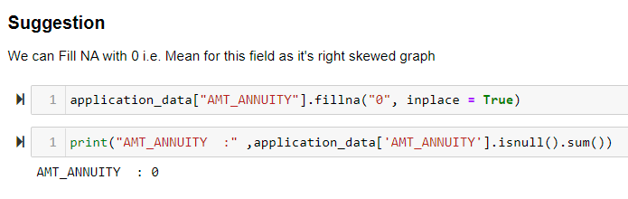
dropping Nans cont:

Slide 10
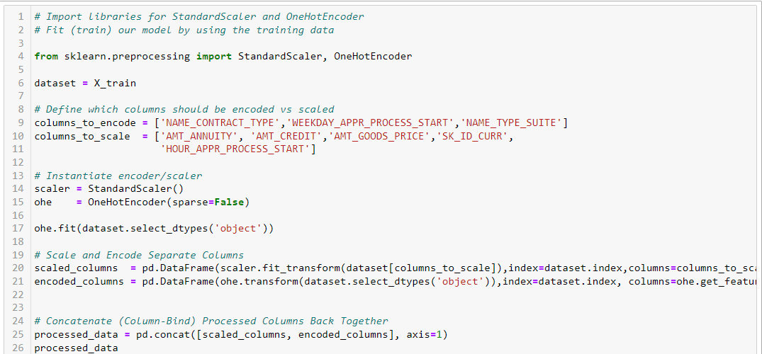
modelling:
For this project we decided to use an efficient approach by using the Logistic Regression algorithm.
Logistic regression takes in independent features and returns output as categorical output.

Slide 11
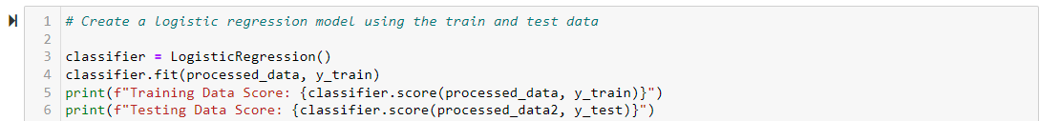
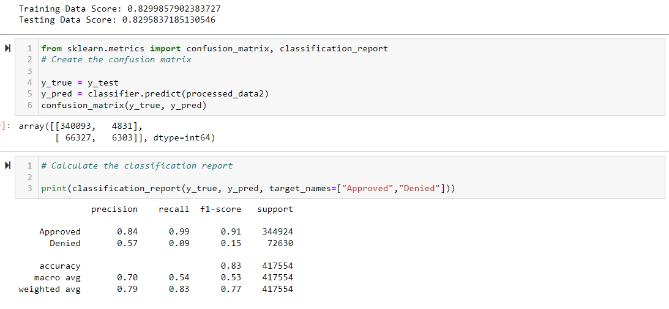
Modelling cont:

Slide 12
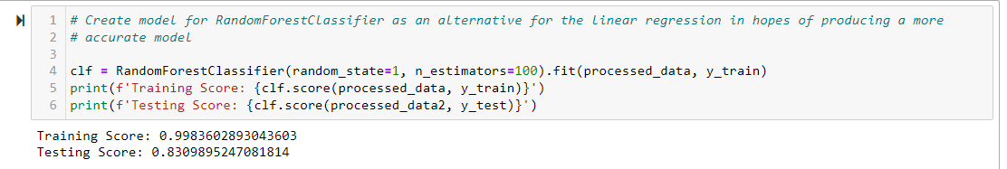
Optimization:
Though we achieved a satisfactory score with our logistic regression model, we wanted to improve upon it.
We selected the Random Forrest Classifier to take advantage of the depth of modeling functionality to improve our accuracy score.

Slide 13
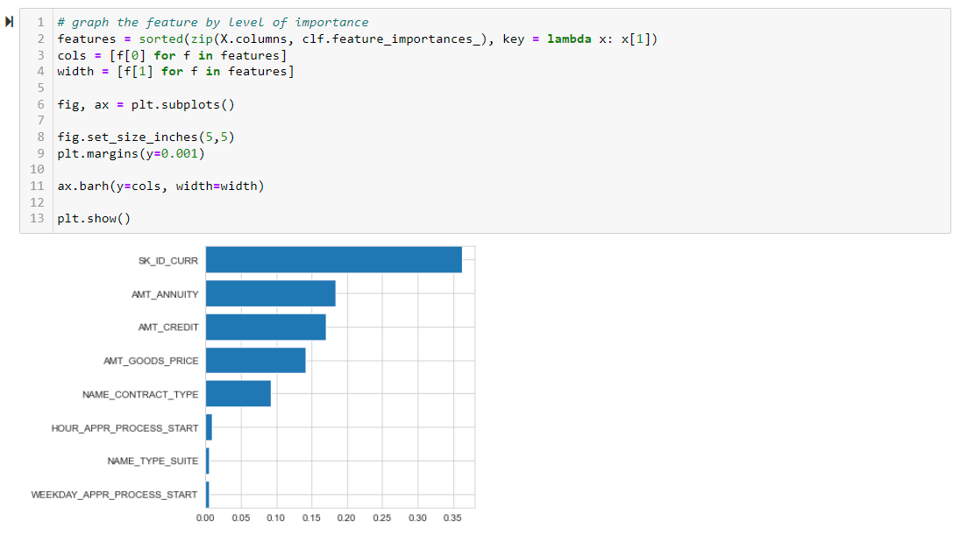
Optimization cont:

Slide 14
evaluation:
For this project we are use a simpler approach by using the Confusion matrix.
Evaluation analysis refers to the description and model regularities or trend for objects whose behavior changes overtime.
Common metrics calculated from the Confusion metrics are Precision and Accuracy.

Slide 15
Project challenges:
Time associated with dataset selection.
Workload associated with data cleaning and model optimization.
Data size was very large, took a lot of time to train the models.
Get dummies trap
Get Dummies Trap Source: https://builtin.com/machine-learning/dummy-variable-trap-pandas

Slide 16
conclusion:
As we had hoped, our logistic regression and random forest model were strong choices for our dataset.
We received high accuracy scores on both training and test datasets for each model. After attempting optimization, we saw a favorable increase in training. However, the increase was marginal at best for the test.
Random Forest Classifier, with 100 estimators, gave us the best accuracy (83.1%).
Going forward, we would want to add more data and look for data with minimal to no null values.
Try other models (Decision Tree Classifier, Deep Neural Networks, etc.).
Future enhancement would be to include flask front end app.
Notes:
** going forward, further test our dataset by 1. Adding more previous data and look for data with minimal or no null values. , 2. Trying other models (decision tree classifier, create Deep Learning model, any model with binary classification).
Future enhancement of this project could have been a flask app hosted on AWS server, where we could easily add new applicant information and get feedback for either approve or deny a new applicant.

Slide 17
Any questions?

