Slide 1

Credit Card Approval Prediction
Loan Officers:
Rashmi Rekha, Andrew cowan, Kadien peart, Daneil fernandez, Drew Williams

Slide 2
Our project was based around a Kaggle dataset containing characteristics about loan. This project give us an idea of applying machine learning in a real business scenario. A basic understanding of risk analytics in banking and financial services and understand how data is used to minimize the risk of losing money while lending to customers.
Introduction

Slide 3
Credit Card RISK:
A credit card is issued to users to enable the cardholder to pay cardholder's accrued debt.
The loan providing companies find it hard to give loans to the people due to their insufficient or non-existent credit history.
Credit score cards are a common risk control method in the financial industry.
Credit scores can objectively quantify the magnitude of risk.
Logistic model is a common method for credit scoring.
Logistic is suitable for binary classification tasks and can calculate the coefficients of each feature.

Slide 4
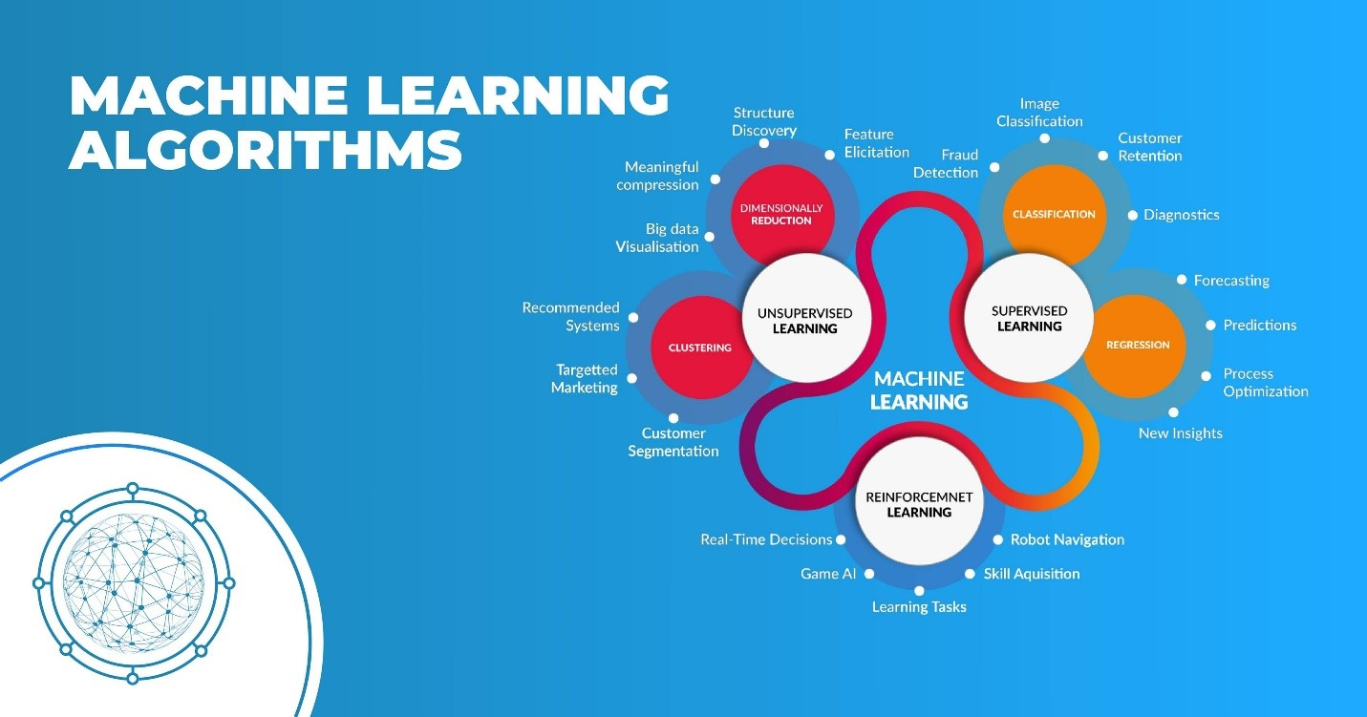

Slide 5
Project scope:
Business Understanding
Data Understanding
Data Preparation
Modeling
Evaluation
Deploy
.

Slide 6
Technical process:
Data Understanding and Data preparation:
Understand, filter, clean, impute, remove, and much more so the data processed can generate results in a more reliable way for the analysis and for model ingestion.
Dropping / Imputing NaNs.
One Hot Encoding - For adding the categorial values to the evaluation and predicting of the Target variable.
Outliers - find and remove outliers that can bias the analysis.
Low Variance variables - remove variables that doesn't have impact on the target variable.

Slide 7
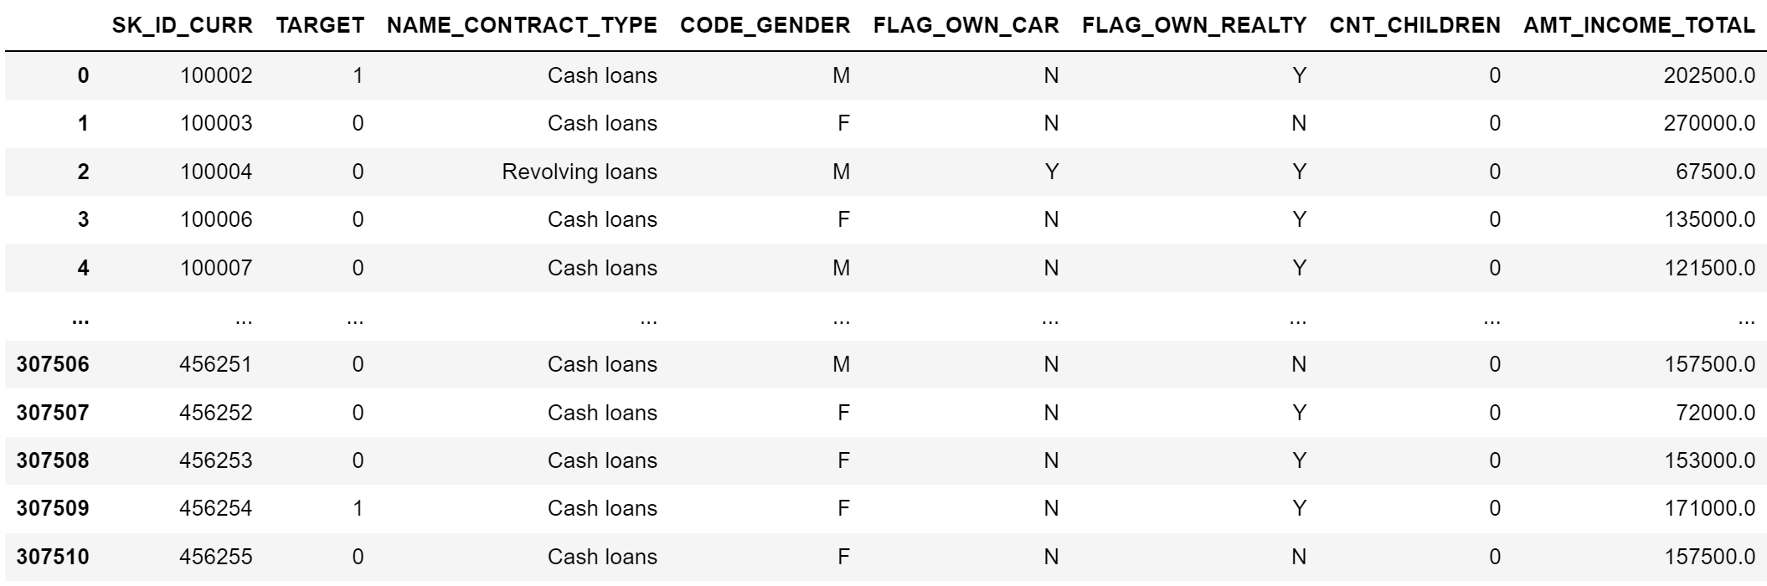
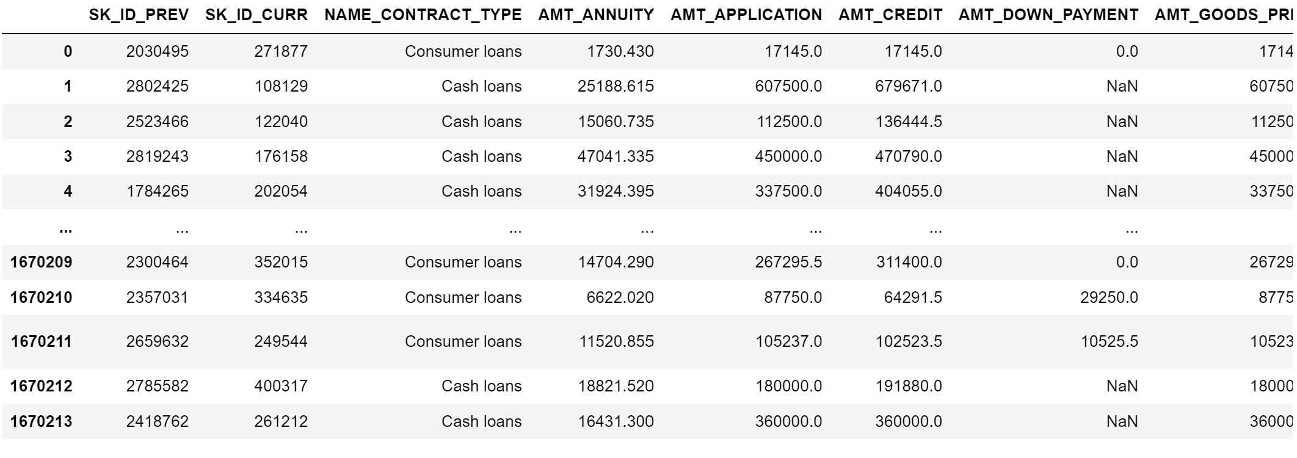
cleanup/transformation:
Loading the CSV into a Jupyter notebook.
.
Application Data
Previous Application Data

Slide 8
dropping Nans:
Removing the Nans.

Slide 9
modelling:
For this project we decided to use a simpler approach by using the Logistic Regression algorithm.
Logistic regression takes in independent features and returns output as categorical output.

Slide 10
evaluation:
For this project we are use a simpler approach by using the Confusion matrix.
Evaluation analysis refers to the description and model regularities or trend for objects whose behavior changes overtime.
Common metrics calculated from the Confusion metrics are Precision and Accuracy.

Slide 11
Optimization:

Slide 12
Comparison:

Slide 13
conclusion:

Slide 14
Technical challenges:

Slide 15
Any questions?

