Slide 1

Yoga Impacts Screen Time Habits
DS8007 Data Visualization
-Rashmi Singh

Slide 2
Problem statement
With the increasing reliance on technology in daily life, people are spending more time than ever before sitting in front of screens.
This sedentary lifestyle has led to many health problems, including obesity, poor posture, eye strain, and mental health issues.
The practice of yoga has been shown to have numerous physical and mental health benefits, including reducing stress and anxiety, improving flexibility and balance, and increasing strength and endurance.
Therefore, it is important to examine the impact of incorporating yoga into the daily routine of individuals with high screen time habits to assess whether it can mitigate the negative effects of excessive screen time on their health and well-being.

Slide 3
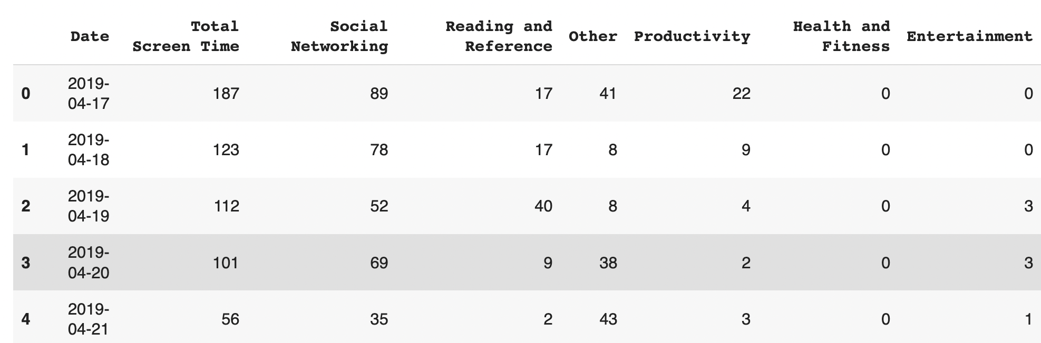
Dataset
Source: https://www.kaggle.com/datasets/thedevastator/how-does-daily-yoga-impact-screen-time-habits?resource=download
This dataset contains information on daily minutes of screen time habits, categorized by type of usage, as well as the effect of yoga on those habits. This is useful for gaining insights into an individual's screen time habits and its variability with respect to doing yoga.
This dataset contains data on daily minutes of screen time between April 17th and May 14th.
This dataset captures my attempt to do at least 10 minutes of yoga every day for a period of 15 days from April 29th to May 13th.

Slide 4
Research work
Total time spent on each activity vs total screen time (Note that we didn't consider the Yoga columns since it has binary values (Did yoga that day or not) not the minutes spent on doing it)
Correlation between total screen time and daily activities.
Linear Regression on the dataset
Perform a t-test to determine the statistical significance of the relationship
Investigate how long it takes to establish a healthy habit, such as decreased phone usage, by looking at changes in average daily screen time over the period of a month or two months before and after beginning yoga practice, adjusting for weekly period effect
The median value for screen time spent on social networking sites for people who do yoga and who do not.

Slide 5
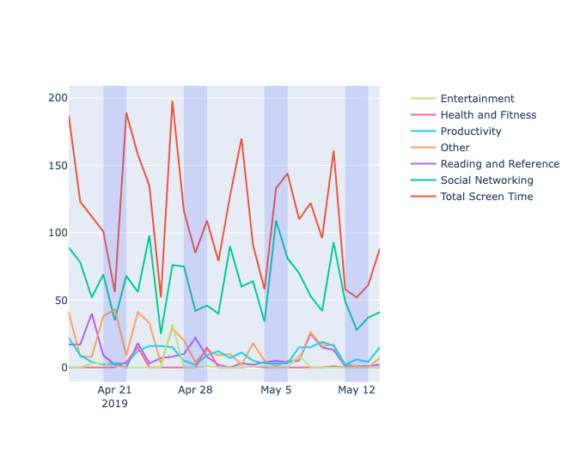
Insight 1: With the increasing reliance on technology in daily life, people are spending more time than ever before sitting in front of screens.
Daily minutes of screen time habits, categorized by type of usage

Slide 6
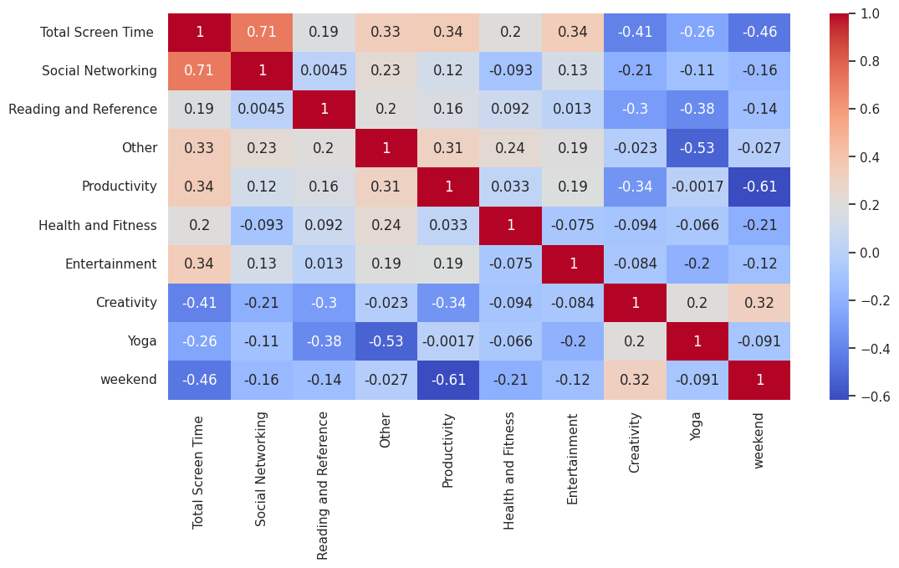
Insight 2: Correlation between total screen time and daily activities.
From the heatmap we can see that there is a strong correlation between total screen time and social networking which means the person has spent more screen time on social networking sites. Also, there is a negative correlation between creativity and total screen time.

Slide 7
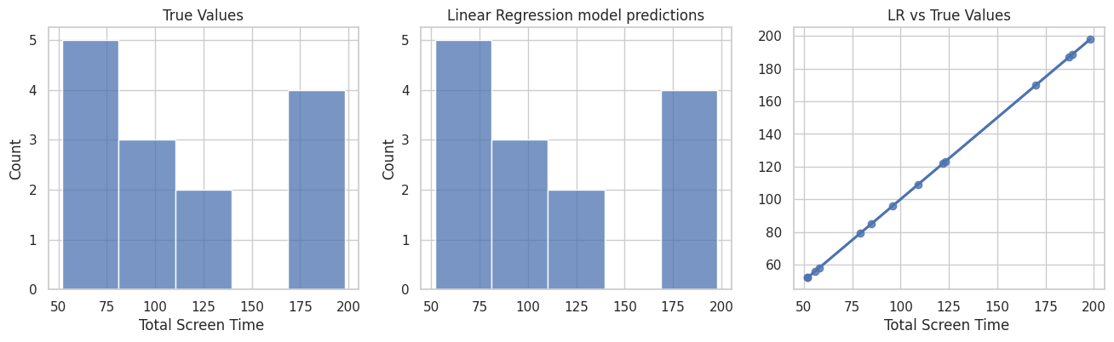
Insight 3: Linear Regression on the dataset
Linear Regression performs very well for this task, for a dataset with low features/rows this is performing exceptionally

Slide 8
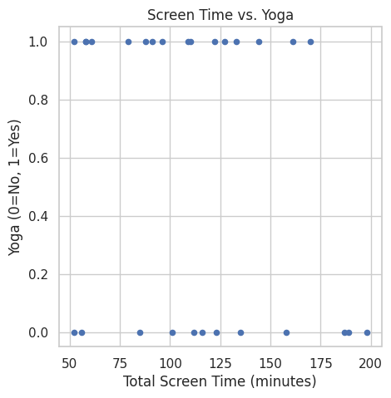
Insight 4: Perform a t-test to determine the statistical significance of the relationship
Based on the t-statistic and p-value from the t-test, it appears that there is a statistically significant relationship between screen time and yoga. The t-statistic of 13.686 and p-value of 0.000 indicate that the probability of seeing this relationship in the data by chance is very low

Slide 9
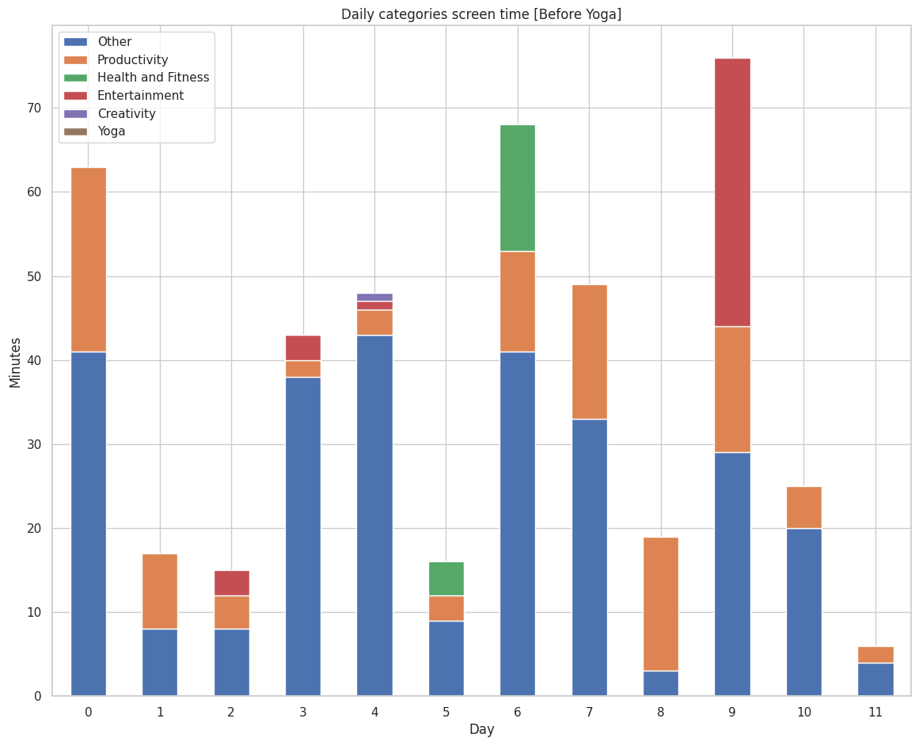
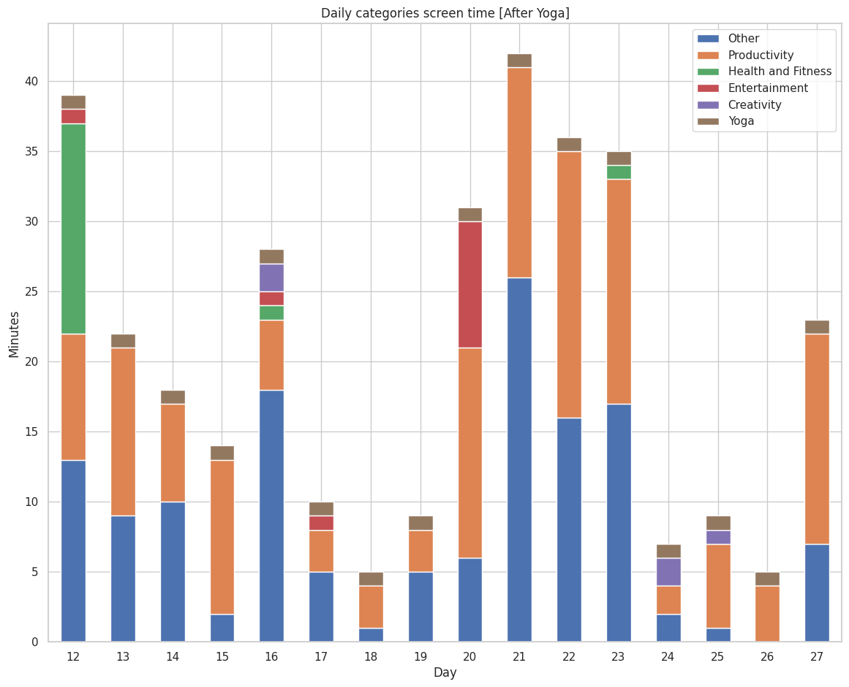
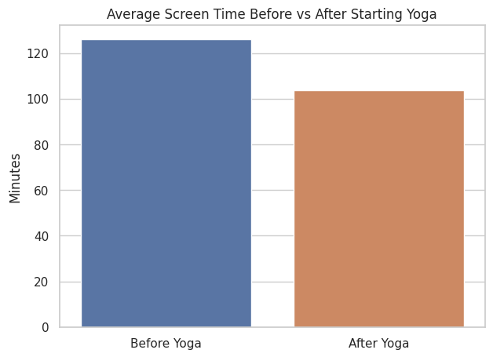
Insight 5: Investigate how long it takes to establish a healthy habit, such as decreased phone usage, by looking at changes in average daily screen time over the period of a month or two months before and after beginning yoga practice, adjusting for weekly period effect
There's a drop of about 20 minutes in the average total screen time
From the analysis we can conclude that the person spent less screen time on the days he did Yoga.

Slide 10
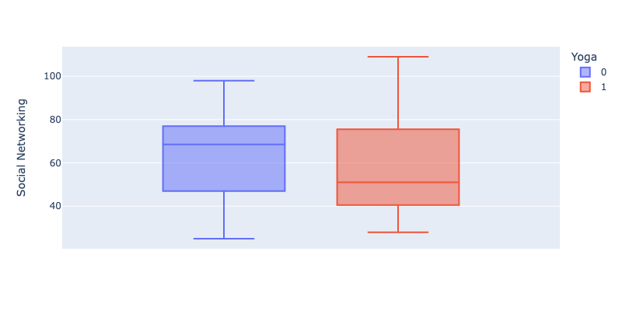
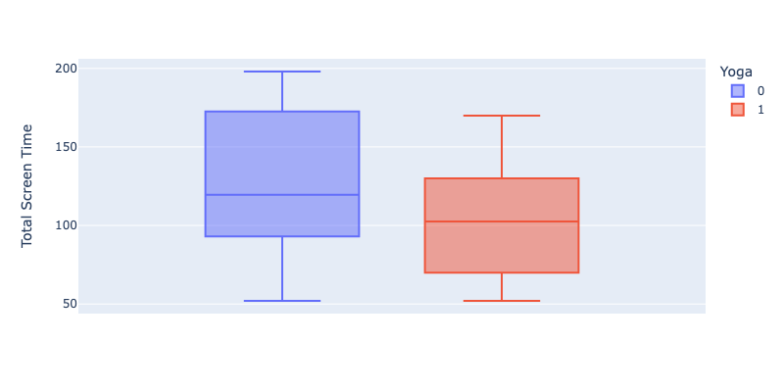
Insight 6: The median value for screen time spent on social networking sites for people who do yoga and who do not.
The median value for screen time spent on social networking sites for people who do yoga is less than the median value for people who do not do yoga. So if the person does Yoga, the time spent on social networking decreases.
From the box plot we can infer that the screen time was less when the person did yoga as compared to the screen time when the person did not do yoga.

Slide 11
Conclusion and Future Work
Based on this data, it appears that most of the screen time was spent on social networking, followed by reading and reference activities and other activities. There was relatively less time spent on productive activities, health and fitness, entertainment, and creativity.
From the analysis we can conclude that the person spent less screen time on the days he did Yoga. So doing Yoga reduces the screen time. Also, productivity of the person becomes low when he spends more screen time and eventually, he becomes a less creative individual.
This dataset captures my attempt to do at least 10 minutes of yoga every day for a period of 15 days from April 29th to May 13th which in return sees an increase of productivity.
Since this data is related to one person's experience only, we can't make decisive general conclusions about the main question as we'd need more data from different people

Slide 12

Q&A Thank you

