Slide 1

Customer Shopping Behavior Analysis
Analyzing 3,900 purchases to uncover insights into spending patterns, customer segments, and product preferences that drive strategic business decisions.

Slide 2

Dataset Overview
3,900
18
50
Total Purchases
Data Columns
Locations
Transactions analyzed across all categories
Comprehensive customer and purchase attributes
Geographic diversity in customer base
25
Product Types
Items across four major categories
Key features include customer demographics (age, gender, location, subscription status), purchase details (item, category, amount, season, size, color), and shopping behavior (discounts, promo codes, previous purchases, frequency, review ratings, shipping type).

Slide 3

Data Preparation & Cleaning
01
Data Loading & Exploration
Imported dataset using pandas, analyzed structure with df.info() and summary statistics with .describe()
02
Missing Data Handling
Imputed 37 missing Review Rating values using median rating per product category
03
Feature Engineering
Created age_group bins and purchase_frequency_days columns for deeper analysis
04
Database Integration
Connected to PostgreSQL and loaded cleaned data for SQL analysis

Slide 4
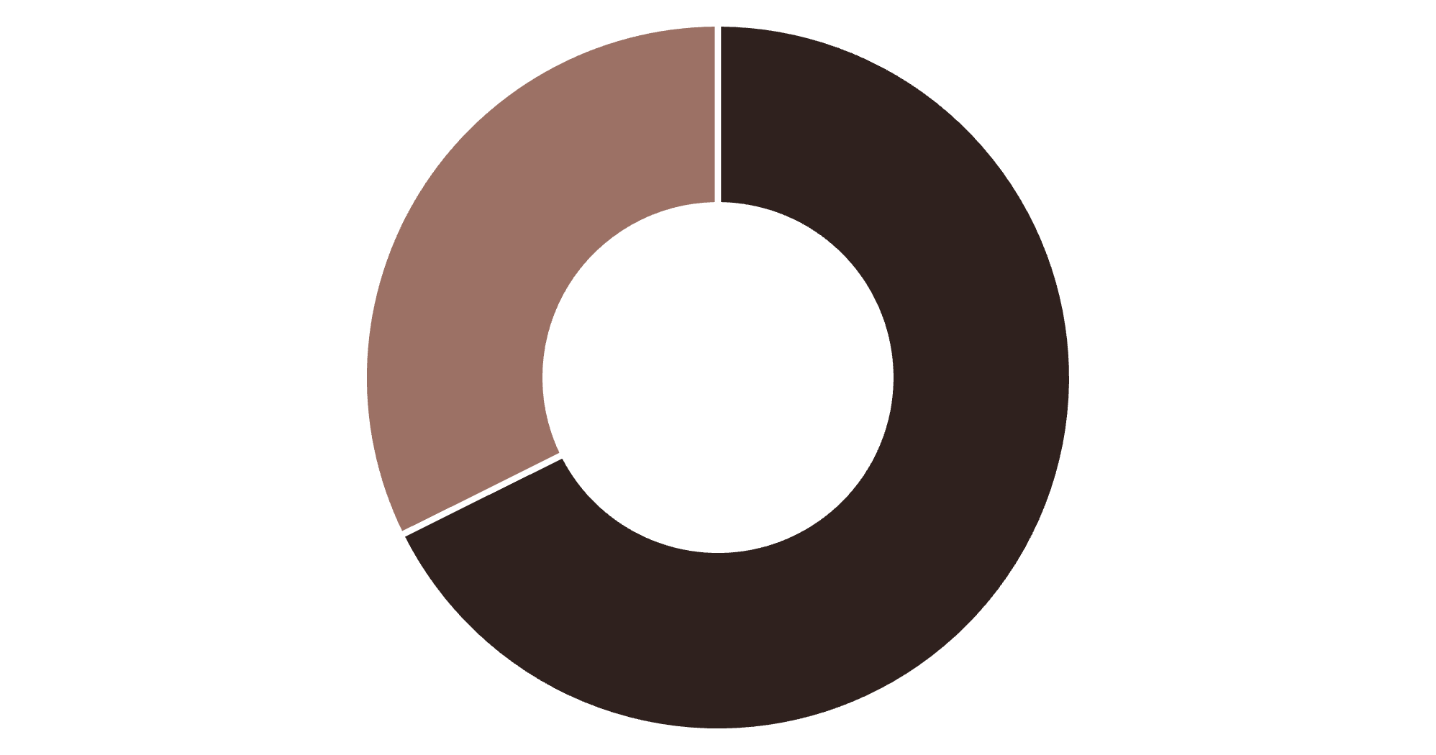
Revenue Insights by Gender
Male Customers Drive Revenue
Male customers generated $157,890 in total revenue compared to $75,191 from female customers, representing 68% of total sales.
This significant difference suggests opportunities for targeted marketing campaigns to increase female customer engagement.
Male
Female

Slide 5

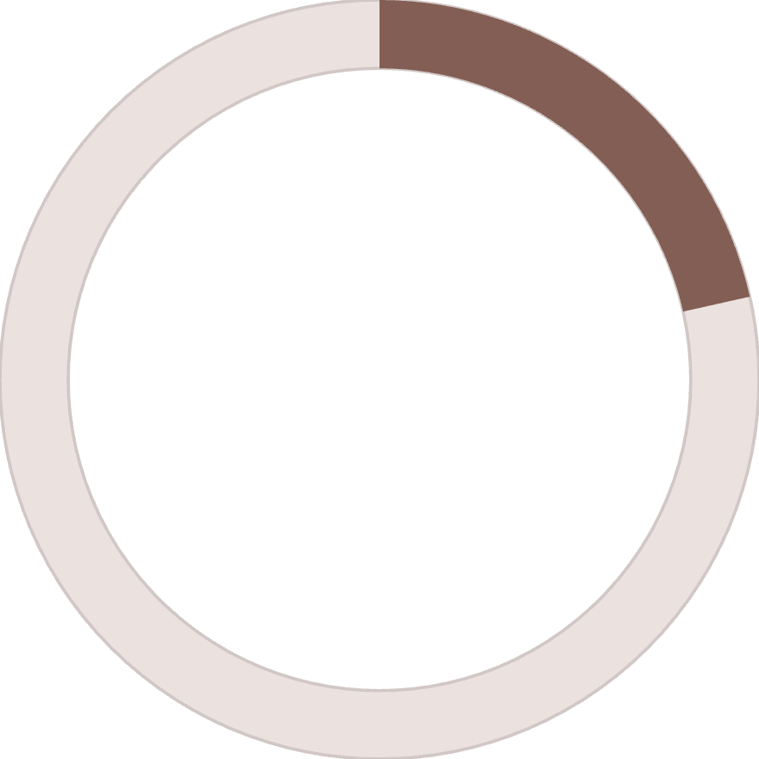
Smart Discount Users
839
21.5%
High-Spending Discount Users
Percentage of Total
Customers who used discounts but still spent above average purchase amount
Represents savvy shoppers who maximize value
These customers demonstrate that discounts don't always mean lower revenue—they can attract quality-conscious buyers who spend more overall. Strategic discount placement on premium items could boost both volume and margins.

Slide 6

Top-Rated Products & Shipping Preferences
Highest-Rated Products
Shipping Type Analysis
Gloves - 3.86 rating
Standard
Sandals - 3.84 rating
Boots - 3.82 rating
$58.46 avg spend
Hat - 3.80 rating
Skirt - 3.78 rating
Express
Feature these products prominently in marketing campaigns to leverage positive customer sentiment.
$60.48 avg spend
Express shipping users spend slightly more on average, indicating higher purchase urgency and willingness to pay premium.

Slide 7
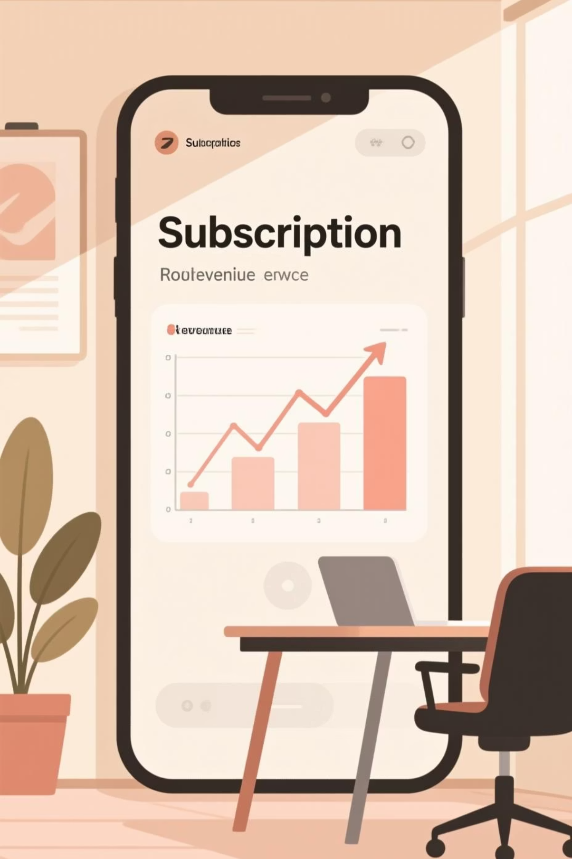

Subscription Status Comparison
Subscribers
1,053 customers
Average spend: $59.49
Total revenue: $62,645
Non-Subscribers
2,847 customers
Average spend: $59.87
Total revenue: $170,436
While non-subscribers generate more total revenue due to volume, subscribers show comparable spending patterns. The opportunity lies in converting more customers to subscription status to build predictable revenue streams.

Slide 8




Customer Segmentation Analysis
Loyal
1
3,116 customers
Returning
2
701 customers
New
3
83 customers
The customer base is dominated by loyal buyers (80%), with returning customers at 18% and new customers at just 2%. This strong loyalty foundation presents opportunities for referral programs and exclusive benefits to reward top customers.
Key Insight: 958 repeat buyers (>5 purchases) are subscribers, suggesting subscription programs effectively retain high-value customers.

Slide 9
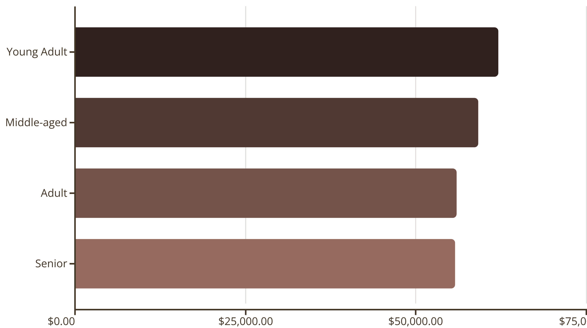
Revenue by Age Group
Young adults lead revenue generation at $62,143, followed closely by middle-aged customers. Revenue is relatively balanced across age groups, indicating broad market appeal with slight skew toward younger demographics.

Slide 10
Strategic Recommendations
Boost Subscriptions
Loyalty Programs
Review Discount Policy
Promote exclusive benefits and rewards to convert high-frequency buyers into subscribers
Reward repeat buyers to accelerate movement into the loyal customer segment
Balance promotional sales boosts with margin control—target discounts strategically
Product Positioning
Targeted Marketing
Highlight top-rated products (Gloves, Sandals, Boots) in marketing campaigns
Focus efforts on young adults and express-shipping users who show higher engagement

