Slide 1
Student Wellbeing — EDA Summary
First-year submission — Coding Ninjas 10X
Generated: 2025-09-28 16:27

Slide 2
Dataset & Cleaning
Original rows: 10200, columns: 8
After cleaning: 10000 rows. Duplicates removed, medians used for imputation.

Slide 3
Key Insights (Top 5)
1. More study hours generally -> higher CGPA
2. Optimal sleep (6-8 hrs) correlates with better CGPA
3. High stress associates with lower CGPA
4. Extracurriculars show slight positive association
5. Attendance positively correlates with CGPA

Slide 4
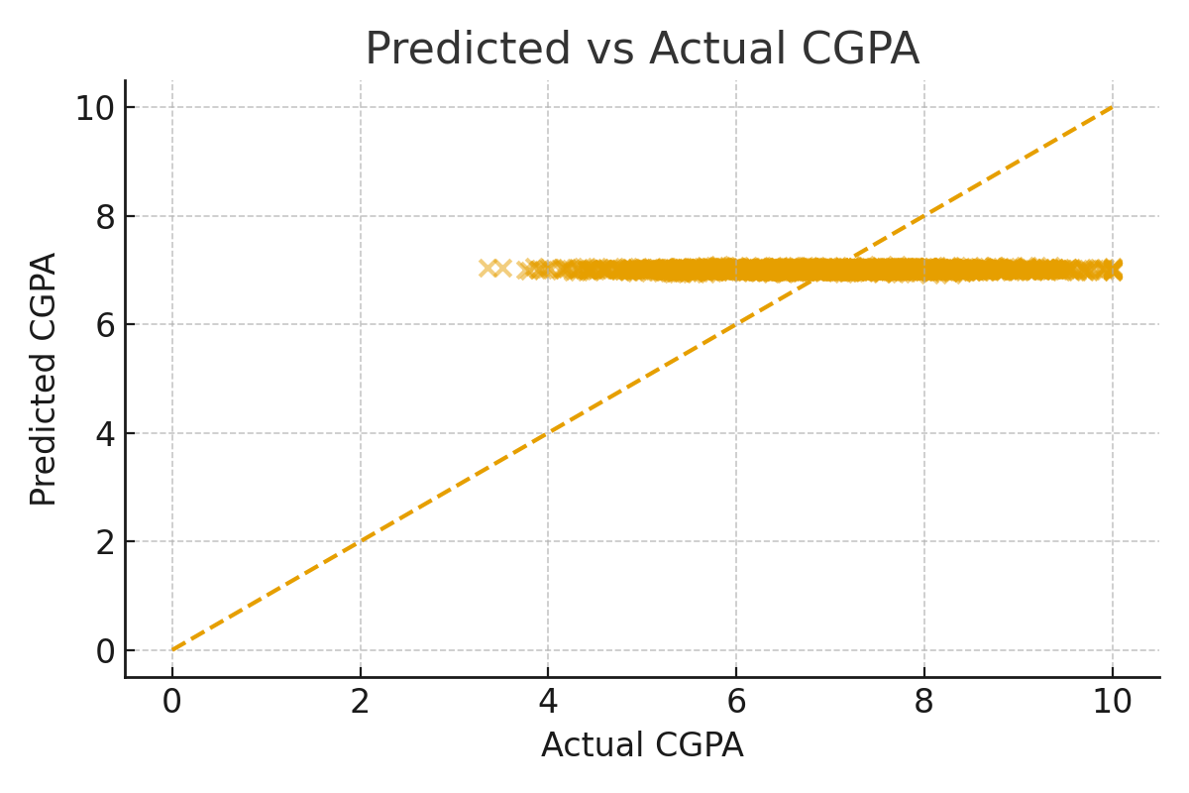
Predicted vs Actual (Linear Regression)

Slide 5
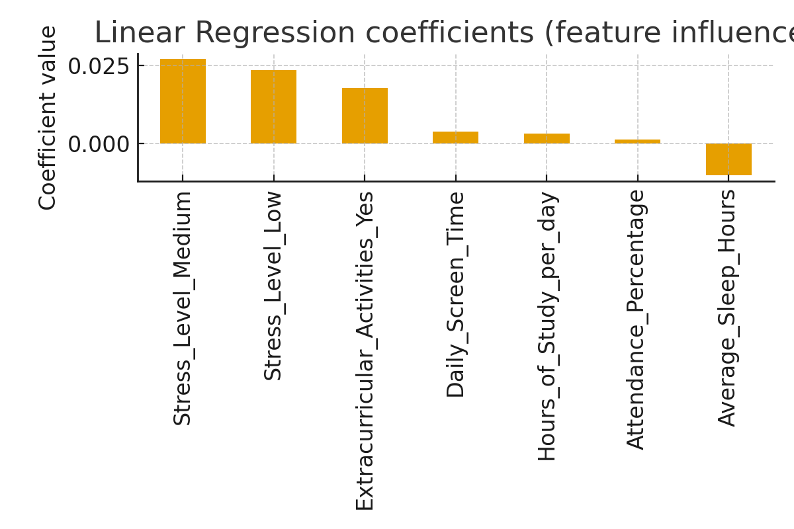
Model Coefficients & Metrics
RMSE: 1.202\nR²: 0.000
Note: This is a simple baseline model for illustration.

