Slide 1
Data Analyst Internship:
A 4 Month Upskilling Roadmap
Name : Rashmi Thakur Role : Data Analyst Trainee Company : IDS infotech Ltd.

Slide 2

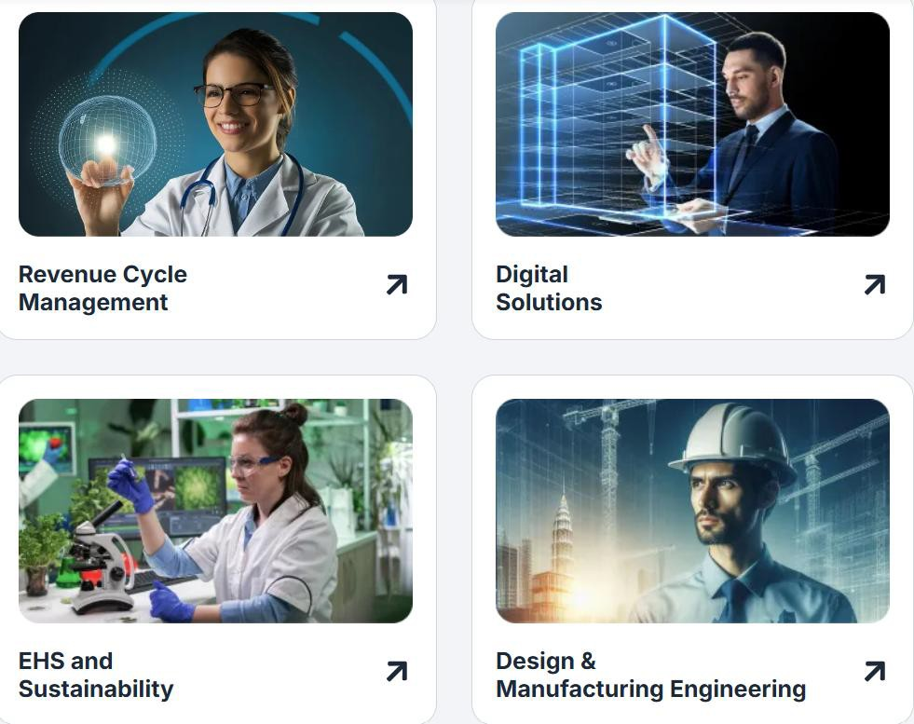
About the Company
IDS Infotech Limited
Based in Rajiv Gandhi IT Park, Chandigarh
Works in areas like data analytics, pharma, publishing, and legal services
IDS Infotech provides services in revenue cycle management, digital solutions, content management, sustainability, and engineering design, helping businesses improve efficiency through technology and data.

Slide 3
Week 1–2 – Excel Fundamentals
Data Handling & Basics
Introduction to Excel interface (rows, columns, sheets),Data entry, formatting, sorting & filtering ,Data cleaning (remove duplicates, text to columns)
Functions & Formulas
Basic formulas: SUM, AVERAGE, COUNT ,Logical functions: IF, nested IF , Lookup functions: VLOOKUP, XLOOKUP, INDEX-MATCH
Data Analysis
Pivot Tables (creation, grouping, filtering), Pivot Charts for visualization , Conditional Formatting for insight.
Project : To design a basic interactive dashboard in Excel for data visualization and reporting

Slide 4
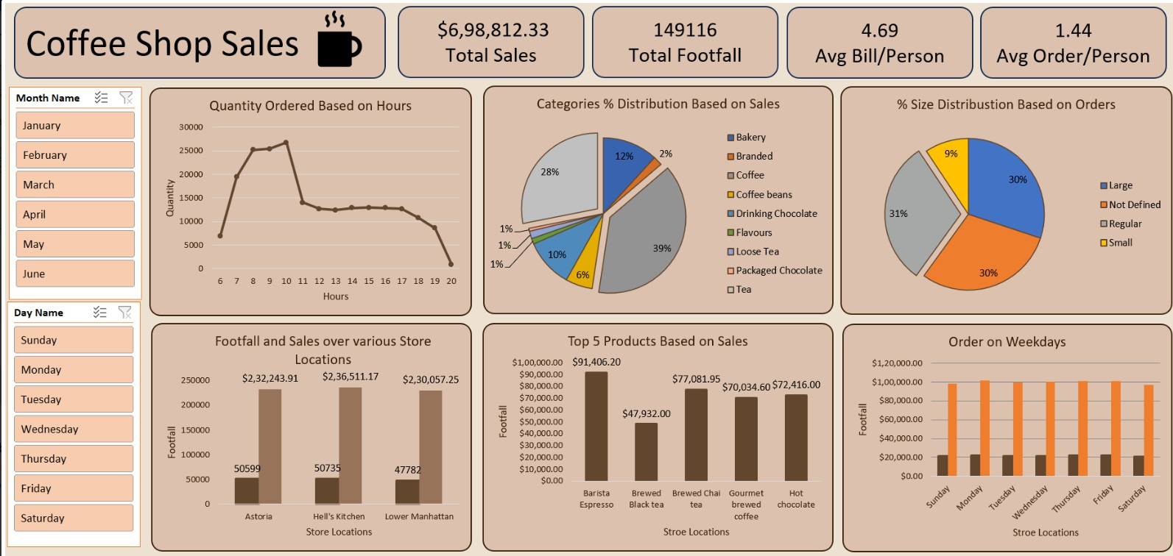

Slide 5
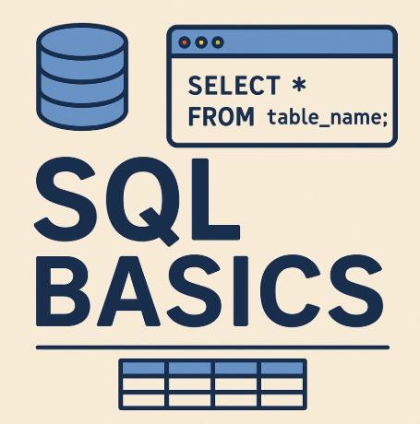
Week 3–4: SQL Fundamentals
SQL Queries (SELECT, WHERE, ORDER BY)
Joins (INNER, LEFT, RIGHT)
Aggregations (GROUP BY, HAVING)
Subqueries & Nested Queries
DML Operations (INSERT, UPDATE, DELETE)
Project : To extract, manipulate, and analyze structured data using SQL queries

Slide 6
Week 5–8 : End-to-End Dashboard Development with Power BI
Power BI Interface & Data Loading
Power Query (data cleaning & transformation)
Data Modeling & Relationships
Basic DAX (measures & calculated columns)
Advanced DAX (CALCULATE, FILTER, time intelligence)
KPI creation & business metrics
Power BI Service (publishing dashboards)
Row-Level Security (RLS).
Project 1 : Create a Power BI dashboard that provides a comprehensive,
interactive, and data-driven view of its sales operations.

Slide 7
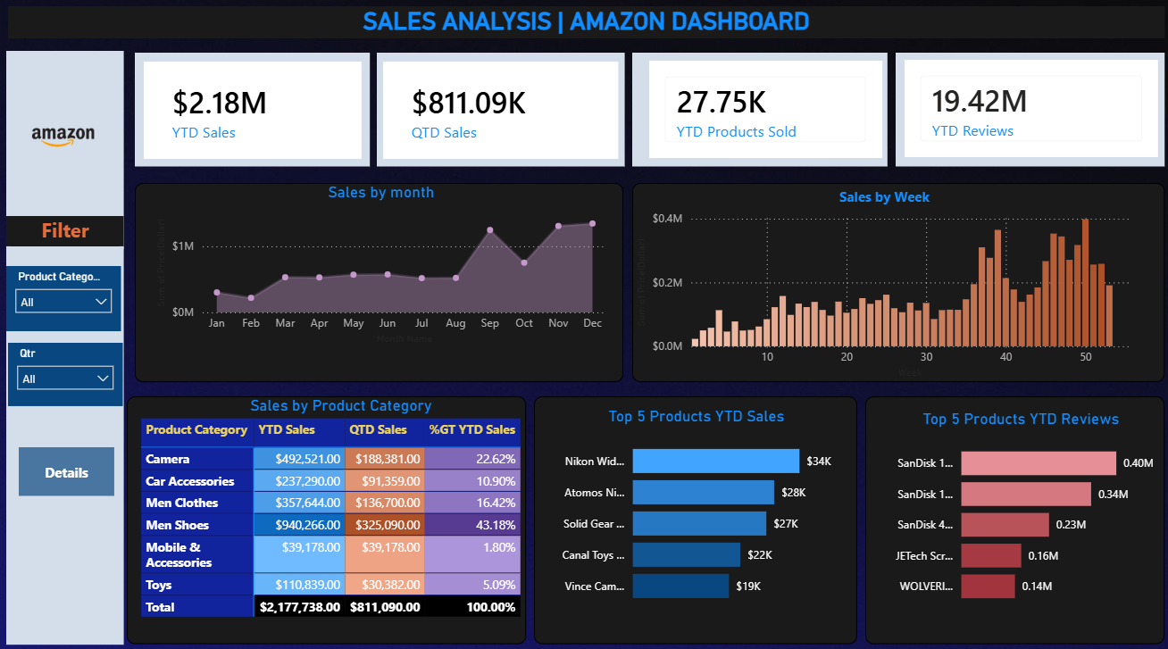

Slide 8
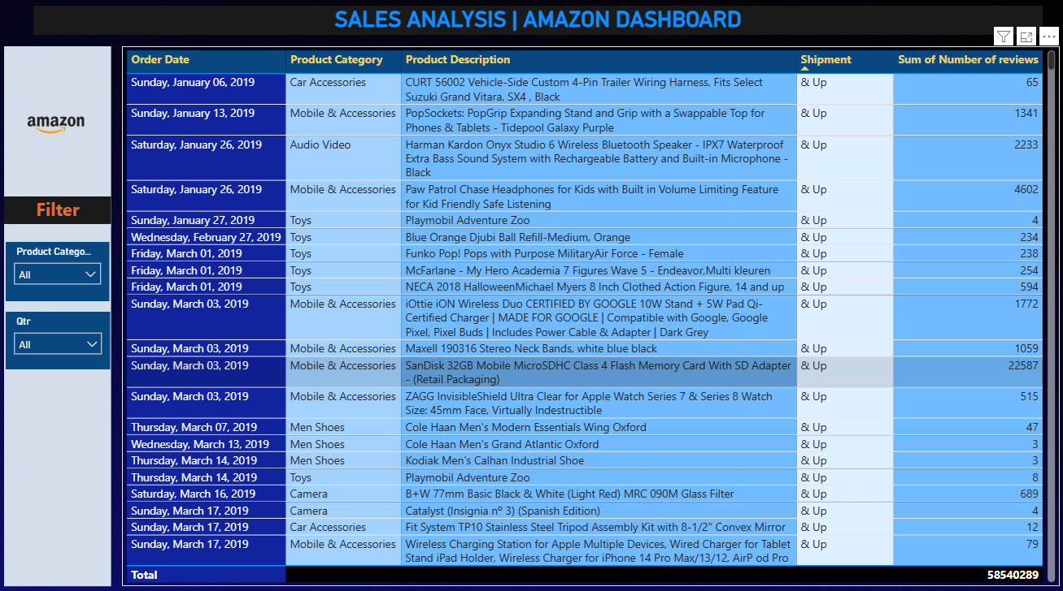
Tooltip

Slide 9
Week 9–11: Data Analysis using Python & EDA
Python Fundamentals
Variables, loops, functions, and basic scripting
Libraries: Pandas & NumPy
Data manipulation, filtering, aggregation, and numerical operations
Statistical Fundamentals
Mean, Median, Standard Deviation, Distribution, Correlation, Outlier detection
Data Visualization
Plotly for creating interactive and static visualizations
Project : To perform data analysis and exploratory data analysis (EDA) using
Python in order to uncover patterns, trends, and insights from raw data.

Slide 10
Project 1 : Manufacturing Performance Dashboard
Business Problem : Manufacturing organizations face challenges in tracking production performance, machine efficiency, product quality, and operational costs due to fragmented data sources. This limits visibility into operational bottlenecks and impacts decision-making.
Key Challenges
Monitoring Production vs Target
Tracking Machine Utilization & Downtime
Managing Quality & Rejection Rates
Controlling Maintenance & Operational Costs
Improving Capacity Utilization & Efficiency

Slide 11
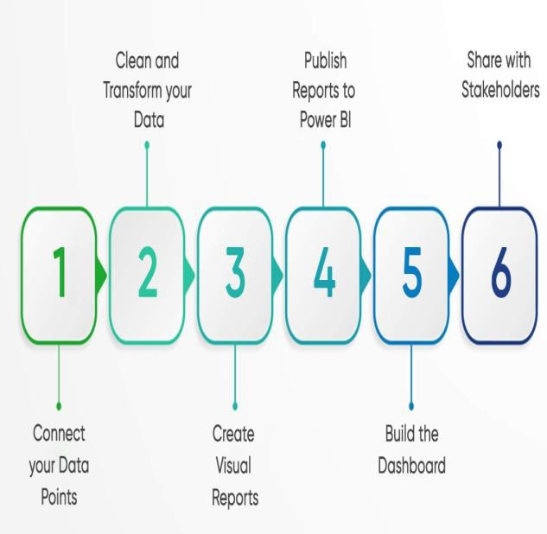
Power BI Dashboard Development Process
Identify data sources (SQL, Excel, ERP, SharePoint)
Load data into Power BI (Get Data)
Build data model (create relationships)
Create DAX measures (KPIs & calculations)
Apply theme and design
Build dashboard pages (Home, Production tab , Quality & Maintenance Tab , Cost & Efficiency Tab )
Add slicers and navigation
Configure tooltips
Publish to Power BI Service
Pin visuals to dashboard
Schedule data refresh
Share dashboard and set permissions

Slide 12
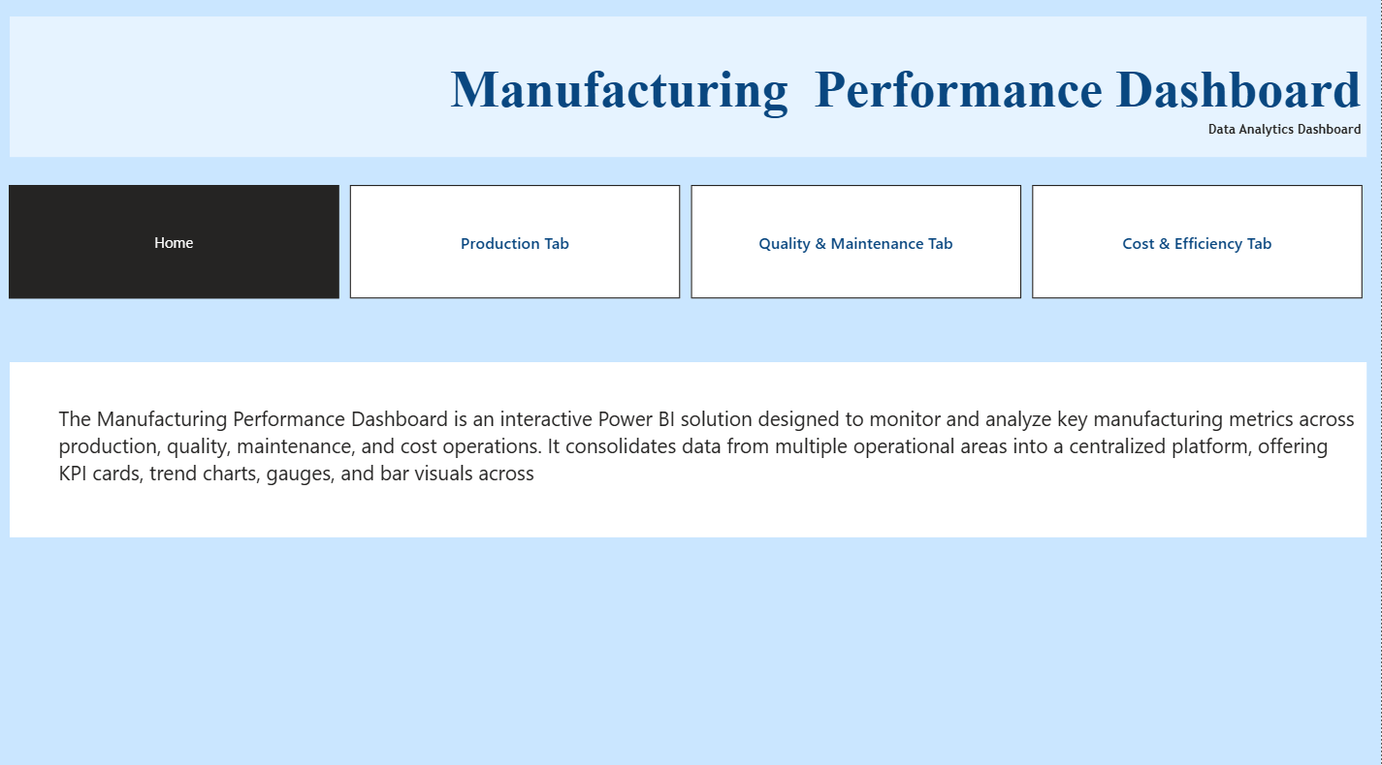

Slide 13
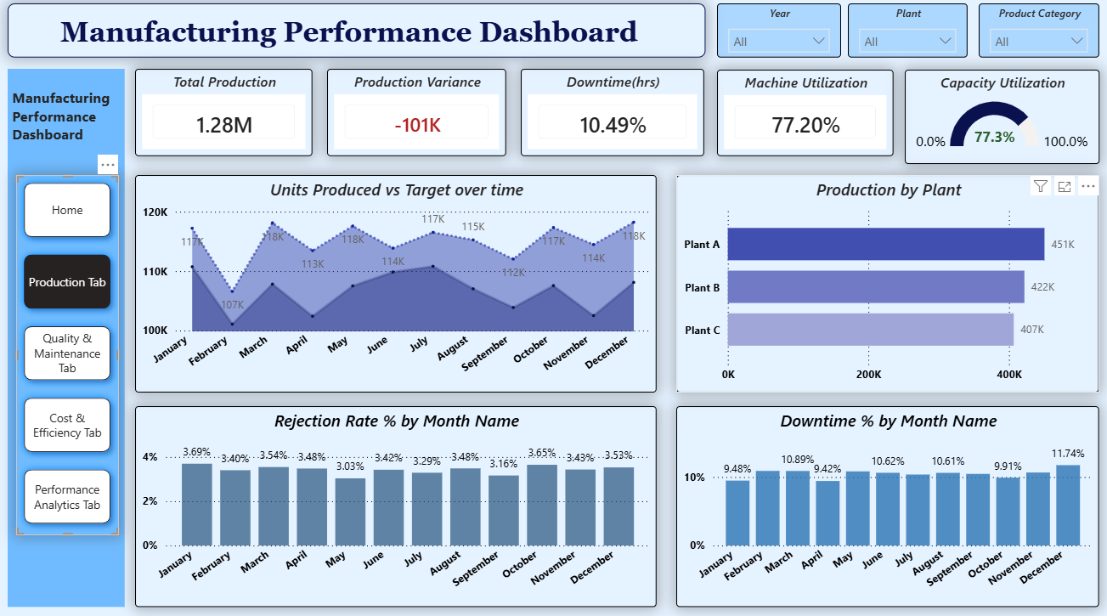

Slide 14
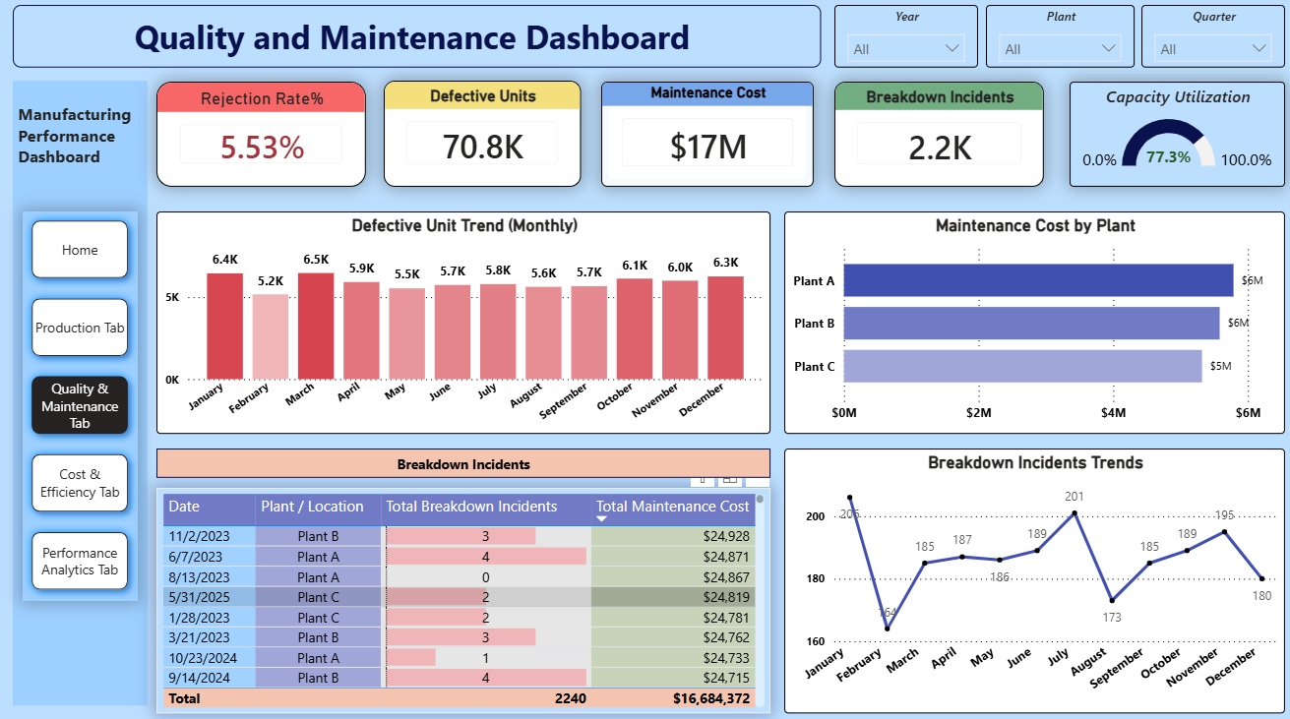

Slide 15
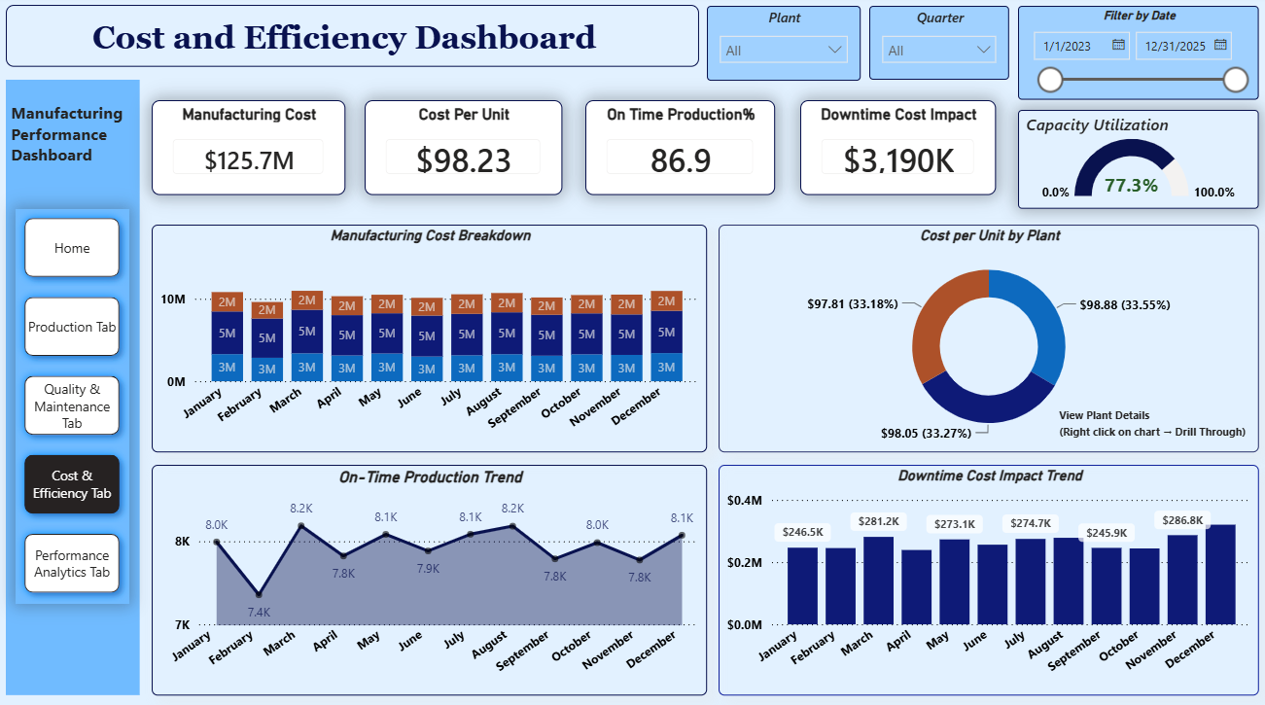

Slide 16
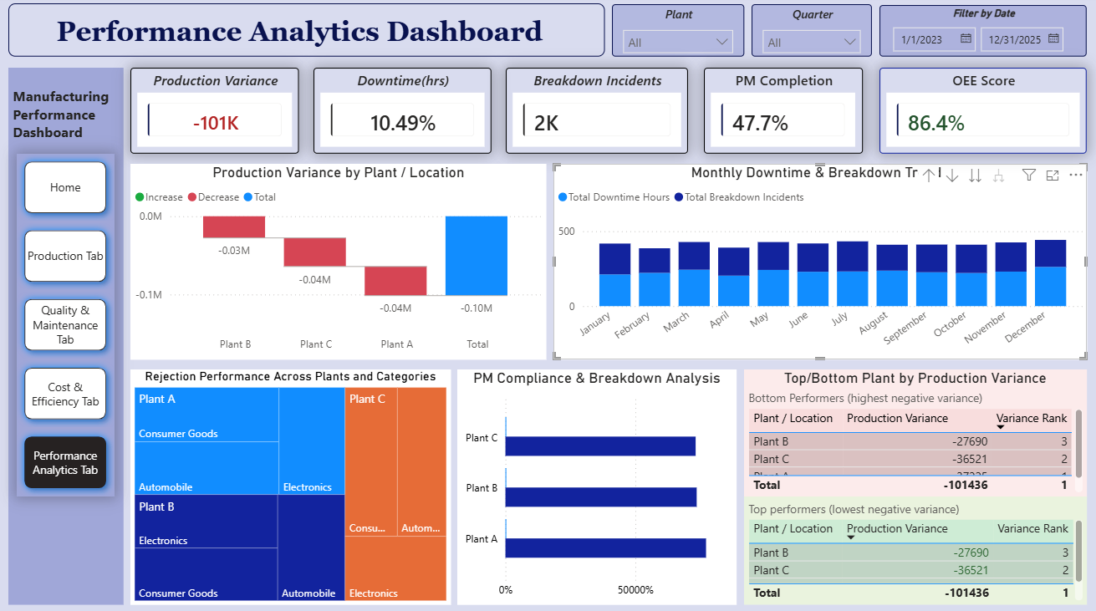

Slide 17
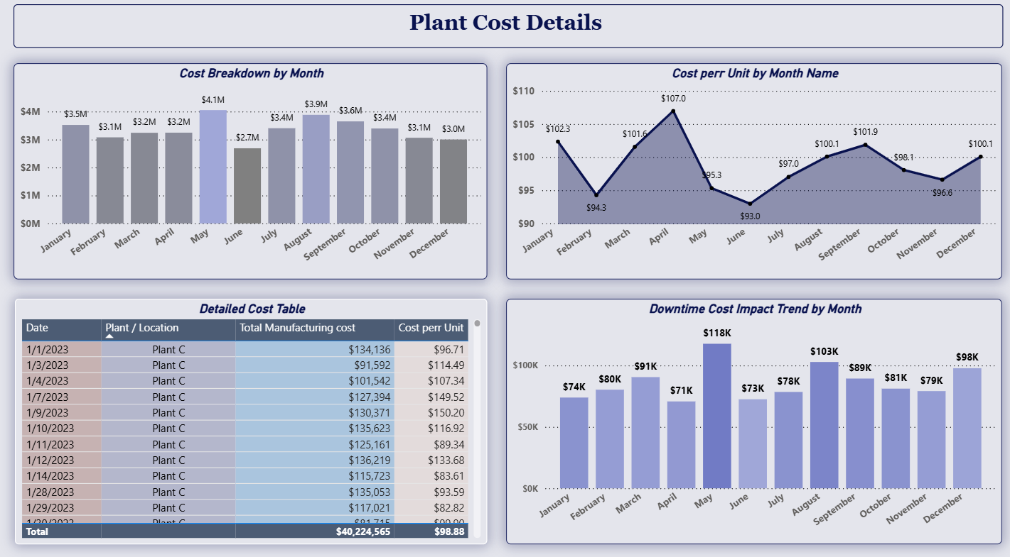
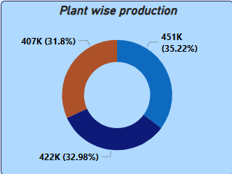
ToolTips
Drill Down Functionality
Tooltip

Slide 18
Thank You!!!

