Slide 1
Deep Learning about Deep Learning Projects
Presented By,
Megha Nagabhushan,
Rashmi Tripathi

Slide 2

Motivation
Lack of understanding
Lot of unfamiliar concepts
Time consuming
Less Productivity

Slide 3
Architecture
Deep Learning Source Code
Code Structure Analysis
Features Extractor
Features
Clustering
User Program
Dynamic Visualization
Static Visualization
Output

Slide 4

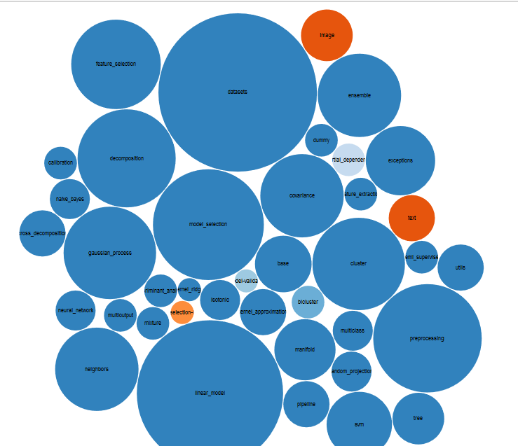
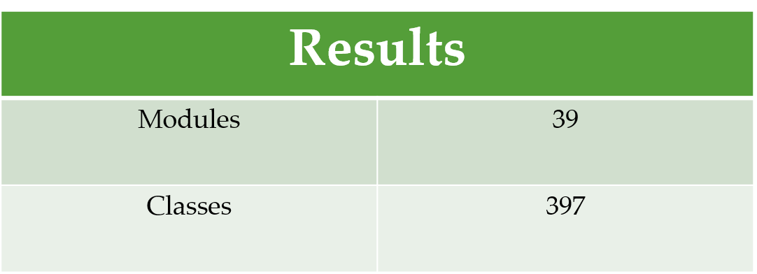
Experiment 1 – Scikit Learn

Slide 5

Experiment 2 – Tensor Flow
Structure | Total
Packages | 319
Modules (Number of python files) | 268
Classes | Still in progress
Important API’s | 1356

