Slide 1
Deep Learning about Deep Learning Projects
Presented By,
Megha Nagabhushan,
Rashmi Tripathi

Slide 2
Deep Learning
1.‘Deep Learning’ means using a neural network
with several layers of nodes between input and output
2. the series of layers between input & output do
feature identification and processing in a series of stages,
just as our brains seem to.
3.GitHub, one of the popular online repository hosting service has 867 deep leaning projects

Slide 3
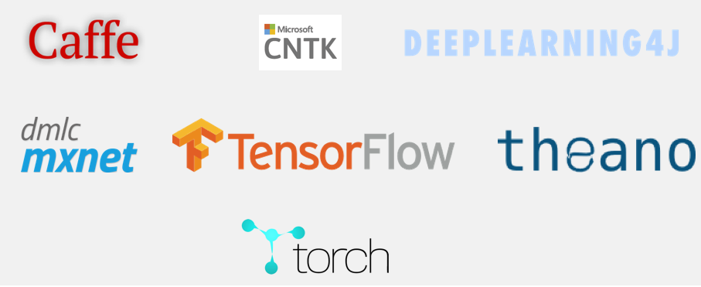
Deep Learning Projects

Slide 4

Existing Challenges while learning Deep Learning
Lack of understanding
Lot of unfamiliar concepts
Time consuming
Less Productivity

Slide 5
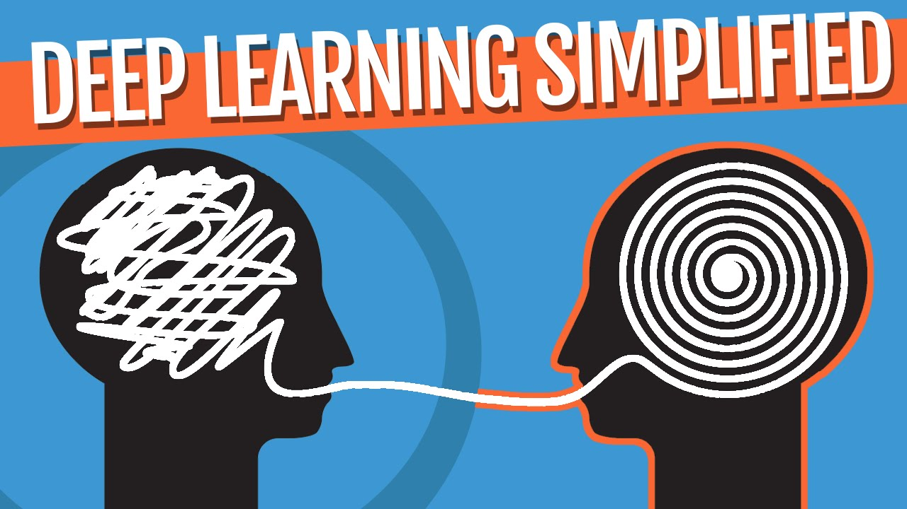

What our Project Model will Do ?

Slide 6
Model Problem Statement
Helps in understanding the network and logical flow of the code.
We are building an intelligent model that helps in internal learning and interpretation of the existing model.
This intelligent model can be used to cascade the features of different projects and develop a new project.

Slide 7
How ??
Using Callgraphs
Callgraphs (also known as a call multigraph) is a control flow graph, which represents calling relationships between subroutines in a computer program. Each node represents a procedure and each edge (f, g) indicates that procedure f calls procedure g. Thus, a cycle in the graph indicates recursive procedure calls.

Slide 8
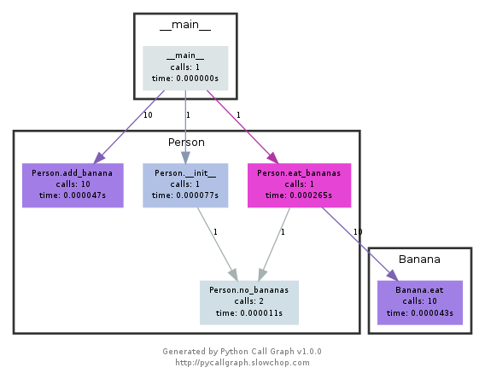
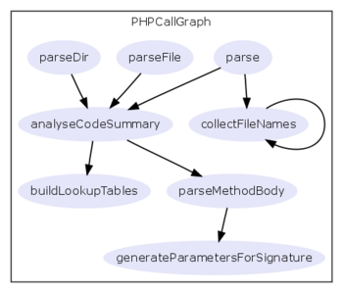
Sample Call Graph

Slide 9
Types of Call Graph
Static Call Graph | Dynamic Call Graph
It represents every possible run of the program. The exact static call graph is an undecidable problem, so static call graph algorithms are generally over approximations. That is, every call relationship that occurs is represented in the graph, and possibly also some call relationships that would never occur in actual runs of the program. | A dynamic call graph is a record of an execution of the program, e.g., as output by a profiler. Thus, a dynamic call graph can be exact, but only describes one run of the program

Slide 10
Architecture
Deep Learning Source Code
Code Structure Analysis
Features Extractor
Features
Clustering
User Program
Dynamic Visualization
Static Visualization
Output

Slide 11
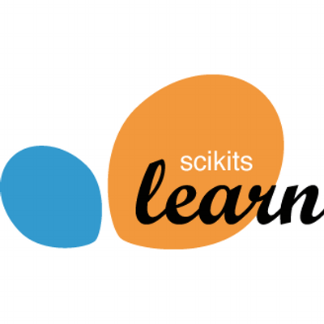
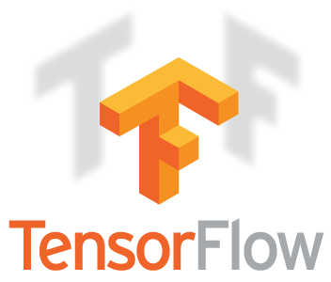
Source Code selected for Experiments

Slide 12

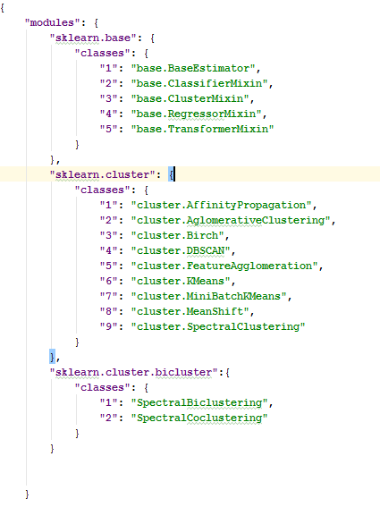
Experiment 1

Slide 13

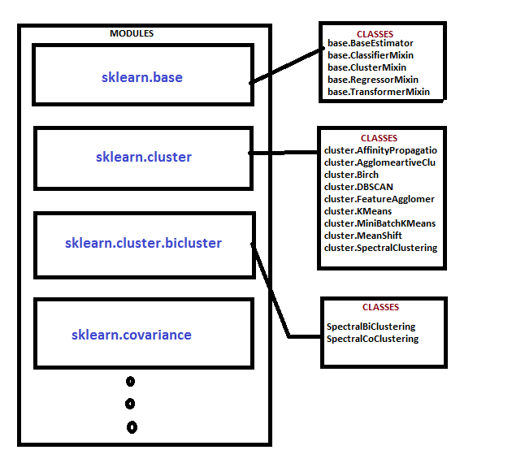
Experiment 1

Slide 14
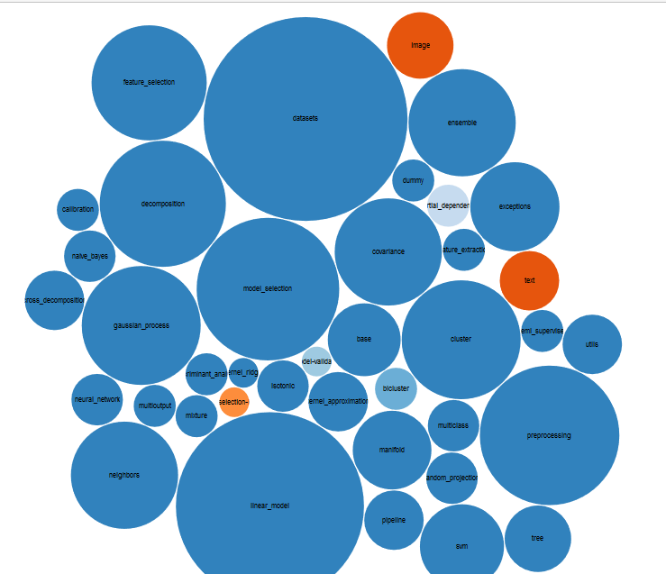
Experiment 1

Slide 15
Experiment 1
Results
Modules | 39
Classes | 397

Slide 16
Experiment 2 - Tensorflow
TensorFlow is open source project created by Google Brains Team for machine learning purposes providing a Python API and C++ API.
The experiment is executed in many iterations.
Rashmi Tripathi

Slide 17
Iteration Information
Iteration | Description
1 | Collect about all the packages need to be iterated over for all classes
2 | Collect Classes and functions information
3 | Visualize using any of JavaScript available using d3.js
4 | Generate dynamic graph using pycallGraph

Slide 18
First Iteration Results
Structure | Total
Packages | 319
Modules (Number of python files) | 268
Classes | Still in progress
Important API’s | 1356

Slide 19
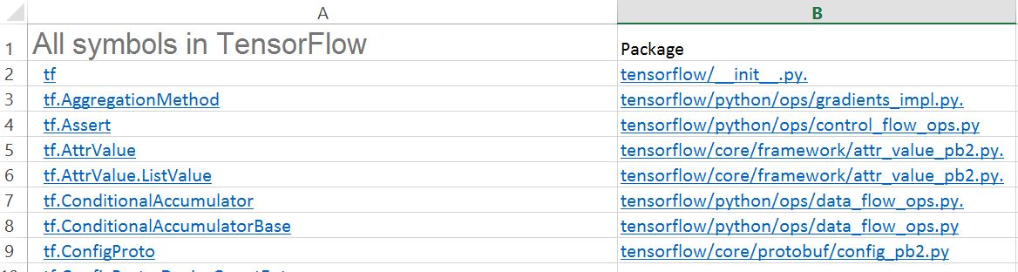
First Iteration Results

Slide 20
Future Developments
Merge the visualization with virtual reality for better understanding
To show the actual time between each function call.

Slide 21
References
Herbsleb, James, Christian Kästner, and Christopher Bogart. "Intelligently Transparent Software Ecosystems." IEEE Software 33.1 (2016): 89-96.
L. Dabbish et al., “Leveraging Transparency,” IEEE Software, vol. 30, no. 1, 2013, pp. 37–43.
K.T. Stolee, S. Elbaum, and D. Dobos, “Solving the Search for Source Code,” ACM Trans. Software Eng. and Methodology, vol. 23, no. 3, 2014, article 26. L. Martie, T.D. LaToza, and A. van der Hoek,
“CodeExchange: Supporting Reformulation of Code Queries in Context,” to be published in Proc. 30th Int’l Conf. Automated Software Eng., 2015.
H. Cleve and A. Zeller, “Locating Causes of Program Failures,” Proc. 27th Int’l Conf. Software Eng. (ICSE 05), 2005, pp. 342–351.

Slide 22


