Slide 1
The United States Opioid Epidemic: Data and Visualizations
Demographics

Slide 2
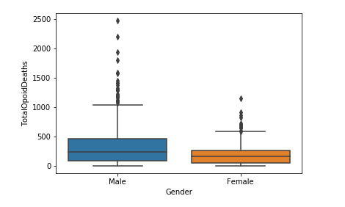
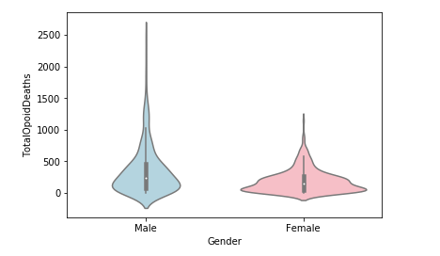
Opioid Overdose Deaths by Gender

Slide 3
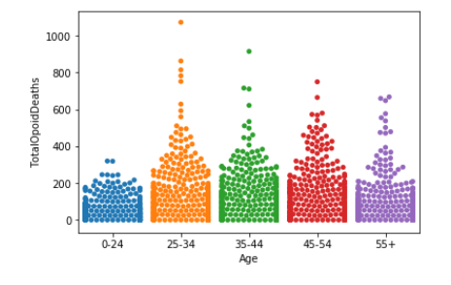
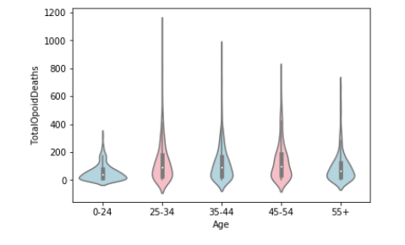
Opioid Overdose Deaths by Age

Slide 4
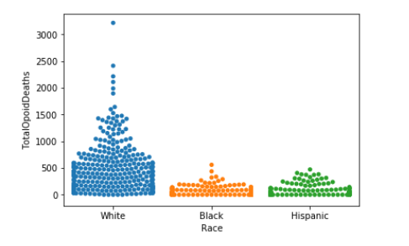
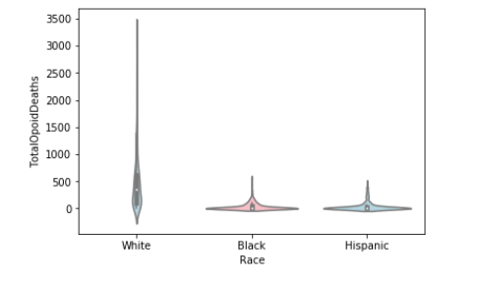
Opioid Overdose Deaths by Race

