Slide 1
T-Health
project

Slide 2
Student Members
Fasil Girma Habtegiorgis (000-61-0529)
Hailemariam Mesfin Ayalew (000-10-9440)
Nahu Bethsiha Merawi (000-61-0519)
Samson Gebissa Tulu (000-10-9291)
Abdukrasheed Mustapha (000-61-0539)

Slide 3
Contents
Project Overview
Requirement Description
Project Features
Use Case Diagrams
Class Diagrams
Prototype

Slide 4
Project Overview
t-Health is a comprehensive, integrated information system designed to manage the information and servicing process of patients visiting the Maharishi University of Management clinic as opposed to the current system which is outdated. t-Health is the way to advance and automate the current manual system.

Slide 5
Description
In recent times, clinics and hospitals are becoming more reliant on the capability of patient records information system to assist in the diagnosis process and management, for better and improved services and practices. The main goal of t-Health will, therefore, be to streamline the flow of information across the clinic towards effective decision making for patient care, in an optimized and efficient manner. Furthermore, enhanced security and integrity are the main aspects of t-health since the recording of patient information can be a record of medical, personal, financial, or legal documents that are very sensitive.

Slide 6
Features
The essential features of t-Health are :
Patient profile creation and management
Patient demographics and basic health information management
Patient diagnosis and prescription management
Track patient medical history
Generate e-visit letter
Provide health usage facility statistics

Slide 7
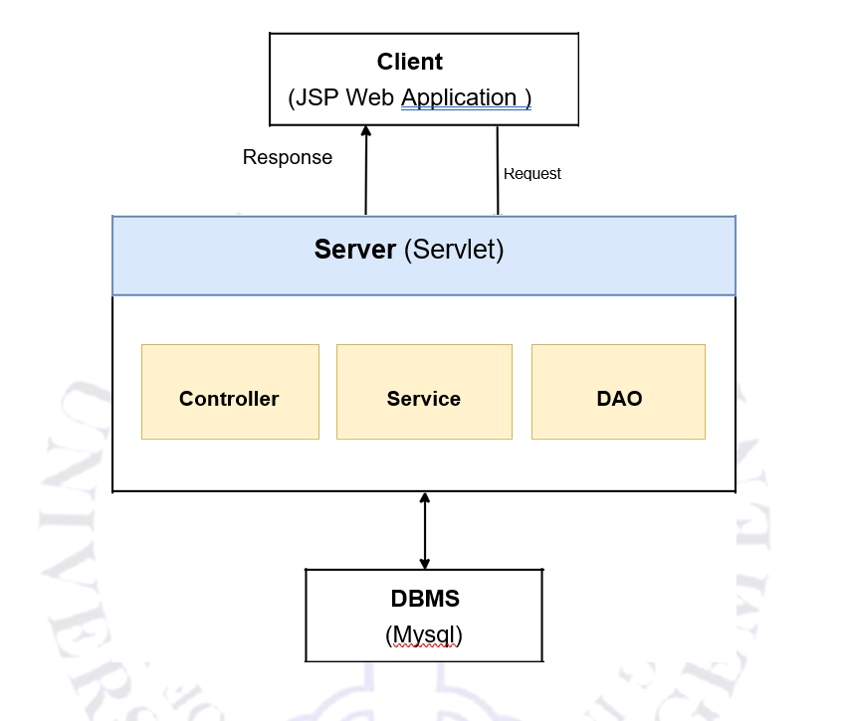
Software Architecture

Slide 8
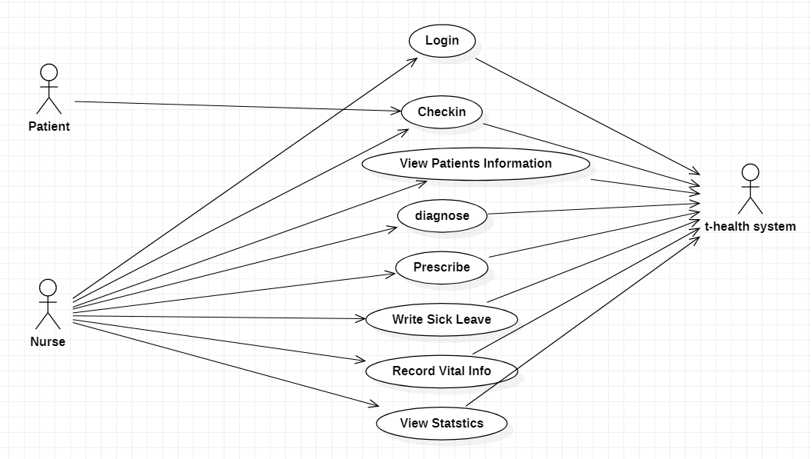
Use Case Diagram

Slide 9
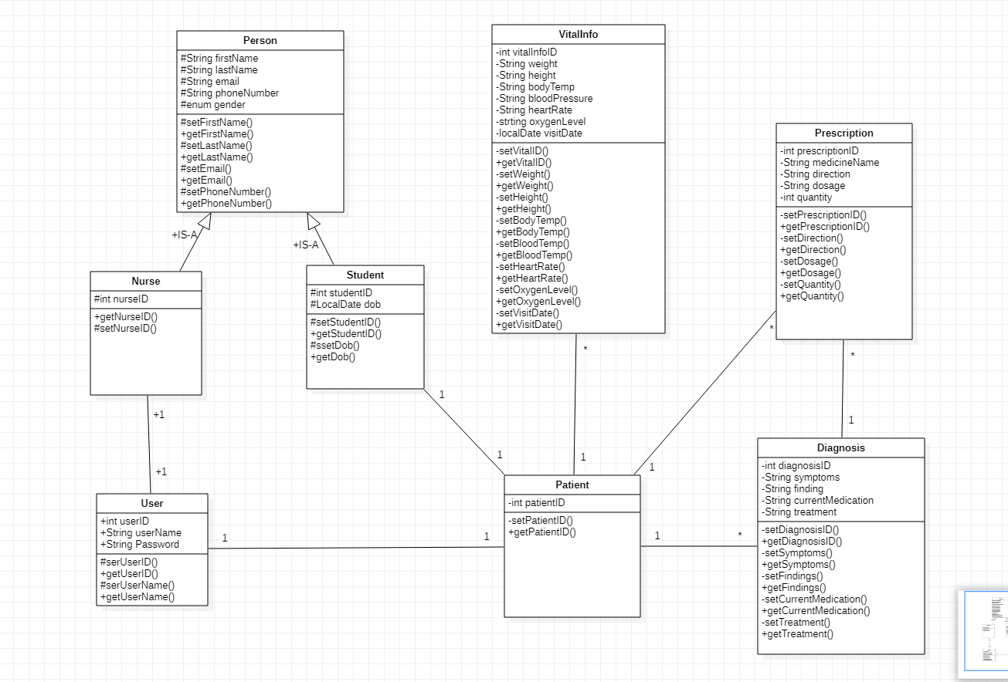
Class Diagram

Slide 10
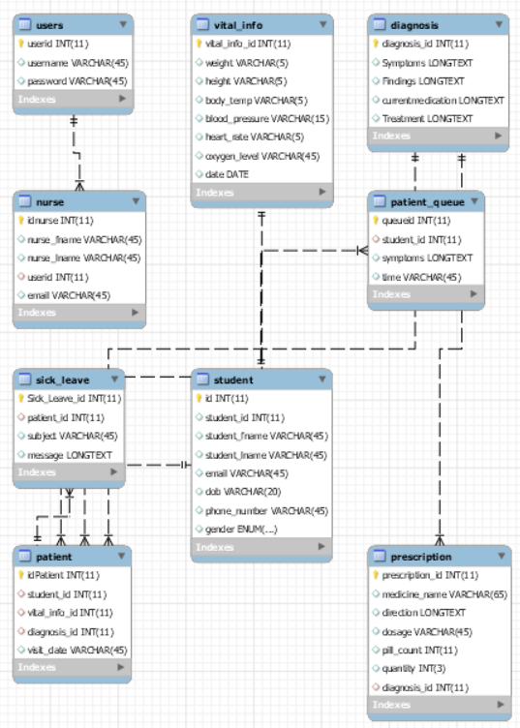
ER Diagram

Slide 11
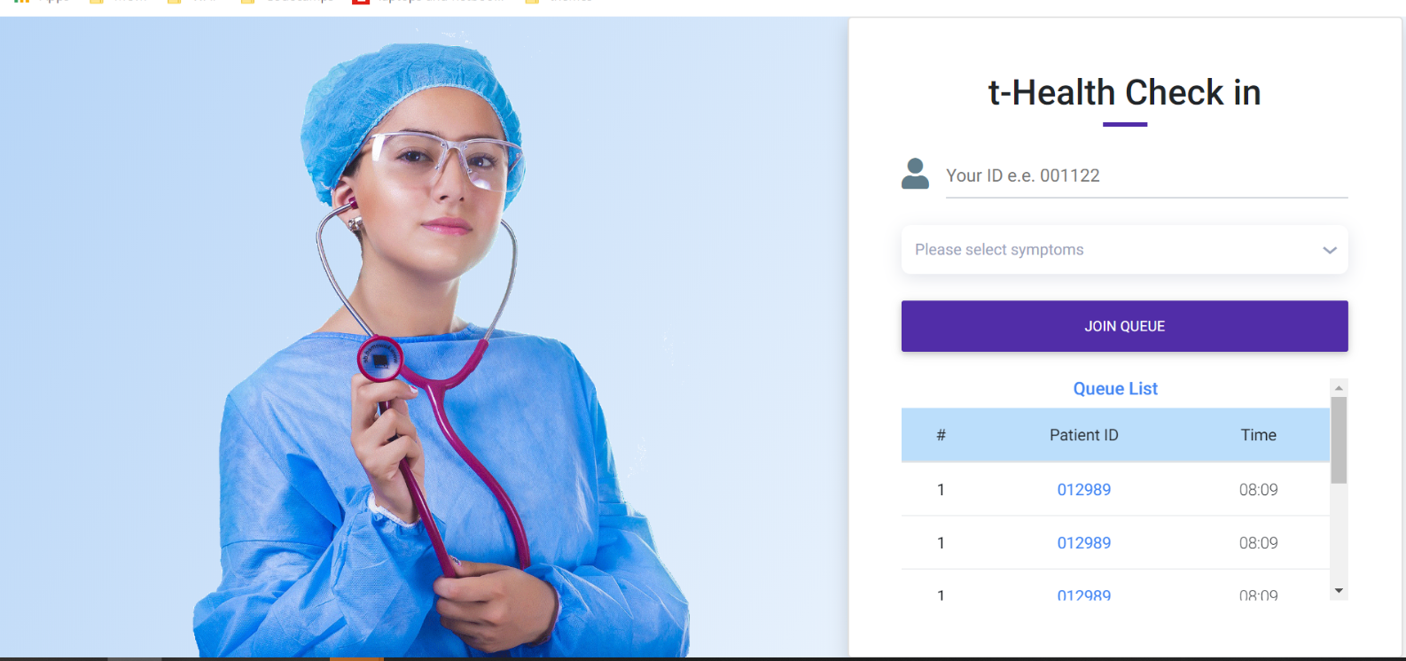
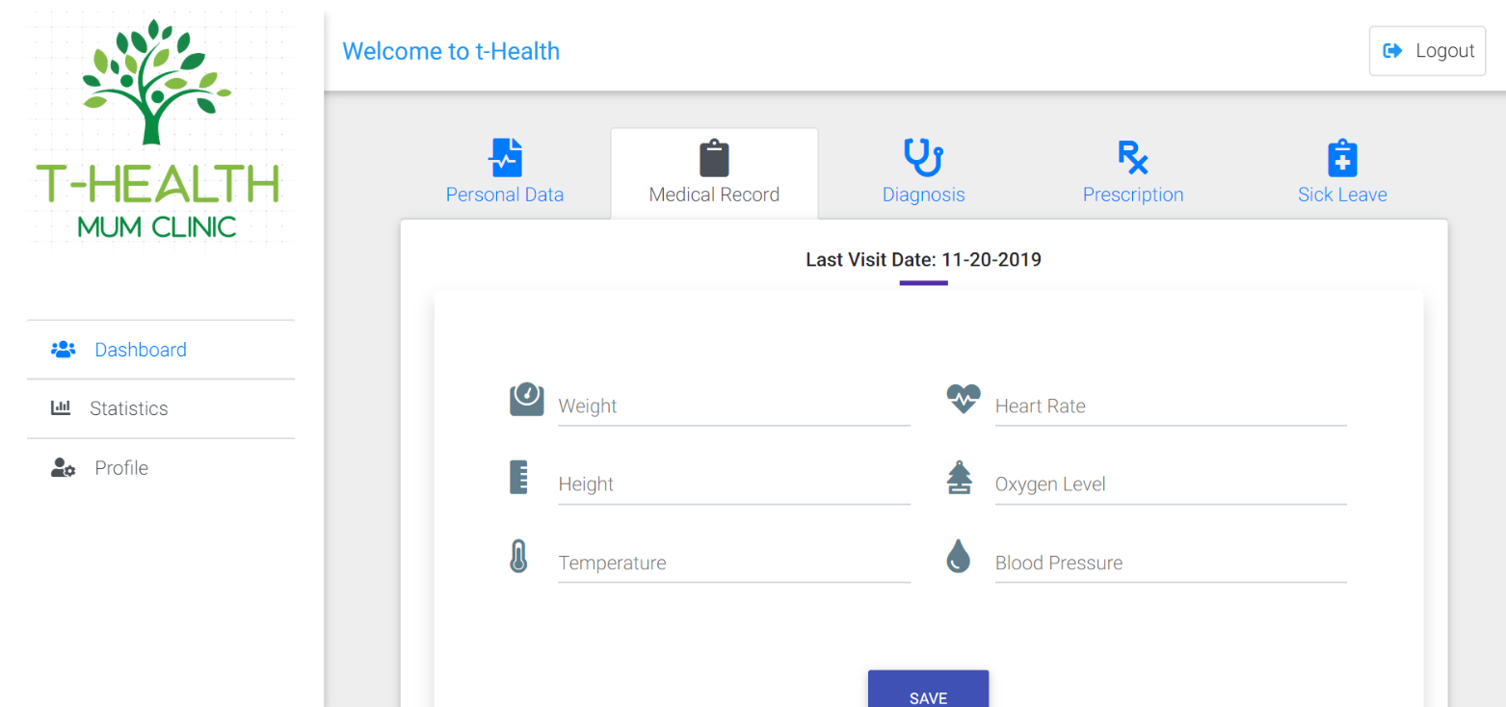
Prototype

Slide 12
Back of the Envelope Calculation
Targeted number of users : 10 ,000
Targeted Geographical location of users : Fairfield, United States of America
Manpower skillset required
1 front end
1 backend
1 devops
1 system analyst
1 quality Assurance
Development time span: 2 days
Memory allocation
Patient record Storage: 5MB
System Minimum Storage (User storage (5MB) * targeted users (10,000)): 50GB
Users peak time: 8:00AM - 4:30 PM
Platform targeted: Web
Scalability plans:
Moving from ORM database system (Mysql) to NoSql (SQL Graph)
Deployment of more servers
CAP Theorem Compliance: Consistence and Availability

Slide 13
Future Extensions
Statistics
Mobile apps
Retrieving records
Making this system available for all MUM members
Referrals

Slide 14
Demo

Slide 15
Thank You!!

