Slide 1
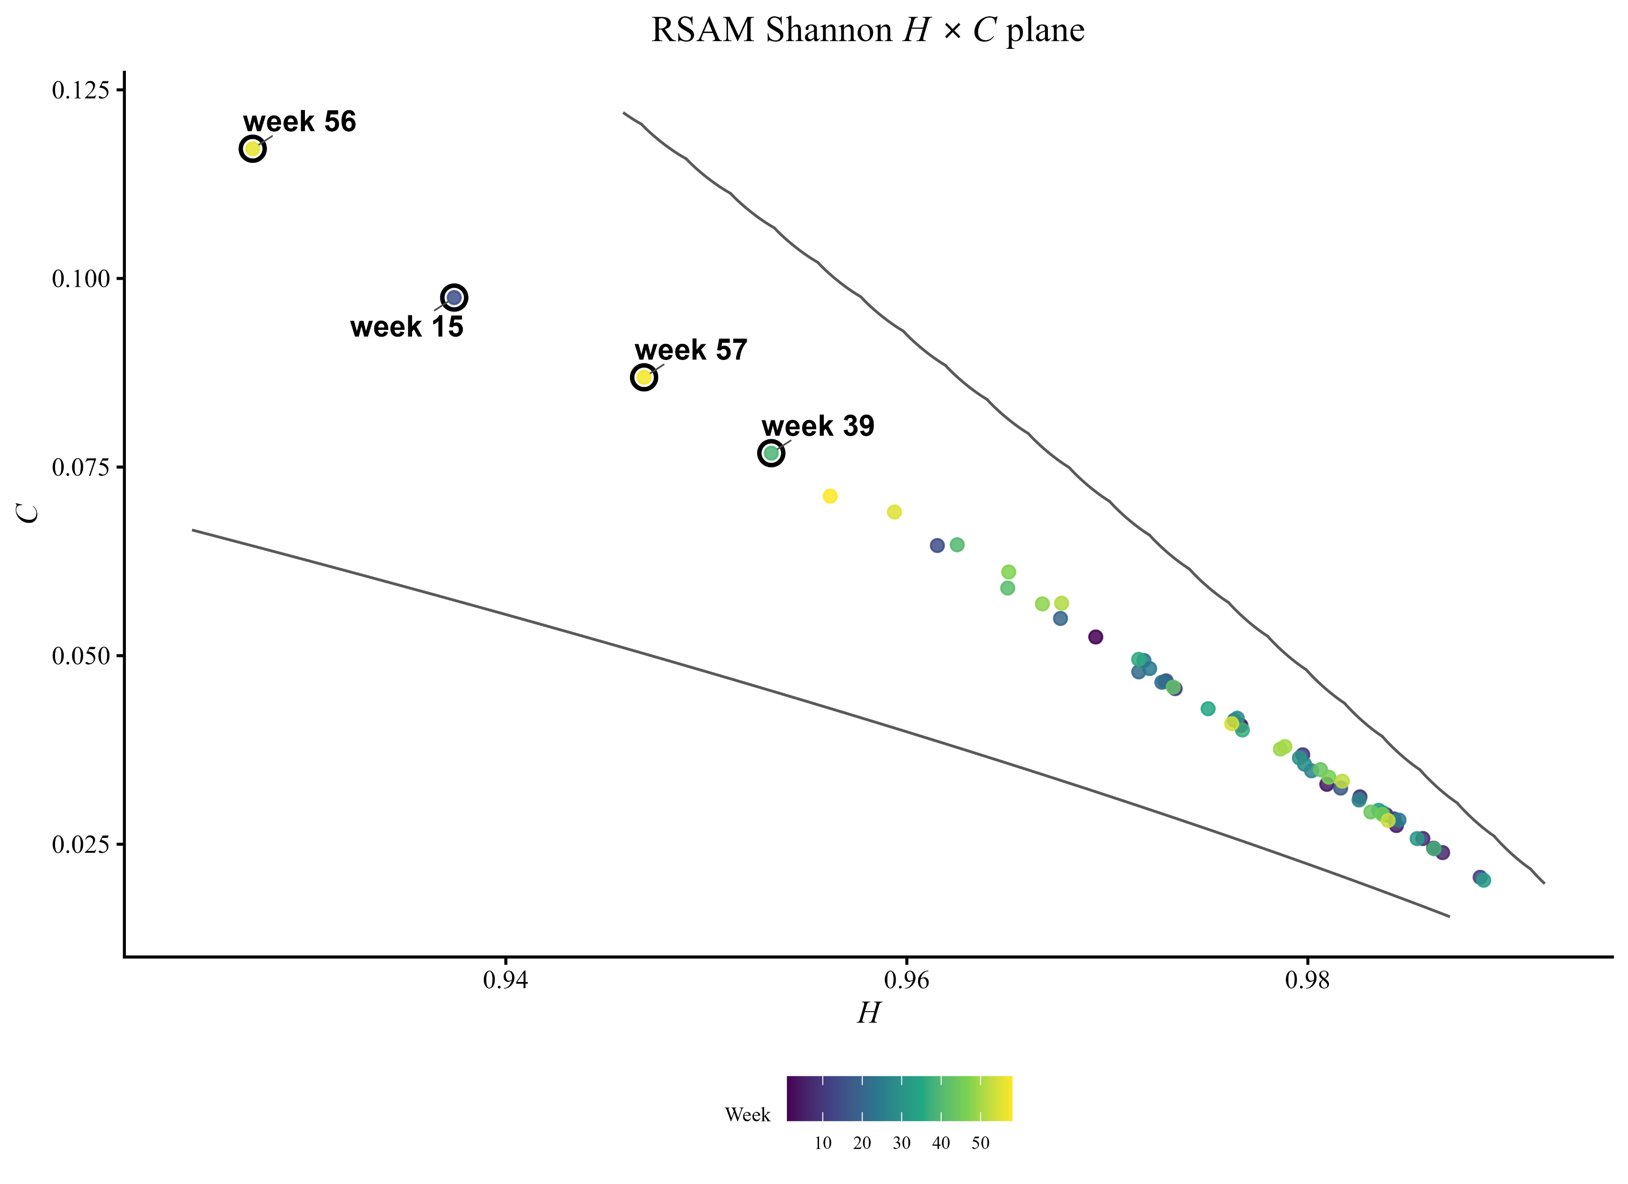
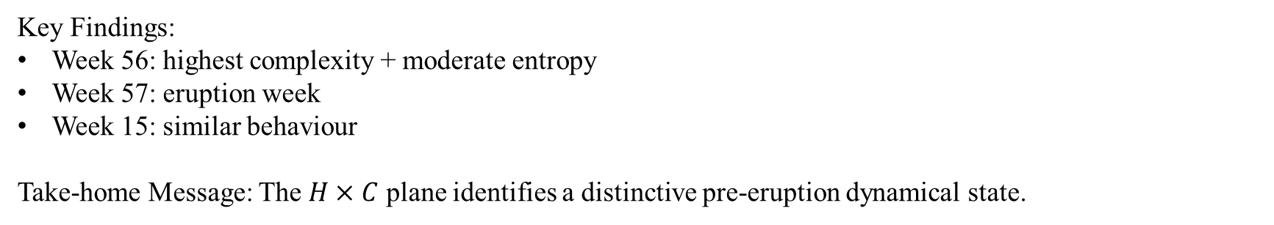
Identifying Volcanic Unrest via the Entropy–Complexity Plane
Rasika Dilhani (Data Science PhD student), Alejandro C. Frery and Andrea Rey (supervisors)
Objective: Identify volcanic eruption signatures using the entropy-complexity plane.​
Data: Continuous RSAM seismic data from WIZ station, Whakaari (White Island), New Zealand.​
Method: ​
Ordinal patterns transformation​
Analysis of Shannon, Rényi, and Tsallis entropy, Fisher information, and statistical complexities
Key Findings:
Week 56: highest complexity + moderate entropy
Week 57: eruption week
Week 15: similar behaviour
Take-home Message: The $H×C$ plane identifies a distinctive pre-eruption dynamical state.

