Slide 1
Underwater Multimedia Communication and Cable Protection System
14 life below water

Slide 2
Content
Introduction
Probleam Statement
Project Flow
Coding block details
Advantages, Disadvantages
Applications
Result

Slide 3
Introduction
This project presents an underwater multimedia communication and cable protection system using Arduino in Tinkercad.A sensor continuously monitors the environment around the underwater cable.When a danger such as leakage or disturbance is detected, a red LED blinks as a warning.
A buzzer turns ON to provide an immediate sound alert.A servo motoractivates to simulate a protective action for the cable.The system is automatic, low-cost, and helps improve underwater cable safety.

Slide 4
Probleam Statment
• Protect underwater communication cables from damage.
• Need early detection and protection system.

Slide 5
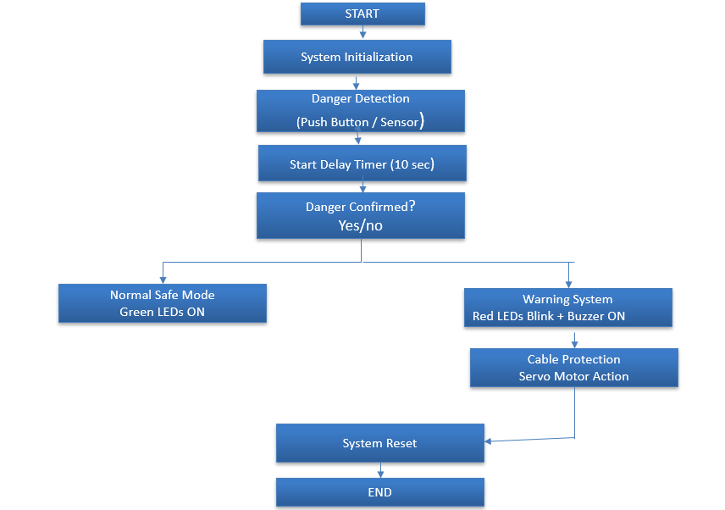
Project Flow

Slide 6
Coding block details
Start
⬇
Initialize sensor pin (INPUT)
⬇
Initialize LED and buzzer pins (OUTPUT)
⬇
Read sensor value
⬇
Is danger detected?
⬇
YES ➜ Turn ON buzzer ➜ Blink red LED ➜ Continue monitoring
⬇
NO ➜ Turn OFF LED ➜ Turn OFF buzzer
⬇
Repeat process continuously

Slide 7
Advantages and Disadvantages
✅ Advantages
1️⃣ Gives early warning before cable damage
2️⃣ Easy to build and low cost
3️⃣ Provides both light and sound alert
4️⃣ Improves safety of underwater systems
5️⃣ Works automatically without human monitoring
❌ Disadvantages
1️⃣ Limited detection range
2️⃣ Sensor accuracy depends on environment
3️⃣ May give false alert if sensor is disturbed

Slide 8
Applications
1️⃣ Ocean Research & Marine Monitoring
2️⃣ Defence & Navy Communication
3️⃣ Oil & Gas Industry
4️⃣ Disaster Monitoring & Early Warning

Slide 9
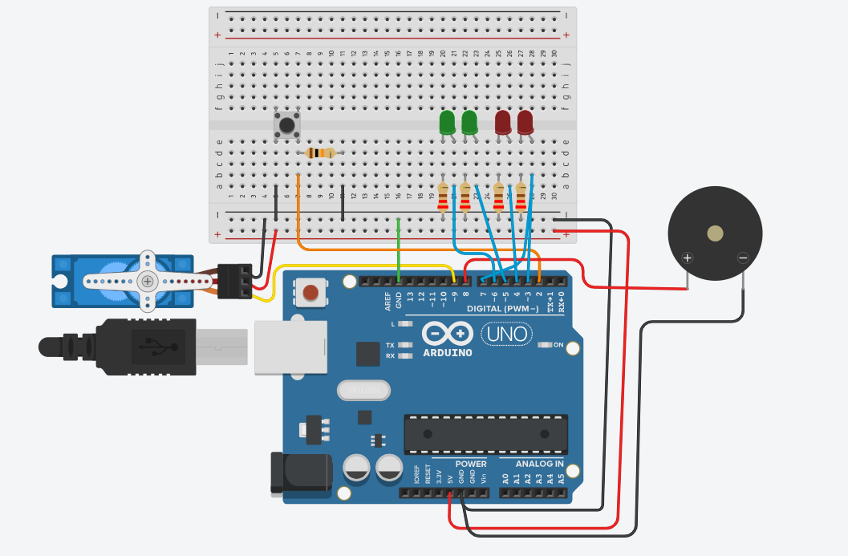
Results

Slide 10
Thank you

