Slide 1
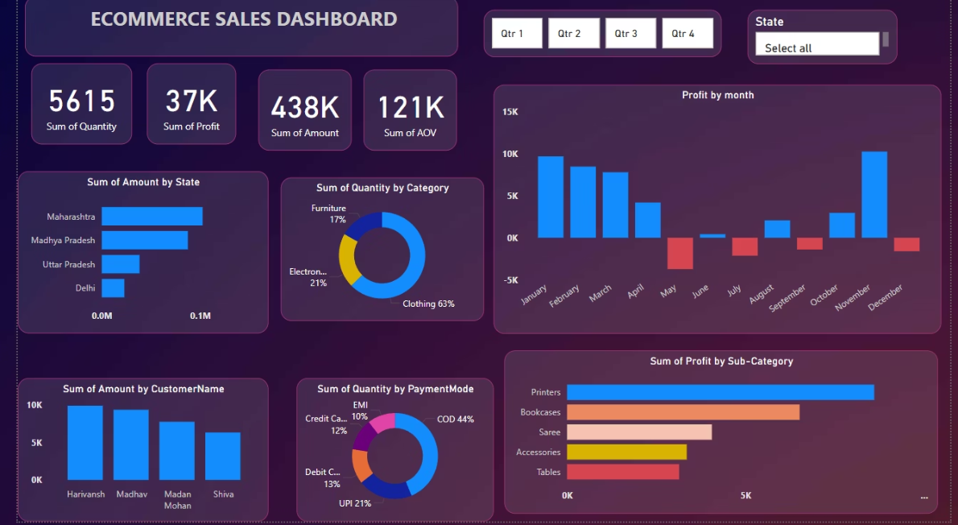
E-Commerce Sales Dashboard using Power BI
This presentation highlights my data analyst internship project.
Presented by : Rasika Mahindrakar
Date: 30-05-2025

Slide 2



Dashboard Features
Analyze Sales Data
Uncover Key Insights
Build Interactive Dashboard
Visualize e-commerce sales data effectively.
Gain actionable insights for business growth.
Support data-driven decision-making processes.

Slide 3
Key Insights and KPIs
Key Columns
Additional Data
Amount, AOV, Category
Quantity, Profit, City
Sub-Category, Order ID
State, Payment Mode, ID
Order Date, Customer Name
Source: E-commerce sales dataset

Slide 4
Key Insights and KPIs
5
2
Key Performance Indicators
Trend Analyses
Calculated using DAX measures.
Monthly sales and profit trends tracked.
Identified top-selling products and high-performing categories. Key metrics include Total Sales, Total Profit, Quantity Sold, and Average Order Value (AOV).

Slide 5



Dashboard Features
Interactive Filters
Quarter, State, and Category slicers.
Diverse Charts
Line, Bar, Donut, and Column charts.
KPI Cards
Display Total Profit, Quantity, and AOV.

Slide 6



Tools & Techniques Used
Power BI
Power Query
DAX
Primary visualization tool.
For data transformation.
Data Analysis Expressions.
Applied skills in data modeling, cleaning, custom visualizations, and dashboard design.

Slide 7
Learnings
Data Integration
1
Connecting and joining tables.
Interactive Analysis
2
Using parameters and filters.
Data Storytelling
3
Communicating insights effectively.
Design Principles
4
Balancing aesthetics and usability.

Slide 8

Dashboard Preview
This preview showcases the final interactive Power BI dashboard, ready for stakeholder use.

Slide 9






Conclusion
Interactive Dashboard
Delivered for business stakeholders.
Enhanced Skills
Strengthened data analysis and visualization.
Data Storytelling
Demonstrated Power BI's capabilities.

