Slide 1
Snack Ordering app for a movie Theatre Website Design
Rasika Mathur

Slide 2
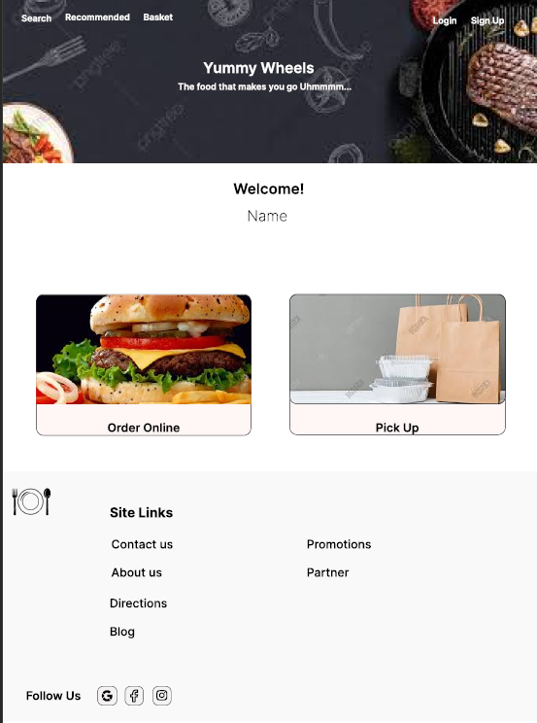
Project overview
The product:
Yummy wheels is an online food delivery app. That allows its users to order snacks during a movie at the theatre any time.This app is great for family who wants to watch movie and even don’t get disturbed.
Project duration:
March 2022 to August 2022

Slide 3
Project overview
The problem:
Users don’t want to get disturbed during a movie or don’t want to stand in long que.
The goal:
The goal of the project is to allow the users to order food online just by using the app and get the order to their seats.
.

Slide 4
Project overview
My role:
UX designer designing an app for Yummy wheels from conception to delivery.
Responsibilities:
Conducting interviews, paper and digital wireframing, low and high-fidelity prototyping, conducting usability studies, accounting for accessibility, and iterating on designs.

Slide 5
User research
Personas
Problem statements
User journey maps
Understanding
the user

Slide 6
User research: summary
I conducted interviews and created empathy maps to understand the users I’m designing for and their needs. A primary user group identified through research were parents who wants to enjoy the movie with family but gets disturbed with the child as the child Is hungry.
This user group confirmed that as they are too busy with work but love watching movies together but due to the child they are not able to watch the movie without disturbance.

Slide 7
User research: pain points
1
2
3
Age
Accessibility
Pain point
As some users can’t wait in long queue they can easily order from this app and the food gets delivered in their place.
Previously There was no such technology available for theatre.
Text-heavy menus in apps are often difficult to read and order from

Slide 8

“I’m busy during weekdays but love watching movies on weekends”
Persona: Manan
Problem statement:
Manan is a busy working adult who likes watching movies with his family but as his child is small and disturbs him while watching movie.Since Manan dosen’t like going to the theater due to this reason. As he was introduced with the app he was happy that his child will now not disturb him whenever he is hungry Manan orders snacks online and and enjoys the movie without getting up from his seat.
Goals
To make users happy with the product.
To give them comfort and easy delivery..
Frustrations
The children don’t allow to watch movie as they are not interested and cannot leave them alone.
Ordering may take some time.
Age:
Education:
Hometown:
Family:
Occupation:
35
Graduated
Hyderabad
Married
Works at Wipro
Manan is a busy working parent who likes watching movies, but cannot go as his child does not allow him to watch movies and keeps on disturbing him. Manan found an app which delivers food in theatre. Now Manan is happy as he can watch movie without even getting up from his seat and the food will be delivered on time.

Slide 9
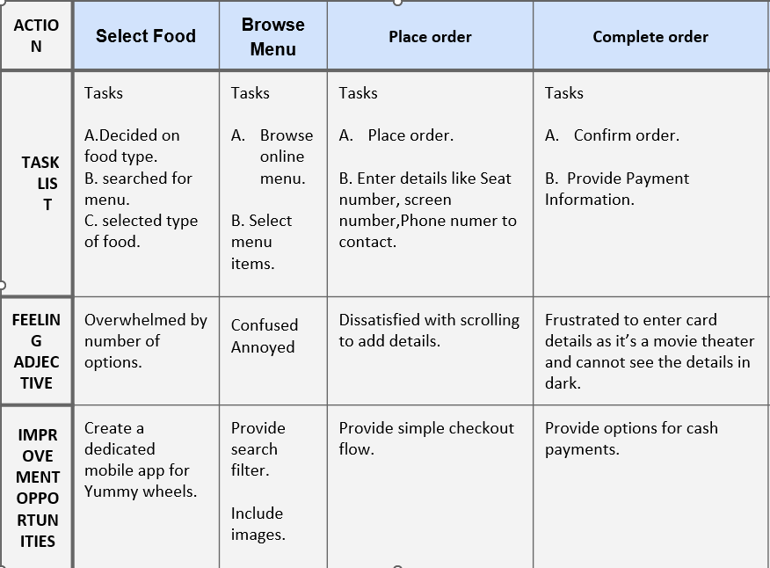
Persona : Manan
An easy and quick way to order.
User journey map
Mapping Manan’s user journey revealed how helpful it would be for users to have access to a dedicated Yummy Wheels app.

Slide 10
Sitemap
Paper wireframes
Digital wireframes
Low-fidelity prototype
Usability studies
Starting
the design

Slide 11
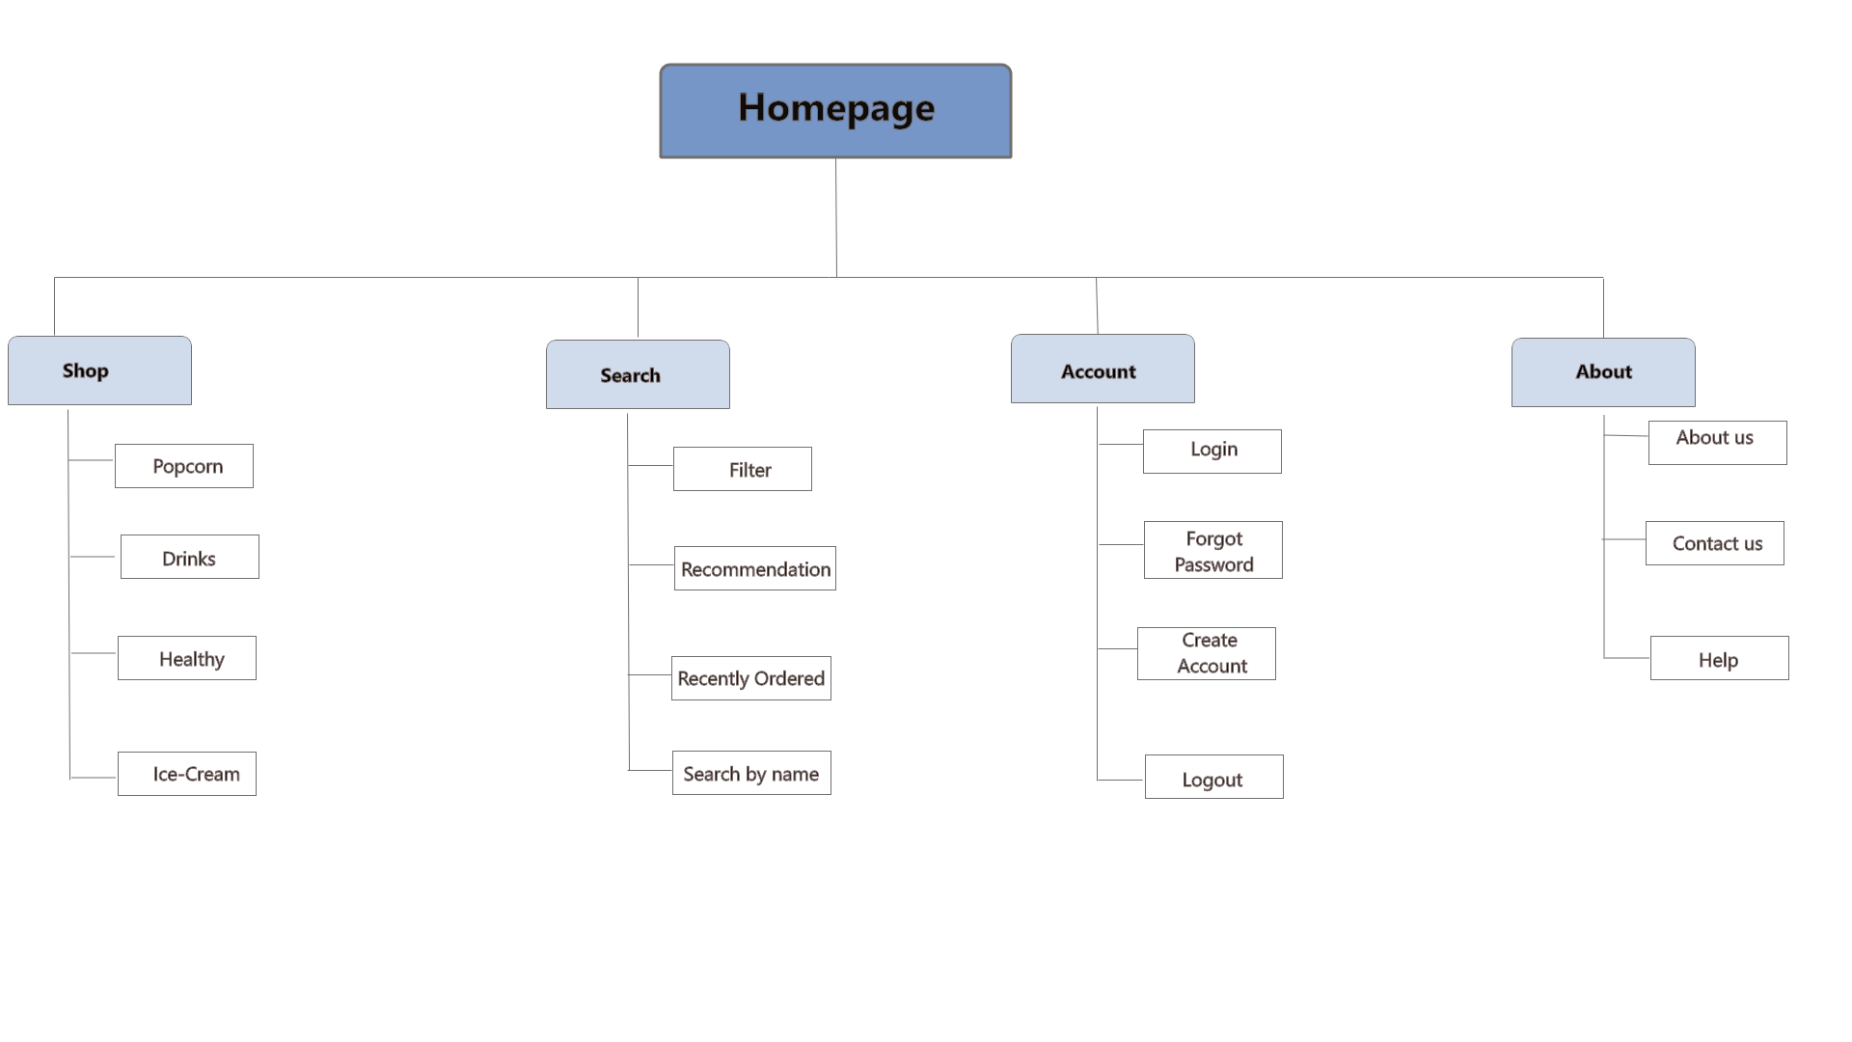
Sitemap
Difficulty with website navigation was a primary pain point for users, so I used that knowledge to create a sitemap.
My goal here was to make strategic information architecture decisions that would improve overall website navigation. The structure I chose was designed to make things simple and easy.

Slide 12
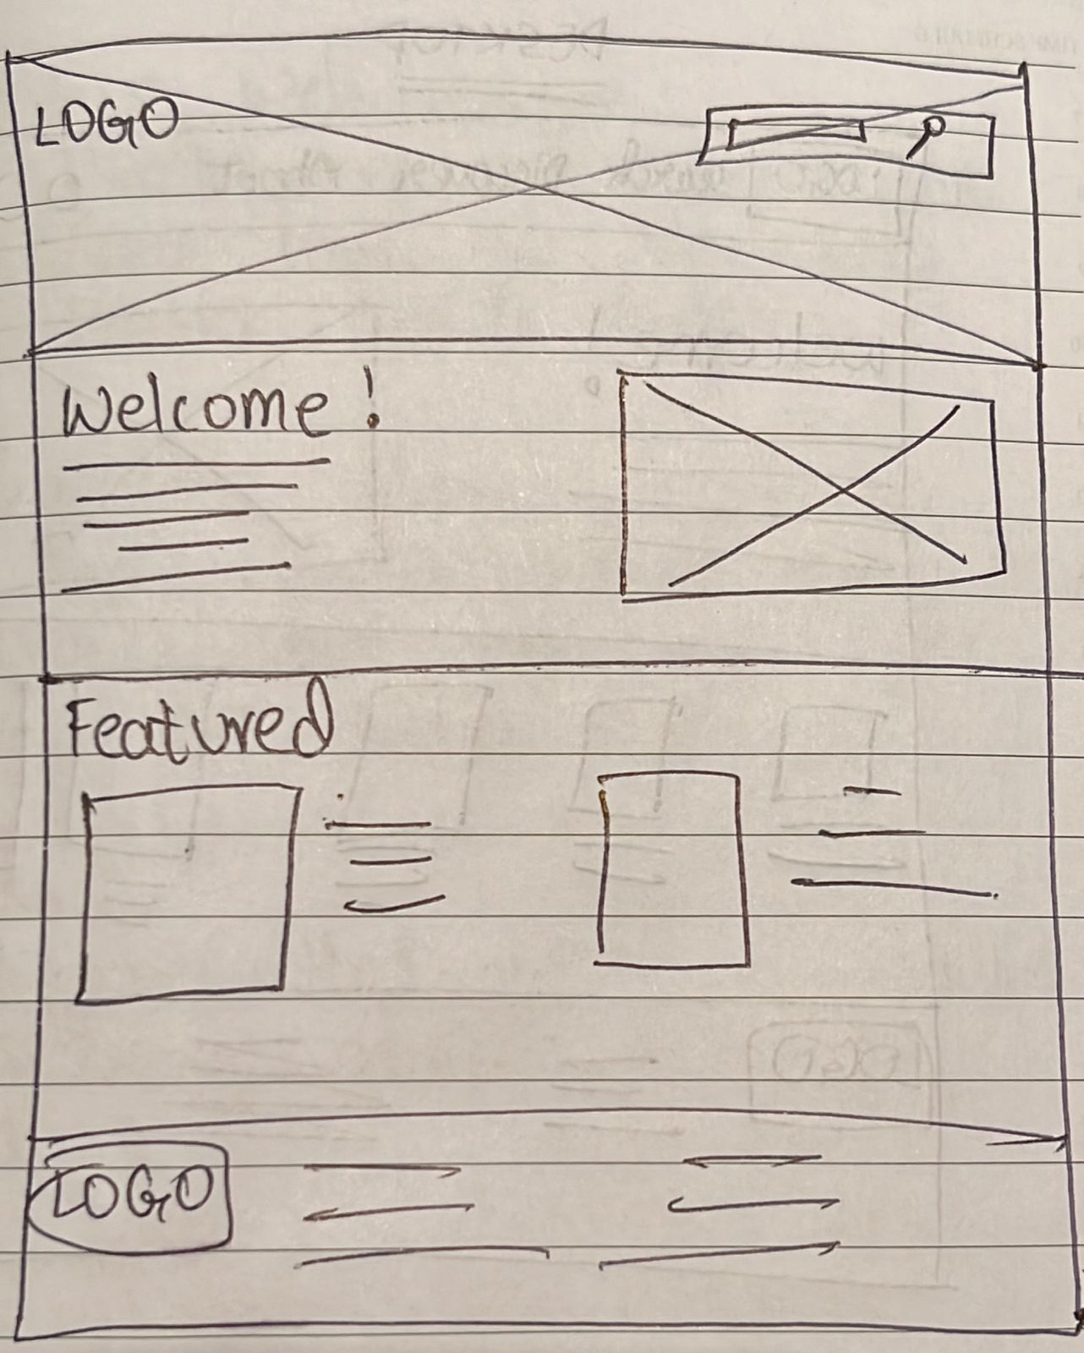
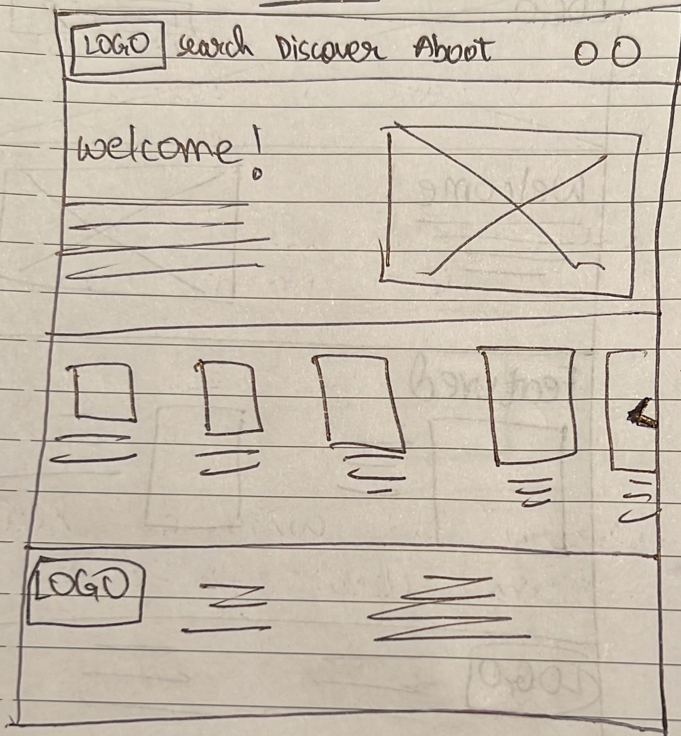
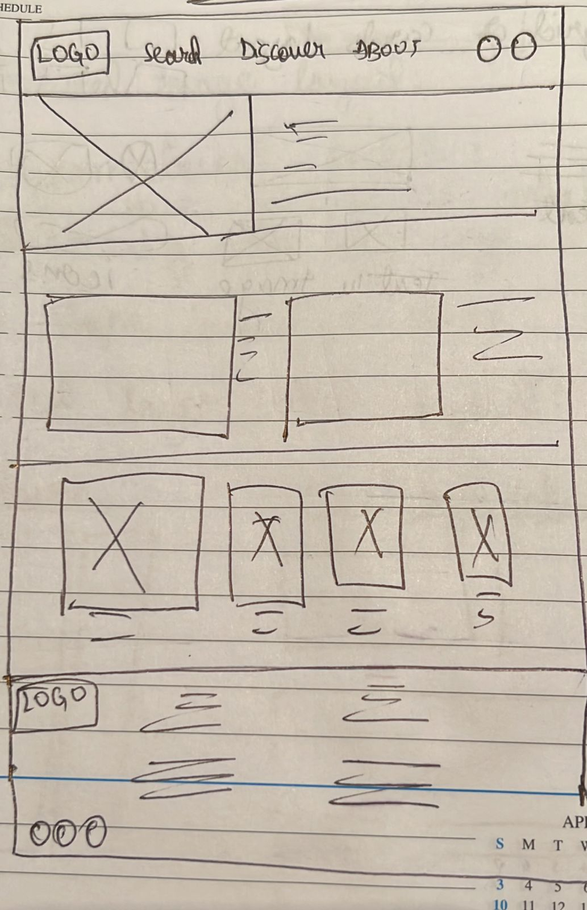
Paper wireframes
Next, I sketched out paper wireframes for each screen in my app, keeping the user pain points about navigation, browsing, and checkout flow in mind.
The home screen paper wireframe variations to the right focus on optimizing the browsing experience for users.

Slide 13
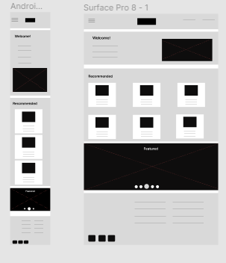
Paper wireframe
screen size variation(s)
customers access the site on a variety of different devices, I started to work on designs for additional screen sizes to make sure the site would be fully responsive.

Slide 14
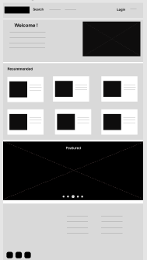
Digital wireframes
Moving from paper to digital wireframes made it easy to understand how the redesign could help address user pain points and improve the user experience.
Prioritizing useful button locations and visual element placement on the home page was a key part of my strategy.
The search button helps the user to search for the food they like to order.
The login button allows the user to login and use the app.

Slide 15
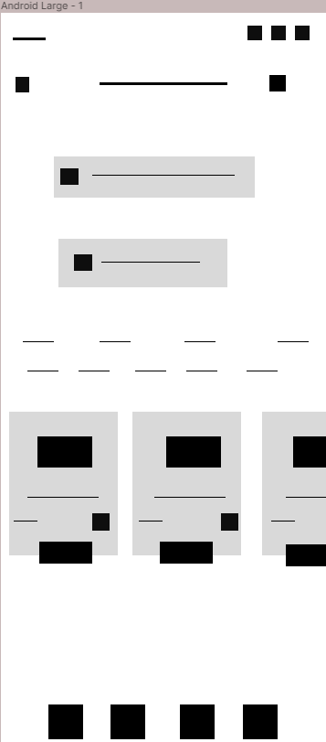
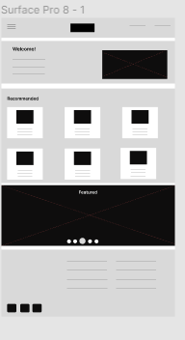
Digital wireframe
screen size variation(s)

Slide 16
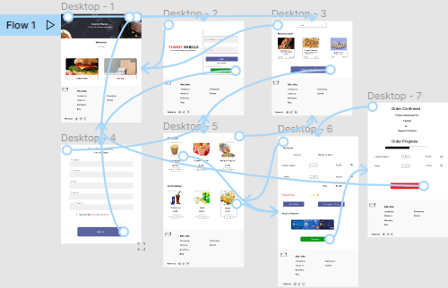
Low-fidelity prototype
To create a low-fidelity prototype, I connected all of the screens involved in the primary user flow of adding an item to the cart and checking out.
At this point, I had received feedback on my designs from members of my team about things like placement of buttons and page organization. I made sure to listen to their feedback, and I implemented several suggestions in places that addressed user pain points.

Slide 17
Usability study: parameters
Study type:
Unmoderated usability study
Location:
United States, remote
Participants:
5 participants
Length:
20-30 minutes

Slide 18
Usability study: findings
I conducted two rounds of usability studies. Findings from the first study helped guide the designs from wireframes to mockups. The second study used a high-fidelity prototype and revealed what aspects of the mockups needed refining.
1
2
3
Finding
Finding
Finding
Users want to order quickly
Users want contact less delivery.
.
Payment option is confusing

Slide 19
Refining
the design
Mockups
High-fidelity prototype
Accessibility

Slide 20
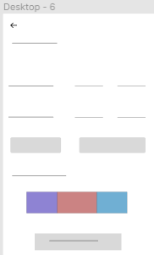
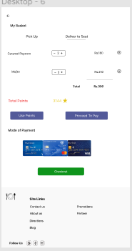
Mockups
Based on the insights from the usability study, I made changes to improve the site’s checkout flow. One of the changes I made was adding the option to allow the users to pick up or deliver their order to their seat.
Before usability study
After usability study

Slide 21
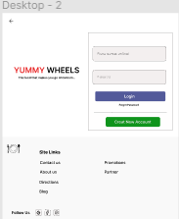
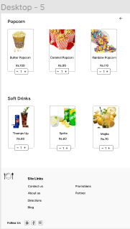
Mockups: Original screen size

Slide 22
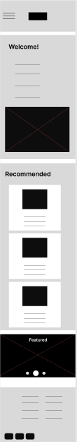
Mockups: Screen size variations
I included considerations for additional screen sizes in my mockups based on my earlier wireframes. Because users shop from a variety of devices, I felt it was important to optimize the browsing experience for a range of device sizes, such as mobile and tablet so users have the smoothest experience possible.
Tab Screen
Phone Screen

Slide 23
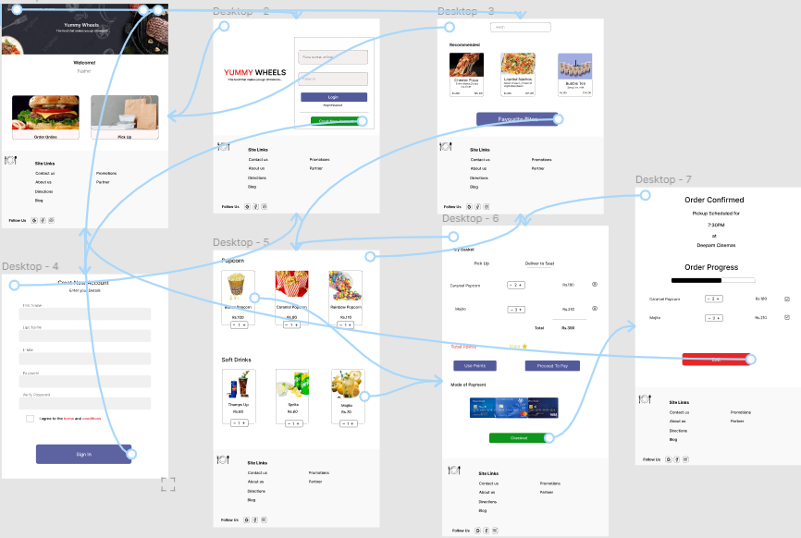
High-fidelity prototype
My hi-fi prototype followed the same user flow as the lo-fi prototype, and included the design changes made after the usability study, as well as several changes suggested by members of my team

Slide 24
Accessibility considerations
1
2
3
Used detailed imagery to help all users better understand the designs.
I used headings with different sized text for clear visual hierarchy .
Used icons to help make navigation easier.

Slide 25
Going forward
Takeaways
Next steps

Slide 26
Takeaways
Impact:
Our target users shared that the design was intuitive to navigate through, more engaging with the images, and demonstrated a clear visual hierarchy.
What I learned:
While designing the Yummy Wheels app, I learned that the first ideas for the app are only the beginning of the process. Usability studies and peer feedback influenced each iteration of the app’s designs.
.

Slide 27
Next steps
1
2
Conduct follow-up usability testing on the new website
Identify any additional areas of need and ideate on new features

Slide 28
Insert a few sentences summarizing the next steps you would take with this project and why. Feel free to organize next steps in a bullet point list.
Let’s connect!
Email: rasika.mathur30@gmail.com
Thank you for your time reviewing my work on the Yummy Wheels app! If you’d like to see more or get in touch, my contact information is provided below

