Slide 1
CookBook App and Responsive Website
Rasika Mahur

Slide 2
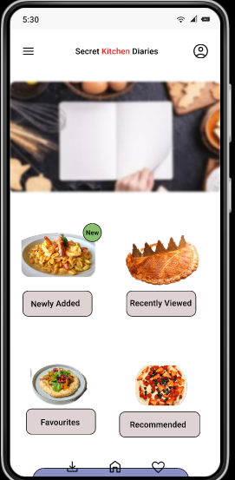
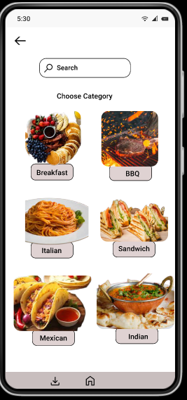
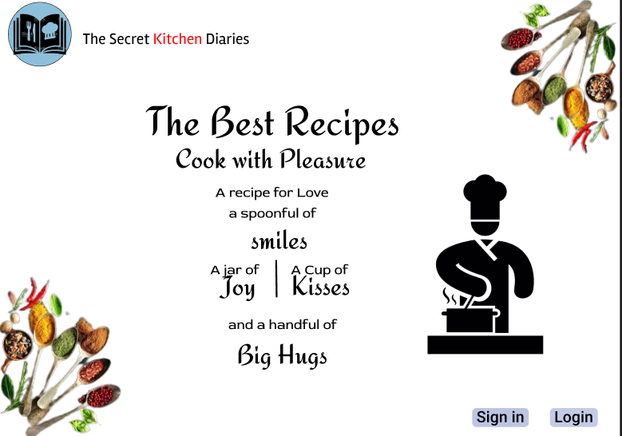
Project overview
The product:
Cookbook, collection of recipes, instructions, and information about the preparation and serving of foods. At its best, a cookbook is also a chronicle and treasury of the fine art of cooking.
The book helps many users who don’t know how to cook, who are learning how to cook, who stay away from their homes but like home food.
Project duration:
March 2022-Sept 2022

Slide 3
Project overview
The problem:
60% of the population has left their homes to work or study in different cities. They miss the home food, this book will help them to cook as per their tastes and not miss their homes. This book is even for those who cannot cook and need guidance.
The goal:
Design an app that will help the users to go through the recipes and try out new cuisines everyday.

Slide 4
Project overview
My role:
UX Designer leading the app and responsive website desig from conception to delivery.
Responsibilities:
Conducting interviews, paper and digital wireframing, low and high-fidelity prototyping. Conducting usability studies, accounting for accessibility, iterating on designs, determining information architecture, and responsive design.

Slide 5
User research
Personas
Problem statements
Competitive audit
Ideation
Understanding
the user

Slide 6
User research: summary
I used Cookbook data to develop interview questions, which were then used to conduct user interviews. Most interview participants reported feeling bad about not able to eat their home food and some participants said not able to cook as they don’t have anyone to guide. This app will help such user’s to cook homely food under the guidance, Just by following simple steps.

Slide 7
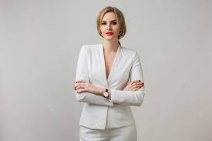
Persona 1: Ridhima
“To be good at PR you need to know about what is in and be up on all trends”
Frustrations
Since Ridhima freelancers, each client makes her have an email account with their company. She has a hard time keeping track of all of them and responding promptly.
Problem statement:
Ridhima is a Freelance PR Strategist who needs to keep a track of email accounts of all her clients and respond promptly, because to manage her clients and look for new products to enhance productivity.
Goals
Manage all her clients.
Looking for new products to enhance productivity.
Ridhima
Age:
Education:
Hometown:
Family:
Occupation:
34
Employee
Hyderabad
Single
Freelance PR Strategist
Ridhima is a passionate freelancer who gives her all to each and everyone of her clients. She has trouble keeping track of tasks, and managing all of her client accounts. She enjoys a thriving social life.

Slide 8

“A recipe has no soul u as a cook must bring the soul.”
Persona 2: Raasi
Goals
To encourage people in cooking
Looking for new recipes/videos to attract users.
Frustrations
Since users are busy in their work/study they don’t get time to prepare food instead they prefer ordering it online.
Problem statement:
Raasi is an employee at Google who needs to cook food for herself whenever she gets time
because she is usually busy due to work.
Raasi
Age:
Education:
Hometown:
Family:
Occupation:
34
Employee
Hyderabad
Single
Employee at google
Raasi is an employee at Google who stays in a self catering apartment she barely gets time to cook food as she works late she gets tired and orders some food online. This app will help her to cook under guidance.

Slide 9
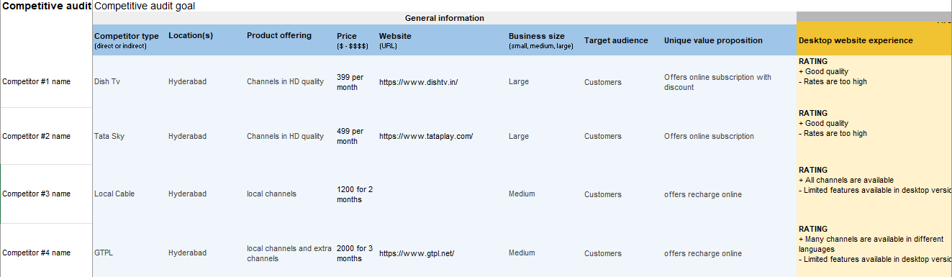
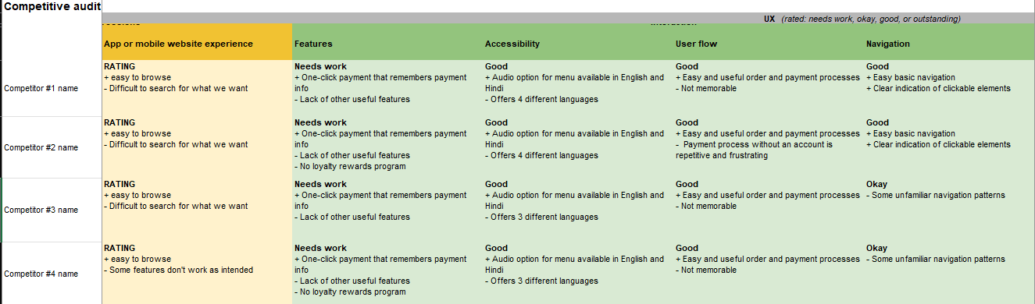
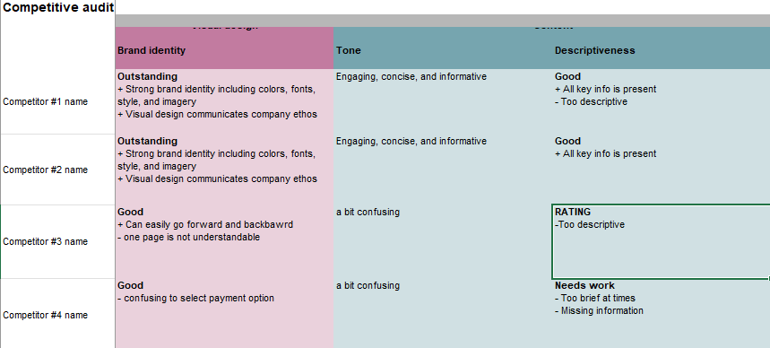
Competitive audit
An audit of a few competitor’s products provided direction on gaps and opportunities to address with cookBook app.

Slide 10
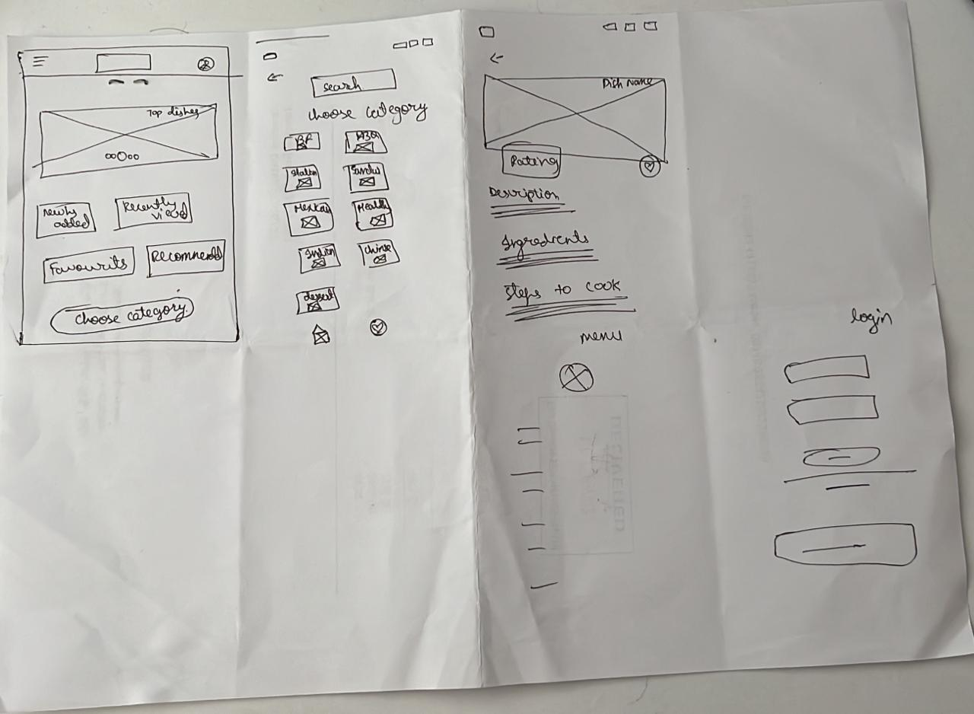
Ideation
[I did a quick ideation exercise to come up with ideas for how to address gaps identified in the competitive audit.My focus was specifically on simple recipe feature.

Slide 11
Digital wireframes
Low-fidelity prototype
Usability studies
Starting
the design

Slide 12
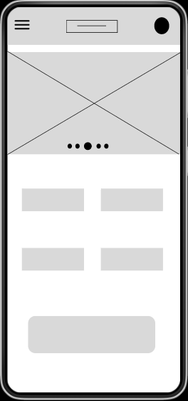
Digital wireframes
Digital wireframes
These are the hero images/Top dishes images to attract users.
After ideating and drafting some paper wireframes, I created the initial designs for the Cookbook.These designs focused on delivering personalized guidance to users.
This button will take the user to different categories/cuisine

Slide 13
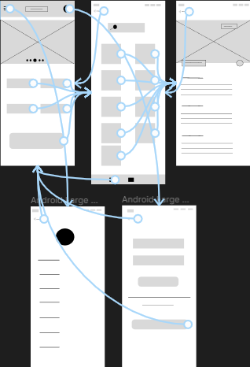
Low-fidelity prototype
To prepare for usability testing, I created a low-fidelity prototype that connected the user flow.
View https://www.figma.com/file/otJNcmrItSzPAJhYwL7Qr4/Cookbook?node-id=0%3A1

Slide 14
Usability study: parameters
Study type:
Unmoderated usability study
Location:
Australia, remote
Participants:
5 participants
Length:
30-60 minutes

Slide 15
Usability study: findings
Insert a one to two sentence introduction to the findings shared below.
1
2
3
Finding
Finding
Finding
People want easy access to recipes that specifically use the food they already own.
People had difficulty in understanding the measurements.
People Preffered clear indications.

Slide 16
Refining
the design
Mockups
High-fidelity prototype
Accessibility

Slide 17
Before usability study
After usability study
Mockups
Based on the insights from the usability studies, I applied desig changes like providing a clear section from the home screen to browse recipes that specifically use items available in “My Food”.

Slide 18
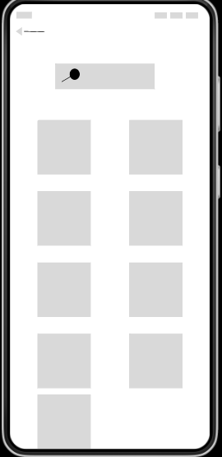
Before usability study
After usability study
Mockups
Additional design changes included adding an option of Sharing the recipe, adding to Favorites and making any changes.

Slide 19
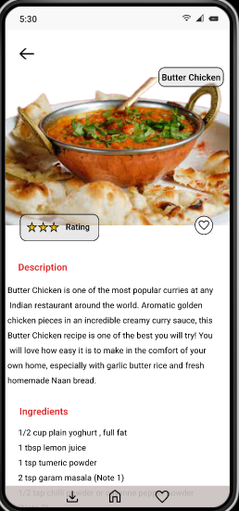
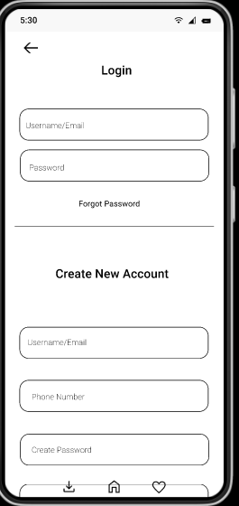
Mockups

Slide 20
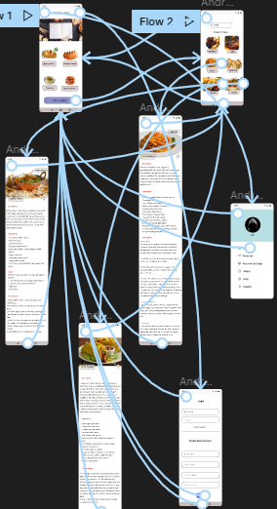
High-fidelity prototype
The high-fidelity prototype followed the same user flow as low-fidelity prototype, including design changes made after the usability study.
View the Cook Book high-fidelity prototype.

Slide 21
Accessibility considerations
1
2
Clear lables for interactive elements that can be read by screen readers..
Initial focus of the home screen on personalized recommendations help define the primary task or action for the user.

Slide 22
Responsive Design
Information architecture
Responsive design

Slide 23
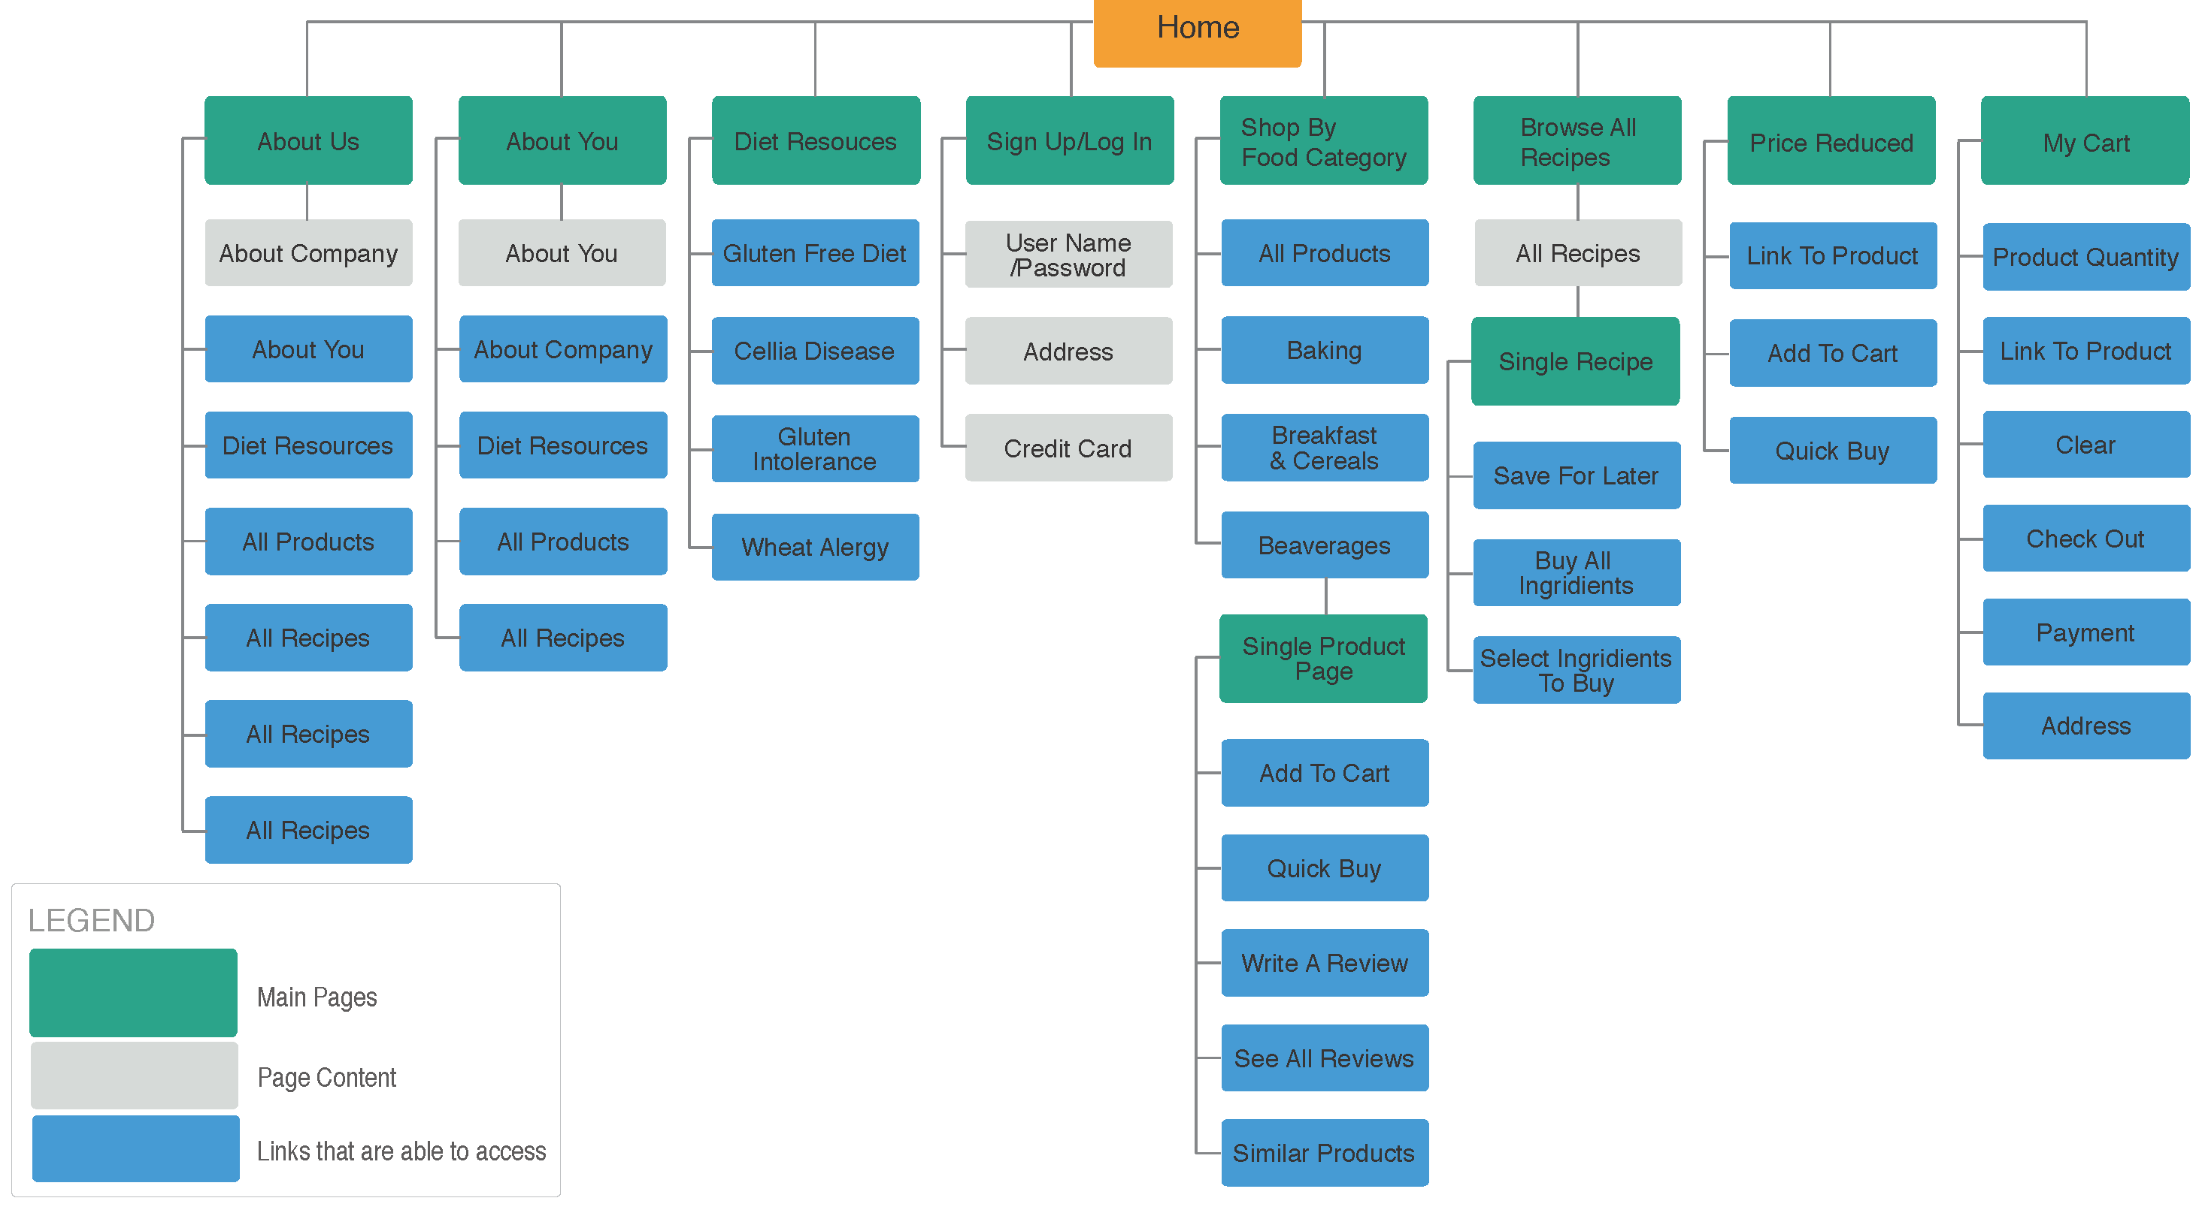
Sitemap
With the app designs completed, I started work on designing the responsive website. I used the cook book sitemap to guide the organizational sctructure of each screen design’s to ensure a cohesive and consistent experience across devices.

Slide 24
Responsive designs
Mobile Website
Desktop
[The designs for screen size variations included mobile, desktop. I optimized the designs to fit specific user needs of each device and screen size.

Slide 25
Going forward
Takeaways
Next steps

Slide 26
Takeaways
Impact:
Users shared that the app made food waste seem like something they could actually help reduce. One quote from peer fedback was that “the Cook Book app helps them to try out new recipes with guidance that’s easy and engaging”.
What I learned:
I learned that even though the problem I was ‘trying to solve was a big one, deligently going through each step of the design pocess and aligning with specific user needs helped me come up with solutions that werw bith feasible and useful.

Slide 27
Next steps
1
2
Conduct research on how successful the app is in reaching the goal.
Add more videos to attract and encourage people to cook.

Slide 28
Insert a few sentences summarizing the next steps you would take with this project and why. Feel free to organize next steps in a bullet point list.
Let’s connect!
Thank you for your reviewing my work on the Cook Book app! If you’d like to see more or would like to get in touch. My contact information is provided below
Email: rasika.mathur30@gmail.com

