Slide 1
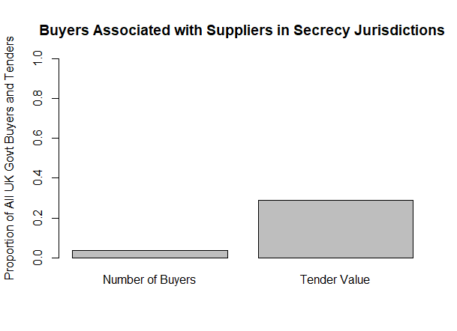
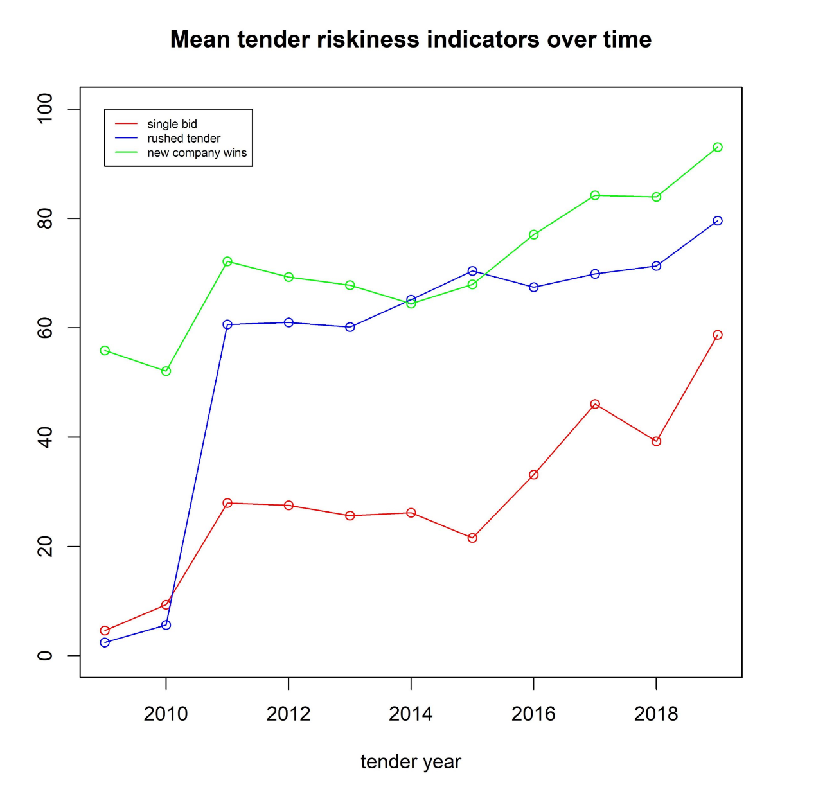
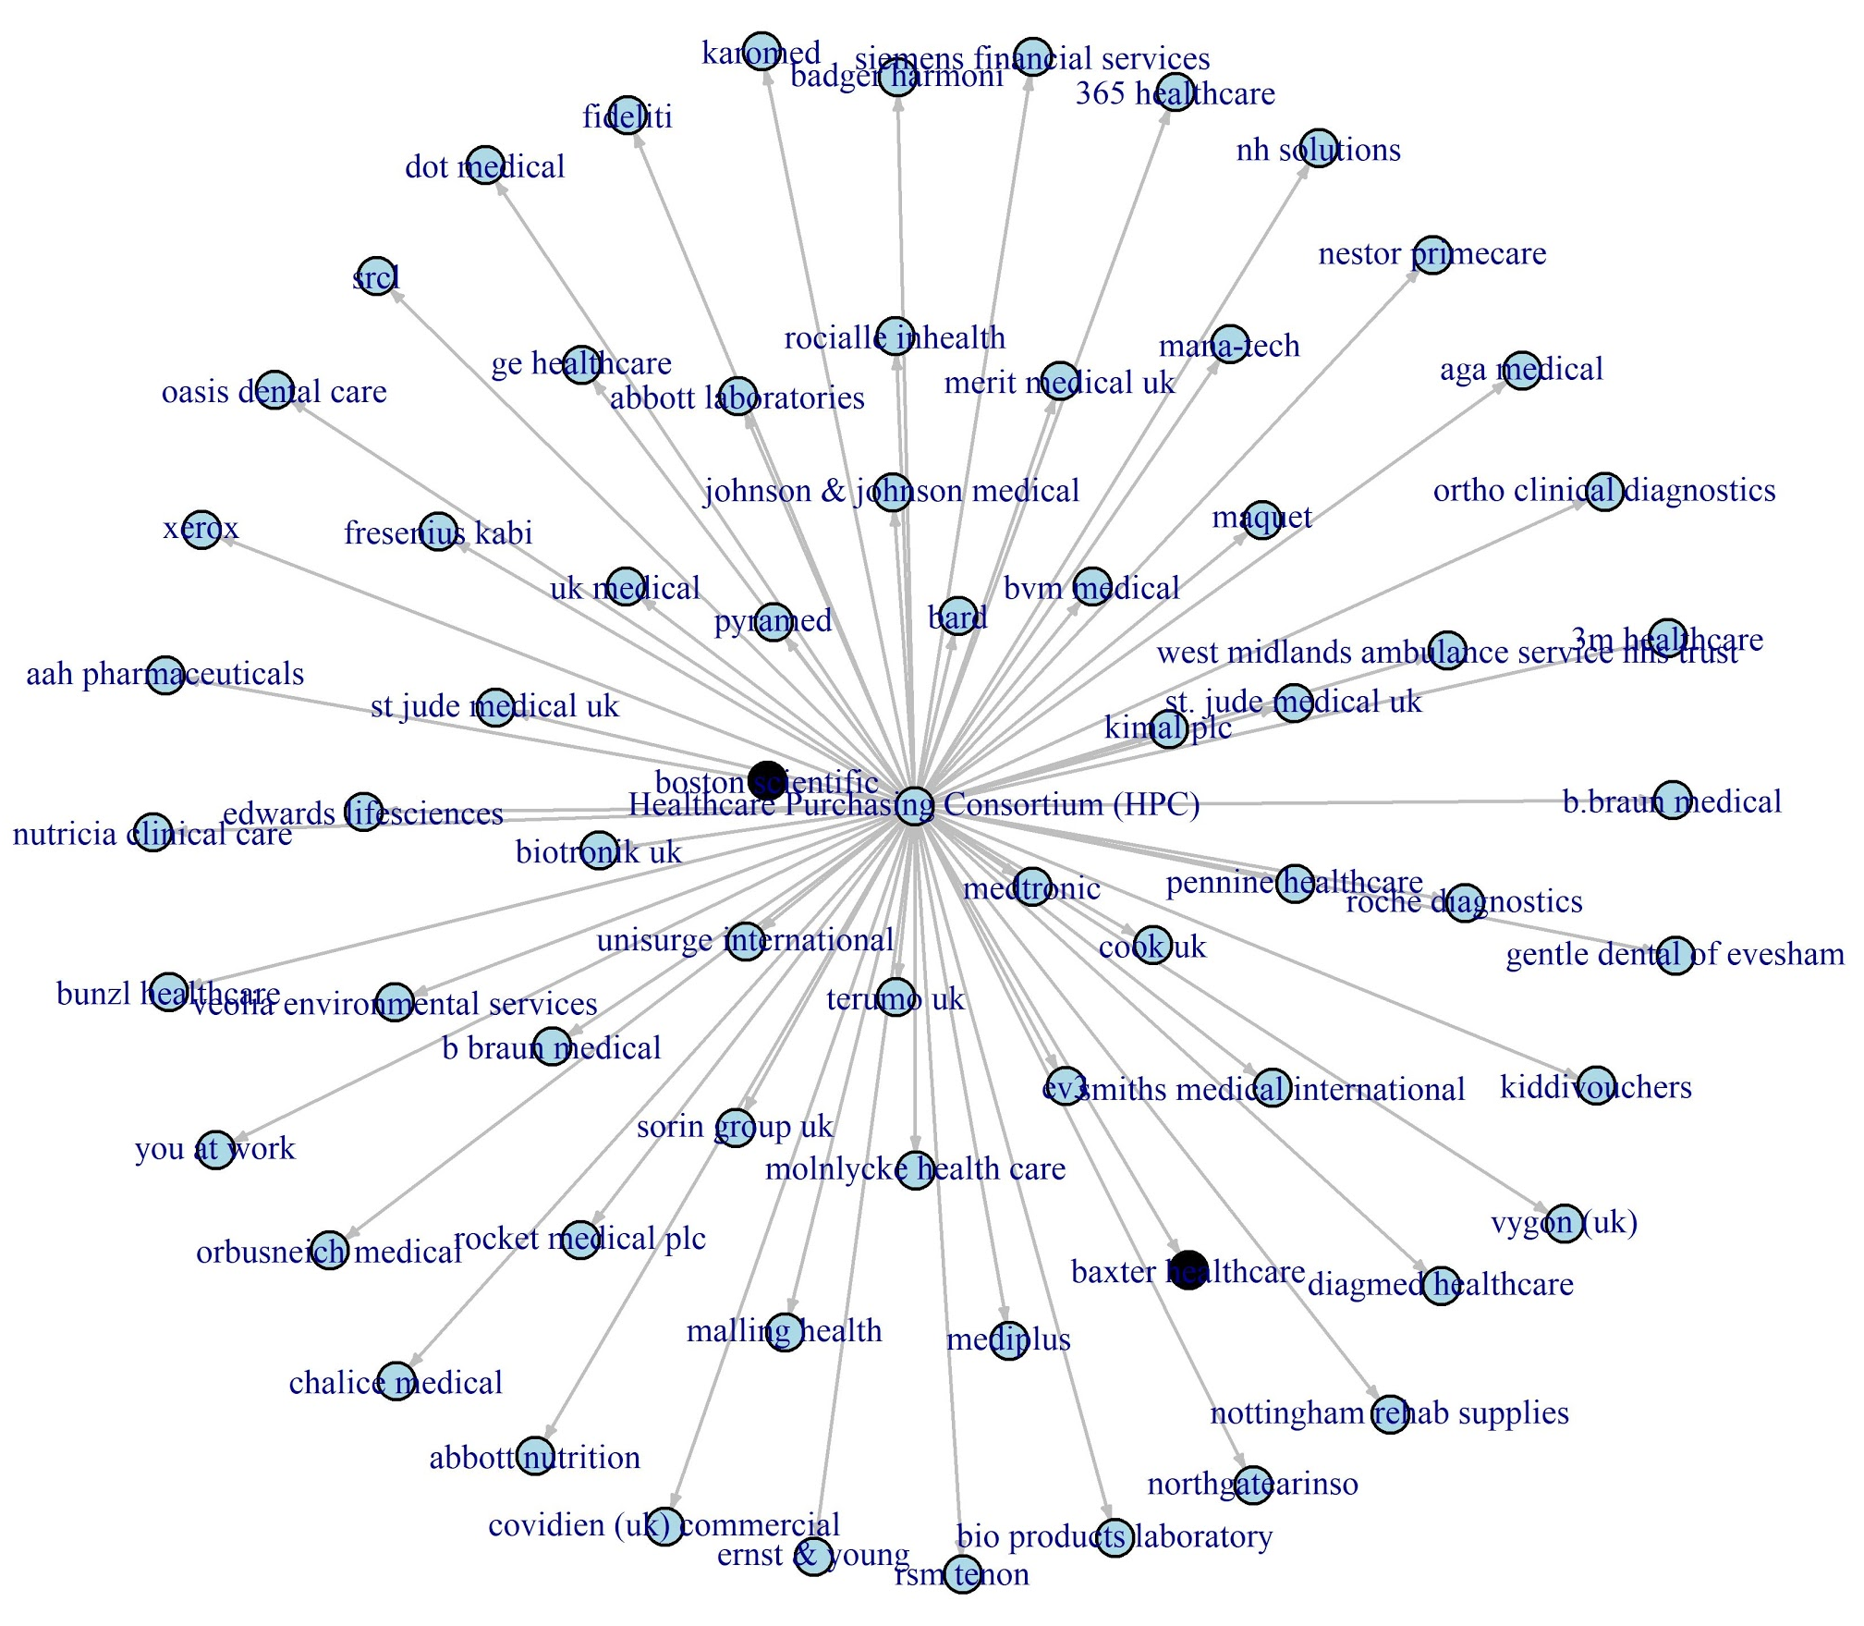

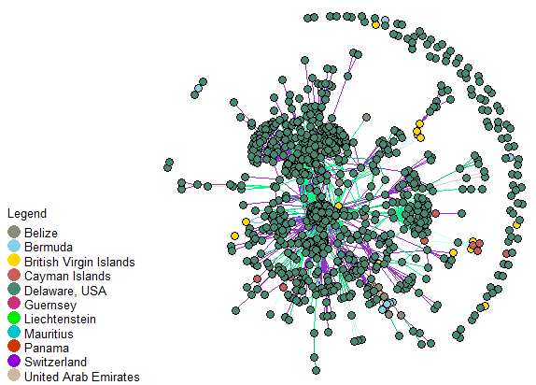
The Company (Registers) We Keep
CAN UK PUBLIC COMPANY DATA HELP US SPOT SUSPICIOUS ACTIVITY AND INTERESTING OWNERSHIP STRUCTURES?
Group 3 – Rasim Alam, Leonie Beyrle, Taran Raghuram
Executive Summary
Recommendations
The vast majority of companies and contracts appear to be legitimate, but a small percentage do not appear to be complying with the spirit and perhaps the letter of the law
Not only are some of these firms active, but they are receiving a substantial amount of public procurement funds
Data quality prevents us from making stronger claims about the features of companies and predicting who else might be suspicious based on these features (such as company size, industry, etc…)
(Data) Quality, quality, quality
Greater up front data validation during input (dropdowns, not open response)
Complete data releases (basic company and ownership data should be 1:1, not merely overlapping)
Institute common unique entity ID across registers
Investigate “bid competitiveness” and networks between companies and public departments that hire them
Background and motivation
Overview of Data Used and Processing
Around 70% of large-scale corruption schemes involve anonymous companies, i.e. companies whose true owners and beneficiaries are unknown for example because (i) the company is incorporated in a “secrecy jurisdiction” where shareholder information is not disclosed or (ii) a nominee, without any connection to the real owner, is acting as shareholder.
Recent years have seen a worldwide movement towards more transparency regarding corporate beneficial ownership. The UK’s Persons of Significant Control (PSC) register, launched in 2016, is one of the old and most comprehensive public ownership registers. All UK-incorporated companies are required to disclose any person who holds more than 25% of their shares or voting rights or otherwise exercises substantial control over them in the register.
This project examines whether the PSC register can help us identify interesting and potentially suspicious patterns in corporate ownership or whether it merely produces “zombie transparency”. The patterns identified do not necessarily indicate corruption - some of them illustrate interesting features of entirely legal complex corporate structures, while others indicate potential non-compliance with disclosure requirements and may warrant further scrutiny.
Previous analyses of the PSC register were carried out by NGOs, not academic researchers, with a view to gathering information about individual companies, rather than analyzing the whole universe of companies. This project takes a bottom-up approach, using descriptive statistics to identify interesting patterns, then mapping relevant subsets of the dataset.
 | UK Companies House Database (government) | UK Persons of Significant Control (PSC) Register (government) | EU Opentender Database (Digiwhist - Digital Whistleblower Project)
What does the data tell us | Full universe of UK companies | Who owns / benefits from UK companies → PSC: 25% or more of shares / voting rights | Companies which received contracts from UK public entities (2009-2019)
Key variables | Unique company number, name, registered address, incorporation date, industry | PSC type (individual or company), name, address, nationality/ place of incorporation | Tender and bid prices, buyer and bidder names, tender descriptions
Obser- vations | Approx. 5.6m companies | Approx. 7.5m PSCs (individuals and corporates) | 365,000 tenders awarded by UK public entities in last 11 years
Secrecy Jurisdictions and Public Procurement
Secrecy Jurisdictions were derived from the Financial Security Index’s secrecy score, and those above a score of 70 were included in our data.
Many of the registered companies did not provide an address, or if they did, provided only the country “United States” rather than specific addresses within the country -- for example, “Delaware, USA”
Despite data issues, we found 8452 companies owned by entities registered in secrecy jurisdictions, which is unlikely to be compliant with UK disclosure requirements
These companies sometimes receive multiple contracts with these agencies. For the Healthcare Purchase Consortium, its closest suppliers in the chart have received several contracts, and this includes two companies registered in secrecy jurisdictions
In line with these findings, UK tenders are getting less transparent over time
We also find that ~200 companies registered in secrecy jurisdictions win public tenders from ~700 of the largest buyers in the UK, earning public money via companies with little transparency
Suppliers who won contracts and are registered in Secrecy Jurisdictions are largely registered in Delaware
Owner Registered in Secrecy Jurisdiction
Owner Not Registered in Secrecy Jurisdiction

