Slide 1

AGENTIC AI CAPSTONE PROJECT
AI IT Support Assistant
An agentic workflow that understands an IT request, decides which tool it
needs, executes it against real data, and responds — built with LangGraph,
OpenRouter, and Streamlit.
Tool Calling · State Management · Conditional Routing · LangGraph
Presented by Rajat Singodia
Submitted for Evaluation | September 2026

Slide 2




Problem Statement
Why a scripted or keyword-based bot isn't enough
Employees at a fictional organization raise repetitive IT requests — password resets, laptop issues, connectivity problems — through email or a rigid ticketing form. Handling these manually is slow, and keyword-matching bots misclassify anything phrased even slightly differently.
Free-form requests
No smart routing
Risk of bad data
Lost context
Employees describe issues in their own words, not fixed menu options.
Systems can't tell a “how do I…” question apart from a “this is broken” report.
Manual or naive bots can invent details or create duplicate tickets.
Employee ID or issue details typed once get forgotten the next message.
AI IT Support Assistant | Agentic AI Capstone Project
2

Slide 3





Solution Overview
An agentic LangGraph workflow with four tools
The assistant is a LangGraph state machine. An LLM call (via OpenRouter) classifies the user's intent and extracts only what they explicitly stated, the graph routes to the right tool, and a second LLM call phrases the tool's raw result into a friendly reply — never inventing facts along the way.
Knowledge Search
Ticket Lookup
Finds how-to articles in the local KB
Checks status of an existing ticket
Understands free-form natural language requests
Decides which tool is required, with no hard-coded keyword rules
Asks for missing information instead of guessing
Ticket Creation
System Status
Remembers context (employee ID, draft ticket) across turns
Raises a new ticket, validated first
Reports live status of internal systems
AI IT Support Assistant | Agentic AI Capstone Project
3

Slide 4
Architecture Diagram
LangGraph workflow: state, nodes, conditional edges
START
entry_router
fill_slot
classify_intent
resume, no LLM call
route_by_intent
LLM tool-call
knowledge_search
ticket_lookup
ticket_creation
system_status
needs_clarification?
END
generate_response
clarifying question
LLM phrases result
END
final answer
AI IT Support Assistant | Agentic AI Capstone Project
4

Slide 5






Technology Stack
Everything needed runs locally except the LLM call
Python 3.10+
LangGraph
OpenRouter API
Core application language
State, nodes, conditional routing
Single key, swappable LLM (tool calling + text)
Streamlit
Local JSON
python-dotenv
Chat UI, session state, debug panel
Employees, tickets, KB, system status
Environment variable / secret loading
AI IT Support Assistant | Agentic AI Capstone Project
5

Slide 6

Project Structure
Modular by responsibility — graph, tools, data, and UI stay separate
Separation of concerns
ai-it-support-assistant/
├── app.py Streamlit chat UI
├── agent/
│ ├── state.py Shared AgentState
│ ├── graph.py Nodes + conditional edges
│ ├── tools.py The 4 tools (pure functions)
│ ├── llm_client.py OpenRouter API wrapper
│ └── db.py Local JSON data access
├── data/
│ ├── employees.json
│ ├── tickets.json
│ ├── knowledge_base.json
│ └── system_status.json
├── requirements.txt
├── .env.example
├── .gitignore
└── README.md
graph.py orchestrates; tools.py never imports LangGraph or the LLM client.
No hard-coded values
Model name, API key, and paths all come from environment variables.
db.py isolates file I/O
Swapping JSON for SQLite later means changing one module, not the app.
Testable in isolation
Tool functions take plain params and return plain dicts — unit-testable without the graph or a live API key.
AI IT Support Assistant | Agentic AI Capstone Project
6

Slide 7


Key Design Decisions
Choices that make the agent reliable, not just functional
Structured tool-calling for routing
The LLM never invents ticket data
A forced function call (route_request) returns strict JSON — far more reliable than asking the LLM to “reply in JSON”.
Missing fields are returned as null and re-validated in code before create_ticket() is ever called.
State-driven slot filling
Duplicate prevention in the tool layer
awaiting_field / ticket_draft persist in state, so fill_slot resumes a ticket without even calling the LLM.
create_ticket() always checks for an open ticket in the same category first — can't be bypassed by rephrasing.
Two-stage LLM usage
Deterministic fallback responses
One call decides what to do; a second decides how to phrase it. Decision-making and voice stay independently testable.
If the phrasing call fails, a template-based reply keeps the app usable instead of crashing.
AI IT Support Assistant | Agentic AI Capstone Project
7

Slide 8
Safety & Validation Guardrails
The agent never blindly executes an action — per the assignment's core requirement
Validates before creating
No duplicate tickets
Communicates missing info
employee_id, category, and description are all confirmed present before create_ticket() runs.
An existing open ticket in the same category is returned instead of creating a new one.
A specific clarifying question is asked — never a silent guess or a generic error.
Handles tool failures gracefully
Never invents data
Retrieved vs. generated
Unknown employee IDs, empty search results, and API errors all return a clear message, not a crash.
The classifier extracts only what the user stated; nulls are treated as missing, never filled in.
Tool results are passed to the phrasing LLM as ground truth — it is told to phrase, not to add facts.
AI IT Support Assistant | Agentic AI Capstone Project
8

Slide 9
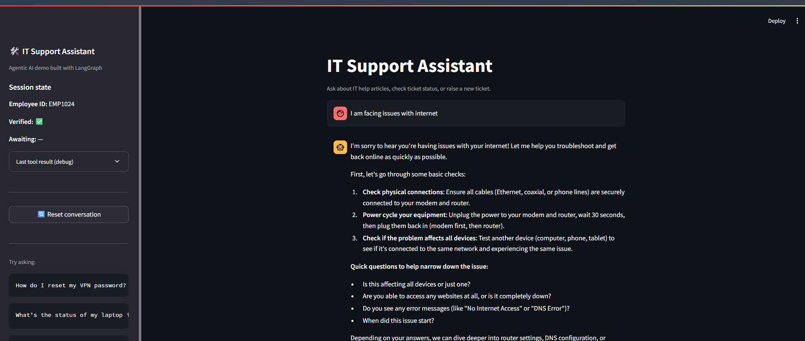
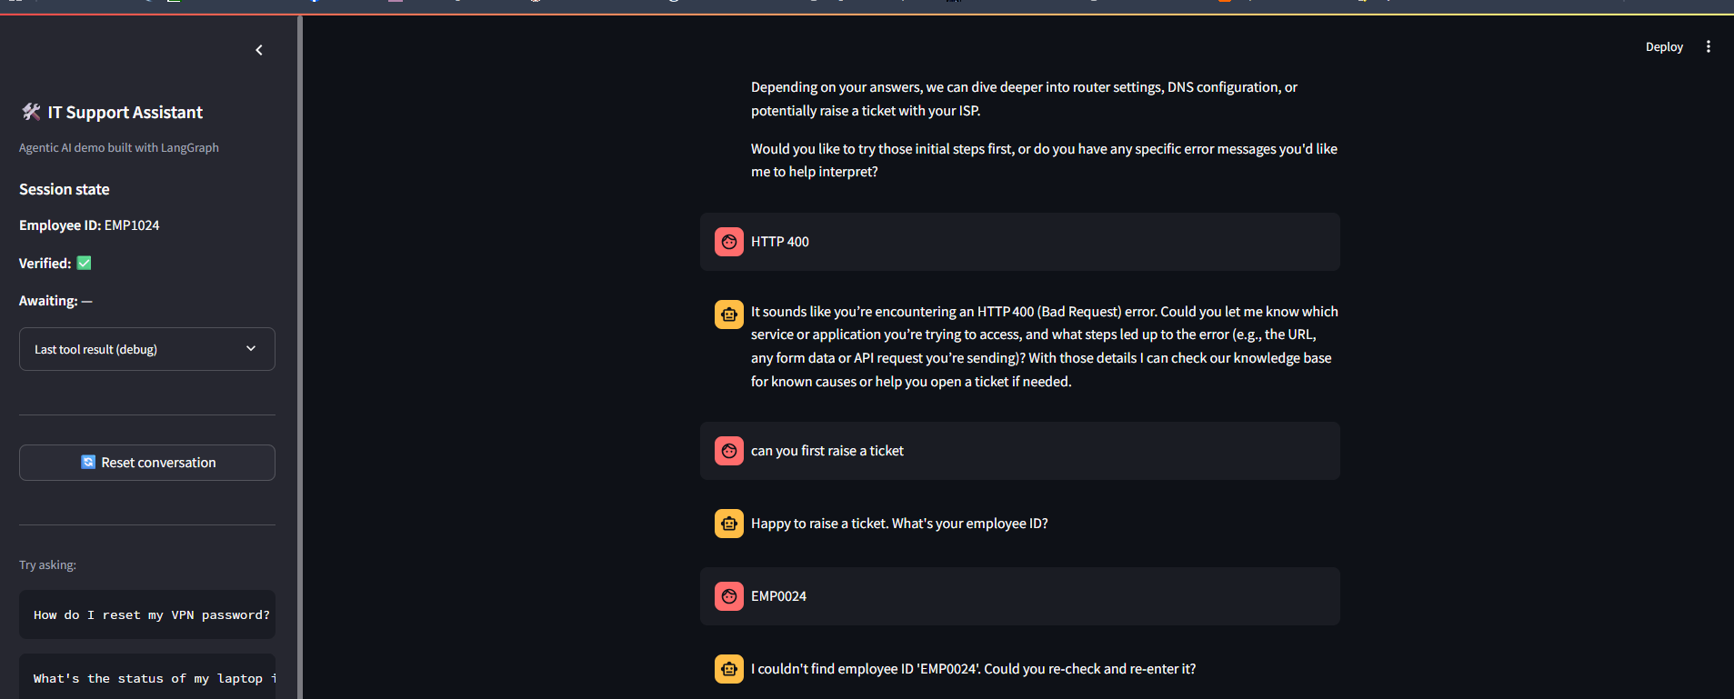
Live Demo — Intent Classification
General troubleshooting, then a routed ticket-creation flow begins
General question → general_chat node responds directly
Unknown employee ID → graceful clarification, not a guess

Slide 10
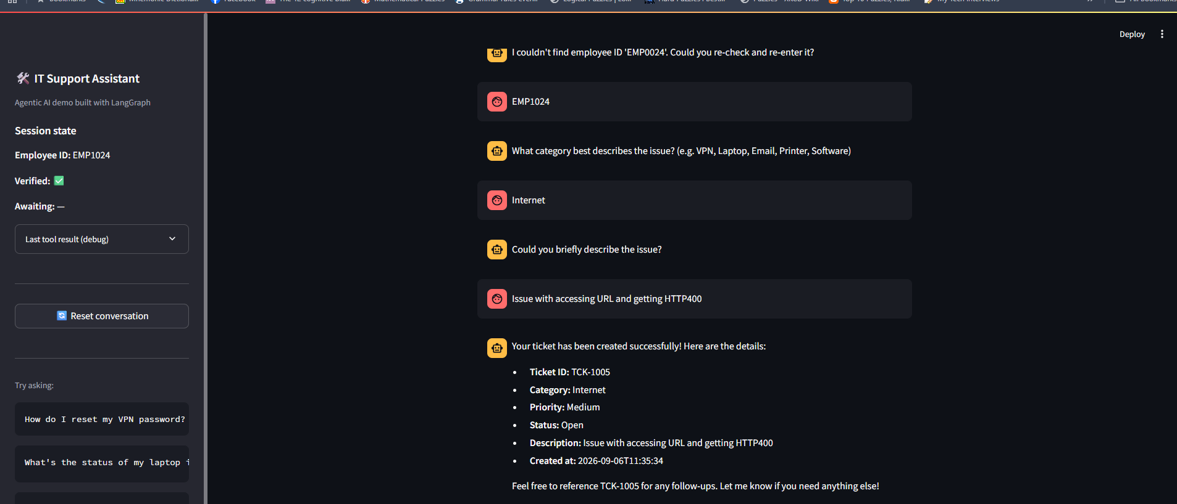
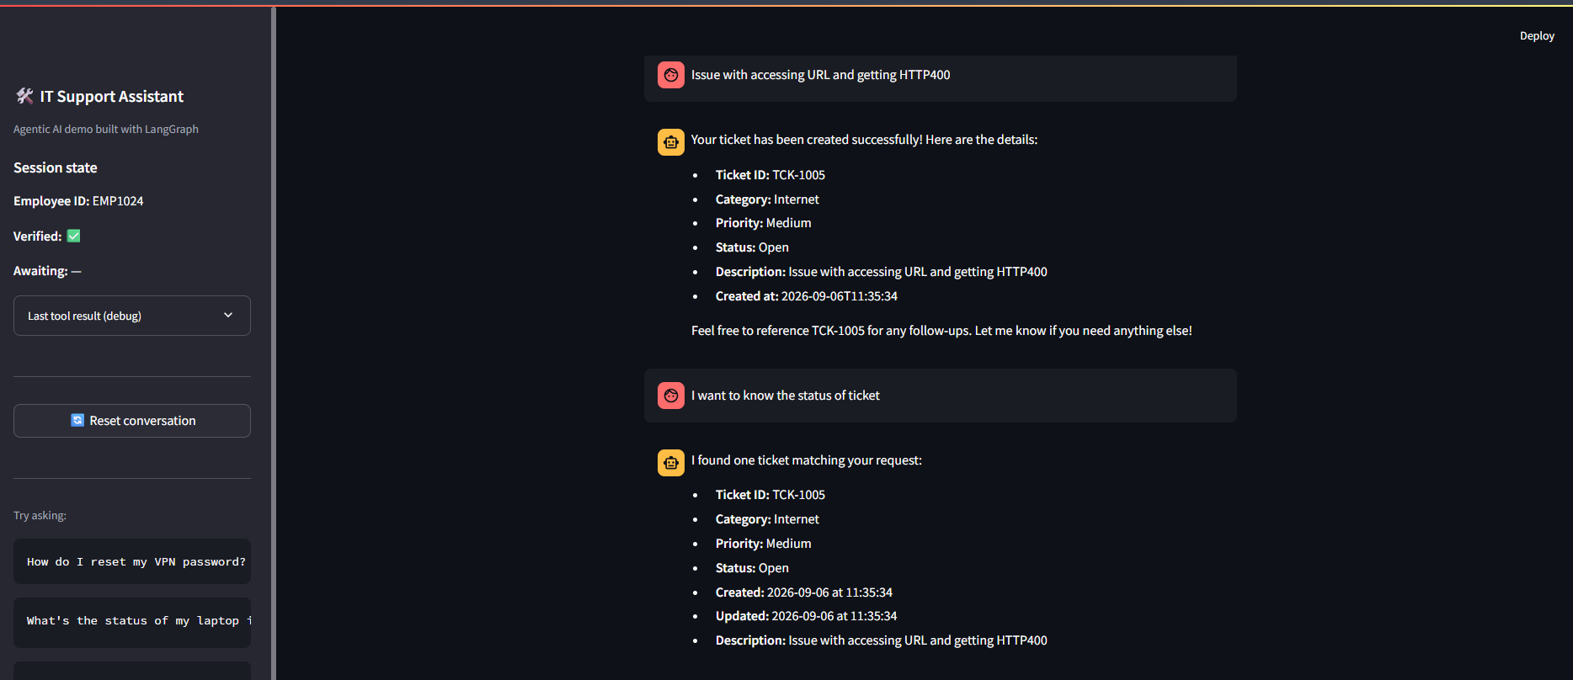
Live Demo — Ticket Creation & Lookup
Slot filling across turns, then a grounded status lookup
Employee verified → category → description → ticket TCK-1005 created
Ticket lookup returns the same ticket — grounded, not re-generated

Slide 11
Limitations
Known trade-offs, made explicitly rather than hidden
Keyword-based KB search
Simple overlap scoring, not embeddings — fine for a small local KB, won't scale to a large article set.
No real authentication
Employee ID is trusted based on lookup only, mirroring a low-stakes internal tool.
Session-only persistence
State lives in st.session_state; no LangGraph checkpointer yet, so it won't survive a server restart.
Priority defaults to Medium
The assistant doesn't infer urgency from issue severity unless the user states it.
One intent per turn
A message combining two requests (e.g. “check my ticket and raise a new one”) is handled as a single intent.
AI IT Support Assistant | Agentic AI Capstone Project
11

Slide 12



Setup, Run & Repository
Runnable end-to-end with sample data — no external DB required
1. Clone & configure
2. Set environment variables
git clone <repo> · python -m venv venv · pip install -r requirements.txt
cp .env.example .env → add OPENROUTER_API_KEY (never commit .env)
3. Run the app
4. Sample data included
streamlit run app.py → opens at localhost:8501
5 employees, 4 tickets, 7 KB articles, 4 system statuses — ready to evaluate immediately
GitHub repository includes source code, README, sample data, requirements.txt, .env.example, and this architecture diagram. .gitignore excludes .env — API keys are never committed.
AI IT Support Assistant | Agentic AI Capstone Project
12

Slide 13

Thank You
Questions & Live Demonstration
AI IT Support Assistant — Built with LangGraph, OpenRouter & Streamlit

