Slide 1












Autonomy roadmap: where we stand
Task autonomy
SHORT TERM
One planner for every application
5
Inspection
4
Adaptive execution
Auto rigging
Automatic planning
3
Automatic planning
3
Sealant
Programmed
2
Programmed
Common motion
planning framework
Pick & place
2
WE ARE HERE
Manual
Sanding
1
Manual
1
Built once, tuned per task
Polishing
Notes:
AUTONOMY ROADMAP: WHERE WE STAND (about 60 seconds) - builds on click
[Faded pyramid] Autonomy in robotics grows in five levels.
[CLICK 1 - Level 1] At the base, people guide the work by hand.
[CLICK 2 - Level 2 + 'We are here'] Level 2: robots repeat taught or offline-programmed paths. Most of our cells are here today.
[CLICK 3 - Level 3 + short term] My short-term goal is level 3: one common motion planning framework. The animation shows it: whatever the panel shape, the planner generates the path itself. The same framework serves inspection, auto rigging, sealant, pick and place, sanding and polishing - built once, tuned per task.

Slide 2
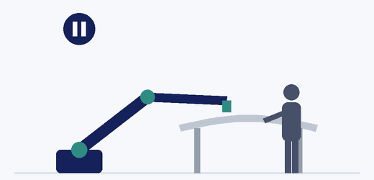
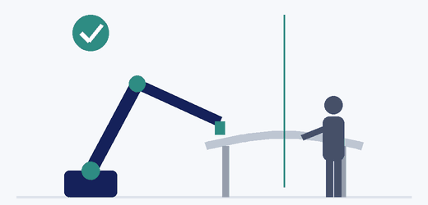










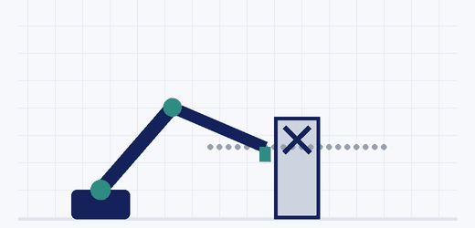

Next levels: platform, then Physical AI
LONG TERM
Level 5 · Physical AI
Level 4: stops, then replans
Level 5: predicts, keeps going
5
5
Learned skills
see, predict, adapt
4
4
3
MID TERM
Level 4 · Full robotics software platform
2
Orchestration
1
Design
Test
Deploy
Improve
Vision
Motion
planner
Control
Virtual
cell
Shared software stack
Every path tested before the robot moves
Notes:
NEXT LEVELS: PLATFORM, THEN PHYSICAL AI (about 90 seconds) - builds on click
[CLICK 1 - Level 4, mid term] My mid-term goal is level 4, delivered as a full robotics software platform - a product line, not one-off cells. Vision, the motion planner, control and a virtual cell all plug into one shared software stack, and orchestration on top coordinates the whole task. The platform follows a continuous loop: design, test, deploy, improve. Testing matters most for the planner, because a new path could collide with the part, the fixture or the cell. The animation shows the virtual cell catching a collision and re-routing the path - in MIL and SIL - before the real robot ever moves.
[CLICK 2 - Level 5, long term] My long-term goal is Physical AI: robots with learned skills that see, predict and adapt. Level 4 already runs tasks on its own. But look at the two animations: when a person steps into the cell - for example to clean a surface before drilling - a level 4 robot detects them, stops and waits, then replans. Safe, but slow. With Physical AI, the robot predicts the person's movement, keeps working on another area and carries on. That is where Physical AI adds real value: in unpredictable, shared spaces.

