Slide 1


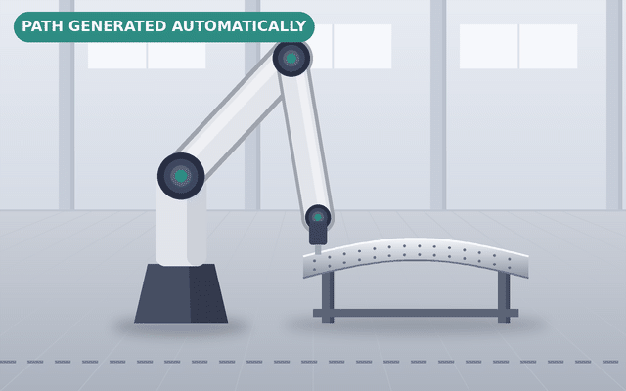









Autonomy roadmap: where we stand
Cognitive autonomy
SHORT TERM
One motion planning framework for every application
5
Inspection
4
Adaptive execution
Auto rigging
3
Automatic planning
Sealant
2
Programmed
Pick & place
Common motion
planning framework
WE ARE HERE
Manual
Task-specific planner, toolpath, constraints
Sanding
1
Polishing
Notes:
AUTONOMY ROADMAP: WHERE WE STAND (about 60 seconds) - builds on click
[Faded pyramid] Autonomy in robotics grows in five levels.
[CLICK 1 - Level 1] At the base, people guide the work by hand.
[CLICK 2 - Level 2 + 'We are here'] Level 2: robots repeat taught or offline-programmed paths. Most of our cells are here today.
[CLICK 3 - Level 3 + short term] My short-term goal is level 3: one common motion planning framework. The animation shows it: whatever the panel shape, the planner generates the toolpath itself. The same framework serves inspection, auto rigging, sealant, pick and place, sanding and polishing - built once, with a task-specific planner, toolpath and constraints.
[CLICK 4 - Level 4] Level 4, adaptive execution.
[CLICK 5 - Level 5] And level 5, cognitive autonomy, enabled by Physical AI. These are my mid- and long-term goals - next slide.

Slide 2

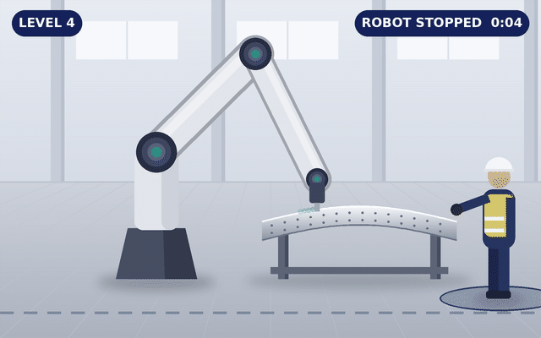
















Next levels: platform, then cognitive autonomy
LONG TERM
Level 5 · Cognitive autonomy enabled by Physical AI
Learned skills: see, predict, adapt
5
Cognitive autonomy
Level 4
Safety stop, robot waits
4
Adaptive execution
Level 5
Understands the person, keeps working
3
Automatic planning
A person steps in: level 4, then level 5
time
2
Programmed
MID TERM
Level 4 · Full robotics software platform
WE ARE HERE
Orchestrator
Manual
coordinates
Design
Test
1
Vision
Motion
planner
Control
Virtual
cell
Improve
Deploy
Shared software stack: interfaces, data, tools
Robot cell
Every path tested
in the virtual cell
before the robot moves
Notes:
NEXT LEVELS: PLATFORM, THEN PHYSICAL AI (about 90 seconds) - builds on click
The full pyramid stays from the previous slide.
[CLICK 1 - Level 4, mid term] My mid-term goal is level 4, delivered as a full robotics software platform. Each software component - vision, the motion planner, control and the virtual cell - sits on one shared software stack: common interfaces, data and tools. On top, an orchestrator coordinates them all for the task, and the platform drives the real robot cell. Around it runs a continuous loop: design, test, deploy, improve. Testing matters most for the planner, because a new path could collide with the part, the fixture or the cell - so every path is checked in the virtual cell, in MIL and SIL, before the robot moves.
[CLICK 2 - Level 5, long term] My long-term goal is level 5, cognitive autonomy, enabled by Physical AI. Level 4 can already complete a task on its own. The difference shows when the cell is unpredictable. In the animation a person steps in to prepare the surface, for example cleaning it before drilling. A level 4 robot follows its safety rules: it stops and waits until the person leaves - look at the grey gap in the timeline, that is lost cycle time. At level 5, with Physical AI, the robot understands what the person is doing, predicts their movement and keeps working safely in another area - no gap. That is the value of Physical AI in manufacturing: in shared, dynamic situations, not everywhere.
MEDIA TIP: a short real clip (your RL POC, or a licensed stock clip of a person working next to a robot) can replace the photo for extra impact.

