Slide 1

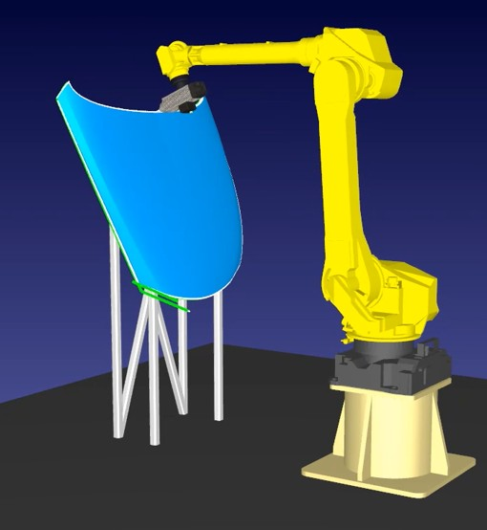
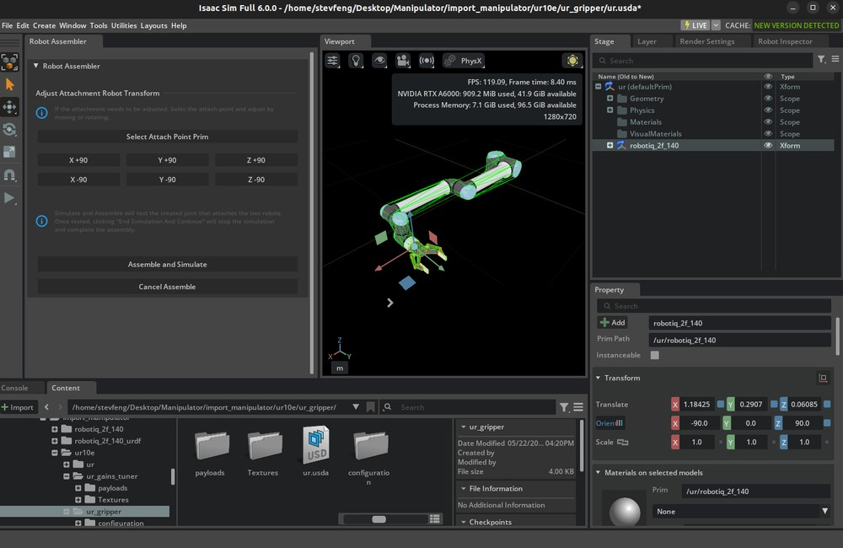

Automatic Inspection Motion Across Parts and Robots
Less robot programming. Fewer physical trials. Reusable software.
IN COLLABORATION WITH IRT JULES VERNE
Framework in development
COMMON PLANNING FRAMEWORK
1 Generate scan paths
2 Generate robot motion
3 Validate before execution
4 Execute approved motion
Open CASCADE + point-cloud processing
Tesseract
NVIDIA Isaac Sim
FANUC robot
Generate paths from measured surfaces.
No complete CAD required.
Generate robot motion automatically.
GTSP sequences 100+ defect visits.
Rescan only flagged regions.
Find reachability, collision and
coverage issues before
physical trials.
Run the validated inspection
trajectory on the robot.
Planners: Tesseract / HPP / MoveIt 2 Future: RL / VLA
Simulation feedback refines the motion
EXPECTED VALUE
Faster inspection preparation
Fewer physical trial runs
Less repeated engineering
Less manual teaching for new panels
Resolve motion issues before using the cell
Reuse software across parts and robots
Notes:
AUTOMATIC MOTION GENERATION: New panel geometry or changed defect regions can require repeated path programming. Use measured point clouds, or suitable CAD when available, plus inspection requirements to generate sensor poses and feasible timed robot motion. This reduces waypoint teaching and preparation effort while applying coverage, orientation and stand-off requirements consistently. Engineering setup and validation remain necessary. Intended benefits are not measured achievements. Presenter wording: A new panel should require new geometry and inspection settings, with much less manual reconstruction of the robot program.
MAIN MESSAGE: We are developing one reusable platform to generate inspection robot motion, check it in the digital twin, and deploy it through robot-specific execution adapters. The intended value is less manual programming for a new part, fewer physical trial-and-error runs, and less duplicated engineering when another robot or task is introduced.
PROBLEM-TO-VALUE: 1) New parts or changed measured geometry require robot program rework. Generate surface coverage poses and feasible timed robot motion automatically to reduce manual teaching and path rework. A complete CAD model is not mandatory when suitable sensor point clouds are available. 2) Discovering reachability, collision or coverage problems on the physical cell consumes robot availability and engineering time. Validate those aspects in NVIDIA Isaac Sim, revise motion from feedback, and release the approved trajectory for robot execution. Simulation reduces avoidable physical trials; it does not replace actual cell commissioning or guarantee safety or inspection performance. 3) Robot-specific implementations repeat geometry, planning and validation integration. Common interfaces and reusable components let the team select a planner for the use case and change robot models/drivers/adapters while retaining the shared core. Robot agnosticism is an architecture goal, not plug-and-play support for every robot.
These current-problem statements are a qualitative framing of the project rationale; no measured baseline, achieved saving, or fully autonomous/no-programming claim is asserted. Validate the baseline with the team. Possible demonstrator measures: engineering hours per new panel, number of physical validation iterations, integration effort for another robot, and cycle time for reinspection.
COLLABORATION AND TECHNOLOGY: The user identifies IRT Jules Verne as collaborator using Tesseract plus Open CASCADE. Open CASCADE supports CAD geometry processing; point-cloud processing is a separate measured-geometry input. Tesseract supports robot motion planning. The common framework has selectable Tesseract, HPP and MoveIt 2 options as shown in the user's latest slide photograph; this does not assert all are integrated. The user's latest photograph says HPP–Tesseract–MoveIt2 benchmarking completed. Earlier conversation described HPP vs IRT JV benchmarking. Slide states that benchmarking guides planner selection against inspection requirements. This connects the completed comparison to a decision purpose without asserting an unprovided winner, quantitative result, or confirmed selection rationale. If asked by the board, present the actual comparison findings and requirements in supporting material. Reinforcement learning and VLA are future options.
ROUTE OPTIMIZATION: GTSP chooses an efficient order and, where applicable, alternatives for visiting 100+ defect locations. Local scan paths cover only the flagged regions for further analysis. Distinguish this sequencing from scan coverage generation and robot trajectory generation. No global optimality guarantee or quantified saving is claimed.
SYSTEM INTEGRATION: The inspection application/supervisor supplies geometry, task requirements and defect locations. Planning sends scene and trajectory data to the digital twin. Validation results drive revision before approval. Robot-specific interfaces execute the approved trajectory and return status to the supervisor. Detection and interpretation of defects belong to the inspection system.
TALK TRACK (45 seconds): Today a new panel or robot can mean repeated programming and physical trial runs. With IRT Jules Verne, we are developing a common platform that turns measured surfaces into scan paths and robot motion. We validate that motion in Isaac Sim so we can correct reachability, collision and coverage issues before occupying the real cell. The same software components can then be reused with another planner or robot adapter. For follow-up inspection, route optimization visits the detected defects efficiently and scans only those regions. We will demonstrate the value through programming effort, physical trial iterations and inspection cycle time.
IMAGES: First image is an AI-generated representative FANUC scanning illustration; point cloud is illustrative, not acquired data. Second is an official NVIDIA Isaac Sim UR10e setup example, not the project FANUC digital twin. Source https://docs.isaacsim.omniverse.nvidia.com/latest/robot_setup_tutorials/tutorial_import_assemble_manipulator.html ; asset https://docs.isaacsim.omniverse.nvidia.com/latest/_images/isim_6.0_full_tut_gui_connect_gripper_assembler_2.png . The second workflow image is a representative FANUC machining example from RoboDK: https://robodk.com/doc/fr/Example-5-Axis-Cutting.html . It is not the project Tesseract interface. The final robot photograph is the official FANUC R-2000iC/210L product image from https://www.fanucamerica.com/products/robot/r-2000ic-210l . IRT collaboration and technology selections are supplied by the user.

