Slide 1

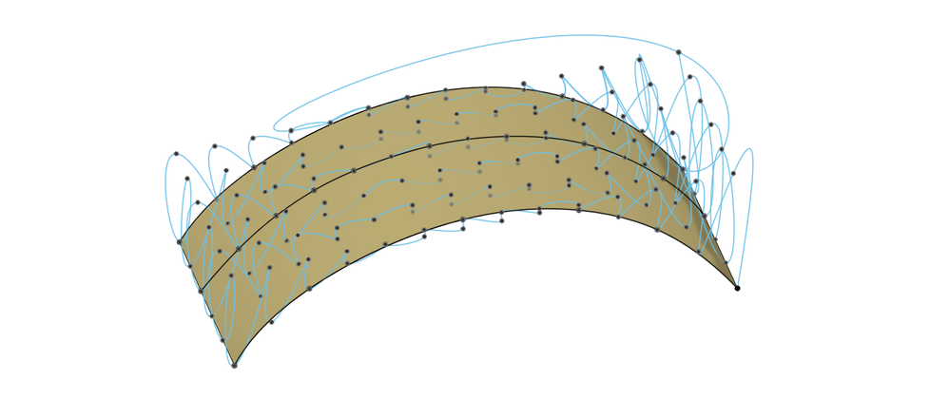
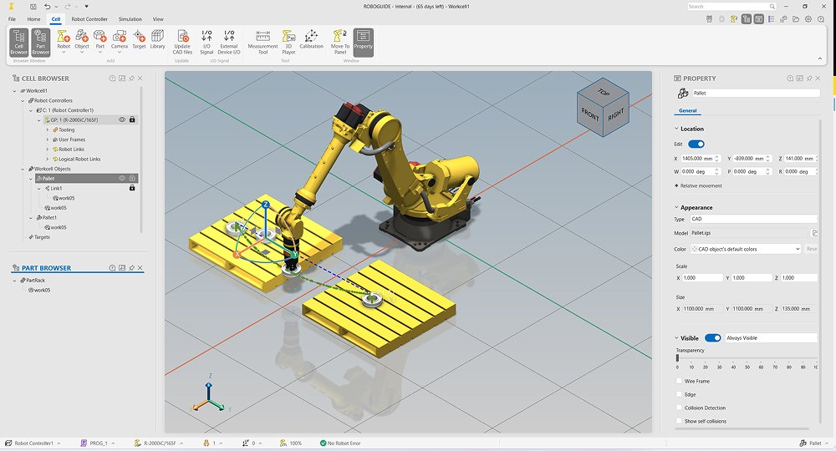
Common Motion Planning Framework
One reusable platform for inspection motion, with a path to AI-based planning
FANUC R-2000iC/210L
Generate the
inspection path
COMMON FRAMEWORK / IN DEVELOPMENT
Digital twin
validation
Convert sensor path into robot motion
Select a planning option by use case
IRT JV
HPP / LAAS
AI / FUTURE
MoveIt 2 +
Tesseract
Constrained
planning
Reinforcement
learning (RL)
Vision / language /
action (VLA)
CAD / scan data +
inspection requirements
Planned for
inspection
Alternative
option
Set coverage passes,
sensor orientation
and surface distance
Verify coverage,
sensor pose and
robot trajectory
1 Find joint positions for each sensor pose
2 Select continuous, collision-free motion
3 Apply scan speed and trajectory timing
FANUC robot execution
Open3D +
Open CASCADE
Revise and recheck
if needed
After validation and approval
ROS 2 + robot-specific interface
Output: joint positions and velocities over time
Representative CAD and simulation images; actual project environment may differ. Sources: Autodesk Community and FANUC.
Benchmarking completed
Reuse across robots and future AI methods
HPP and IRT JV approaches compared
for motion planning and execution.
Common interfaces allow new planning methods and robot adapters.
Every generated trajectory follows the same validation process.
Notes:
Board talk track: We are developing a common motion-generation platform for aircraft inspection. Starting from panel geometry and sensor requirements, we generate the coverage path, choose suitable robot configurations and produce a timed trajectory. We have benchmarked HPP and IRT JV, and plan to use IRT JV for this demonstrator. Common interfaces let us add other planners and support different robots without rebuilding the complete stack. Our roadmap includes reinforcement learning and vision-language-action models, with their outputs connected to the same trajectory verification and digital twin validation process before physical execution. The value proposition is reusable inspection software, consistent validation and an architecture that can evolve. No quantified benefits are claimed without measured evidence. AI roadmap clarification: RL and VLA are future integration targets explicitly requested by the user, not delivered features or benchmarked candidates. They may provide learned policies or action proposals rather than a complete offline trajectory. The future architecture must adapt their outputs to the robot motion and validation interfaces; no specific model, performance, automatic safety guarantee or implementation date is claimed. Inspection motion generation: The path-generation component uses panel CAD or measured geometry and inspection requirements to define coverage passes. Each sensor pose includes position, orientation and required stand-off distance from the surface. The motion-planning component uses the robot model to find joint configurations for the sensor poses (inverse kinematics), select a continuous collision-free sequence, and add timing under inspection-speed and robot-motion constraints. The result is a trajectory of joint positions and velocities over time, which can be checked in the digital twin before execution. Infeasible paths require revision. These are intended responsibilities, not a claim that every step has been delivered. Representative imagery: CAD surface with inspection points from Autodesk Community, https://forums.autodesk.com/t5/fusion-manufacture-forum/surface-inspection-exact-points/td-p/10132375 (image https://forums.autodesk.com/t5/image/serverpage/image-id/889442iA7227BE8053AC087/image-size/large?px=999&v=v2). This represents CAD geometry and inspection positions, not the exact continuous scan path of this demonstrator or an Open3D/Open CASCADE screenshot. Digital twin illustration is a FANUC ROBOGUIDE screenshot from https://www.fanucamerica.com/press-releases/fanuc-introduces-enhanced-next-gen-roboguide-robot-simulation-software (image https://cdn.craft.cloud/6166486b-1eb4-43d5-990c-ea573de4e750/assets/images/roboguide-new-features.jpg). It illustrates virtual robot simulation only; ROBOGUIDE is not asserted to be the selected digital twin software. Purpose: board-level explanation of a common motion planning framework under development. Multiple options are intended within one platform and are selected by use case, not run sequentially. IRT JV is planned for this aircraft-panel inspection demonstrator. HPP/LAAS is shown as an alternative framework option, not as already integrated. A completed benchmarking study compared HPP and IRT JV; this slide does not claim a measured winner. Shared trajectory output feeds pre-execution digital twin validation, then robot-specific execution interfaces. If checks fail, revise motion and validate again. Robot-agnostic reuse is a design objective and still requires robot models, drivers and adapters. Sources: user requirements in the current conversation; IRT_JV_vs_LAAS_HPP_Conversation_QA.docx, Library ID libfile_784d5dbdeadc81918f2f567b5e8e5956, pages 3–6. That conversation record describes IRT MoveIt2/Tesseract and ROS2 execution, and LAAS HPP. Scan-path generation from CAD/point clouds can use Open3D/Open CASCADE before robot motion planning. Within the IRT pipeline, Descartes and TrajOpt are described for Cartesian path planning and optimization. Confirm exact vendor integration before presenting those details as delivered. FANUC photograph/product image source: https://www.fanucamerica.com/products/robot/r-2000ic-210l ; image asset https://cdn.craft.cloud/6166486b-1eb4-43d5-990c-ea573de4e750/assets/products/r-2000ic-210l/R-2000iC_210L-Beauty-Shot-Right.png . The image represents the robot model and is not a photograph of the inspection demonstrator. No AI-generated robot imagery is used.

