Slide 1
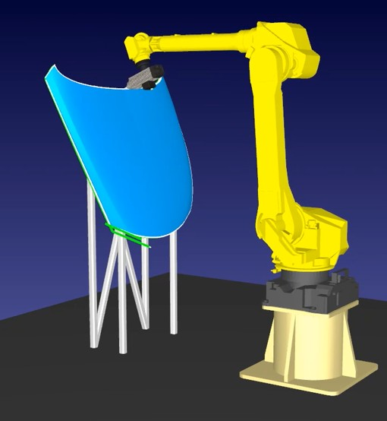
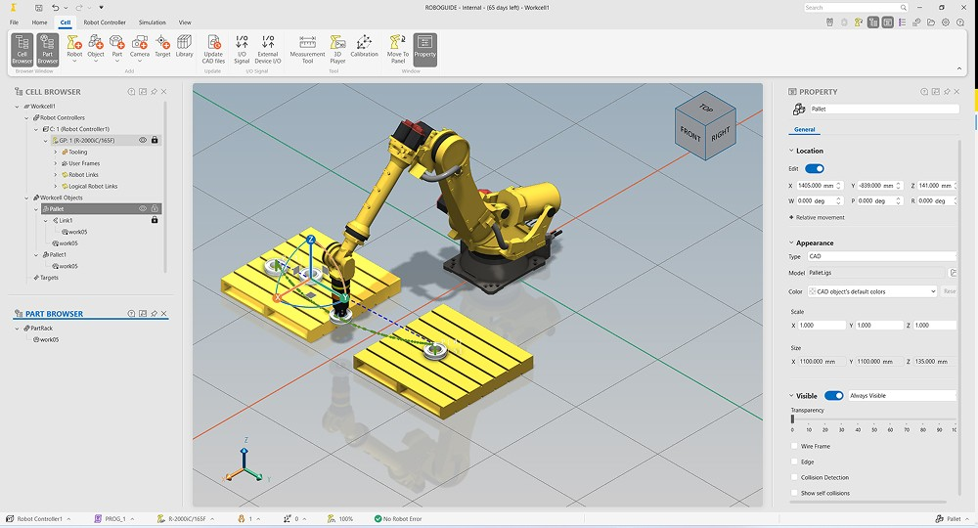

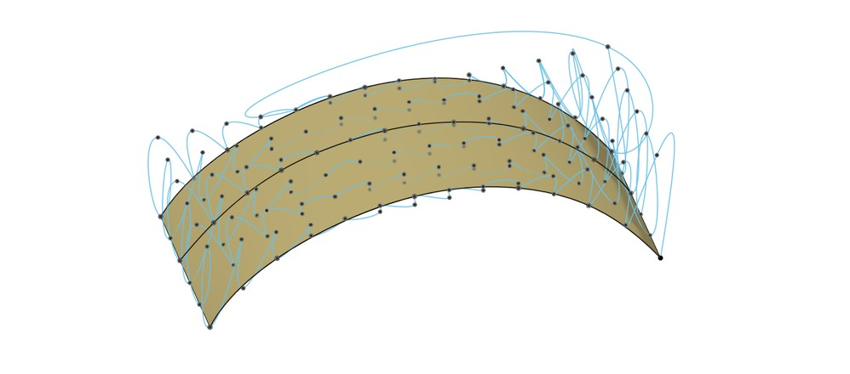
Automating Inspection Motion Across Parts and Robots
A common framework to reduce manual programming and reuse planning capabilities across applications
INTEGRATED WITH THE INSPECTION SYSTEM
Application / supervisor supplies the task and geometry; receives validation status and execution progress
COMMON MOTION PLANNING FRAMEWORK / IN DEVELOPMENT
1 Generate tool paths
2 Generate robot motion
3 Validate in digital twin
4 Execute inspection
Adapt coverage, tool orientation
and surface distance to flat,
curved or complex geometry.
Automatically convert tool poses
into continuous robot motion,
with collision checks and timing.
Simulate the planned motion.
Check coverage and feasibility
before physical execution.
Run approved motion through
robot-specific interfaces; return
execution status to the system.
Open CASCADE + Open3D
MoveIt 2 / Tesseract, HPP
Shared scene and trajectory data
FANUC + ROS 2 integration
Planning options: IRT JV (planned), HPP, future AI (RL / VLA)
HPP–IRT JV benchmarking completed
Validation feedback for replanning
Less manual programming
Earlier detection of motion issues
Reuse beyond one inspection cell
Generate paths for new parts from geometry
and process requirements.
Find infeasible paths in simulation before
using the physical cell.
Extend to other robots and surface processes
with common software and adapters.
Intended benefits. Representative images: Autodesk Community, RoboDK and FANUC; not screenshots of the current platform.
Notes:
Board talk track: We are developing a common motion-generation platform for aircraft inspection. Starting from panel geometry and sensor requirements, we generate the coverage path, choose suitable robot configurations and produce a timed trajectory. We have benchmarked HPP and IRT JV, and plan to use IRT JV for this demonstrator. Common interfaces let us add other planners and support different robots without rebuilding the complete stack. Our roadmap includes reinforcement learning and vision-language-action models, with their outputs connected to the same trajectory verification and digital twin validation process before physical execution. The value proposition is reusable inspection software, consistent validation and an architecture that can evolve. No quantified benefits are claimed without measured evidence. AI roadmap clarification: RL and VLA are future integration targets explicitly requested by the user, not delivered features or benchmarked candidates. They may provide learned policies or action proposals rather than a complete offline trajectory. The future architecture must adapt their outputs to the robot motion and validation interfaces; no specific model, performance, automatic safety guarantee or implementation date is claimed. Inspection motion generation: The path-generation component uses panel CAD or measured geometry and inspection requirements to define coverage passes. Each sensor pose includes position, orientation and required stand-off distance from the surface. The motion-planning component uses the robot model to find joint configurations for the sensor poses (inverse kinematics), select a continuous collision-free sequence, and add timing under inspection-speed and robot-motion constraints. The result is a trajectory of joint positions and velocities over time, which can be checked in the digital twin before execution. Infeasible paths require revision. These are intended responsibilities, not a claim that every step has been delivered. Representative imagery: CAD surface with inspection points from Autodesk Community, https://forums.autodesk.com/t5/fusion-manufacture-forum/surface-inspection-exact-points/td-p/10132375 (image https://forums.autodesk.com/t5/image/serverpage/image-id/889442iA7227BE8053AC087/image-size/large?px=999&v=v2). This represents CAD geometry and inspection positions, not the exact continuous scan path of this demonstrator or an Open3D/Open CASCADE screenshot. Digital twin illustration is a FANUC ROBOGUIDE screenshot from https://www.fanucamerica.com/press-releases/fanuc-introduces-enhanced-next-gen-roboguide-robot-simulation-software (image https://cdn.craft.cloud/6166486b-1eb4-43d5-990c-ea573de4e750/assets/images/roboguide-new-features.jpg). It illustrates virtual robot simulation only; ROBOGUIDE is not asserted to be the selected digital twin software. Purpose: board-level explanation of a common motion planning framework under development. Multiple options are intended within one platform and are selected by use case, not run sequentially. IRT JV is planned for this aircraft-panel inspection demonstrator. HPP/LAAS is shown as an alternative framework option, not as already integrated. A completed benchmarking study compared HPP and IRT JV; this slide does not claim a measured winner. Shared trajectory output feeds pre-execution digital twin validation, then robot-specific execution interfaces. If checks fail, revise motion and validate again. Robot-agnostic reuse is a design objective and still requires robot models, drivers and adapters. Sources: user requirements in the current conversation; IRT_JV_vs_LAAS_HPP_Conversation_QA.docx, Library ID libfile_784d5dbdeadc81918f2f567b5e8e5956, pages 3–6. That conversation record describes IRT MoveIt2/Tesseract and ROS2 execution, and LAAS HPP. Scan-path generation from CAD/point clouds can use Open3D/Open CASCADE before robot motion planning. Within the IRT pipeline, Descartes and TrajOpt are described for Cartesian path planning and optimization. Confirm exact vendor integration before presenting those details as delivered. FANUC photograph/product image source: https://www.fanucamerica.com/products/robot/r-2000ic-210l ; image asset https://cdn.craft.cloud/6166486b-1eb4-43d5-990c-ea573de4e750/assets/products/r-2000ic-210l/R-2000iC_210L-Beauty-Shot-Right.png . The image represents the robot model and is not a photograph of the inspection demonstrator. No AI-generated robot imagery is used.
Management framing: The framework is designed to adapt tool paths to different surface geometries rather than require a separately taught robot program for each part. Do not claim every arbitrary geometry is supported: success depends on valid CAD or point-cloud data, task constraints and robot reach. Open CASCADE and point-cloud processing such as Open3D provide geometry capabilities; application-specific coverage algorithms still need implementation and validation. Automatic robot motion generation converts tool poses to feasible robot joint configurations and timed motion. Benefits on this slide are intended outcomes; no measured percentage or achieved cycle-time reduction is asserted. Proposed integration: the inspection application/supervisor supplies task requirements and geometry and coordinates execution; planning and digital twin exchange scene/trajectory data and feasibility results; approved trajectory goes to robot-specific execution interfaces; progress/status returns to the supervisor. Inspection sensor data and defect analysis remain the inspection system's responsibility. Reuse for other surface processes such as scanning, painting or dispensing requires process-specific parameters and validation. AI RL/VLA are future integration targets, not current proven capabilities. VLA expands to vision-language-action models. Images are representative only. The robot motion image is a FANUC machining example from RoboDK documentation https://robodk.com/doc/fr/Example-5-Axis-Cutting.html, image https://cdn.robodk.com/doc/fr/Example-5-Axis-Cutting_files/img8.png, cropped to robot and workpiece; it is not IRT software or the inspection demonstrator. Talk track: We start from the part geometry and inspection requirements, generate the tool path, and automatically calculate executable robot motion. The digital twin lets us identify infeasible paths before running the cell. Because these components expose common interfaces, the investment can be reused across parts, robots and other surface processes. IRT JV is our planned demonstrator approach after benchmarking against HPP, and the same architecture is intended to accommodate future AI techniques.

