Slide 1

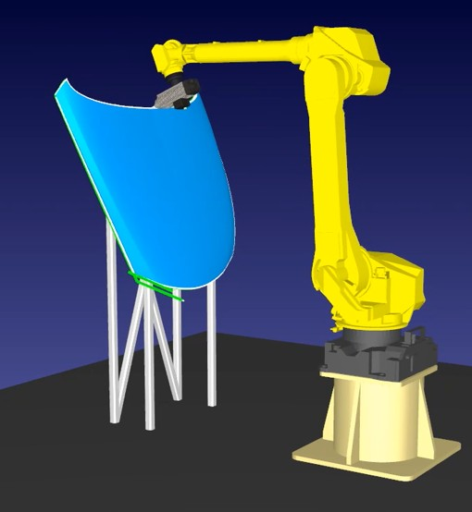
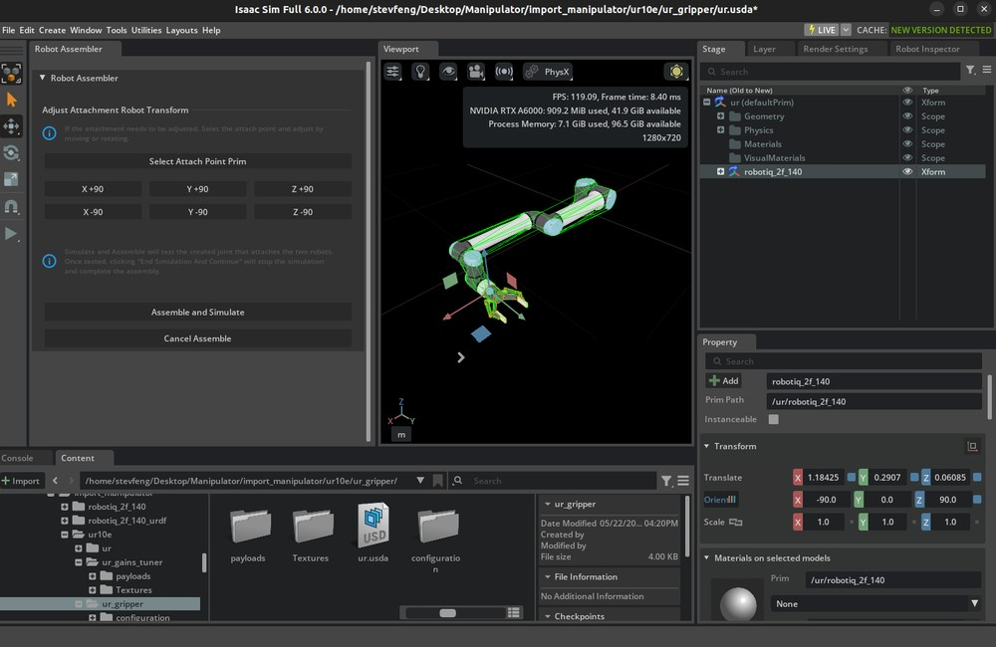

Full-Surface Scanning. Targeted Defect Reinspection.
IN COLLABORATION WITH IRT JULES VERNE
Developing a reusable motion planning framework for aircraft inspection
COMMON PLANNING FRAMEWORK (IN DEVELOPMENT)
Connected to the inspection system
IRT JV contribution: toolpath generation + robot motion planning
Scan data and defects in; validated motion and status out
1 Generate scan paths
2 Optimize route and motion
3 Validate in digital twin
4 Inspect with FANUC
Open CASCADE + point-cloud processing
Robot motion planning: Tesseract
Integration with NVIDIA Isaac Sim
Generate paths on measured surfaces.
No complete CAD model required.
GTSP optimizes 100+ defect visits.
Generate robot motion and local
scan paths automatically.
Validate coverage, reachability and
collision risks. Feed results back
before robot execution.
Execute approved surface scans.
Revisit only flagged regions
for detailed defect analysis.
Selectable planners: IRT JV / HPP Future AI: RL, VLA
HPP–IRT JV benchmarking completed
Simulation feedback refines the plan
Less manual programming
Less travel and repeat scanning
Reuse beyond one robot or task
Adapt to new parts using measured geometry
Optimize the route and focus follow-up scans
Common components with selectable planners
Representative visuals: scanning illustration, RoboDK, NVIDIA Isaac Sim and FANUC.
Notes:
Developed in collaboration with IRT Jules Verne using Tesseract for robot motion planning and Open CASCADE for CAD geometry processing. Sensor point-cloud processing is a separate geometry input, enabling surface inspection without complete CAD. NVIDIA Isaac Sim is the digital twin integration platform identified by the user. The framework is in development; these labels do not assert completed integration. Shared geometry and planned trajectories pass to the digital twin for pre-execution validation; results feed back for refinement. GTSP sequences 100+ defect locations and targeted reinspection regions; it does not itself generate robot trajectories. HPP–IRT JV benchmarking completed, per user. HPP is an alternative and RL/VLA future options. Intended value: less manual programming, less travel and repeated scanning, reusable components across robots and surface processes with suitable adapters and validation. No quantified savings or arbitrary-geometry guarantee claimed. First visual is a generated representative FANUC scanning illustration; points are not real acquired data. Second visual is a representative FANUC machining example from https://robodk.com/doc/fr/Example-5-Axis-Cutting.html, not Tesseract or the project interface. Third image is a representative NVIDIA Isaac Sim UR10e setup example, not the project FANUC digital twin. Source: https://docs.isaacsim.omniverse.nvidia.com/latest/robot_setup_tutorials/tutorial_import_assemble_manipulator.html ; asset https://docs.isaacsim.omniverse.nvidia.com/latest/_images/isim_6.0_full_tut_gui_connect_gripper_assembler_2.png . Fourth visual is official FANUC R-2000iC/210L product photo: https://www.fanucamerica.com/products/robot/r-2000ic-210l . Talk track: We collaborate with IRT Jules Verne to turn measured surfaces into toolpaths and feasible robot motion. Open CASCADE supports CAD geometry, alongside point-cloud processing for parts without complete CAD. Tesseract handles robot motion planning. The common platform supports selectable planners and connects to NVIDIA Isaac Sim to verify motion and return feedback before execution.

