Slide 1

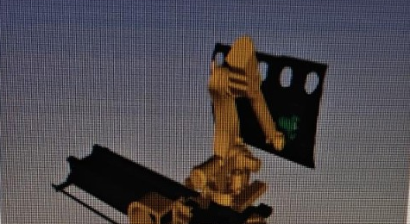
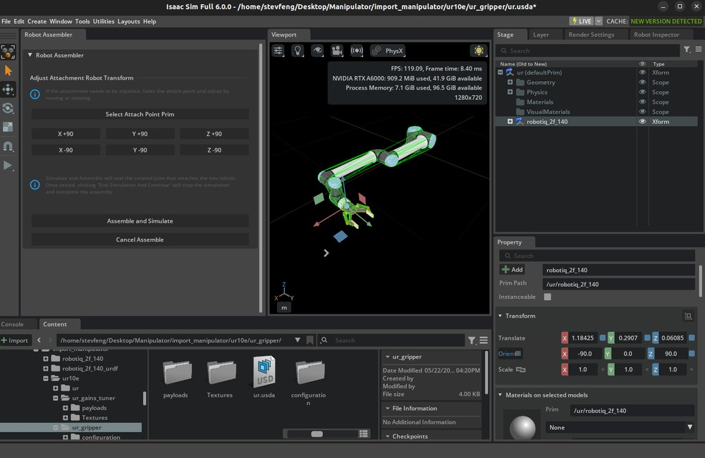
Automatic motion generation for aircraft inspection
Less programming for new panels. Reusable planning across robots.
IN COLLABORATION WITH IRT JULES VERNE
Framework in development
1 Generate & optimize motion
2 Validate before execution
3 Reuse a common platform
New panel geometry means
repeated robot programming
Motion issues consume physical trial time
Separate robot solutions duplicate effort
Tesseract
HPP
MoveIt 2
Shared motion + validation interfaces
Generate scan paths from point clouds.
Tesseract generates robot motion.
Robot models + execution adapters
No complete CAD needed
Check reach, collisions and coverage.
Refine the plan before FANUC execution.
Reuse the core across parts and robots.
Select the planner for the task.
GTSP sequences 100+ defects.
Rescan only flagged areas.
Digital twin: NVIDIA Isaac Sim
Future AI: reinforcement learning / VLA
EXPECTED VALUE
Less programming and travel
Fewer physical trial runs
Less repeated engineering
HPP / IRT benchmarking completed: guides planner selection for each inspection use case.
Representative visuals. Framework in development. Benefits to be measured.
Notes:
PRESENTER SCRIPT (about 2 minutes)
The problem is the repeated programming and trial effort whenever panel geometry, inspection regions or the robot changes. We are developing automatic motion generation to reduce that effort, in collaboration with IRT Jules Verne.
First, the inspection system provides surface geometry and inspection requirements. We can use sensor point clouds when complete CAD is unavailable. Where CAD is available, Open CASCADE supports geometry processing. We generate the sensor scan path, then use Tesseract to calculate feasible robot motion while respecting the required coverage, sensor orientation and stand-off. This reduces manual waypoint teaching for each new panel.
For follow-up analysis, we use GTSP to sequence visits to more than 100 defect locations efficiently. We generate local scans only for the flagged regions. Motion generation reduces programming effort. Sequencing and targeted rescanning reduce travel and unnecessary inspection.
Second, we integrate with NVIDIA Isaac Sim to check reachability, collisions and coverage before execution. Simulation results feed back into planning so we can correct issues before using the physical cell. After approval, the FANUC robot executes the trajectory. This aims to reduce physical trial runs, while retaining physical commissioning and validation.
Third, we are building common software components and interfaces, with different planning options selected for each use case. Our HPP and IRT benchmarking helps evaluate those options against inspection requirements. Robot models and execution adapters allow reuse across robots without rebuilding the common core. Reinforcement learning and vision-language-action approaches are future options, not current delivered capabilities.
The expected value is faster inspection preparation, fewer physical trial runs and less repeated engineering. We intend to measure preparation effort, trial iterations and reinspection cycle time as the demonstrator develops.
SYSTEM CONNECTIONS
The inspection supervisor supplies geometry, inspection constraints and detected defect locations. The planning framework produces scan poses, routes and robot trajectories. The digital twin exchanges scene, trajectory and validation results with planning. Approval gates release to robot execution adapters. Execution returns status to the supervisor. GTSP sequences visits; it does not detect defects or independently generate robot trajectories.
SUPPORTING PROJECT CONTEXT AND IMAGE SOURCES
AUTOMATIC MOTION GENERATION: New panel geometry or changed defect regions can require repeated path programming. Use measured point clouds, or suitable CAD when available, plus inspection requirements to generate sensor poses and feasible timed robot motion. This reduces waypoint teaching and preparation effort while applying coverage, orientation and stand-off requirements consistently. Engineering setup and validation remain necessary. Intended benefits are not measured achievements. Presenter wording: A new panel should require new geometry and inspection settings, with much less manual reconstruction of the robot program.
MAIN MESSAGE: We are developing one reusable platform to generate inspection robot motion, check it in the digital twin, and deploy it through robot-specific execution adapters. The intended value is less manual programming for a new part, fewer physical trial-and-error runs, and less duplicated engineering when another robot or task is introduced.
PROBLEM-TO-VALUE: 1) New parts or changed measured geometry require robot program rework. Generate surface coverage poses and feasible timed robot motion automatically to reduce manual teaching and path rework. A complete CAD model is not mandatory when suitable sensor point clouds are available. 2) Discovering reachability, collision or coverage problems on the physical cell consumes robot availability and engineering time. Validate those aspects in NVIDIA Isaac Sim, revise motion from feedback, and release the approved trajectory for robot execution. Simulation reduces avoidable physical trials; it does not replace actual cell commissioning or guarantee safety or inspection performance. 3) Robot-specific implementations repeat geometry, planning and validation integration. Common interfaces and reusable components let the team select a planner for the use case and change robot models/drivers/adapters while retaining the shared core. Robot agnosticism is an architecture goal, not plug-and-play support for every robot.
These current-problem statements are a qualitative framing of the project rationale; no measured baseline, achieved saving, or fully autonomous/no-programming claim is asserted. Validate the baseline with the team. Possible demonstrator measures: engineering hours per new panel, number of physical validation iterations, integration effort for another robot, and cycle time for reinspection.
COLLABORATION AND TECHNOLOGY: The user identifies IRT Jules Verne as collaborator using Tesseract plus Open CASCADE. Open CASCADE supports CAD geometry processing; point-cloud processing is a separate measured-geometry input. Tesseract supports robot motion planning. The common framework has selectable Tesseract, HPP and MoveIt 2 options as shown in the user's latest slide photograph; this does not assert all are integrated. The user's latest photograph says HPP–Tesseract–MoveIt2 benchmarking completed. Earlier conversation described HPP vs IRT JV benchmarking. Slide states that benchmarking guides planner selection against inspection requirements. This connects the completed comparison to a decision purpose without asserting an unprovided winner, quantitative result, or confirmed selection rationale. If asked by the board, present the actual comparison findings and requirements in supporting material. Reinforcement learning and VLA are future options.
ROUTE OPTIMIZATION: GTSP chooses an efficient order and, where applicable, alternatives for visiting 100+ defect locations. Local scan paths cover only the flagged regions for further analysis. Distinguish this sequencing from scan coverage generation and robot trajectory generation. No global optimality guarantee or quantified saving is claimed.
SYSTEM INTEGRATION: The inspection application/supervisor supplies geometry, task requirements and defect locations. Planning sends scene and trajectory data to the digital twin. Validation results drive revision before approval. Robot-specific interfaces execute the approved trajectory and return status to the supervisor. Detection and interpretation of defects belong to the inspection system.
TALK TRACK (45 seconds): Today a new panel or robot can mean repeated programming and physical trial runs. With IRT Jules Verne, we are developing a common platform that turns measured surfaces into scan paths and robot motion. We validate that motion in Isaac Sim so we can correct reachability, collision and coverage issues before occupying the real cell. The same software components can then be reused with another planner or robot adapter. For follow-up inspection, route optimization visits the detected defects efficiently and scans only those regions. We will demonstrate the value through programming effort, physical trial iterations and inspection cycle time.
IMAGES: First image is an AI-generated representative FANUC scanning illustration; point cloud is illustrative, not acquired data. Second is an official NVIDIA Isaac Sim UR10e setup example, not the project FANUC digital twin. Source https://docs.isaacsim.omniverse.nvidia.com/latest/robot_setup_tutorials/tutorial_import_assemble_manipulator.html ; asset https://docs.isaacsim.omniverse.nvidia.com/latest/_images/isim_6.0_full_tut_gui_connect_gripper_assembler_2.png . Third is an editable conceptual architecture diagram. IRT collaboration and technology selections are supplied by the user.
FIRST COLUMN TALK TRACK: We automate the inspection motion and optimize the sequence of defect visits. Point-cloud information supports scan path generation without a complete CAD model. Tesseract generates robot motion, while GTSP sequences the defect visits. Targeted follow-up scans cover only flagged regions. This reduces manual programming, unnecessary travel and repeat scanning.
ADDED IMAGE: Cropped robot-motion illustration from the user-supplied image(20261007-001948).png. Representative visual, not evidence of the project Tesseract implementation.
BENCHMARK TALK TRACK: We have completed benchmarking between the HPP and IRT approaches. This gives us a basis for selecting a planner against the requirements of each inspection use case. It also supports our decision to provide multiple planning options through a common platform. The board takeaway is that planner choice is informed by comparison, while the shared software remains reusable. No winning planner or quantitative improvement is asserted without the actual benchmark results. Open CASCADE supports CAD geometry processing when CAD is available.

