Slide 1
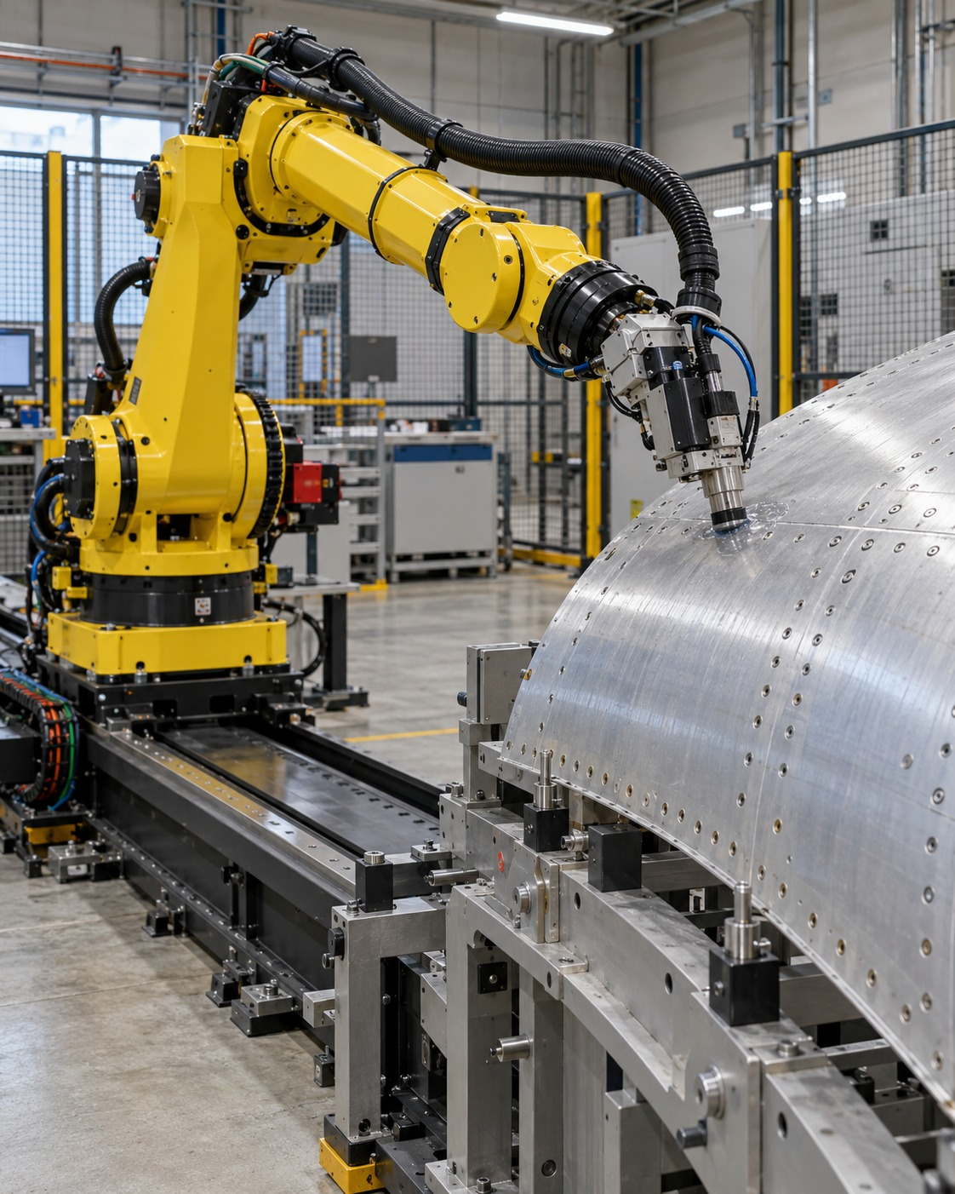

Autonomy
in Motion
Motion planning & execution
for aircraft manufacturing
Rasitha R.
Technical Specialist Interview
01
Notes:
Introduce your focus: turning motion-planning capability into an integrated, reusable industrial robotics product.
Visuals reused from the previous deck are illustrative AI-generated scenes, not records of Airbus projects.

Slide 2
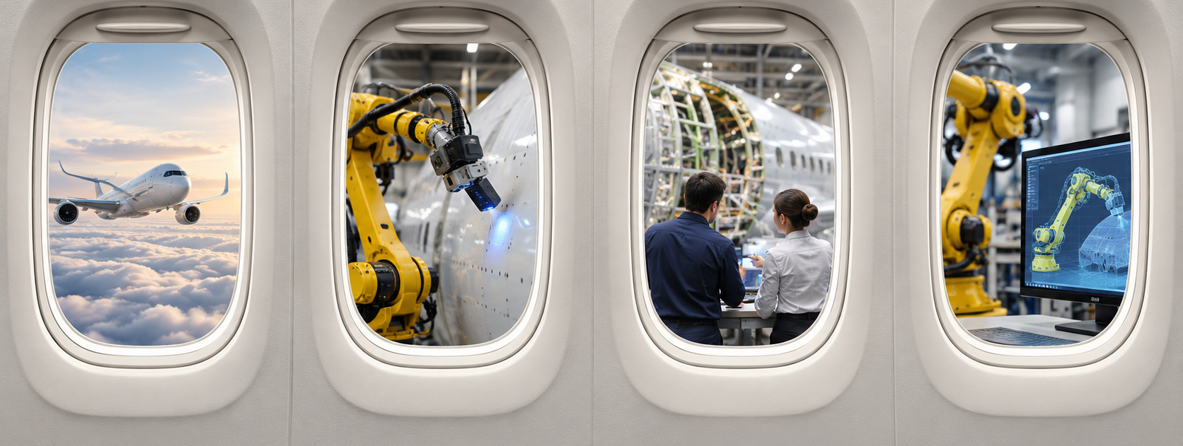
A window into my journey
01
02
03
04
My background
My Airbus work
My influence
Vision & roadmap
02
Notes:
Four aircraft windows introduce the presentation chapters: my foundations, Airbus contributions, influence and networks, and the vision and roadmap.
Visuals reused from the previous deck are illustrative AI-generated scenes, not records of Airbus projects.

Slide 3
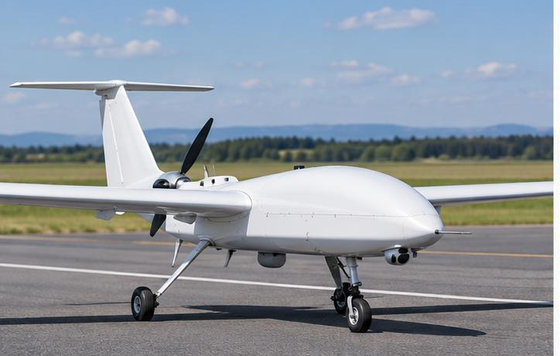
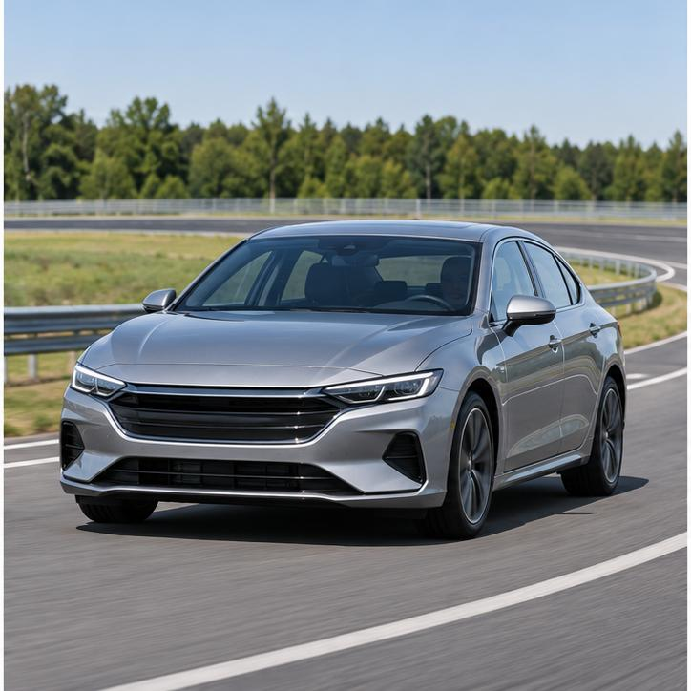
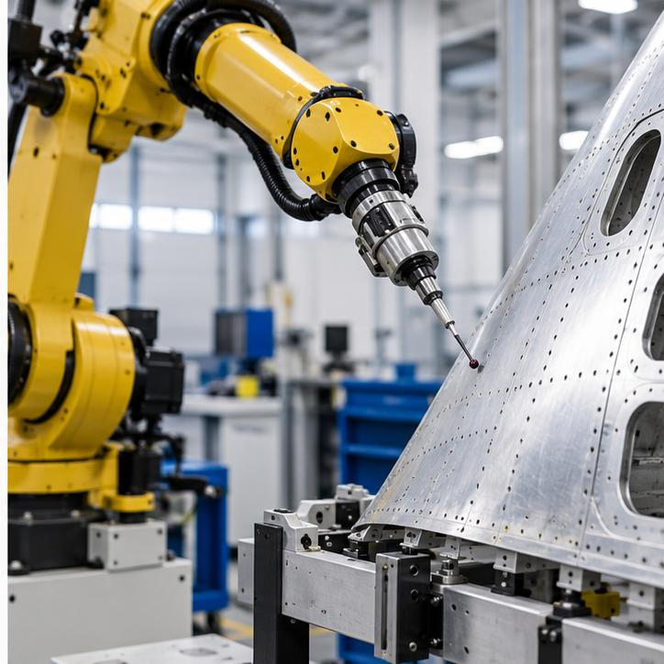
One passion. A journey across autonomous systems.
2011
2 years
Dates to add
1 year
5.5 years
2022
Bachelor’s
Guest lecturer
Master’s
DRDO ADE
Danlaw
Airbus
Engineering foundation
Teaching & mentoring
Postgraduate study
Flight dynamics & autopilot
ADAS
Industrial robotics
From controlling a vehicle to orchestrating a complete robotic system.
03
Notes:
Bachelor’s completed in 2011, followed without a gap by two years as guest lecturer. Master’s followed; exact dates and degree details need confirmation. ADE duration one year; Danlaw ADAS 5.5 years; Airbus joined in 2022. Months are not supplied and are not inferred. The timeline is sequential, not proportional to duration.
Visuals reused from the previous deck are illustrative AI-generated scenes, not records of Airbus projects.

Slide 4
From the road to the robot: the same core questions
Understand the surroundings
Choose the path
Control the movement
ADAS
Industrial robotics
Stay on the road.
Choose safe, feasible motion.
Measure & adjust
Follow the part.
Meet the process needs.
Transfer the system thinking. Adapt the planning to the manufacturing task.
04
Notes:
Both domains translate goals into feasible motion and use feedback. Robotics adds task-specific requirements such as tool orientation, surface coverage and contact. This describes transferable thinking, not a claim that the same planner suits every task.
Visuals reused from the previous deck are illustrative AI-generated scenes, not records of Airbus projects.

Slide 5

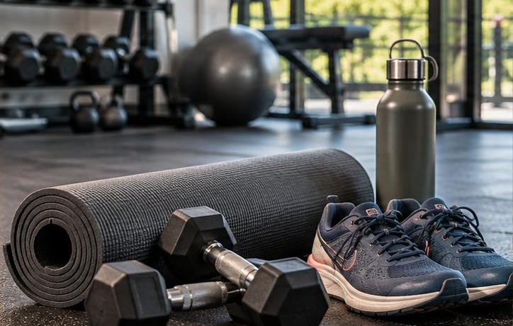

Beyond engineering
Dance & acting
Fitness
Travel & the outdoors
Creativity and expression
Energy and consistency
Trekking, hiking and discovery
05

Slide 6
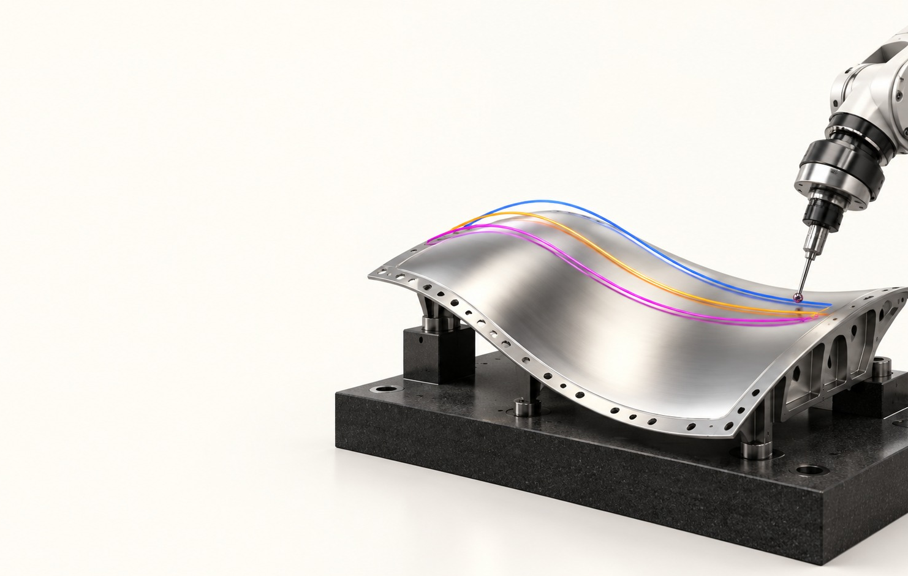
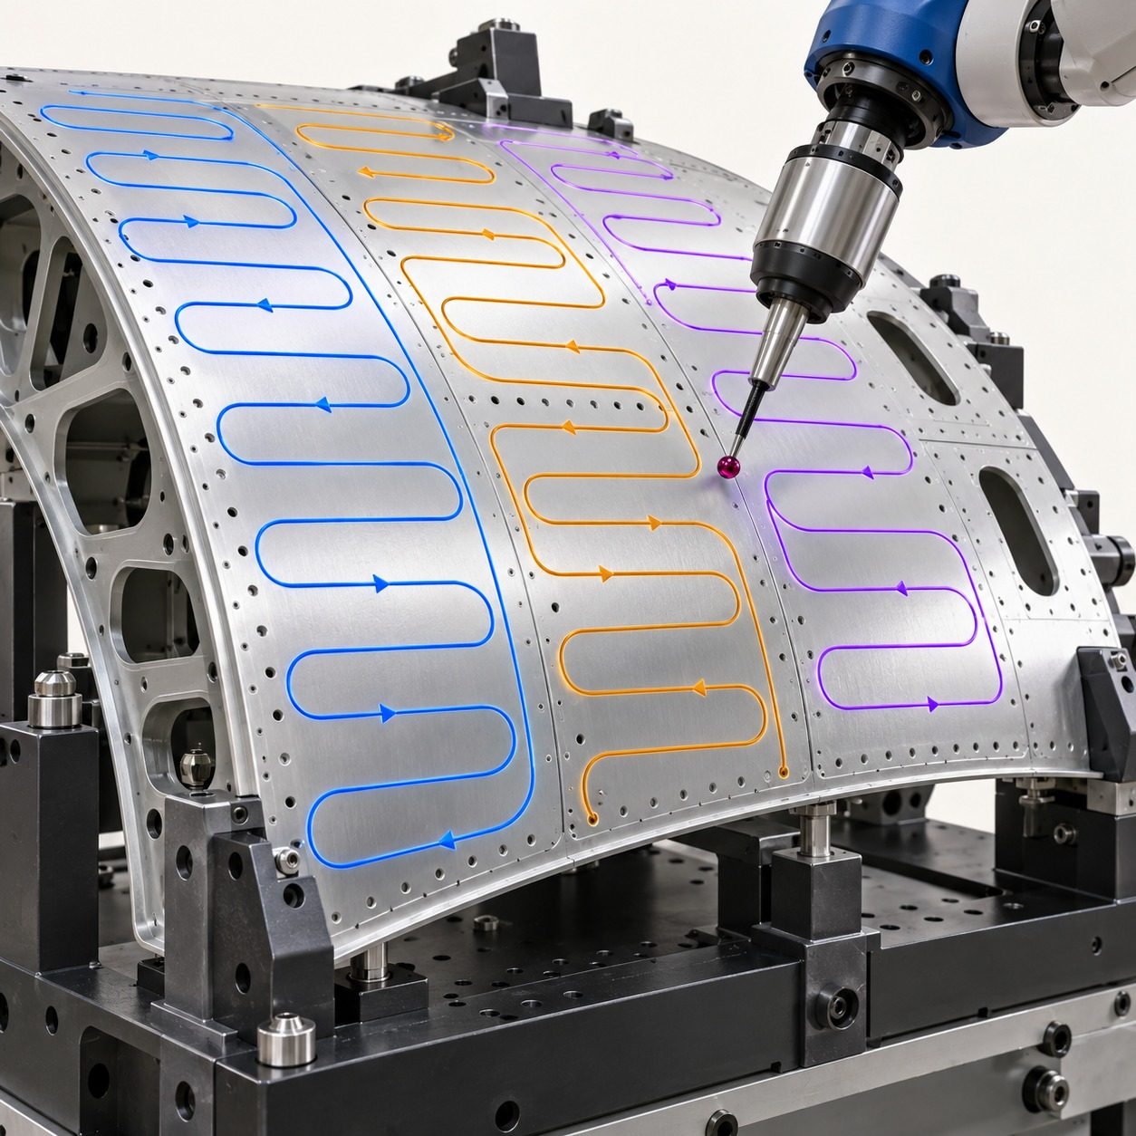
My Airbus journey: from paths to task intelligence
REACT
Primer-skin NDT
Intelligent scan plan
Constrained planning
and task supervision
Robot motion for
panel inspection
Defect sequencing
and targeted rescans
Next horizon: reuse these capabilities across manufacturing applications.
06
Notes:
Describe your precise ownership and evidence for each project verbally. REACT includes HPP constrained planning and supervision. These milestones describe capabilities, not a dated project-delivery sequence.
Visuals reused from the previous deck are illustrative AI-generated scenes, not records of Airbus projects.

Slide 7
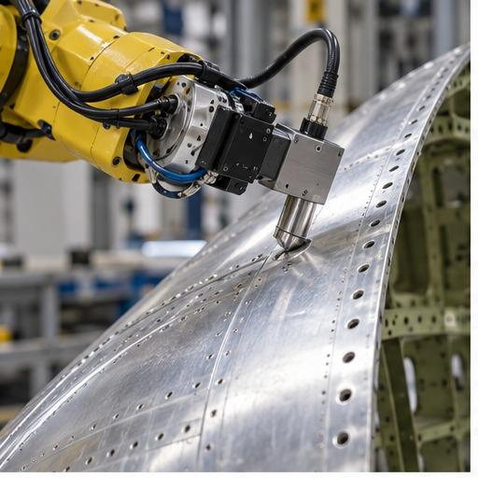
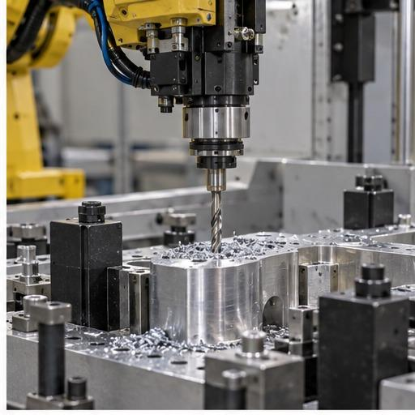
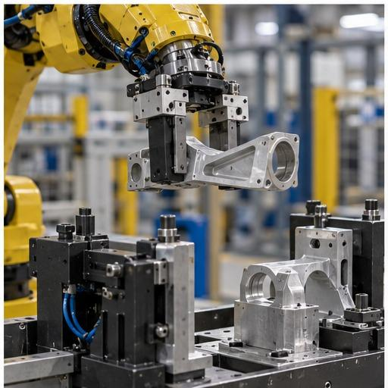
The task determines the way to move
Follow a surface
Reach a precise point
Transfer & position
Inspection · sanding · cleaning
Drilling · alignment
Pick-and-place · auto-rigging
A shared platform should offer a choice of planning methods.
07
Notes:
These are simple groupings for a nontechnical audience. Real tasks can combine several motion needs. Planner selection must consider the robot, process, geometry and required accuracy.
Visuals reused from the previous deck are illustrative AI-generated scenes, not records of Airbus projects.

Slide 8
Turning technical ideas into shared knowledge
Patent
IDDs
White paper
[Title & status]
[Titles & status]
Published
[Your contribution]
[Your contribution]
[Title & publication date]
Make ideas reusable through protected innovation and published knowledge.
08
Notes:
Replace bracketed fields with verified titles, statuses and personal contributions before presenting. Patent and IDD counts/statuses are not supplied. The user confirmed a published white paper. Do not imply a patent grant without confirmation.
Visuals reused from the previous deck are illustrative AI-generated scenes, not records of Airbus projects.

Slide 9
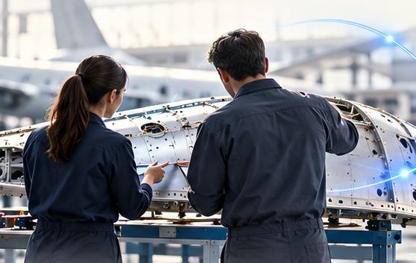
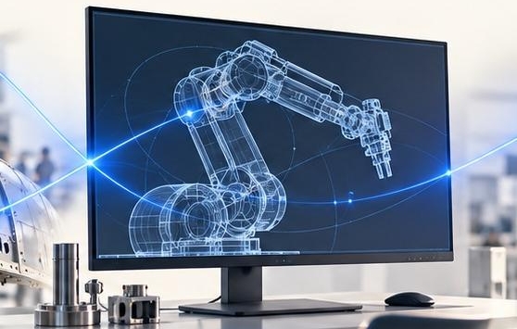
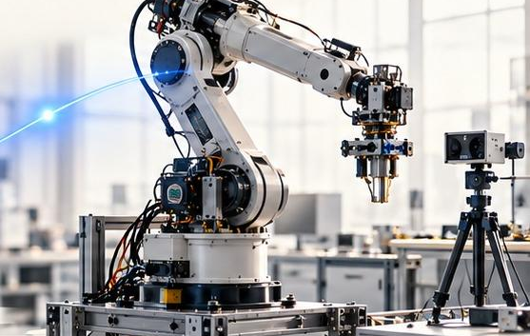
Influence through connection and shared decisions
Application teams
Integration teams · RXU
Research partners
Clarify the process need
and motion requirements
Align interfaces and
bring components together
LAAS · IRT Jules Verne
Compare approaches and learn
Clarify the need → demonstrate options → build alignment.
09
Notes:
IRT Jules Verne collaboration involves using their motion-generation approach; do not describe it as co-developing the common framework. Add a concrete example of a decision influenced or knowledge transferred when speaking.
Visuals reused from the previous deck are illustrative AI-generated scenes, not records of Airbus projects.

Slide 10
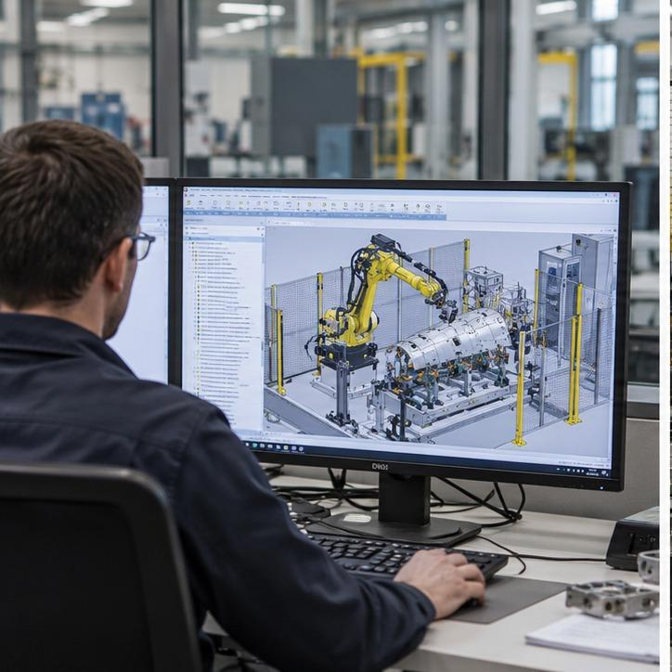
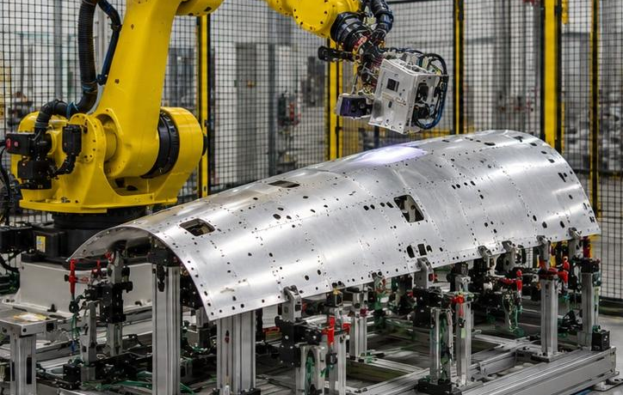
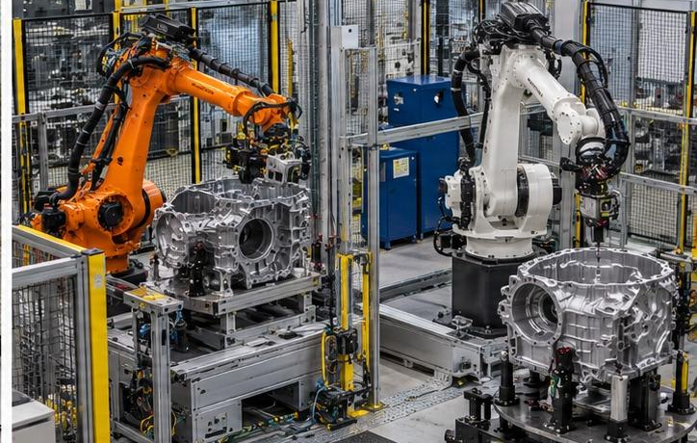
The manufacturing opportunity
Predictable preparation
Reliable execution
Faster reuse
Less repeated programming
Motion that meets process needs
Proven capabilities for the next task
Measure value: preparation effort · process quality · reuse effort.
10
Notes:
These are proposed value measures, not demonstrated savings. Baselines and acceptance targets should be agreed with application owners.
Visuals reused from the previous deck are illustrative AI-generated scenes, not records of Airbus projects.

Slide 11
A progressive path to autonomy
Task autonomy
Selected tasks within agreed limits
Adaptive execution
Measure, adjust and recover
Automatic planning
Software prepares the motion
Manual / OLP / NC
Expert foundation for known processes
Increase automation where it adds value. Validate every step.
11
Notes:
The widening tiers show a foundation-to-autonomy progression. Offline and manual programming remain valuable and appropriate for many processes. Autonomy levels depend on application risk, variability and economics.
Visuals reused from the previous deck are illustrative AI-generated scenes, not records of Airbus projects.

Slide 12
Build on expertise. Make preparation more predictable.
Same panel · different preparation effort
01
Capture expert methods
02
Reuse validated plans
03
Reduce repeated setup
Engineer A
Engineer B
Engineer C
Illustrative variation — not measured hours
12
Notes:
Current manual, offline and NC programming encode valuable expertise. Preparation time can vary with experience and task familiarity. Bars are illustrative, have no hour scale, and must not be interpreted as measured performance or a quantified autonomy benefit. The aim is to make proven expertise reusable, freeing engineering capacity.
Visuals reused from the previous deck are illustrative AI-generated scenes, not records of Airbus projects.

Slide 13


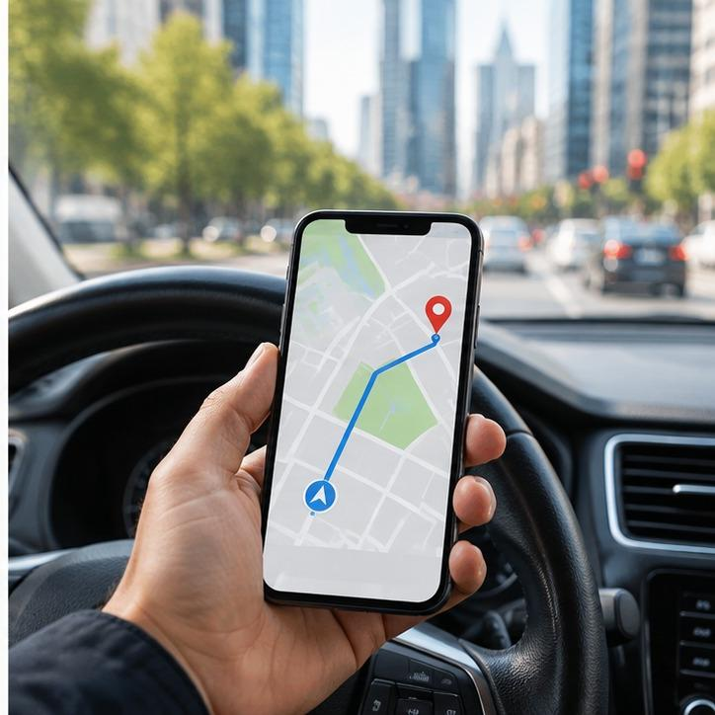
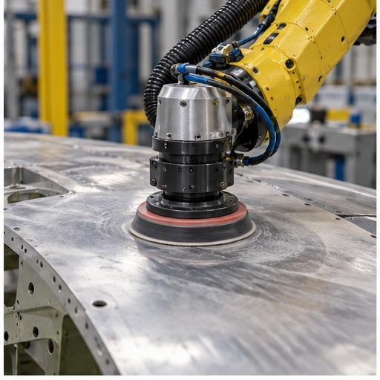
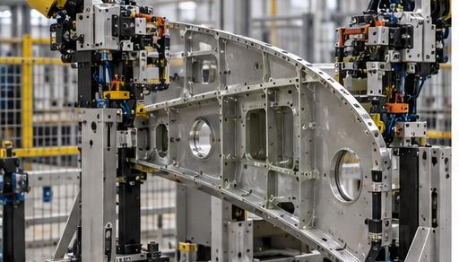
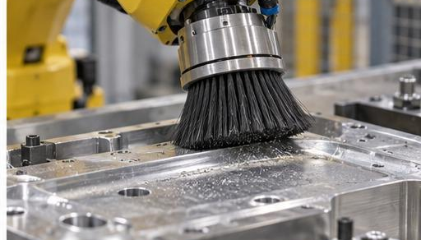
One platform. Choose the capability for the job.
One phone, many apps
One robotics platform, many tasks
Inspection
Sanding
Drilling
Banking
Shopping
Navigation
Shared phone services
Auto-rigging
Pick-and-place
Cleaning
Choose planners · validate · execute
A common foundation with task-specific choices—not one universal planner.
13
Notes:
The phone analogy illustrates shared services with selectable applications. Robotics requires a portfolio of compatible planning methods with common data, interfaces, validation and execution. This is the proposed product direction, not a claim that every planner can be interchanged without integration.
Visuals reused from the previous deck are illustrative AI-generated scenes, not records of Airbus projects.

Slide 14
A complete robotics product
Perception
Planning
Control
Supervision
Know the part
Choose the motion
Execute accurately
Monitor & recover
Common software platform · interfaces · data · connectivity
Define
→
Develop
→
Validate
→
Deploy
→
Support & improve
My broader systems experience supports the full product lifecycle.
14
Notes:
The product-line approach uses a common foundation and managed task-specific variation. Include requirements, integration, test evidence, deployment, maintenance and feedback. Planning must work with sensing, control, supervision and equipment connectivity.
Visuals reused from the previous deck are illustrative AI-generated scenes, not records of Airbus projects.

Slide 15
From a manufacturing need to a working robot
Choose the task
Prepare the path
Check virtually
Run & monitor
Define the process need
Select a suitable method
Validate before robot trials
Measure the result
Make each new application easier to prepare, validate and deploy.
15
Notes:
A simplified user journey for the proposed platform. Virtual checks complement physical trials and process acceptance; they do not remove the need for validation.
Visuals reused from the previous deck are illustrative AI-generated scenes, not records of Airbus projects.

Slide 16
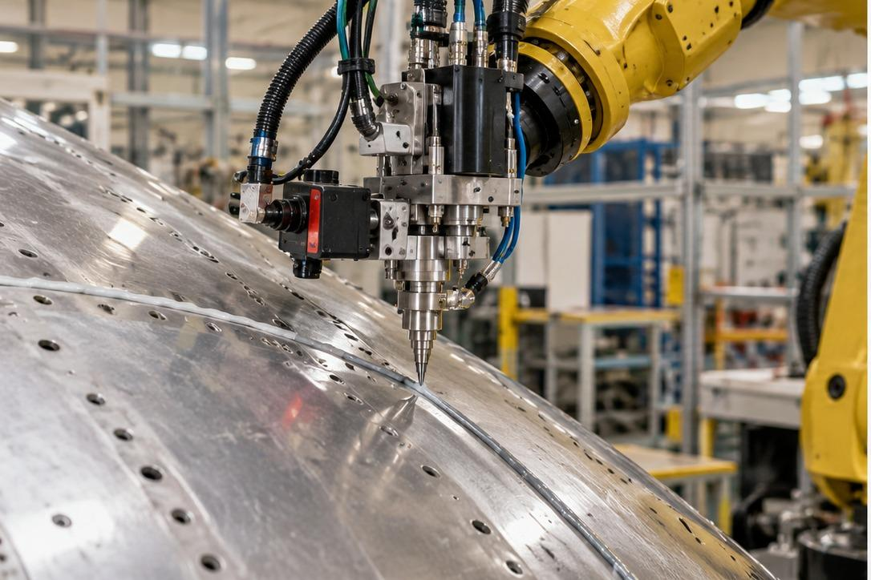
Vision & challenges
One robotics platform.
The right motion capability for every task.
Different tasks
One working system
Changing conditions
Select the right planner
Connect the components
Adapt without losing accuracy
16
Notes:
Vision is a proposed direction. Key challenges are heterogeneous task constraints, integration across components, and robust behavior when conditions change. Initial use cases should establish the interfaces and evidence before scaling.
Visuals reused from the previous deck are illustrative AI-generated scenes, not records of Airbus projects.

Slide 17
Roadmap · 2027 | Establish the common foundation
Q1
Q2
Q3
Q4
Connect
Plan & validate
Refine
Integrate & prove
Robot, part & task data
Select methods; check paths
Sequence & smooth motion
RXU integration; robot trials
Agreed interfaces
Pilot in simulation
Process-ready trials
Acceptance evidence
Proposed phases · subject to resources, priorities and robot access
17
Notes:
Proposed schedule; depends on people, application priorities, robot access and integration capacity. Q1 establish data and interfaces. Q2 develop planning and validation. Q3 sequencing, smoothing and process trials. Q4 simulation-to-execution integration with RXU and pilot acceptance. Agree owners, baselines and acceptance criteria before committing dates.
Visuals reused from the previous deck are illustrative AI-generated scenes, not records of Airbus projects.

Slide 18
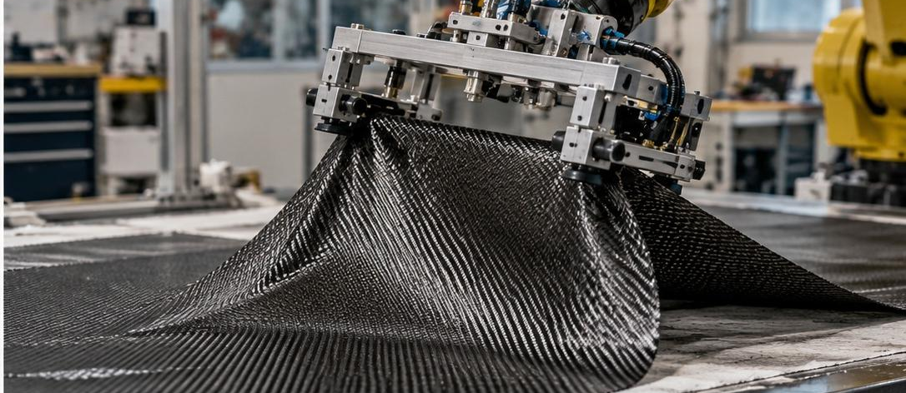
Roadmap · 2028–2029+ | Add adaptability, then scale
2028 · Adaptive execution
2029+ · Learn from variation
Respond to changes in the part or process.
Explore flexible materials and unfamiliar shapes.
Gate: stable accuracy and recovery
Gate: repeatable value before wider use
18
Notes:
Proposed direction, not a funded commitment. Begin with bounded adaptation and reliable recovery. Later investigate learning methods for greater uncertainty, including flexible materials. Scale only after technical and manufacturing value are demonstrated.
Visuals reused from the previous deck are illustrative AI-generated scenes, not records of Airbus projects.

Slide 19
Building a lasting robotics capability
Technical depth
Flight control → ADAS → robotics
System perspective
From planning to complete product delivery
Shared capability
Methods, interfaces and knowledge that others can reuse
Less repeated preparation. Reliable motion. Reuse across manufacturing tasks.
19
Notes:
Close by connecting your career and present work to the proposed product direction. Avoid unverified savings or claims of funded roadmap commitments. Invite discussion on the first pilot and success criteria.
Visuals reused from the previous deck are illustrative AI-generated scenes, not records of Airbus projects.

