Slide 1

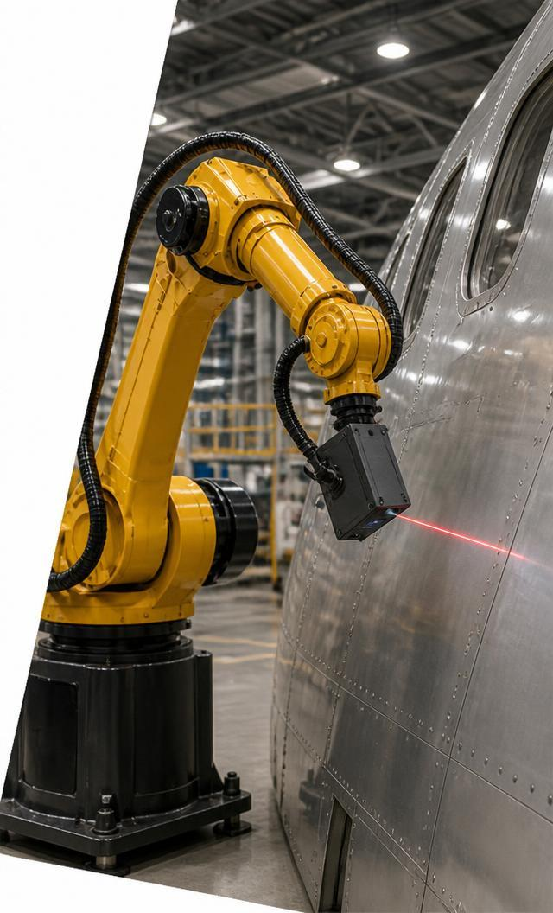
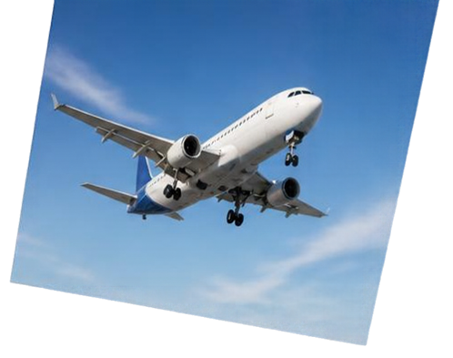
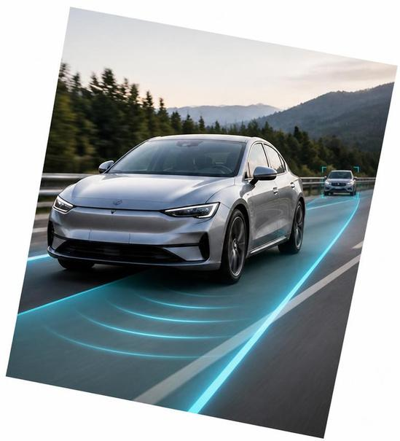
Autonomy in Motion
Rasitha R
Motion Planning & Execution

Slide 2
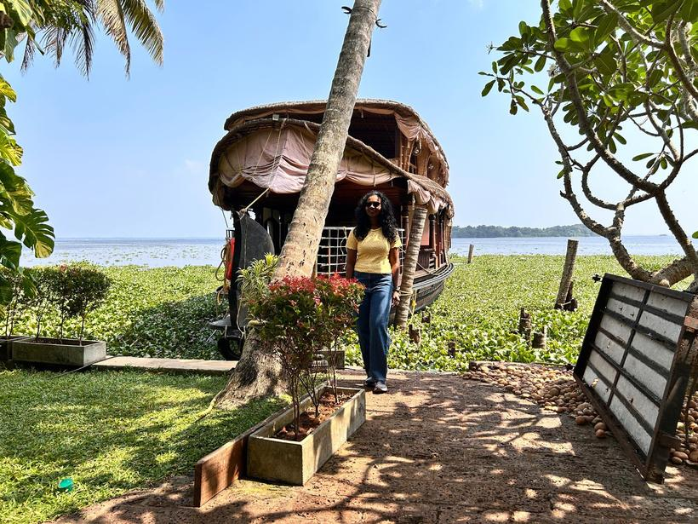
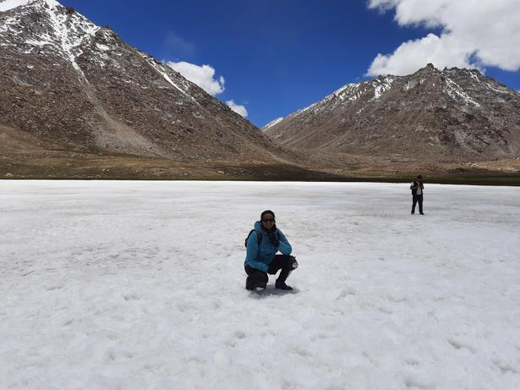
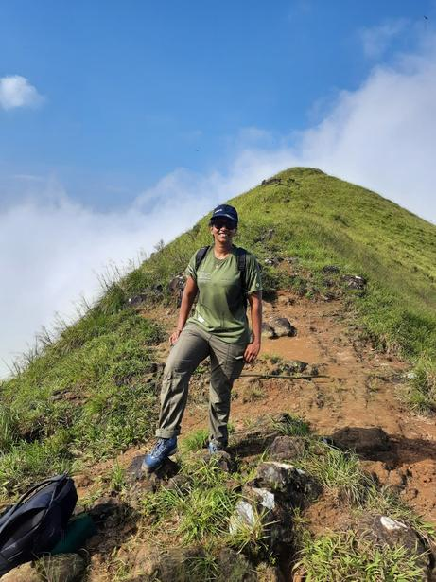
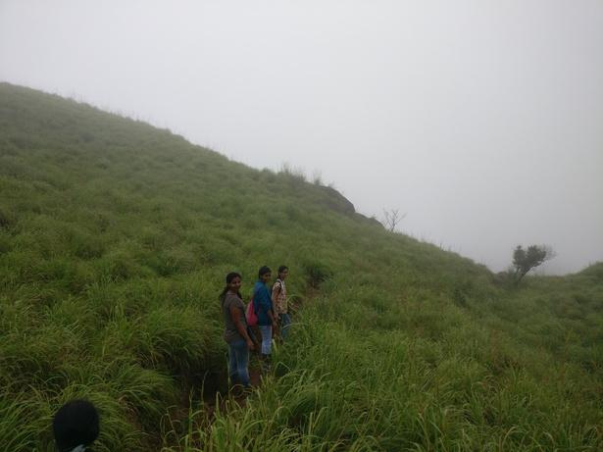
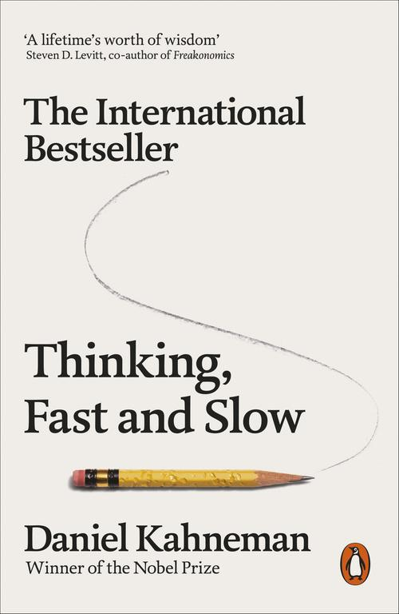


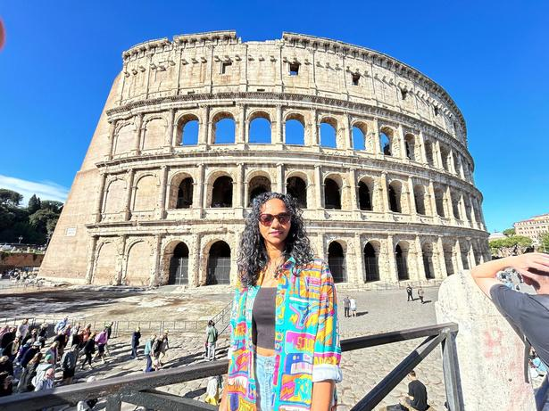
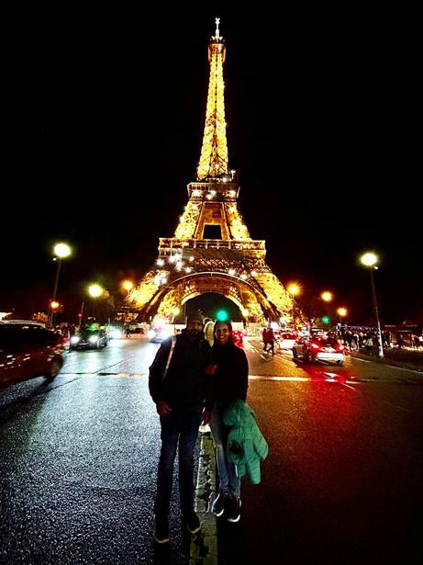
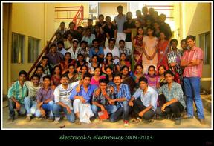

What Shaped My Journey
Rooted in Kerala. Shaped by curiosity.
Roots & expression
Curiosity & exploration
Imagination & perspective
Kerala’s culture → classical dance
Kerala’s Western Ghats & beaches
sparked trekking & travel
Reading, encouraged by my husband
Classical dance
Creativity
Resilience • adaptability
Reflection
2011 • Bachelor’s
Engineering foundation
2011–2013
Guest Lecturer
Teaching & mentoring
2013–2015 • Master’s
Control Systems
Calicut University
GUIDING PRINCIPLES Grounded Roots • Precision Creativity • Expedition Resilience • Cognitive Integrity

Slide 3
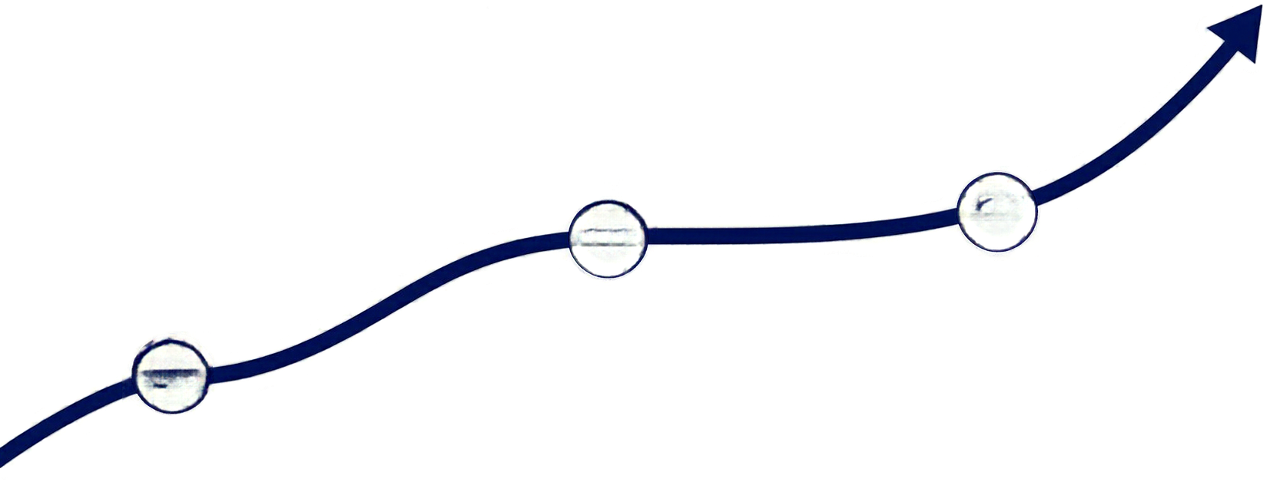
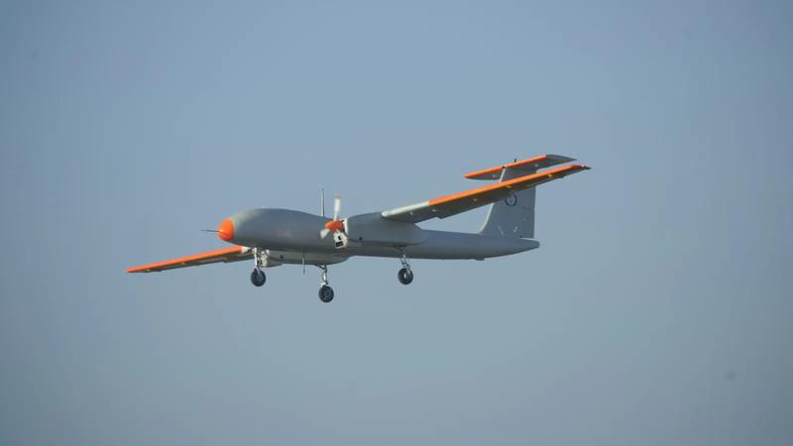
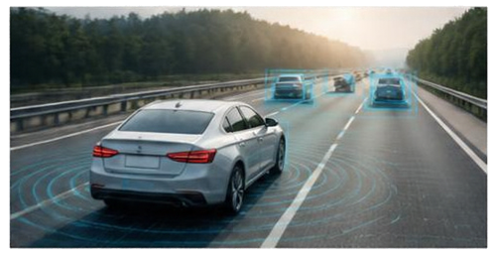
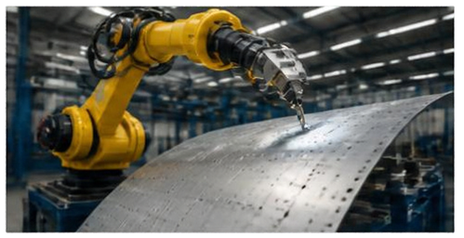


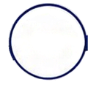
Career trajectory
One passion for autonomy, across flight, vehicles and factories
2015–2016 ADE–DRDO
Aeronautical Development
Establishment
03
02
  Enabled Rustom-2’s maiden flight with flight-control stabilisation software
2016–2022 Danlaw
2022–Present Airbus
  Led autonomous systems development
  Enabled autonomous platooning through leader–follower coordination.
  Leading motion planning
  Enabling less manual programming & reuse across applications
01
Programmes: A320 inspection • eAction

Slide 4

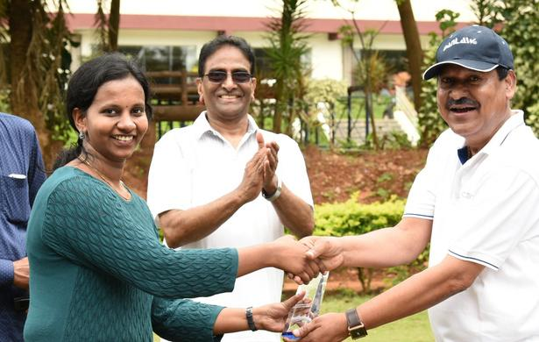
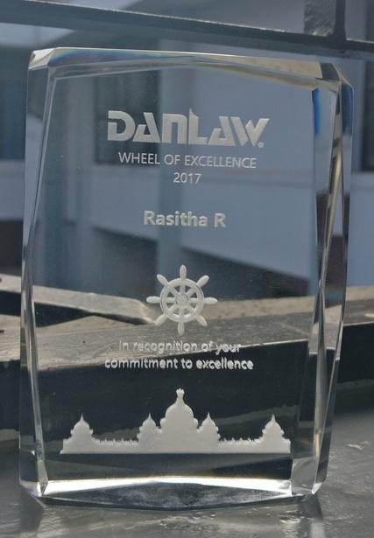


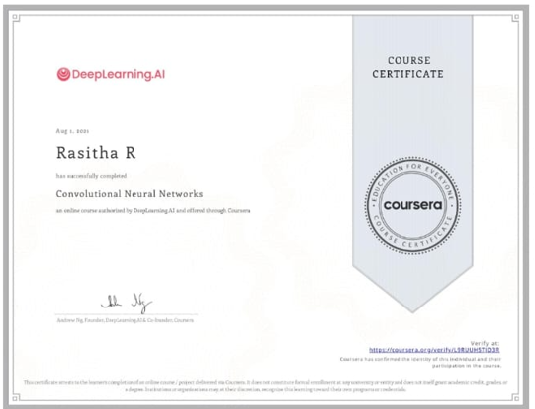
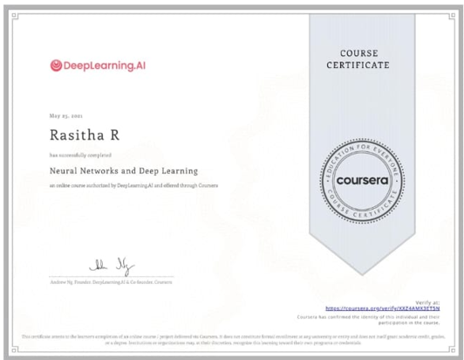
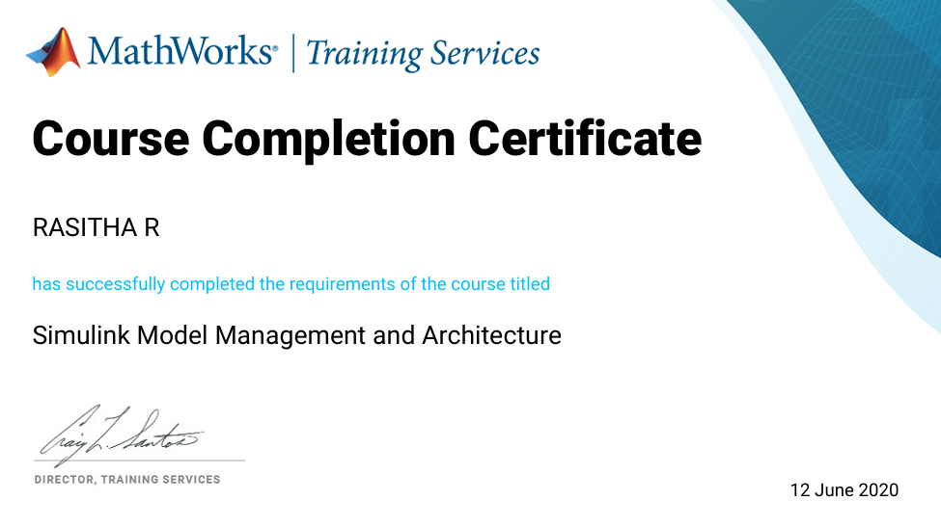
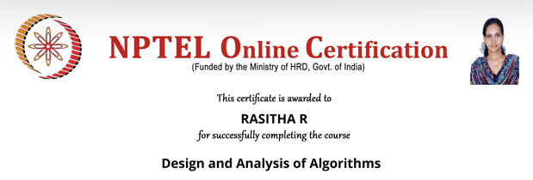
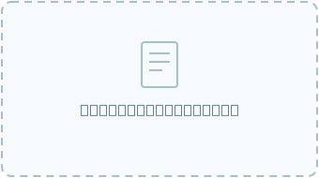
Achievements & recognition
Academic excellence, industry recognition and continued learning
Gold Medalist
2× Wheel of Excellence
Spot Award
Master’s in Control Systems
Calicut University, 2015
Danlaw, 2017 & 2018
Enabled driver assistance systems
Delivered quality software rapidly
Airbus, Wings of Wonder, 2022
Made robotics relatable to children through interactive learning
Design, Analysis &
Algorithms, NPTEL
Deep Learning
Specialization, Coursera
Neural Networks
and Deep Learning, Coursera
Simulink Model Management &
Architecture, Mathworks
Notes:
Gold Medallist for a master’s in Control Systems at Calicut University. Wheel of Excellence Award at Danlaw, received twice. Spot Award from Airbus. Certifications: Design and Analysis of Algorithms from NPTEL; Deep Learning Specialization and Neural Networks and Deep Learning from Coursera; Simulink Model Management and Architecture from MathWorks. Award illustrations are generic symbolic artwork generated with imagegen; they are not photographs of the actual awards.

Slide 5
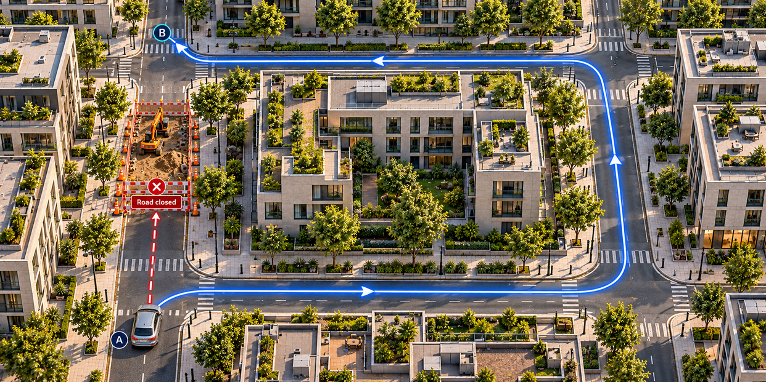
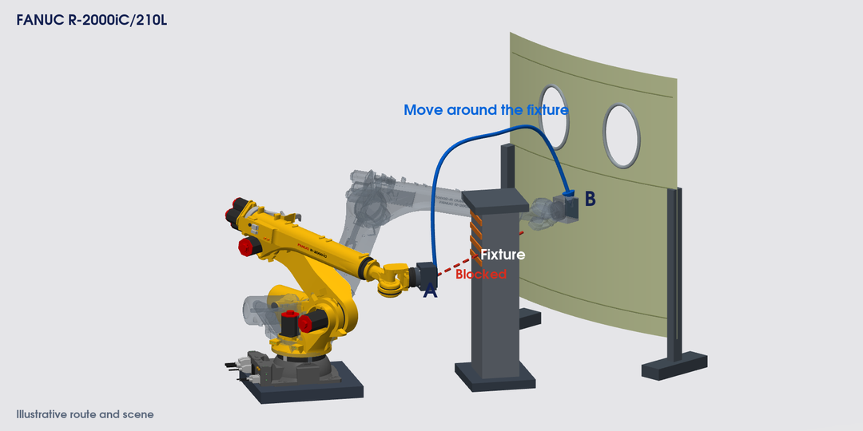
Motion planning
From Google Maps to robot movement
On the road
A: Start point • B: Destination
Obstacle: Roadworks block the direct road.
Plan: Take a detour around the block.
At the aircraft
A: Start position • B: Inspection position
Obstacle: A fixture blocks the direct route.
Plan: Move around it with the whole arm.
Maps guides the driver. Robot planning works out how the whole arm moves.

Slide 6










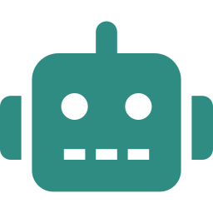


Where autonomous motion adds value
A new panel arrives
Offline programming
Autonomous motion planning
New variant: geometry or pose changes
New variant
Edit OLP path
Post & load
Trial run
Scan
Localise
Plan
Execute
CAD change
in robot sim
robot program
touch-up on cell
3D point cloud
register to CAD
collision-free
with feedback
Repeat per variant
Automatic per part
WHAT AUTONOMY CHANGES
Automatic motion planning
Adaptive execution
Task autonomy
Collision-free paths from CAD + scan
Real-time path correction from sensors
Task-level decisions within safety limits
Less programming
Fewer corrections
Less intervention
Target: lower preparation cost
Notes:
WHY AUTONOMOUS MOTION MATTERS (about 50 seconds)
[Left] A new panel arrives: a different shape, or a different position.
[Middle, coral: offline programming] With offline programming, that means going back to programming: a new variant means a CAD change, so we edit the path in offline programming and robot simulation, post-process and load the robot program, and then run a trial with touch-up on the cell. And we repeat this loop for every variant.
[Right, teal: autonomous motion planning] With autonomous motion planning, the cell scans the part to get a 3D point cloud, localises it by registering it to the CAD, plans a collision-free path with inverse kinematics, and executes it with sensor feedback. Automatic, for every part, with no loop.
[Band] Automatic motion planning generates collision-free paths from CAD and scan data, so less programming. Adaptive execution corrects the path in real time from sensors, so fewer corrections. Task autonomy takes task-level decisions within safety limits, so less intervention.
[Target] The target: lower preparation cost and more engineering capacity.

Slide 7



My Airbus milestones
Integrated motion planning • validated inspection • adaptive execution
REACT
Primer Skin NDT Inspection
Intelligent Scan & Plan
Saint-Nazaire . Airbus India
ZAL - Hamburg, Montoir
Saint-Nazaire . Airbus India
  Led first robotics software stack to TRL3 & pre-TRL4
  Plans its own path in 0.7–10 s
  ≈ €2.1M/year · 1.5-year payback
  TRL4: probe path planned automatically
  Full, repeatable scan coverage
  11 inspectors freed, €1.1M/yr*
  Lead/mentor: scan & defect sequencing
  100+ panels, no reprogramming
  Built for < 95-min cycle time
NDT – Non Destructive Testing · *Example estimate, to be confirmed with plant data

Slide 8



My Airbus milestones
Reusable software • process quality • adaptable planning
SAMU · Sealant deposition
iMOD2 · MATS
eAction · Nextgen Layup
Illescas . Airbus India
ZAL - Hamburg
Illescas . Airbus India
  Sealant on frame edges
  Edge scan + live path correction
  Replaces manual sealing
  Software standardization through the unified RXU stack.
  Building reusable robot control
  Leading data-driven layup optimisation
  Inline detection of missing tows
  Supports +20% productivity, > 50% RC cut
MATS - Modular Automated Track System • SAMU – Spraying and Auto Masking Unit • RXU - Robotics Unified Software Architecture • RC – Recurring Cost

Slide 9
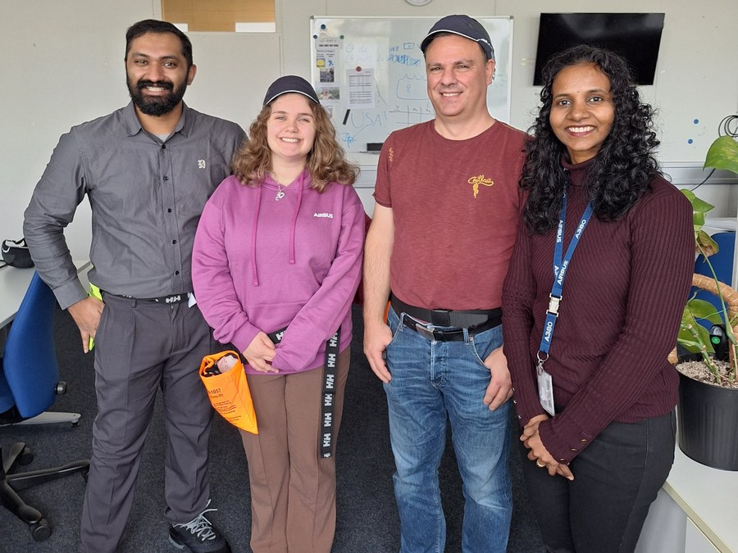
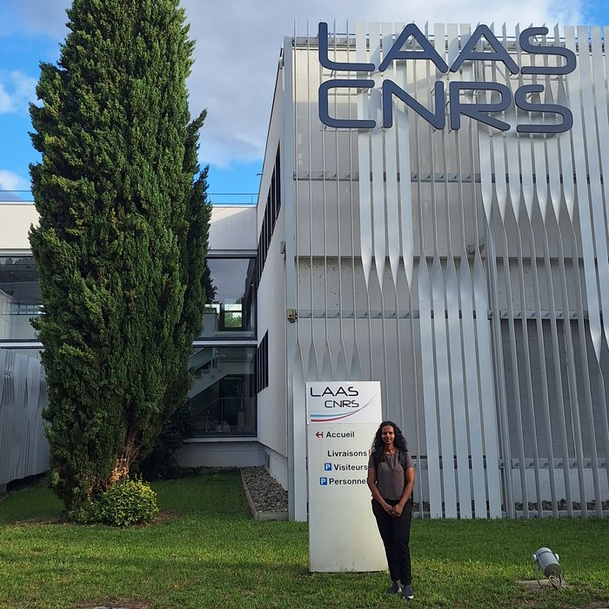





My network & technical influence
Collaboration across Airbus, academia, research and industry
WITHIN AIRBUS
BEYOND AIRBUS
Industrial &
plant
Academia
ZIDJ, KOM
Research institutes
Research
Rasitha
1X
Manufacturing
Industry
OMR, OMT
EU collaborations
Practical plant challenges, solved together
One solution, reused across plants and teams
Learn · Co-develop · Bring in
Latest research and partner tech reach Airbus faster
Notes:
Style option for slide 9 of Autonomy in Motion. Rebuilt from the user reference image(20261020-060042).png using native editable text and diagram objects, with its real photos and logos retained using native crop windows. The screenshot is low resolution. Use original photo/logo files for final quality. Airbus siglums are transcribed as ZIDJ, 1XRD, OMR, OMT and OMM. Verify whether the research siglum begins with the numeral 1. CNRS and Helmut Schmidt logos are cut off at the reference edge and therefore appear as plain text. The user reference places Helmut Schmidt University under EU projects; confirm actual project names before finalisation. Categories represent the user-provided network, not invented endorsements. Suggested contribution statement: I connect teams and share results that others can reuse. Circular design requested by the user. Seven lines represent collaboration and knowledge exchange, not measured influence or a reporting hierarchy. Central name uses the user's supplied profile name. Slides 1 to 8 of the approved main deck are unchanged.

Slide 10




Innovate, prove , share
PROOFS OF CONCEPT In Collaboration with 1XRD
SHARED KNOWLEDGE
Adaptive motion with RL
Manipulation with Physical AI
2 white papers · 1 IDD · 1 active patent
POC LEAD
MENTOR
Guide to choosing planners
WHITE PAPER
Classical to learning-based methods, compared
WHITE PAPER
Offline + online programming
How offline preparation and online adaptation combine
DEFENSIVE PUBLICATION
Safe learning for robots
Navigates around changing obstacles
Task-specific VLA model selected jointly with 1XRD
Real-time learning that never breaks hard limits
Transfers learned motion to new panels, without reprogramming
Automates decisions for delicate object manipulation
PATENT
Self-aware motion planning
CRAFT · Pick & place
COLLABORATOR
Led by 1XRD
Working together, learning first-hand
Real-time collision and singularity avoidance across panel shapes
PRINCIPLE
Innovate where it solves a real manufacturing need, and share it so others can build on it
Notes:
INNOVATION WITH 1XRD (about 75 seconds)
[Title] Innovation for me always happens together with research. These two proofs of concept were done in collaboration with 1XRD.
[Card 1] In the first, I was POC lead. Building on 1XRD learnings, we used reinforcement learning so the robot's motion learns and adapts: it navigates around changing obstacles, and it transfers learned motion to new panels without reprogramming.
[Card 2] In the second, I was mentor. Together with 1XRD we selected a task-specific vision-language-action model, and used touch to guide the robot's decisions when manipulating delicate objects.
[Arrow] What I learned did not stay inside the POCs. I captured it as shared knowledge and protected ideas.
[Right side] Two white papers: one is a guide to choosing motion planners, from classical to learning-based methods; the other shows how offline preparation and online adaptation combine. An IDD on safe learning, so learning never breaks hard limits; this came directly from the RL work. And an active patent on self-aware motion planning: real-time collision and singularity avoidance across panel shapes.
[Principle] My principle: apply Physical AI where it meets a real Manufacturing Engineering need and delivers tangible process value.
IF ASKED ABOUT THE PAPERS: be ready to give the full title and co-authors (Phani Kiran for the white papers; Parameswaran S and Alexandre Arnold for the patent).
VIDEO: if you have POC videos, play them from a separate slide or embed one under each card's heading line.

Slide 11

My vision: autonomy across applications
One framework. Every application.
SHORT TERM
One motion planning framework for every application
3
Automatic planning
Software prepares the
route
WE ARE HERE
2
Programmed
Reprogram for every new variant
1
Manual
Slow and operator-
dependent
Notes:
AUTONOMY ROADMAP: WHERE WE STAND (about 60 seconds) - builds on click
[Faded pyramid] Autonomy in robotics grows in five levels.
[CLICK 1 - Level 1] At the base, people guide the work by hand.
[CLICK 2 - Level 2 + 'We are here'] Level 2: robots repeat taught or offline-programmed paths. Most of our cells are here today.
[CLICK 3 - Level 3 + short term] My short-term goal is level 3: one common motion planning framework. The animation shows sealant on the edge of an aircraft frame: the robot scans the edge, the planner generates the path itself, and the robot applies the bead. Then a different frame comes in, and the same steps run again with no reprogramming. The same framework serves inspection, auto rigging, sealant, pick and place, sanding and polishing - built once, with a task-specific planner, toolpath and constraints.
[CLICK 4 - Level 4] Level 4, adaptive execution.
[CLICK 5 - Level 5] And level 5, cognitive autonomy, enabled by Physical AI. These are my mid- and long-term goals - next slide.

Slide 12








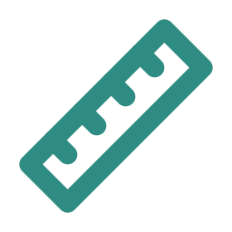


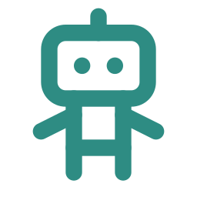
















My vision: autonomy across applications
From a smart platform to a thinking robot
LONG TERM
Zero programming, full autonomy
Safety rules never move
Cognitive autonomy
Physical AI: one single AI stack
5
4
Adaptive execution
SEE
UNDERSTAND
PREDICT
ADAPT
LEARN
Robot adjusts
to the surface
Reads the scene
Knows the goal, not just the path
Anticipates people
Re-plans instantly
Gets smarter with use
3
Automatic planning
Operator steps in, robot keeps working
2
MID TERM
Level 4 · Full robotics software platform
WE ARE HERE
Programmed
Orchestrator
coordinates
Design
Test
1
Manual
Vision
Motion
planner
Control
Virtual
cell
Improve
Deploy
Shared software stack: interfaces, data, tools
Robot cell
Every path tested
in the virtual cell
before the robot moves
Notes:
NEXT LEVELS: PLATFORM, THEN PHYSICAL AI (about 90 seconds) - builds on click
The full pyramid stays from the previous slide.
[CLICK 1 - Level 4, mid term] My mid-term goal is level 4, delivered as a full robotics software platform. Each software component - vision, the motion planner, control and the virtual cell - sits on one shared software stack: common interfaces, data and tools. On top, an orchestrator coordinates them all for the task, and the platform drives the real robot cell. Around it runs a continuous loop: design, test, deploy, improve. Testing matters most for the planner, because a new path could collide with the part, the fixture or the cell - so every path is checked in the virtual cell, in MIL and SIL, before the robot moves.
[CLICK 2 - Level 5, long term] My long-term goal is level 5, cognitive autonomy, enabled by Physical AI. Level 4 can already complete a task on its own. The difference shows when the cell is unpredictable. In the animation the robot is cleaning chips from freshly drilled holes, and an operator steps in to check the holes. A level 4 robot follows its safety rules: it stops and waits until the person leaves - look at the grey gap in the timeline, that is lost cycle time. At level 5, with Physical AI, the robot understands what the person is doing, predicts their movement and keeps working safely in another area - no gap. That is the value of Physical AI in manufacturing: in shared, dynamic situations, not everywhere.
The other difference is how it is built. At level 4, vision, planning, control and simulation are separate parts, each doing one job and talking to each other through the shared software stack. At level 5, one large AI model sees, understands, plans and moves the robot together - that is what lets it react to a person in real time.
MEDIA TIP: a short real clip (your RL POC, or a licensed stock clip of a person working next to a robot) can replace the photo for extra impact.

Slide 13



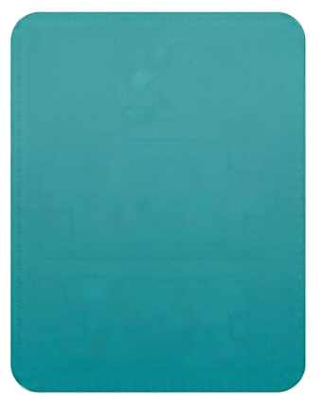


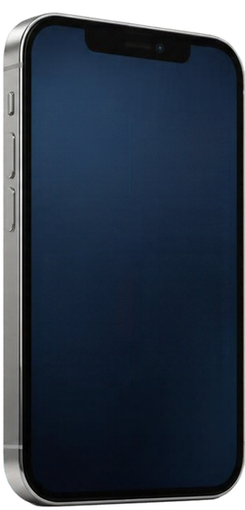
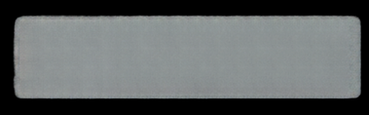












My vision: one foundation, many applications
Shared capabilities. Task-specific choices.
Inspection
Auto Rigging
Common
Motion Planning
Framework
Sealant
Pick & Place
Select toolpath, planner
and constraints per task
Sanding
Polishing
One phone.
Many apps.
Reuse proven
work
Integrate
faster
Share
improvements

Slide 14

My vision: autonomy across applications
Cognitive autonomy
SHORT TERM
One motion planning framework for every application
5
Robot handles on agreed
task
Inspection
4
Adaptive execution
Robot adjusts to the surface
Auto rigging
3
Automatic planning
Sealant
Programmed
Pick & place
2
WE ARE HERE
Common motion
planning framework
Task-specific planner, toolpath, constraints
Sanding
1
Manual
Polishing
Notes:
AUTONOMY ROADMAP: WHERE WE STAND (about 60 seconds) - builds on click
[Faded pyramid] Autonomy in robotics grows in five levels.
[CLICK 1 - Level 1] At the base, people guide the work by hand.
[CLICK 2 - Level 2 + 'We are here'] Level 2: robots repeat taught or offline-programmed paths. Most of our cells are here today.
[CLICK 3 - Level 3 + short term] My short-term goal is level 3: one common motion planning framework. The animation shows sealant on the edge of an aircraft frame: the robot scans the edge, the planner generates the path itself, and the robot applies the bead. Then a different frame comes in, and the same steps run again with no reprogramming. The same framework serves inspection, auto rigging, sealant, pick and place, sanding and polishing - built once, with a task-specific planner, toolpath and constraints.
[CLICK 4 - Level 4] Level 4, adaptive execution.
[CLICK 5 - Level 5] And level 5, cognitive autonomy, enabled by Physical AI. These are my mid- and long-term goals - next slide.

Slide 15
My vision: autonomy across applications
SHORT TERM
One motion planning framework for every application
5
Cognitive autonomy
4
Adaptive execution
3
Automatic planning
2
Programmed
WE ARE HERE
1
Manual
Notes:
AUTONOMY ROADMAP: WHERE WE STAND (about 60 seconds) - builds on click
[Faded pyramid] Autonomy in robotics grows in five levels.
[CLICK 1 - Level 1] At the base, people guide the work by hand.
[CLICK 2 - Level 2 + 'We are here'] Level 2: robots repeat taught or offline-programmed paths. Most of our cells are here today.
[CLICK 3 - Level 3 + short term] My short-term goal is level 3: one common motion planning framework. The animation shows sealant on the edge of an aircraft frame: the robot scans the edge, the planner generates the path itself, and the robot applies the bead. Then a different frame comes in, and the same steps run again with no reprogramming. The same framework serves inspection, auto rigging, sealant, pick and place, sanding and polishing - built once, with a task-specific planner, toolpath and constraints.
[CLICK 4 - Level 4] Level 4, adaptive execution.
[CLICK 5 - Level 5] And level 5, cognitive autonomy, enabled by Physical AI. These are my mid- and long-term goals - next slide.

Slide 16
My vision: autonomy across applications
Each level removes a pain point. One common framework brings levels 3 to 5 to every application.
THE PROGRESSION
MY VISION: ONE COMMON FRAMEWORK
MY FOCUS
Task autonomy
Inspection
5
Robot handles on agreed task
Common motion planning framework
Sealant
Adaptive execution
3 Automatic planning
4
Robot adjusts to the surface
Auto rigging
Automatic planning
4 Adaptive execution
Pick & place
3
Software prepares the route
5 Task autonomy
Sanding
Programmed automation
Configured per task: toolpath, planner and constraints
Polishing
2
Reprogram for every new variant
1
Manual control
Build once, reuse in every cell
New applications start from a proven base
Improvements shared by all
Slow and operator-dependent
✓
✓
✓
IMPACT
✓ Less reprogramming
✓ Faster new applications
✓ Consistent quality
✓ More capacity for process quality
Add autonomy where it brings value, within validated limits.
Notes:
MY VISION: AUTONOMY ACROSS APPLICATIONS (about 90 seconds)
(Left side = where we are; right side = where I want to take us. Spend more time on the right.)
[Left: progression, bottom to top] Autonomy grows in levels. At level 1, people guide every move, which is slow and operator-dependent. Level 2, programmed automation, is common in our cells today: precise and proven, but every new variant needs reprogramming. Level 3, automatic planning, generates the path, but the real part can differ from the model. Level 4, adaptive execution, corrects with sensors, but complex tasks still need people. And level 5, task autonomy, completes an agreed task, always within validated limits.
[Bracket and arrow] Levels 3 to 5 are my focus. And here is the key point of my vision: I don't want each application to build these levels on its own.
[Right: hub] Instead, they are delivered by ONE common motion planning framework. Automatic planning, adaptive execution and task autonomy are built once, and then configured per task: the toolpath, the planner and the constraints.
[Spokes] The same framework serves inspection, sealant, auto rigging, pick and place, sanding and polishing.
[Value row] So we build once and reuse in every cell, every new application starts from a proven base, and an improvement in one cell helps all of them.
[Impact strip] The impact: less reprogramming, faster new applications, consistent quality, and more engineering capacity for process quality.
[Closing line] And we add autonomy only where it brings value, within validated limits.

Slide 17
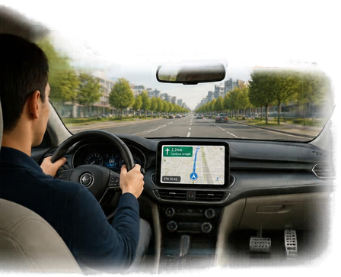
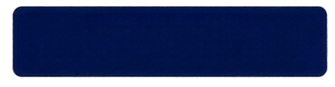






My vision: a complete robotics product
One connected platform. Configured for each application.
A car needs more
than navigation
Vision
See the panel
Motion planning
Choose movement
Control
Execute motion
Simulation
Test virtually
Software stack: connects components & shares data
Task orchestrator: coordinates the whole task
Product line: shared core • task-specific configuration
Applications
Inspection
Sealant
Design
Test
Deploy
Support &
improve
Together, these capabilities contribute a foundation for Physical AI

Slide 18

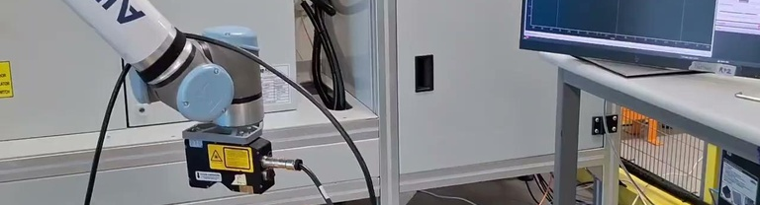
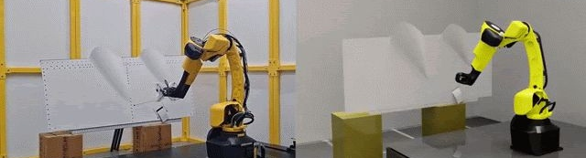
My vision: a complete robotics product
A navigation app alone cannot drive a car; motion planning alone cannot complete a task
LIKE IN A CAR
IN OUR ROBOT CELL
Sees the road
See the panel
Vision
Navigation finds the route
Plan the movement
Motion planning
Steers & brakes
Execute the task
Control
Driver coordinates
Coordinate the whole task
Task orchestrator
Observes & adjusts
Check & correct
Feedback
Driving simulator
Test virtually before the robot moves
Simulation
STANDARDISED SOFTWARE STACK
Simulate
Test
Deploy
Support & improve
Common interfaces • shared data • reusable components
Motion planning is one part. The value comes from the complete system: a foundation for Physical AI.
Notes:
MY VISION: A COMPLETE ROBOTICS PRODUCT (about 60 seconds)
[Subtitle] A navigation app alone cannot drive a car. In the same way, motion planning alone cannot complete a manufacturing task. (Keep the car comparison short: one sentence, then move to the robot cell.)
[Rows] A complete robot cell needs six capabilities working together:
- Vision sees the panel.
- Motion planning plans the movement. This is my focus.
- Control executes the task.
- A task orchestrator coordinates the whole task.
- Feedback checks and corrects during the task.
- Simulation lets us test virtually before the robot moves, so we validate faster and more safely.
[Navy bar] Underneath everything is a standardised software stack: one shared platform with common interfaces, shared data and reusable components. This is what lets us build a capability once and reuse it across applications. [Point to the arrows] And the same stack supports the whole lifecycle: we simulate, test, deploy, and then support and improve.
[Message] So motion planning is one part. The value comes from the complete system, and together these capabilities build a foundation for Physical AI.
IF ASKED "What is the task orchestrator?": The software layer that sequences the steps, connects vision, planning and control, monitors progress, and decides what to do when something changes.
IF ASKED "Why standardise the stack?": Without it, every application builds its own integration. With it, interfaces, data and components are reused, so new applications integrate faster and improvements are shared.

Slide 19
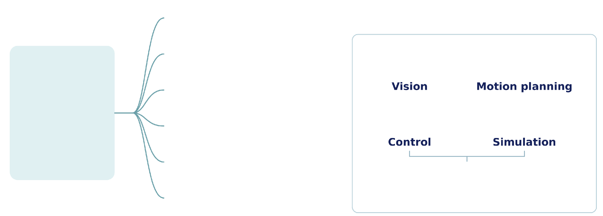
My vision: motion planning to a common stack
One reusable motion core. Multiple applications. One standardised product line.
Common standardised
robotics stack
Inspection
Auto rigging
Sealant
Common motion
planning framework
Pick & place
Task-specific
planner, toolpath
& constraints
Sanding
Software stack: connects & shares data
Task orchestrator: coordinates tasks
Polishing
Reuse proven work • Integrate faster • Share improvements
A shared robotics foundation contributing to Physical AI

Slide 20
My vision: from one framework to one platform
Start by sharing motion planning, then grow it into a standardised software stack for every application
STEP 1 Share motion planning
STEP 2 Share the whole software stack
Inspection
STANDARDISED SOFTWARE STACK
Inspection
Sealant
Vision
Motion planning
Control
Sealant
Motion planning framework
Auto rigging
Task orchestrator
Feedback
Simulation
Auto rigging
One planner, set up per task
Pick & place
Pick & place
grows
into
Sanding
Simulate
Test
Deploy
Support & improve
Sanding
Polishing
Common interfaces • shared data • reusable parts
Polishing
One shared planner serves every application
One standard platform serves every application
THE VALUE
✓
Reuse proven work
✓
Integrate faster
✓
Share improvements
Build once, configure per task: a foundation for Physical AI.
Notes:
MY VISION: FROM ONE FRAMEWORK TO ONE PLATFORM (about 75 seconds)
(Combines the old slides 14 and 15. Tell it as a journey: left box, arrow, right box.)
[Step 1, left] Step one is where I focus today: a common motion planning framework. Instead of every application building its own robot motion, one shared planner serves all of them: inspection, sealant, auto rigging, pick and place, sanding and polishing. Only the settings change per task.
[Arrow] But motion planning alone cannot complete a task. So the next step is to grow this idea.
[Step 2, right] Step two: we share not only motion planning, but the whole software stack. Vision, motion planning, control, a task orchestrator, feedback and simulation, all on one standardised platform with common interfaces, shared data and reusable parts. The same platform supports the full lifecycle: simulate, test, deploy, and support and improve. And it still serves the same applications.
[Value] The value: we reuse proven work, we integrate new applications faster, and an improvement in one cell helps every cell.
[Message] Build once, configure per task. That is a foundation for Physical AI.
SIMPLE VERSION FOR NON-TECHNICAL LISTENERS: "First we share the robot's 'route planner' across all our robot applications. Then we share the robot's whole 'brain and nervous system', so every new application starts from a proven base instead of from zero."
IF ASKED "Isn't every application too different?": The process is different, but the core problems are the same: seeing the part, planning collision-free motion, executing and correcting. That is what we share. The task-specific part is configuration.
IF ASKED "Why standardise the stack?": Without it, every application builds its own integration. With it, interfaces, data and components are reused, so new applications integrate faster and improvements are shared.

Slide 21
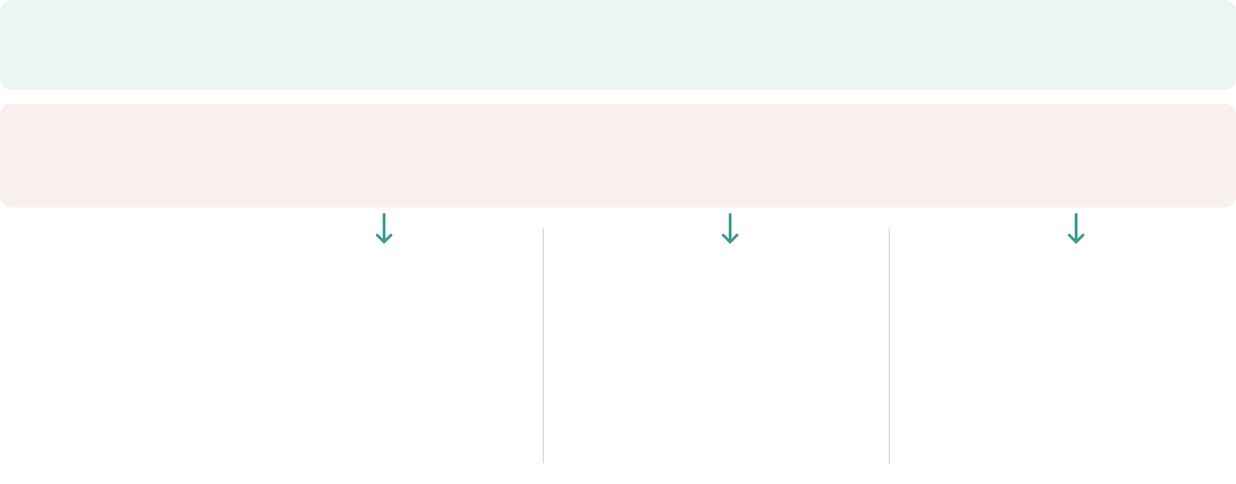
Vision & challenges
From application-specific effort to reusable, adaptive robotics
Business
challenges
New panels,
repeated programming
One-off solutions,
repeated integration
Complex tasks,
manual intervention
Technical
challenges
Different surfaces,
obstacles & motion limits
Reliable integration,
testing & lifecycle support
Limited task data &
reliable AI decisions
The direction
One motion foundation
Task-specific choices
One robotics platform
Reuse across its lifecycle
Physical AI where useful
Adaptive task decisions
Less preparation effort • reusable engineering • more adaptable manufacturing

Slide 22
Why autonomous motion matters
A new panel
Back to programming
With autonomous motion
Different shape or position
Adjust paths. Run trials. Repeat.
Plan and adapt to the surface
Repeat for every new panel
WHAT AUTONOMY CHANGES
Automatic motion planning
Adaptive execution
Task autonomy
Less programming
Fewer corrections
Less intervention
Target: lower preparation cost and more engineering capacity
Notes:
Suggested narration (about 50 seconds):
Imagine the next aircraft panel arrives for inspection. The inspection requirement is familiar, but its curvature or its position is different. In a workflow based on taught or offline paths, that change can send an engineer back to the program to adjust the motion and try it again on the cell. This is the repeated effort I want to reduce. Automatic motion planning prepares a route for the new geometry, checking reach and configured constraints. Adaptive execution adjusts that motion using measured changes. Task autonomy then completes the agreed inspection, with people handling exceptions. The return loop represents recurring preparation when a new panel geometry requires different robot motion. The intended value is less preparation and correction effort, more engineering capacity for process quality, and a system that can handle supported panel variants more readily.
Bridge from slide 12: The pyramid showed increasing autonomy. This slide explains why capabilities 3, 4 and 5 matter when a real panel changes.
Bridge to the next two vision slides: First, explain how the motion capability could become a common framework across applications. Then explain how it could work with perception, software and simulation in a common robotics platform towards Physical AI. These vision topics intentionally remain outside this slide.
Value framing: Benefits are expected, not measured Airbus savings. Compare the current and proposed workflows on matched panels and equivalent quality criteria. Measure engineering hours for motion preparation, correction hours, cell trial hours and interventions per completed job. Report net cost savings only after including integration, sensing, compute, commissioning, validation and maintenance costs. Do not assume that less programming means zero setup or zero validation.
Capability boundaries: Automatic planning uses a configured robot, tool, task, geometry and constraints. Adaptive execution requires suitable sensing and control. Task autonomy remains within a defined operating envelope and escalates exceptions. This slide does not claim operation on every panel or surface. Offline programming remains useful for stable, repeatable processes. Constraint checking does not replace physical validation or cell safety engineering.
Technical grounding: https://moveit.picknik.ai/main/doc/concepts/motion_planning.html (motion generation, constraints, collision checking and planning pipeline), reviewed 20 October 2026. These are general capability examples, not a claim that a particular software product is deployed at Airbus.
Visual disclosure: Images are AI-generated conceptual illustrations, not actual Airbus project photographs. They illustrate a new panel arriving, manual motion reprogramming and autonomous inspection. The reprogramming image is illustrative rather than a specific software interface. Built-in image_gen prompts: undefined

Slide 23
Where autonomous motion adds value
The more the part varies, the more autonomy helps
1 Part changes
variation, position, geometry
2 Adjust path
in offline programming
↻
4 Trial run
check on the cell
3 Download
program to the robot
Same part, every time
Repeated for every change
Many variants: plans and adapts automatically
PART VARIATION
Offline programming: precise, proven, optimised
Autonomous motion: plans and adapts per variant
Overlap: use both together
WHAT IT ADDS
1
Faster startup for new variants
2
Fewer trial runs on the cell
3
Robust to real-world change
Path generated from the part model and scan, not taught point by point
Reach, collisions and singularities checked before the robot moves
Path corrected to the measured part position during the task
Impact: more variants handled by the same team, and experts focus on process quality
Notes:
WHERE AUTONOMOUS MOTION ADDS VALUE (about 60 seconds)
[Point to the scale] This line shows how much the part varies: from the same part every time on the left, to many variants and changing positions on the right.
[Navy bar] On the left, offline programming is the best choice. It is precise, proven and optimised for cycle time.
[Loop in the middle] When the part changes, in its variation, position or geometry, the offline programming workflow follows four steps: we adjust the path, download the program to the robot, and run a trial on the cell. And this cycle is repeated for every change.
[Teal bar] So as variation grows, this cycle repeats more and more often. This is where autonomous motion adds value, because it plans and adapts the path for each variant. In the middle the two overlap, and we use them together.
[Value panel] Autonomous motion adds three things:
1. Faster start-up for new variants: the path is generated from the part model and the scan, instead of being taught point by point.
2. Fewer trial runs on the cell: reach, collisions and singularities are checked before the robot moves.
3. Robustness to real-world change: the path is corrected to the measured part position during the task.
[Impact] The result: the same team can handle more variants, and our experts can focus on process quality instead of repeated path preparation.
So the message is: choose the right level of autonomy for each task.
IF ASKED "Why not just use offline programming?": For stable, high-volume parts, I would. Autonomy makes sense where variation, uncertainty in part position, or the number of variants make repeated programming costly.
IF ASKED FOR NUMBERS: give a real example from your projects (e.g. preparation time for a new variant before vs after), or say measurement is part of the next validation step.

Slide 24
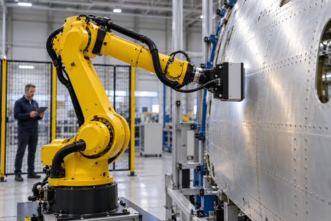
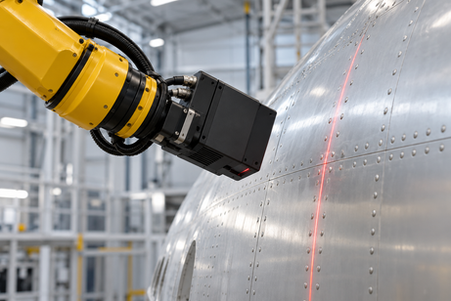
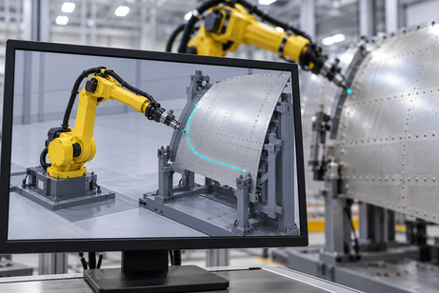
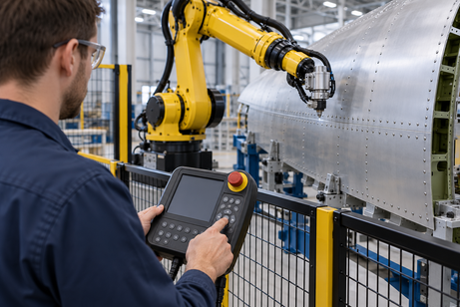
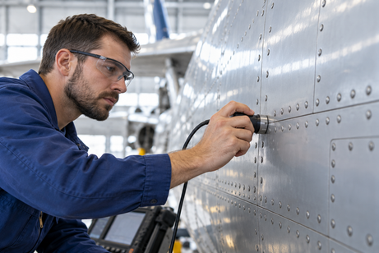
A progressive path to autonomy
From a person guiding each move to a robot handling a defined task
5
Task
autonomy
Adaptive
execution
Robot handles an agreed task
4
Less routine intervention
Robot adjusts to the surface
3
Automatic
planning
Less manual correction
Programmed
automation
2
Software prepares the route
Less programming effort
Robot repeats a taught routine
Manual
control
1
Repeatable known processes
People guide the inspection
Expert process knowledge
Increase autonomy where it adds value. Validate every step.
Notes:
Source: user-supplied reference image(20261020-101400).png for the 3D pyramid shape, and the previously supplied progressive-autonomy slide for content. The five layers distinguish manual control, programmed automation, automatic planning, adaptive execution and task autonomy. NC and offline programming are grouped into programmed automation. These are conceptual capabilities, not a formal autonomy standard. Human expertise, models and offline preparation remain useful. Task autonomy applies to selected tasks within agreed and validated limits. Benefits are intended value, not measured results. Pyramid dimensions are illustrative and do not quantify adoption, scale or intelligence. Suggested narration: Each layer adds a capability. We begin with human expertise and repeatable programs. Planning software reduces preparation effort. Feedback helps the robot adjust. The top is autonomy for selected tasks within validated limits.
Images are AI-generated conceptual illustrations, not photographs of Airbus projects or proof of achieved autonomy. Each scene illustrates the same aircraft-inspection setting. Manual: a person positions a probe. Programmed: a taught repeatable robot routine. Automatic planning: software prepares a route. Adaptive: a wrist-mounted scanner measures the surface to support adjustment. Task autonomy: the robot carries out an agreed inspection task under human supervision. Offline programming and NC remain examples of programmed automation. Intended value is illustrative, not a measured performance claim.
Image prompt set: [{"key":"manual","prompt":"Use case: photorealistic-natural. Asset type: one small landscape photograph-style conceptual illustration for a presentation about progressive manufacturing autonomy, not documentary evidence. Wide 3:2 composition, polished realistic industrial photography, cool neutral hangar, bright soft lighting, physically plausible hardware, uncluttered close framing for legibility at thumbnail size. Curved aluminium aircraft skin panel with rows of rivets. No logos, text, labels, decorative graphics, watermarks or sci-fi holograms. Show a human inspection technician, wearing blue work clothes and safety glasses, manually holding an ultrasonic inspection probe directly against the aircraft skin with their right hand and checking the surface. Hand, probe and surface are central and clear. A realistic human guides the entire operation. No robot."},{"key":"programmed","prompt":"Use case: photorealistic-natural. Asset type: one small landscape photograph-style conceptual illustration for a presentation about progressive manufacturing autonomy, not documentary evidence. Wide 3:2 composition, polished realistic industrial photography, cool neutral hangar, bright soft lighting, physically plausible hardware, uncluttered close framing for legibility at thumbnail size. Curved aluminium aircraft skin panel with rows of rivets. No logos, text, labels, decorative graphics, watermarks or sci-fi holograms. Show a technician using a physical industrial robot teach pendant at the outside of a robot cell. A yellow six-axis industrial arm stands stationary near an aircraft skin panel in the background. Prominent foreground hand pressing the pendant's directional controls communicates a person teaching a repeatable movement. Sensor mounted firmly and coaxially on the robot's final wrist flange; no detached floating tools. Safety barrier between person and robot, no text."},{"key":"planning","prompt":"Use case: photorealistic-natural. Asset type: one small landscape photograph-style conceptual illustration for a presentation about progressive manufacturing autonomy, not documentary evidence. Wide 3:2 composition, polished realistic industrial photography, cool neutral hangar, bright soft lighting, physically plausible hardware, uncluttered close framing for legibility at thumbnail size. Curved aluminium aircraft skin panel with rows of rivets. No logos, text, labels, decorative graphics, watermarks or sci-fi holograms. Show an engineer's monitor in a robotics workcell, angled almost front-on. Monitor clearly depicts a simple 3D simulation of a yellow six-axis robot beside a curved aircraft skin panel, with one cyan planned trajectory curving around a grey fixture to the panel. A yellow real robot and aircraft skin are softly out of focus behind it. The monitor is the central subject, screen has only diagram and no words or numbers. A conceptual route preview, not a specific software product."},{"key":"adaptive","prompt":"Use case: photorealistic-natural. Asset type: one small landscape photograph-style conceptual illustration for a presentation about progressive manufacturing autonomy, not documentary evidence. Wide 3:2 composition, polished realistic industrial photography, cool neutral hangar, bright soft lighting, physically plausible hardware, uncluttered close framing for legibility at thumbnail size. Curved aluminium aircraft skin panel with rows of rivets. No logos,...

Slide 25
Backup: REACT business case
How the ≈ €2.1M / year and 1.5-year payback are calculated (preliminary, A320 inspection)
1
Cost today
2
Automation saves
3
Path planning share
4
Payback
Inspection cost per aircraft:
20 + 10 + 60 = 90 k€
× 600 A320 per year
75% · 80% · 80% of the costs
= 71 k€ per aircraft
× 600 A320 per year
Conservative 5% of 71 k€
= €3,550 per aircraft
× 600 A320 per year
Project cost ≈ €3.16M (once)
÷ €2.13M saved per year
= years to pay back the cost
€54M
€42.6M
≈ €2.1M
≈ 1.5
per year
per year
per year, all 600 aircraft
years
Payback, year by year (like filling a bucket)
• After 1 year: €2.13M saved, cost not covered yet
• After 1.5 years: ≈ €3.2M saved = project cost paid back
• After 2 years: €4.26M saved, ≈ €1.1M extra
Why only 5%?
Path planning is one part of the inspection solution, next to cameras, defect detection and the robot. So only a small share of the savings is credited to it.
Preliminary business case. k€ = thousand euros. A320 inspection stream, 600 aircraft per year.
Notes:
BACKUP - REACT business case. Use only if asked how the numbers were calculated.
1. Inspection costs about 90 thousand euros per aircraft: 20 for surface inspection, 10 for non-quality, and 60 for six days of delivery delay. Times 600 A320s a year, that is about 54 million euros.
2. Automated inspection can save 75 to 80 percent of these costs: about 71 thousand euros per aircraft, or 42.6 million euros a year.
3. Path planning is only one part of the solution, so we credit it with a conservative 5 percent: about 2.1 million euros a year.
4. The project costs about 3.2 million euros in total, so it pays back in about one and a half years.
If asked: the 2.1 million is per year for all 600 aircraft, not per aircraft. Per aircraft, path planning saves about 3,550 euros. Payback: the project costs about 3.16 million once and saves about 2.13 million every year. After one year it is not yet covered; after one and a half years the savings equal the cost.

Slide 26
Backup: NDT inspection impact
Skilled workers freed and money saved by robotic NDT scanning (example estimate)
1
Manual NDT today
2
Robot saves 75%
3
Skilled workers
4
Money saved
Manual scanning per aircraft:
40 h (example)
× 600 A320 per year
Same saving rate as the
inspection business case
40 h × 75% = 30 h per aircraft
One inspector works
≈ 1,600 h per year
18,000 h ÷ 1,600 h
Inspector cost
€60 per hour (example)
18,000 h × €60
24,000 h
18,000 h
≈ 11
≈ €1.1M
per year
saved per year
certified inspectors freed
per year
Plus the cost of human variability
• Re-inspections when results do not agree
• False alarms and missed defects (non-quality)
• Example: 10% repeated scans = + 2,400 h per year
Why it matters
Certified NDT inspectors take years to train and are hard to hire. Freed time supports the A320 rate increase.
Example estimate: replace 40 h per aircraft and €60 per hour with plant data. 75% saving rate as in the inspection business case.
Notes:
BACKUP - NDT inspection impact (EXAMPLE ESTIMATE). Use only if asked.
1. As an example, manual NDT scanning takes about 40 hours per aircraft. Across 600 A320s a year, that is 24,000 hours.
2. Using the same 75% saving rate as the inspection business case, the robot saves 30 hours per aircraft, or 18,000 hours a year.
3. One inspector works about 1,600 hours a year, so that frees about 11 certified inspectors.
4. At an example cost of 60 euros an hour, that is about 1.1 million euros a year, before counting re-inspections caused by human variability.
Say clearly that these are example numbers to be confirmed with plant data.

Slide 27
Backup: how the NDT estimate works
A simple explanation of the example numbers
The idea in one line
Manual hours
per aircraft
× Robot saves
share of scanning
× Aircraft
per year
= Hours saved
per year
40 h
75%
600
18,000 h
Hours → skilled workers
Hours → money
18,000 h ÷ 1,600 h per inspector
≈ 11
18,000 h × €60 per hour
≈ €1.1M
certified inspectors freed
saved per year
What each number means
40 h = time to scan one aircraft by hand (example)
75% = share of scanning the robot takes over
1,600 h = working hours of one inspector per year
€60 = cost of one inspector hour (example)
In one sentence
“The robot scans, so certified inspectors spend their time on interpreting results. Across 600 aircraft, that frees about 11 inspectors a year.”
Example estimate: confirm 40 h per aircraft and €60 per hour with plant data. Like a solar panel: cost today × share saved = yearly saving.
Notes:
BACKUP - simple explanation of the NDT estimate.
Start with the time: as an example, scanning one aircraft by hand takes about 40 hours. The robot takes over about 75% of that scanning, the same saving rate as in the inspection business case. Across 600 A320s a year, that saves about 18,000 hours.
Then turn hours into people: one inspector works about 1,600 hours a year, so 18,000 hours is the time of about 11 certified inspectors.
Then turn hours into money: at an example cost of 60 euros an hour, that is about 1.1 million euros a year.
These are example numbers; the real hours and cost per hour come from the plant.

Slide 28
Backup: NDT calculation step by step
How “11 inspectors freed, €1.1M / year” is calculated (example estimate)
Manual NDT today
40 h per aircraft × 600 aircraft
24,000 h
Which numbers are real?
1
per year
600 A320 per year
Business case
Robot saves 75%
40 h × 75% = 30 h per aircraft × 600
18,000 h
75% saving
Business case
2
saved per year
1,600 h per inspector
Rule of thumb
40 h per aircraft
Example
People freed
18,000 h ÷ 1,600 h per inspector per year
≈ 11
3
€60 per hour
Example
inspectors freed
Money saved
18,000 h × €60 per hour
≈ €1.1M
If the plant says 20 h per aircraft
everything halves: ≈ 5–6 inspectors and ≈ €0.5M per year
4
per year
40 h × 75% × 600 = 18,000 h saved per year → ÷ 1,600 h ≈ 11 inspectors → × €60 ≈ €1.1M per year
Freed time, not job loss: inspectors move to interpreting results and handling higher rates.
Example estimate. Confirm manual NDT hours per aircraft with the plant and the inspector hourly cost with finance.
Notes:
BACKUP - NDT calculation step by step (EXAMPLE ESTIMATE).
1. As an example, scanning one aircraft by hand takes 40 hours. Times 600 A320s, that is 24,000 hours a year.
2. The robot takes over 75% of the scanning, the same rate as the REACT business case: 30 hours per aircraft, 18,000 hours a year.
3. One inspector works about 1,600 hours a year, so 18,000 hours is about 11 inspectors' worth of time. That is freed time, not job loss.
4. At an example 60 euros an hour, that is about 1.1 million euros a year.
Real numbers: 600 aircraft and 75% come from the business case. Examples to confirm: 40 hours per aircraft and 60 euros per hour. If the plant says 20 hours, everything halves.

Slide 29
Backup: Scan & Plan impact
Robot programming avoided across 100+ panel designs (example estimate)
Panel designs
Today each design needs its own robot program
100+
Which numbers are real?
1
panel designs
100+ panel designs
Use case
Programming avoided
100 designs × 40 h per design
4,000 h
< 95-min cycle time
Requirement
2
avoided
1,600 h per person
Rule of thumb
40 h per design
Example
Programmers freed
4,000 h ÷ 1,600 h per programmer per year
≈ 2.5
3
€70 per hour
Example
programmers' work
Money saved
4,000 h × €70 per hour
≈ €0.3M
Not a one-off saving
Every new design or design change would need reprogramming again. Scan & Plan avoids it every time.
4
for the full set of designs
100 designs × 40 h = 4,000 h → ÷ 1,600 h ≈ 2.5 programmers → × €70 ≈ €0.3M
Plus: no dependence on scarce robot programmers, fewer quality escapes, no kneeling or overhead work.
Example estimate. Confirm programming hours per panel design with the team and the hourly cost with finance.
Notes:
BACKUP - Scan & Plan impact (EXAMPLE ESTIMATE).
1. There are more than 100 panel designs, so pre-programming the robot is not possible: today each design would need its own program.
2. As an example, programming one design takes about 40 hours, offline programming plus trials. For 100 designs, that is 4,000 hours avoided.
3. One programmer works about 1,600 hours a year, so that is about two and a half programmers' work - and skilled robot programmers are scarce.
4. At an example 70 euros an hour, that is about 0.3 million euros for the full set of designs. It is not one-off: every new design or change would need reprogramming again.
Real numbers: 100+ designs and the 95-minute cycle come from the use case. Examples to confirm: 40 hours per design and 70 euros per hour.

Slide 30
Backup: SAMU sealant impact
Operator time freed by automating sealant on frame edges (example estimate)
Manual sealing today
30 h of frame sealing per aircraft × 600 aircraft
18,000 h
Which numbers are real?
1
per year
1,600 h per person
Rule of thumb
Robot takes over 70%
30 h × 70% = 21 h per aircraft × 600
12,600 h
600 aircraft per year
Check programme
2
saved per year
30 h per aircraft
Example
70% automated
Example
Operators freed
12,600 h ÷ 1,600 h per operator per year
≈ 8
3
€50 per hour
Example
operators' time freed
Money saved
12,600 h × €50 per hour
≈ €0.6M
Why edges are the gap
Offline programming works on flat surfaces. On frame edges the real position varies by a few mm, so sealing is still done by hand.
4
per year
30 h × 70% × 600 = 12,600 h → ÷ 1,600 h ≈ 8 operators → × €50 ≈ €0.6M per year
Plus: same bead every time, less sealant waste and rework, less hand contact with sealant chemicals.
Example estimate. Confirm manual sealing hours, % automated, aircraft per year and hourly cost with the plant and finance.
Notes:
BACKUP - SAMU sealant impact (EXAMPLE ESTIMATE).
Today, offline programming works for flat surfaces, but on frame edges the real position varies by a few millimetres, so sealant on frames is still applied by hand.
1. As an example, frame sealing takes about 30 hours per aircraft. Across 600 aircraft, that is 18,000 hours a year.
2. If the robot takes over 70% of it, that saves 21 hours per aircraft, or 12,600 hours a year.
3. One operator works about 1,600 hours a year, so that is about 8 operators' time freed.
4. At an example 50 euros an hour, that is about 0.6 million euros a year, plus better bead quality, less waste and less exposure to sealant chemicals.
All inputs except 1,600 hours are examples: confirm them with the plant.

