Slide 1
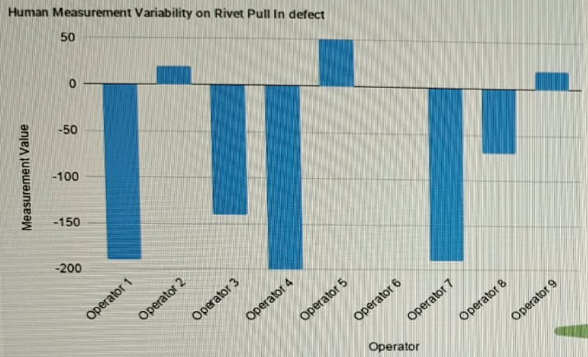
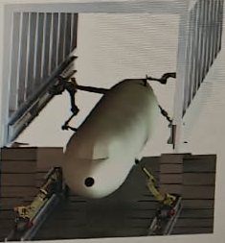
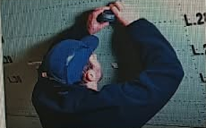
Inspection challenges and the automation opportunity
CHALLENGES
OPPORTUNITY
Manual effort
Difficult access
Variable measurements
Repeatable
automated
inspection
Missed-defect risk, long lead time and low traceability add to the challenge
01
Notes:
The business case comes from the three supplied programme slides. The as-is diagnosis reports large differences between operators measuring identical components, an unreliable basis for comparing measurements and physical access constraints. The storyline identifies inspection capacity bottlenecks, missed defects, late detection and associated liability uncertainty, and the need for flexible standardized automation for aerospace. The technology gap slide adds poor ergonomics, low traceability, high reporting effort and long lead time. The source chart is a crop of the provided human-measurement comparison. Its Onyx comparison is explicitly an expected target, not evidence of achieved NDT-planner accuracy. No numerical performance claim is derived from the chart. Opportunity: a repeatable, traceable automated inspection process, using reusable technology building blocks. Sources: as_is_diagnosation(1).jpeg, Primer_skin_anomaly_storyline(1).jpeg and technology gap(1).jpeg.

Slide 2
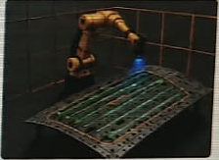
High-level architecture used for NDT planning
INPUTS
AUTOMATIC PLANNING
VALIDATION
Defect poses
and scan regions
GTSP
Defect sequencing
Scan settings
Area, shape, swath width
Coverage generator
Local scan pattern
Robot + panel models
Motion constraints
HPP
Robot motion generation
ROBOGUIDE
Program verification
Demo input: generated defects
Next: physical NDT trials
02
Notes:
This slide describes the architecture of the supplied demonstrator at a high level. Defect poses and regions of interest are the planned interface from vision. The illustrated demonstration uses generated defect poses. GTSP sequences the visits. The configurable coverage generator defines each local swath using the requested area, shape and width. HPP generates robot motion using robot and panel/environment models and motion constraints. FANUC ROBOGUIDE verifies the robot program and simulated execution. The diagram summarizes the workflow rather than specifying internal software message interfaces. Physical robot and sensor execution remains the next validation step based on the supplied evidence. Sources: Prompt.jpeg and Solution_technology.jpeg.

Slide 3
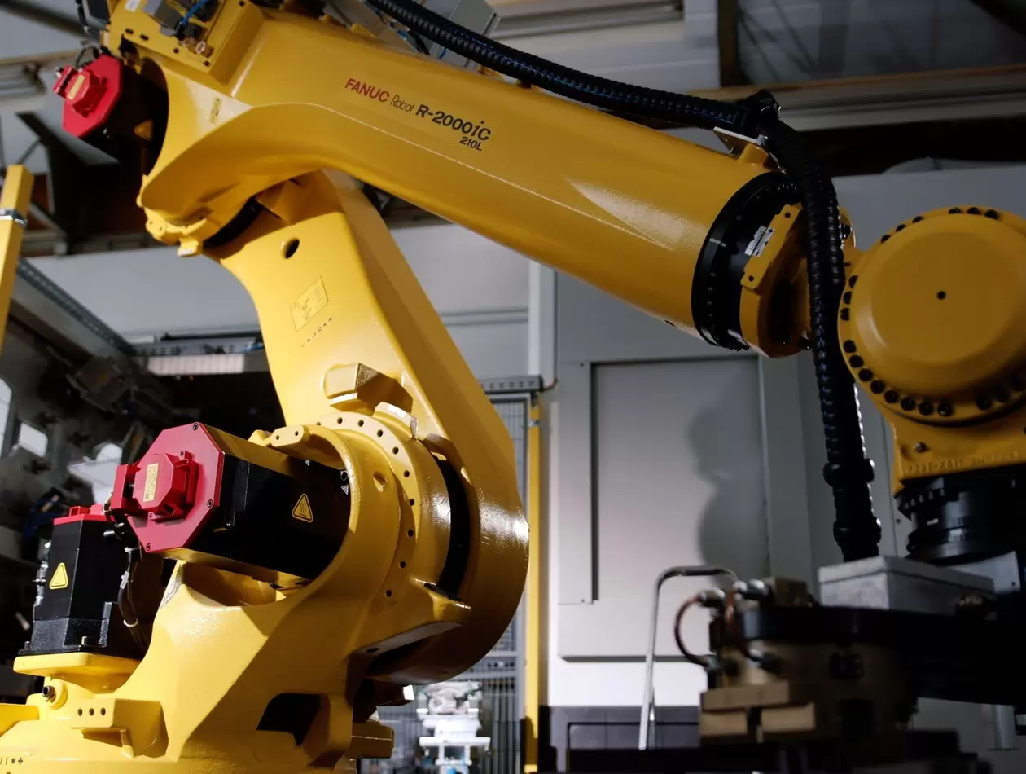
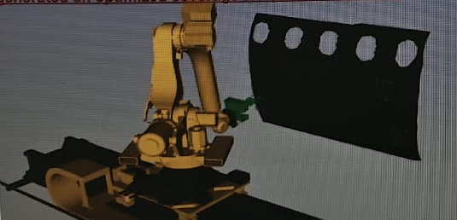
Our approach: automatic NDT scan planning
FANUC R-2000iC/210L
Targeted NDT scan planning
Project simulation
Manufacturer robot reference photo
01 Sequence visits
02 Cover each region
03 Generate motion
04 Verify the program
GTSP
Configurable swath
HPP
03
ROBOGUIDE
Notes:
The robot used for this NDT project is a FANUC R-2000iC, confirmed by the user. The retained project context specifies the R-2000iC/210L. The left image is a genuine FANUC manufacturer reference photograph with the R-2000iC/210L model marking visible. It comes from a different industrial application and is not a photograph of this NDT installation. The right image is the user-supplied project simulation. GTSP sequences the defect visits, configurable swaths define local coverage, HPP generates robot motion, and ROBOGUIDE verifies simulated program execution. This slide illustrates the selected robot and the planning approach without claiming a completed physical NDT deployment. Sources: user confirmation; Solution_technology.jpeg; https://www.fanuc.eu/eu-en/product/robot/r-2000ic210l ; https://www.fanuc.eu/eu-en/case-studies/automating-machining-large-ring-shaped-bearings-robots . Manufacturer image: https://d16ohktstcjvly.cloudfront.net/image/513891251684/image_rdvjd6lkml2116unol0347k57e/-T4%3A3-FWEBP .

Slide 4
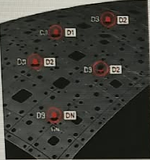
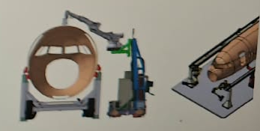

Customer impact
EXPECTED BENEFITS OF NDT PATH PLANNING
Less programming
Less travel & scanning
Reusable planning
Faster preparation
Only flagged regions
New panels and setups
Wider targets: repeatability, full traceability and better ergonomics
04
Notes:
There are two levels of value. The NDT planning contribution is automatic robot motion, optimized visiting sequence and configurable targeted coverage. Expected benefits are less programming, reduced transit and unnecessary scanning, and reuse across panel and robot setups after integration. The wider inspection programme targets objective repeatable measurements, fewer defect escapes, full traceability of outer-skin anomalies, automated MES/UNC connectivity, improved ergonomics and reduced inspection lead time. These system outcomes require qualified sensing, inspection methods, data integration and deployment, and cannot be claimed as outcomes of the planner alone. The programme targets full-fuselage automated inspection over time, using flexible standardized building blocks and internally understood integration. Its technology gaps include machine vision, NDT, motion and lock-in systems, architecture/connectivity, and implementation/change management. No measured savings or defect-reduction rate is provided. The three supplied images illustrate robotic inspection setups and defect regions. They are conceptual context, not measured proof of these benefits. Visual sources: technology gap(1).jpeg and Solution_technology.jpeg. Sources: Primer_skin_anomaly_storyline(1).jpeg, technology gap(1).jpeg, as_is_diagnosation(1).jpeg, Prompt.jpeg and Solution_technology.jpeg.

Slide 5
Simulation demonstrator and customer pilot
MATURITY
Simulation
demonstrator
NEXT STEP
Real-panel pilot
Coverage check
Time comparison
Project simulation still. Video can replace this image.
Limits: localization accuracy, robot reach and sensor setup
05
Notes:
Show the project recording here when available. Suggested narration: generated defect regions enter the planner, a visiting order and local coverage are produced, and the robot follows the planned inspection path in simulation. Current evidence supports a simulation demonstrator with generated defect poses. It does not establish a formal TRL, physical NDT qualification or production acceptance. Proposed customer pilot: use a representative panel and real defect list, validate robot/sensor execution and NDT coverage, then compare preparation time and total cycle time with the current approach. Close by inviting a representative panel and defect set for a pilot. No video was supplied. Image: Solution_technology.jpeg.

