Slide 1
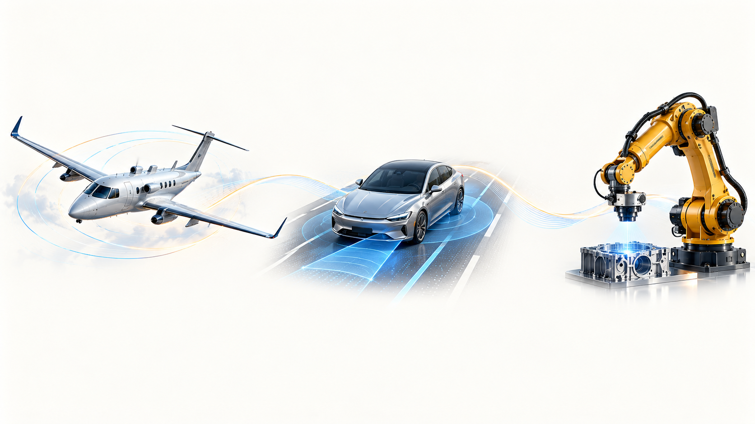
Autonomy in motion
From flight controls to intelligent manufacturing
Rasitha R.
Technical Specialist Interview / Motion Planning & Execution
01
Notes:
My career follows a sustained interest in autonomous systems. I began in flight dynamics and control at DRDO ADE, working on autopilot, then moved to ADAS and industrial robotics. Today my focus is motion planning and execution for aircraft manufacturing.
Basis: user-provided career correction, 9 October 2026: flight dynamics and control at DRDO ADE, autopilot work, then ADAS, then robotics. Project and roadmap scope follows the current Airbus motion generation roadmap read in this conversation. Images are conceptual illustrations, not photos of the presenter or actual project evidence. Reference slides informed visual storytelling only; no layouts, personal claims or career details were copied.

Slide 2
My experience and the direction I propose
01
My foundation
02
My Airbus work
DRDO ADE, autopilot and ADAS
A continuing passion for autonomy
Industrial inspection and scan planning
Lessons from planning to execution
03
My influence
04
My direction
Application teams, RXU and research partners
Technical choices supported by evidence
Reusable motion capability for manufacturing
A staged roadmap with validation gates
The question throughout: how can our experience become a reusable capability?
02
Notes:
I will connect my background to the challenges of industrial robotics, then explain the specialist contribution I propose. The presentation covers personal motivation, Airbus applications, technical judgement, influence, vision and delivery strategy.
Basis: user-provided career correction, 9 October 2026: flight dynamics and control at DRDO ADE, autopilot work, then ADAS, then robotics. Project and roadmap scope follows the current Airbus motion generation roadmap read in this conversation. Images are conceptual illustrations, not photos of the presenter or actual project evidence. Reference slides informed visual storytelling only; no layouts, personal claims or career details were copied.

Slide 3
Different platforms. A connected career journey.
DRDO ADE / Autopilot
ADAS: driver assistance
Airbus: industrial robotics
Help an aircraft maintain
its intended flight.
Help a car respond to
the road around it.
Move a robot tool accurately
across an aircraft part.
My foundation: flight dynamics
and feedback control.
My next domain: assisted
and automated driving.
My focus: manufacturing motion,
from planning to execution.
One continuing interest: helping machines move reliably in the physical world.
03
Notes:
My career began in flight dynamics and control at DRDO ADE, where I worked on autopilot. I then moved into ADAS, meaning advanced driver-assistance systems, and later industrial robotics at Airbus. The common theme is how a system moves as intended and responds to feedback. Flight controls provide a foundation in dynamics and feedback. ADAS provides experience in the road-vehicle domain. Industrial robotics applies the wider systems perspective to precise manufacturing motion. The statements below explain each domain in everyday language. They do not claim that I personally developed every ADAS planning or control function. My exact ADAS responsibilities should be described using a confirmed project example in the interview.
Basis: user-provided career correction, 9 October 2026: flight dynamics and control at DRDO ADE, autopilot work, then ADAS, then robotics. Project and roadmap scope follows the current Airbus motion generation roadmap read in this conversation. Images are conceptual illustrations, not photos of the presenter or actual project evidence. Reference slides informed visual storytelling only; no layouts, personal claims or career details were copied.

Slide 4
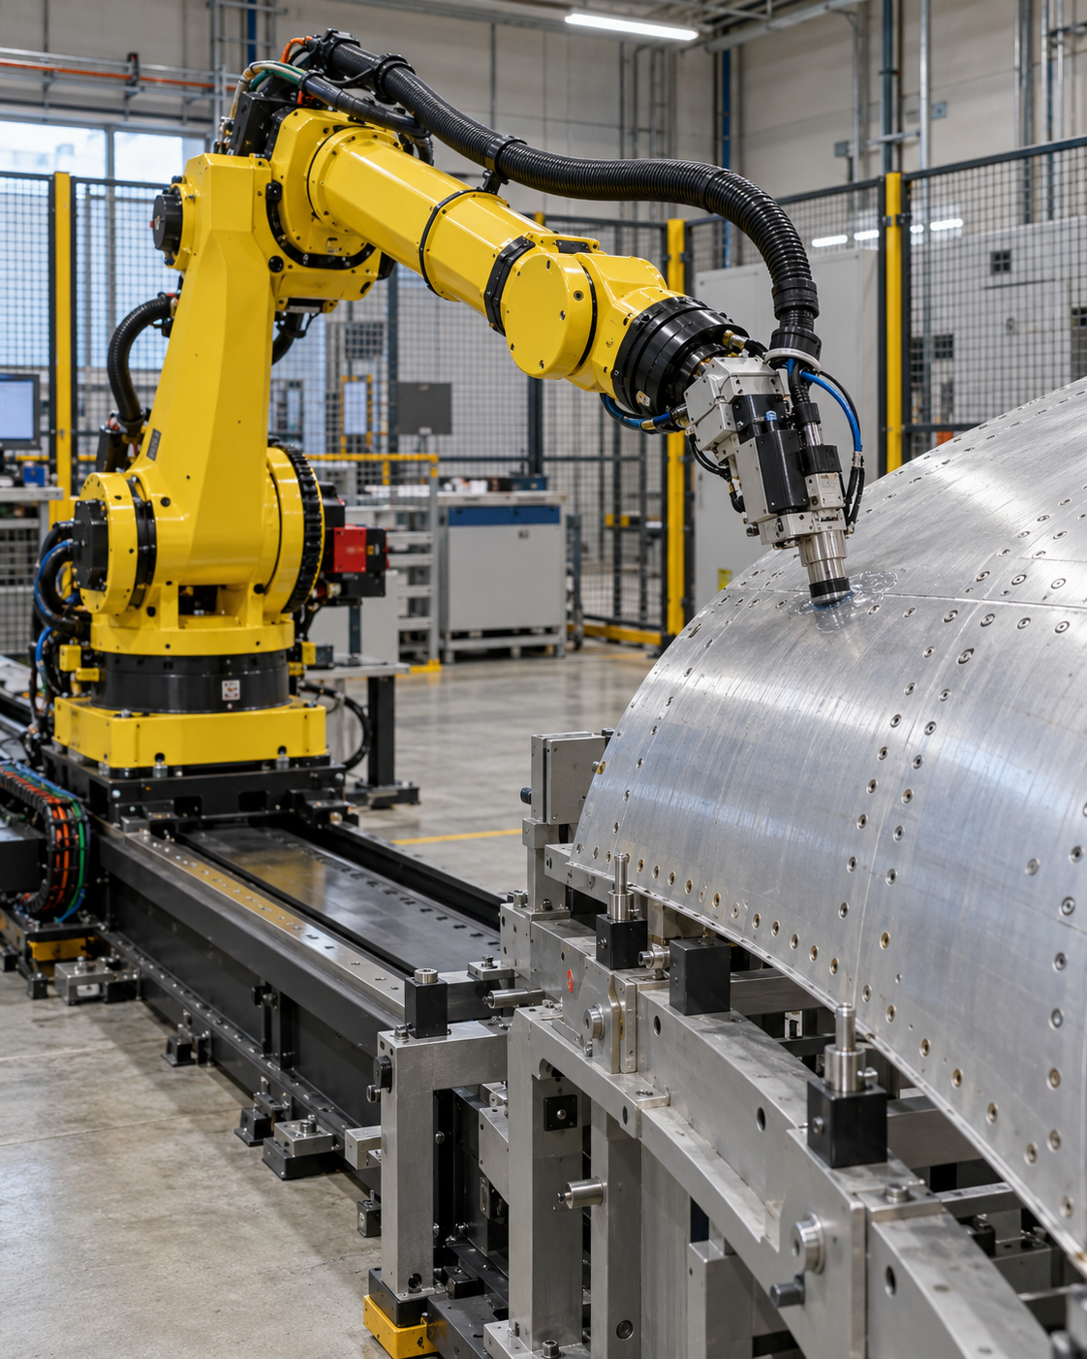
Planning chooses the path. Control follows it.
1
Understand
A car
Where am I, and what is around me?
Follow the road
with suitable steering
and speed.
2
Plan
Where should I move, within my limits?
3
Control
A robot
Make the machine follow that motion.
Follow the panel
with precise tool
position and motion.
4
Use feedback
Measure the result and correct or replan.
What I bring forward: understanding the whole system, from a motion goal to execution.
04
Notes:
For someone unfamiliar with motion planning, I explain it as deciding how to move from the current situation to a goal while respecting the surroundings and the machine's limits. Control then commands the machine to follow the chosen motion, using measurements to correct errors. For a car, an illustrative example is following a suitable path through a lane while maintaining clearance and feasible steering and speed. For an inspection robot, the path keeps a probe at the required position and orientation over a panel while respecting robot limits and avoiding collisions. The engineering questions transfer across domains, but the detailed algorithms and process requirements differ. These are explanatory examples, not claims that I personally implemented a particular ADAS function.
Basis: user-provided career correction, 9 October 2026: flight dynamics and control at DRDO ADE, autopilot work, then ADAS, then robotics. Project and roadmap scope follows the current Airbus motion generation roadmap read in this conversation. Images are conceptual illustrations, not photos of the presenter or actual project evidence. Reference slides informed visual storytelling only; no layouts, personal claims or career details were copied.

Slide 5

Beyond engineering
Dancing & acting
Fitness enthusiast
Travel, trekking & hiking
Creativity and expression
An active lifestyle
Exploring new places and the outdoors
05
Notes:
Outside engineering, my personal interests include dancing, acting, fitness, travel, trekking and hiking. These are personal interests supplied by me, without claims of awards, professional performance or athletic achievements. The image is an illustrative still life, not a photograph of my belongings.
Basis: user-provided career correction, 9 October 2026: flight dynamics and control at DRDO ADE, autopilot work, then ADAS, then robotics. Project and roadmap scope follows the current Airbus motion generation roadmap read in this conversation. Images are conceptual illustrations, not photos of the presenter or actual project evidence. Reference slides informed visual storytelling only; no layouts, personal claims or career details were copied.

Slide 6
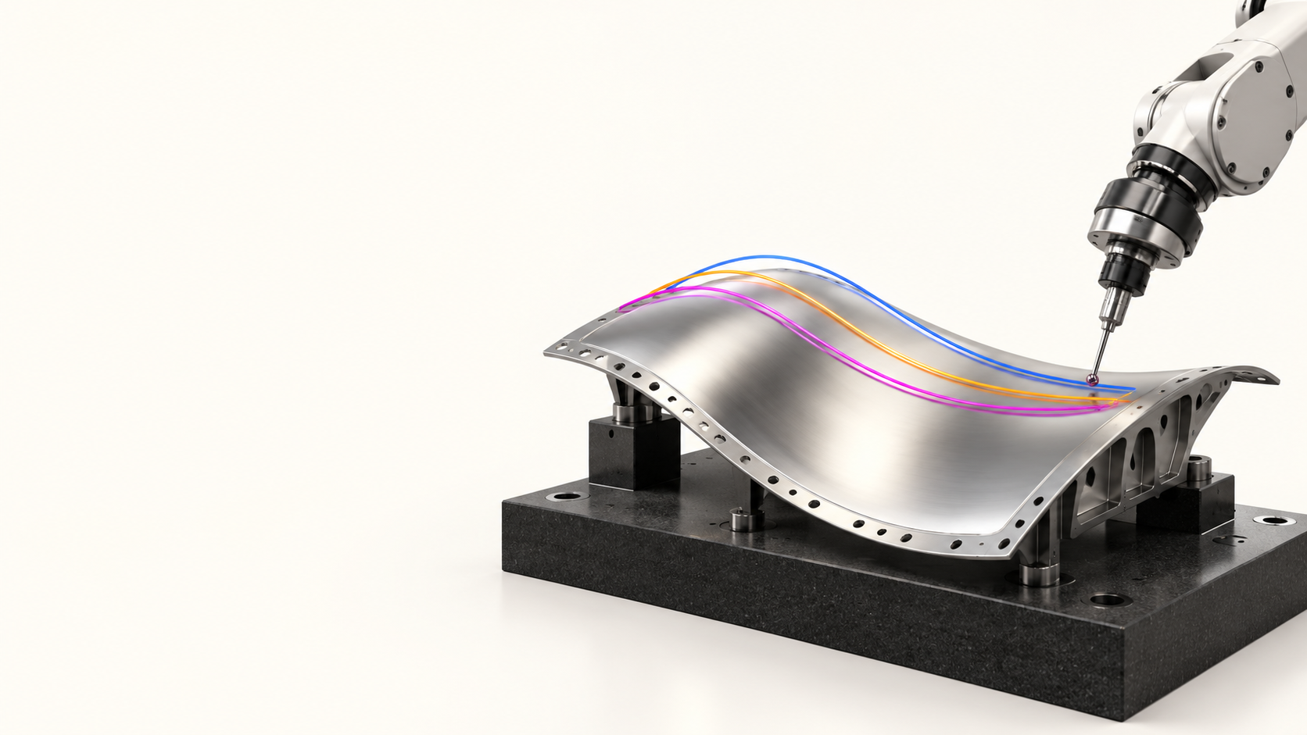
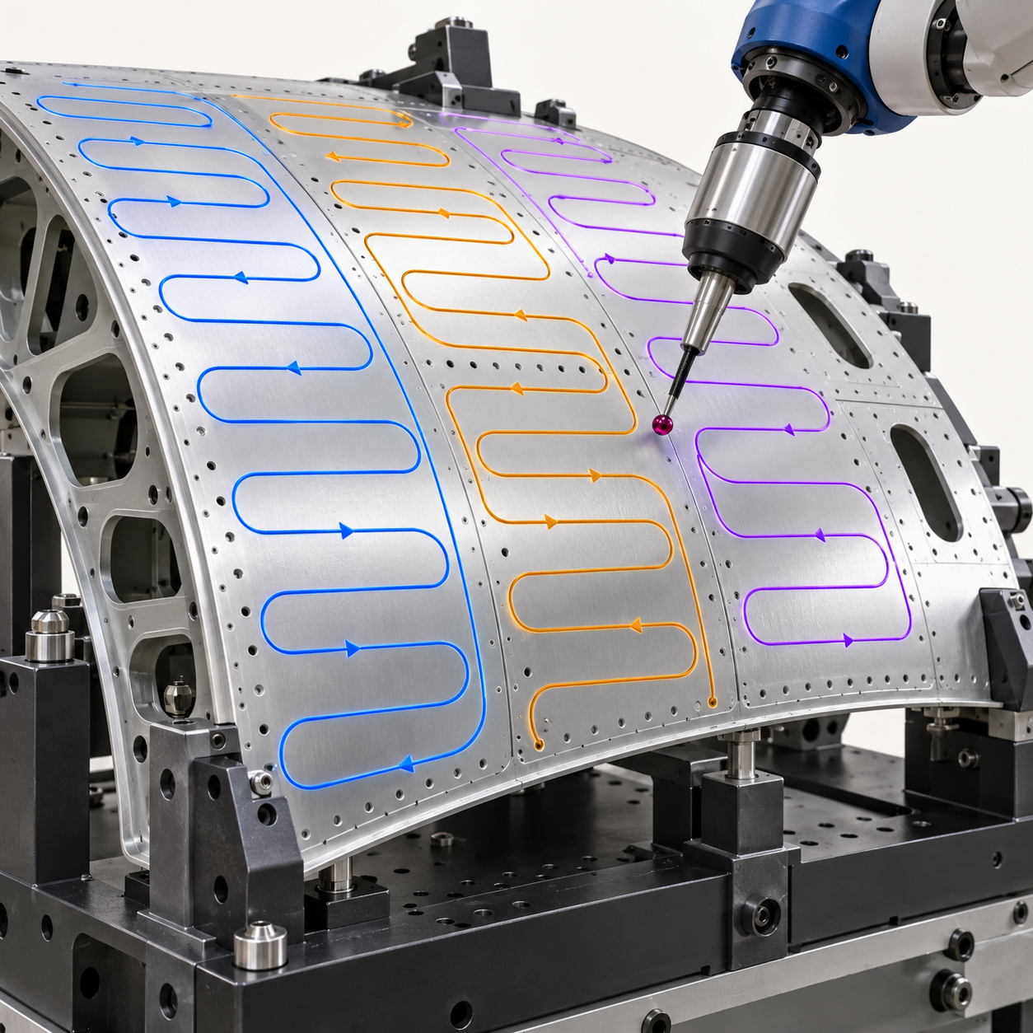
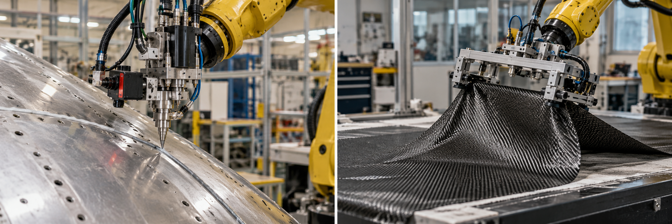
My Airbus journey in motion
Capability progression across my industrial robotics work
REACT
Primer-skin NDT
Intelligent scan plan
Next horizon
Constrained planning
and task supervision
Automatic inspection motion
and process constraints
Defect sequencing
and targeted rescanning
Reusable, adaptive motion
for manufacturing
EXPERIENCE
PROPOSED DIRECTION
06
Notes:
This is a progression of capabilities, not a dated project chronology. REACT, Primer-skin NDT and Intelligent scan plan are confirmed areas of work. Next horizon is a proposed direction, shown with a dashed connection. Images are illustrative. No completion dates or maturity levels are implied.
Basis: user-provided career correction, 9 October 2026: flight dynamics and control at DRDO ADE, autopilot work, then ADAS, then robotics. Project and roadmap scope follows the current Airbus motion generation roadmap read in this conversation. Images are conceptual illustrations, not photos of the presenter or actual project evidence. Reference slides informed visual storytelling only; no layouts, personal claims or career details were copied.

Slide 7
Technical judgement starts with the application
Process requirements
Coverage, stand-off, orientation and collision constraints.
Execution quality
TCP continuity, timing and controller behaviour.
Integration effort
Supported interfaces, failure reporting and reuse.
HPP / MoveIt2 / Tesseract
My proposal: select by evidence, reuse supported capabilities, close proven gaps.
07
Notes:
My benchmarking discussions compare planning approaches using application requirements. No single framework should be treated as universally best. The roadmap proposes reusing existing capabilities, building adapters and developing algorithms only for confirmed gaps. The visual is conceptual. No performance scores are claimed here.
Basis: user-provided career correction, 9 October 2026: flight dynamics and control at DRDO ADE, autopilot work, then ADAS, then robotics. Project and roadmap scope follows the current Airbus motion generation roadmap read in this conversation. Images are conceptual illustrations, not photos of the presenter or actual project evidence. Reference slides informed visual storytelling only; no layouts, personal claims or career details were copied.

Slide 8
Innovation and knowledge I contribute
PATENTS
IDDs
WHITE PAPER
[Patent title]
[IDD title]
Published white paper
[My contribution]
[Filed / published / granted status]
[My contribution]
[Submitted / accepted status]
[Paper title and publication date]
[My contribution / co-authors]
[Add one sentence on the technical idea and its value to Airbus for each contribution.]
08
Notes:
The user requested inclusion of patents, IDDs and a published white paper. “Parent” has been interpreted as “patent” pending confirmation. Titles, counts, inventorship/authorship and patent/IDD status have not been supplied. The bracketed fields are explicit placeholders and must be completed before presenting. Do not describe a patent as granted without confirmation.
Basis: user-provided career correction, 9 October 2026: flight dynamics and control at DRDO ADE, autopilot work, then ADAS, then robotics. Project and roadmap scope follows the current Airbus motion generation roadmap read in this conversation. Images are conceptual illustrations, not photos of the presenter or actual project evidence. Reference slides informed visual storytelling only; no layouts, personal claims or career details were copied.

Slide 9
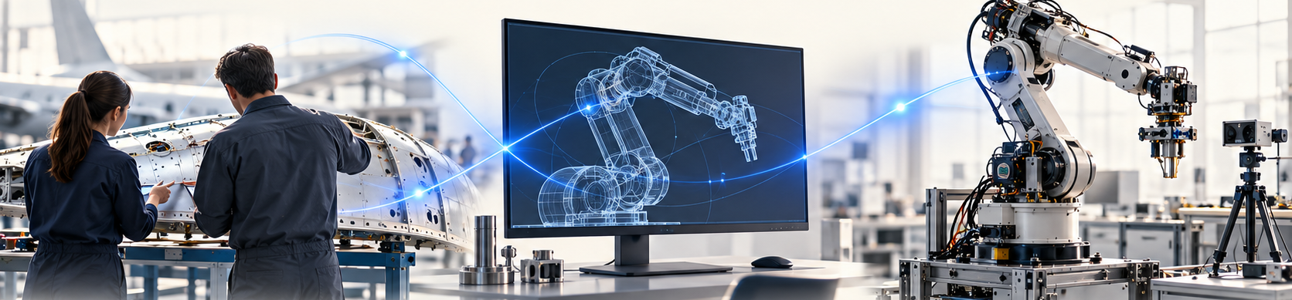
My network connects needs, research and delivery
Application teams
Integration teams
Research partners
Manufacturing and inspection needs
Coverage, accuracy and process constraints
RXU, control and connectivity
Data contracts and execution feedback
LAAS and IRT Jules Verne
Planning methods and motion generation
How I influence: clarify requirements, compare approaches and share decisions.
09
Notes:
I work at the intersection of application requirements, integration and research approaches. LAAS and IRT Jules Verne are relevant external connections. The IRT collaboration concerns generating motion with their planning approach, not jointly developing a common framework. The lower row describes the way I want to make technical exchanges useful: common requirements, comparable evidence and clear decisions.
Basis: user-provided career correction, 9 October 2026: flight dynamics and control at DRDO ADE, autopilot work, then ADAS, then robotics. Project and roadmap scope follows the current Airbus motion generation roadmap read in this conversation. Images are conceptual illustrations, not photos of the presenter or actual project evidence. Reference slides informed visual storytelling only; no layouts, personal claims or career details were copied.

Slide 10
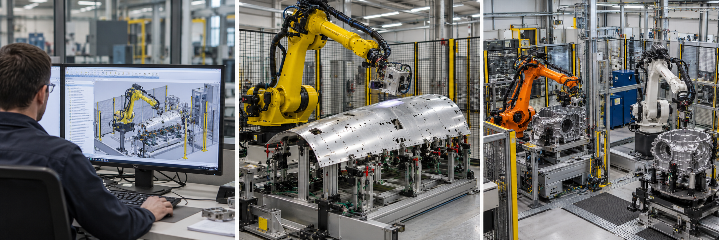
What manufacturing needs from robot motion
Illustrative AI-generated scenes
Less programming
Reliable execution
Reuse across robots
Configurable paths for new panels and process regions.
Continuous motion that respects process and robot limits.
Common interfaces with validated backend adapters.
Measure: preparation time and manual effort
Measure: TCP error, coverage and interruptions
Measure: integration effort for the next application
Manufacturing value, measured against agreed application targets.
10
Notes:
These are proposed priorities drawn from the applications discussed, not an official company-wide strategy. Numerical targets should be agreed with application owners after a baseline. The paired measures keep the specialist vision accountable to manufacturing value.
Basis: user-provided career correction, 9 October 2026: flight dynamics and control at DRDO ADE, autopilot work, then ADAS, then robotics. Project and roadmap scope follows the current Airbus motion generation roadmap read in this conversation. Images are conceptual illustrations, not photos of the presenter or actual project evidence. Reference slides informed visual storytelling only; no layouts, personal claims or career details were copied.

Slide 11
How planning automation can evolve
Build on offline-programming expertise as manufacturing needs evolve
Task-level autonomy
4
Selected tasks, bounded goals
Adaptive execution
3 Adaptive
Feedback, correction and recovery
Automatic planning
2 Automatic planning
Process inputs become robot motion
Offline foundation
1 Offline programming
Prepared paths for known processes
Choose the level that delivers value for the application. Validate every step.
11
Notes:
The pyramid is a proposed capability progression, not a maturity score or a claim that the highest level is needed everywhere. Offline programming is a valuable foundation for predictable tasks and prepared cells. As part variants and process variability grow, automation can reduce repeated preparation and support adaptation. Automatic planning still requires verification. Adaptive execution adds feedback and recovery within validated limits. Task-level autonomy is a longer-term option for selected applications and may combine conventional planning with learning. Appropriate autonomy, application validation and cell safety remain essential at each level.
Basis: user-provided career correction, 9 October 2026: flight dynamics and control at DRDO ADE, autopilot work, then ADAS, then robotics. Project and roadmap scope follows the current Airbus motion generation roadmap read in this conversation. Images are conceptual illustrations, not photos of the presenter or actual project evidence. Reference slides informed visual storytelling only; no layouts, personal claims or career details were copied.

Slide 12
Why autonomy, and why a specialist?
Manufacturing opportunity
New parts and process variation create opportunities
to reuse preparation work and adapt validated motion.
My contribution today
Experience across REACT, inspection and scan planning,
combined with knowledge beyond the planning component.
My specialist contribution
Guide method selection, component interfaces and
validation across a shared robotics product line.
Value to demonstrate
Less preparation effort, reusable software and reliable
process execution, measured against agreed baselines.
From application experience to a capability that future projects can reuse.
12
Notes:
The current project foundation includes offline programming. It offers planned, repeatable operation for known parts and cells. The opportunity is to extend that investment as new parts, robots and process variations increase preparation and integration needs. My specialist role would connect manufacturing requirements to the appropriate planning, control and software approach. I bring motion-planning depth and experience across other robotics components. My work on REACT, inspection motion and scan sequencing provides relevant foundations, without implying that every team outcome is solely mine. Future value should be demonstrated against baseline measures rather than claimed in advance.
Basis: user-provided career correction, 9 October 2026: flight dynamics and control at DRDO ADE, autopilot work, then ADAS, then robotics. Project and roadmap scope follows the current Airbus motion generation roadmap read in this conversation. Images are conceptual illustrations, not photos of the presenter or actual project evidence. Reference slides informed visual storytelling only; no layouts, personal claims or career details were copied.

Slide 13
My vision: a robotics product line
Shared software core, configured for inspection, dispensing and future applications
Perception
Motion planning
Control & execution
Sensors, localization and scene data
Toolpaths, feasible motion and optimization
Tracking, feedback and correction
Connectivity
Task supervision
Application & HMI
Robot, sensor and equipment interfaces
Workflow, recovery and coordination
Process configuration and operator interaction
COMMON PLATFORM / RXU INTEGRATION
PRODUCT LIFECYCLE
Requirements
Architecture
Verification
Deployment
Operation
Manufacturing needs
Interfaces & data
Simulation & trials
Release & commissioning
Monitor, maintain, retire
Product-line approach: reuse core components, configure variants, validate each application.
13
Notes:
My vision is product-oriented industrial robotics: a complete capability integrated with a common software platform and supported across its end-to-end lifecycle. Motion planning is my specialist focus, but its value depends on other components working together. I also have experience beyond planning and bring that wider perspective to interfaces, integration and product decisions. The component groups here describe the proposed product scope, not a claim that I personally delivered every component. The exact examples of my broader component experience should be added when supplied. RXU is the integration context discussed in the roadmap. Product lifecycle includes manufacturing requirements, architecture, verification, deployment, operation, maintenance and controlled updates. The cell safety system remains independently engineered; software integration is not a substitute for safety validation.
Basis: user-provided career correction, 9 October 2026: flight dynamics and control at DRDO ADE, autopilot work, then ADAS, then robotics. Project and roadmap scope follows the current Airbus motion generation roadmap read in this conversation. Images are conceptual illustrations, not photos of the presenter or actual project evidence. Reference slides informed visual storytelling only; no layouts, personal claims or career details were copied.

Slide 14
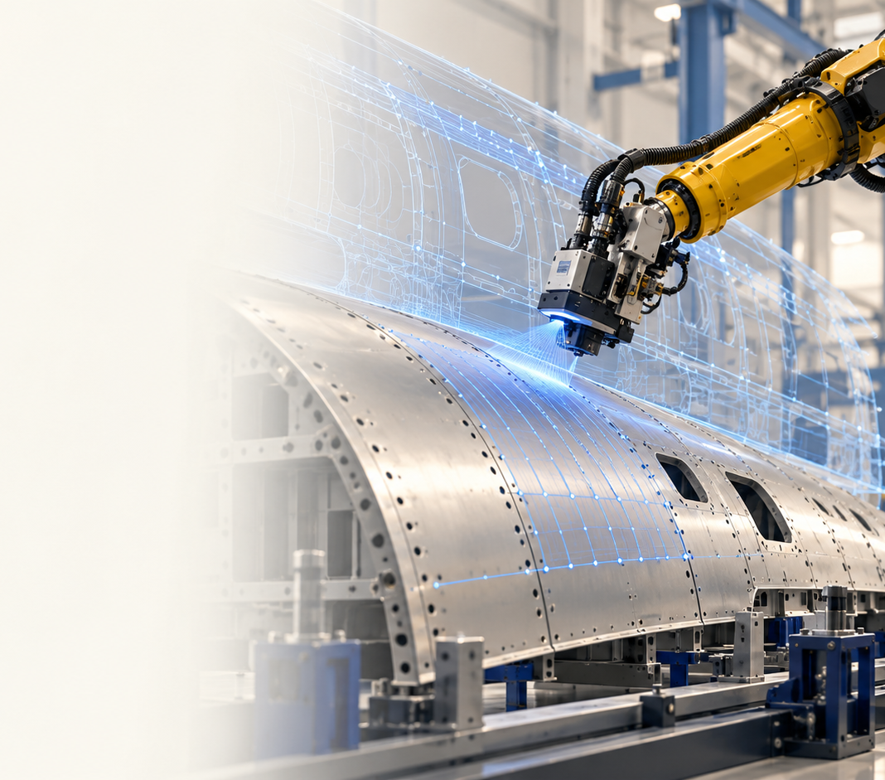
Motion capability within the robotics product
01
Describe the task
Robot, part, tool, region and process constraints
02
Generate motion
Configurable toolpaths and suitable planner backends
03
Validate and execute
Path checks, simulation and robot/controller handoff
04
Adapt when needed
Measured state, bounded corrections and replanning
RXU integration
Control / connectivity
Task supervision
A common application contract, with the planning method chosen for the task.
14
Notes:
The proposed capability starts with a process task and data, produces a toolpath, generates feasible robot motion, validates and executes it, then uses feedback where adaptation is required. The underlying framework can vary by supported capability. RXU integration, control, connectivity and task supervision support the pipeline. This is the architecture I propose to help build, not a claim of an already complete platform. A product line shares maintained components and interfaces while configuring robot, process and application variants. Each variant retains its own acceptance criteria and validation.
Basis: user-provided career correction, 9 October 2026: flight dynamics and control at DRDO ADE, autopilot work, then ADAS, then robotics. Project and roadmap scope follows the current Airbus motion generation roadmap read in this conversation. Images are conceptual illustrations, not photos of the presenter or actual project evidence. Reference slides informed visual storytelling only; no layouts, personal claims or career details were copied.

Slide 15
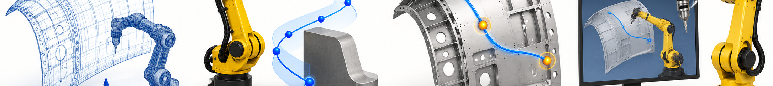
2027: integrate existing capabilities step by step
Q1
Q2
Q3
Q4
Data and toolpaths
Planning and checks
Optimization
Simulation to robot
1 Robot, part and scene adapters
2 Configurable toolpath interface
3 HPP / MoveIt2 / Tesseract adapters
4 Common path and process checks
5 Task / defect sequencing
6 Smoothing, blending and timing
7 Simulator / controller adapters
8 Execution and state feedback
Gate: toolpath through
a common API
Gate: validated
planner output
Gate: optimized motion
revalidated
Gate: robot trials
and process evidence
Throughout: platform integration, regression tests, release gates and lifecycle ownership.
Proposed timing, subject to resources and robot access.
15
Notes:
The sequence follows the latest stepwise framework integration roadmap. These are integration acceptance checkpoints, not eight new algorithms. Start with a thin end-to-end application, then extend capabilities in the numbered order. Integration testing should begin early. Dates depend on resources, capability inventory and robot access.
Basis: user-provided career correction, 9 October 2026: flight dynamics and control at DRDO ADE, autopilot work, then ADAS, then robotics. Project and roadmap scope follows the current Airbus motion generation roadmap read in this conversation. Images are conceptual illustrations, not photos of the presenter or actual project evidence. Reference slides informed visual storytelling only; no layouts, personal claims or career details were copied.

Slide 16
Beyond the baseline: adaptation and learning
Illustrative AI-generated scenes
2028 / Adaptive motion
2029+ / Uncertain manipulation
Scene-driven replanning
Local path correction
Process-aware recovery
Deformable materials and varied objects
Evaluate imitation learning, VLA and RL
Compare with conventional baselines
Evidence before expansion
Preparation starts in 2027
TCP error and task completion
Recovery behaviour and intervention rate
Latency under representative conditions
Select bounded manufacturing tasks
Collect demonstrations and failure cases
Define baseline tests and acceptance criteria
Expand capability only when the application evidence supports it.
16
Notes:
The latest roadmap places dynamic adaptation in 2028 and learning under uncertainty in 2029 and beyond, with data preparation starting in 2027. Evaluate learned policies only for selected tasks where they justify their added complexity. Compare against conventional baselines. These are proposed R&T directions, subject to funding, data and resources.
Basis: user-provided career correction, 9 October 2026: flight dynamics and control at DRDO ADE, autopilot work, then ADAS, then robotics. Project and roadmap scope follows the current Airbus motion generation roadmap read in this conversation. Images are conceptual illustrations, not photos of the presenter or actual project evidence. Reference slides informed visual storytelling only; no layouts, personal claims or career details were copied.

Slide 17
The specialist responsibility I want to take
Product direction
Connect planning with the complete robotics system
on a common software platform.
Lifecycle quality
Define evidence from requirements through validation,
deployment, maintenance and controlled updates.
Breadth and depth
Bring motion-planning expertise and wider component
experience to cross-team integration decisions.
FIRST STEPS
Product requirements / Component interfaces / Lifecycle measures and gates
17
Notes:
The role I propose is to guide technical direction and make it reviewable through evidence, reusable interfaces and shared engineering practices. My first steps would be a capability inventory, agreement on a reference application and baseline measures, then an integration contract with validation gates. These are commitments I propose, not claims of achievements already completed.
Basis: user-provided career correction, 9 October 2026: flight dynamics and control at DRDO ADE, autopilot work, then ADAS, then robotics. Project and roadmap scope follows the current Airbus motion generation roadmap read in this conversation. Images are conceptual illustrations, not photos of the presenter or actual project evidence. Reference slides informed visual storytelling only; no layouts, personal claims or career details were copied.

