Slide 1
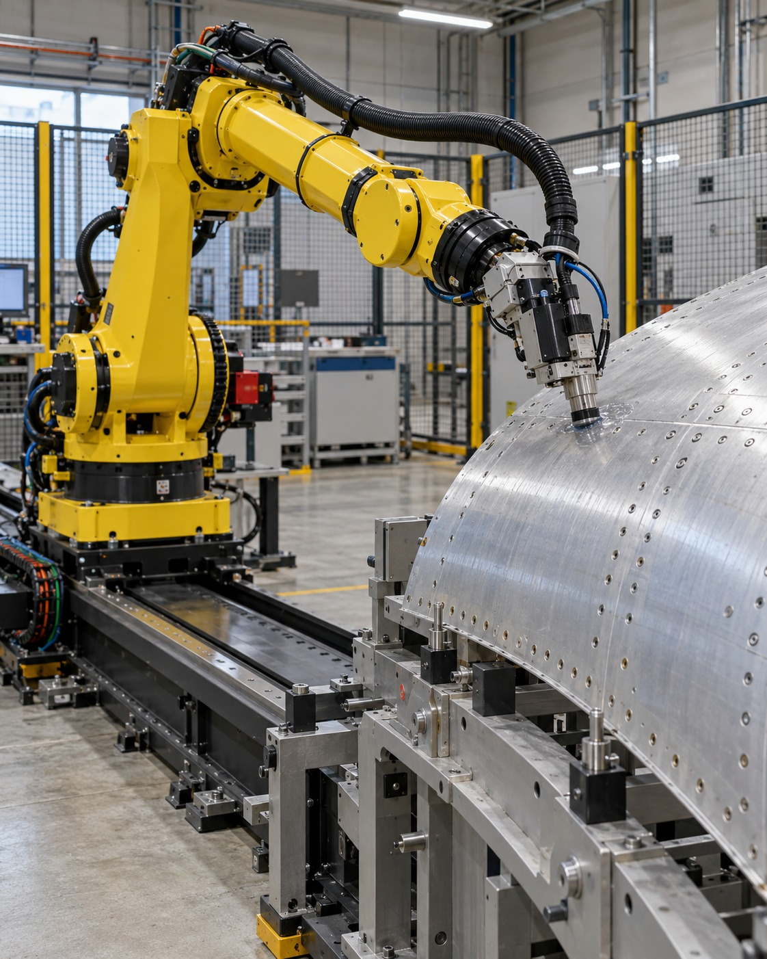
Autonomy
in Motion
Motion planning and execution
for aircraft manufacturing
Rasitha R.
Technical Specialist Interview
01
Notes:
My career follows a sustained interest in autonomous systems: flight dynamics and autopilot at DRDO ADE, then ADAS, then industrial robotics. My focus today is motion planning and execution for aircraft manufacturing. The cover image is an AI-generated conceptual illustration, not a photo of my robot or evidence of a delivered project.
Basis: user-provided career correction, 9 October 2026: flight dynamics and control at DRDO ADE, autopilot work, then ADAS, then robotics. Project and roadmap scope follows the current Airbus motion generation roadmap read in this conversation. Images are conceptual illustrations, not photos of the presenter or actual project evidence. Reference slides informed visual storytelling only; no layouts, personal claims or career details were copied.

Slide 2
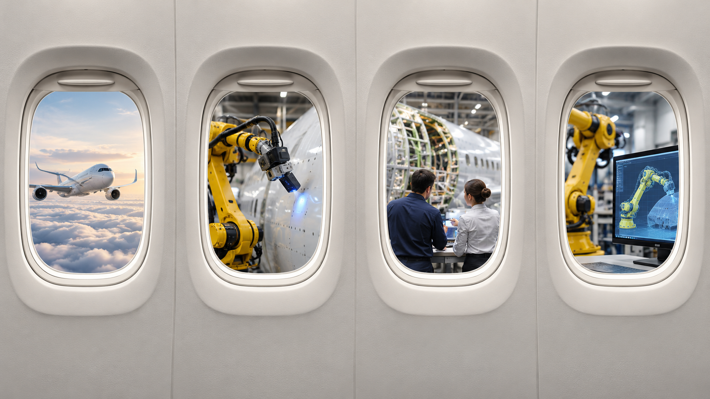
A view of my journey and the future
01
02
03
04
My background
My Airbus work
My influence
Vision & roadmap
02
Notes:
The four aircraft windows introduce the four chapters: my background in flight dynamics, autopilot and ADAS; my industrial robotics work at Airbus; how I influence through collaboration; and my vision with a staged delivery roadmap. This is a visual agenda, not a dated career timeline. All scenes are illustrative.
Basis: user-provided career correction, 9 October 2026: flight dynamics and control at DRDO ADE, autopilot work, then ADAS, then robotics. Project and roadmap scope follows the current Airbus motion generation roadmap read in this conversation. Images are conceptual illustrations, not photos of the presenter or actual project evidence. Reference slides informed visual storytelling only; no layouts, personal claims or career details were copied.

Slide 3
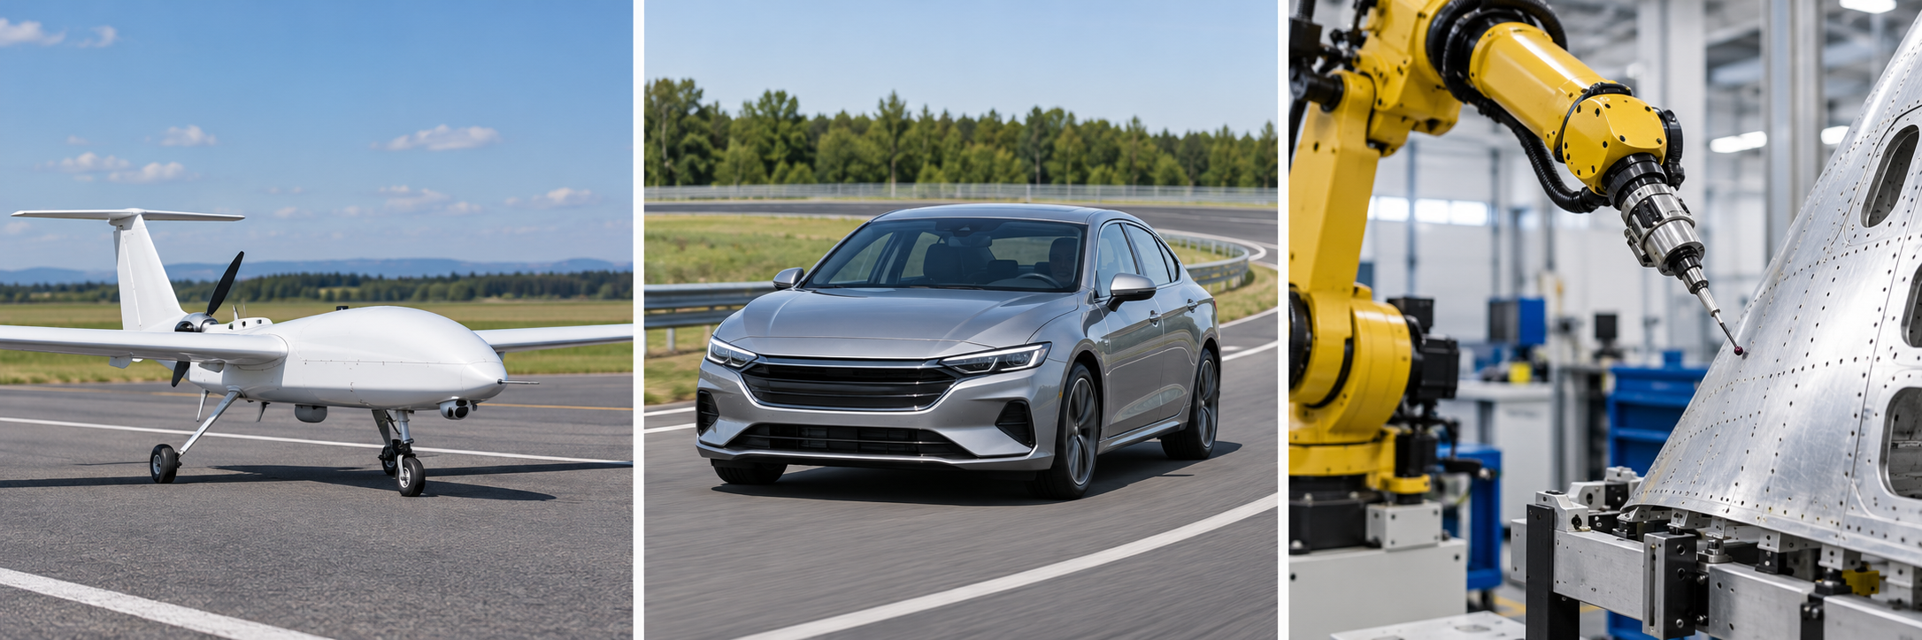
My journey into autonomous systems
Bachelor’s
Guest lecturer
Master’s
DRDO ADE
Danlaw
Airbus
[Mon] 2011
2 years
[Dates]
1 year
5.5 years
[Mon] 2022
Degree completed
Teaching
Postgraduate study
Flight dynamics
& autopilot
ADAS
Industrial robotics
A continuing passion for autonomous systems.
03
Notes:
The user confirmed a continuous career sequence: Bachelor's completed in 2011, two years as a guest lecturer, Master's, one year at DRDO ADE in flight dynamics/control and autopilot, 5.5 years at Danlaw in ADAS, then Airbus from 2022. Exact months, Master's dates and degree specialisations have not been supplied. Do not infer missing dates from rounded durations. [Mon] and [Dates] are explicit editable placeholders. The timeline shows sequence, not elapsed time to scale. The images are conceptual, not actual project photographs.
Basis: user-provided career correction, 9 October 2026: flight dynamics and control at DRDO ADE, autopilot work, then ADAS, then robotics. Project and roadmap scope follows the current Airbus motion generation roadmap read in this conversation. Images are conceptual illustrations, not photos of the presenter or actual project evidence. Reference slides informed visual storytelling only; no layouts, personal claims or career details were copied.

Slide 4
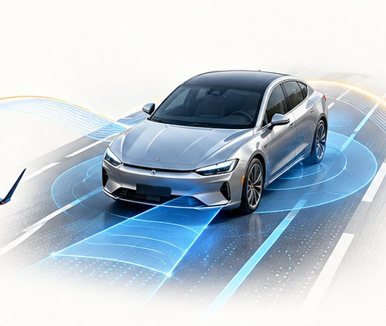
Planning chooses the path. Control follows it.
1
Understand
A car
Where am I, and what is around me?
Follow the road
with suitable steering
and speed.
2
Plan
Where should I move, within my limits?
3
Control
A robot
Make the machine follow that motion.
Follow the panel
with precise tool
position and motion.
4
Use feedback
Measure the result and correct or replan.
What I bring forward: understanding the whole system, from a motion goal to execution.
04
Notes:
For someone unfamiliar with motion planning, I explain it as deciding how to move from the current situation to a goal while respecting the surroundings and the machine's limits. Control then commands the machine to follow the chosen motion, using measurements to correct errors. For a car, an illustrative example is following a suitable path through a lane while maintaining clearance and feasible steering and speed. For an inspection robot, the path keeps a probe at the required position and orientation over a panel while respecting robot limits and avoiding collisions. The engineering questions transfer across domains, but the detailed algorithms and process requirements differ. These are explanatory examples, not claims that I personally implemented a particular ADAS function.
Basis: user-provided career correction, 9 October 2026: flight dynamics and control at DRDO ADE, autopilot work, then ADAS, then robotics. Project and roadmap scope follows the current Airbus motion generation roadmap read in this conversation. Images are conceptual illustrations, not photos of the presenter or actual project evidence. Reference slides informed visual storytelling only; no layouts, personal claims or career details were copied.

Slide 5

Beyond engineering
Dancing & acting
Fitness enthusiast
Travel, trekking & hiking
Creativity and expression
An active lifestyle
Exploring new places and the outdoors
05
Notes:
Outside engineering, my personal interests include dancing, acting, fitness, travel, trekking and hiking. These are personal interests supplied by me, without claims of awards, professional performance or athletic achievements. The image is an illustrative still life, not a photograph of my belongings.
Basis: user-provided career correction, 9 October 2026: flight dynamics and control at DRDO ADE, autopilot work, then ADAS, then robotics. Project and roadmap scope follows the current Airbus motion generation roadmap read in this conversation. Images are conceptual illustrations, not photos of the presenter or actual project evidence. Reference slides informed visual storytelling only; no layouts, personal claims or career details were copied.

Slide 6
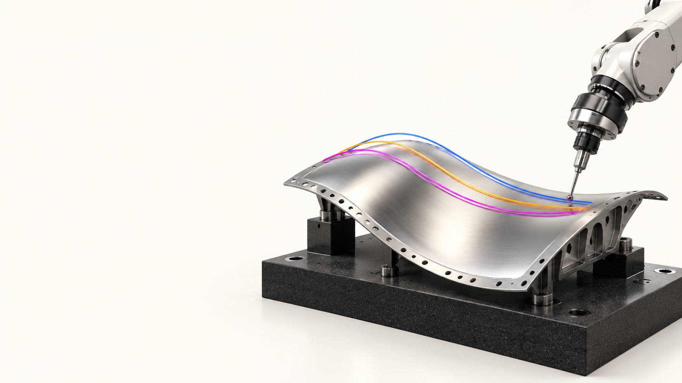
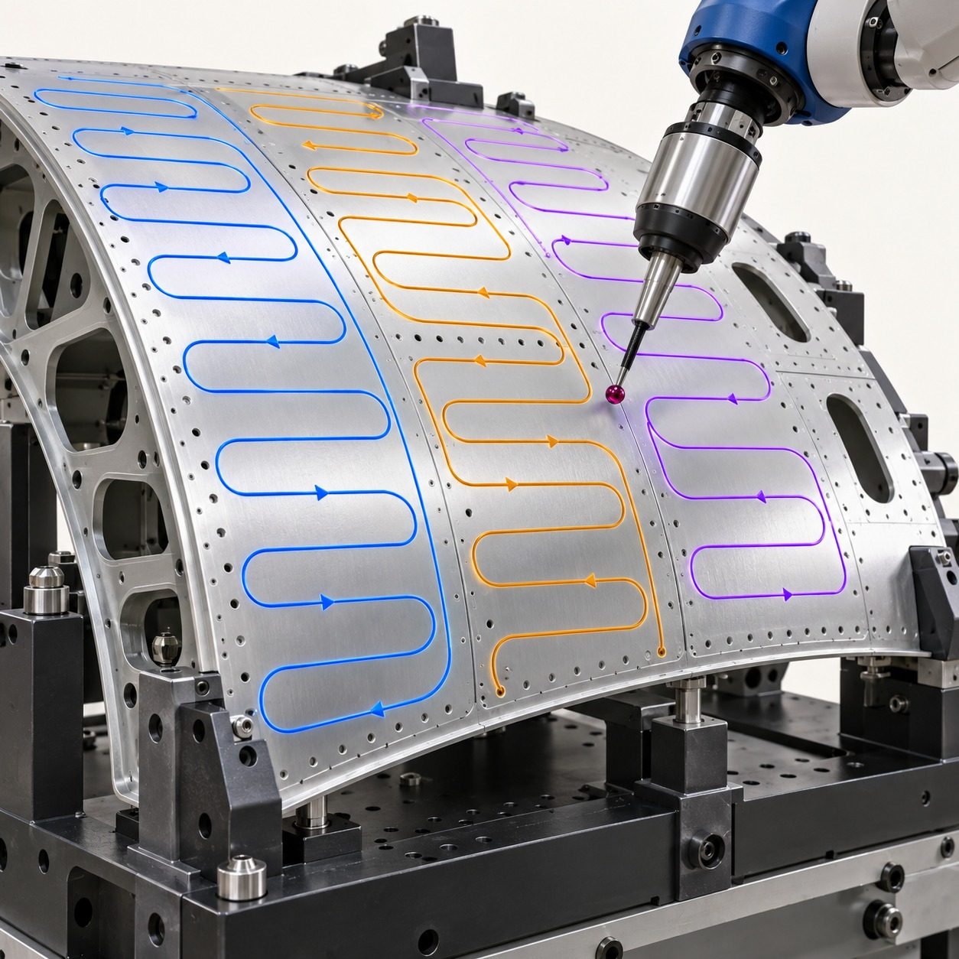
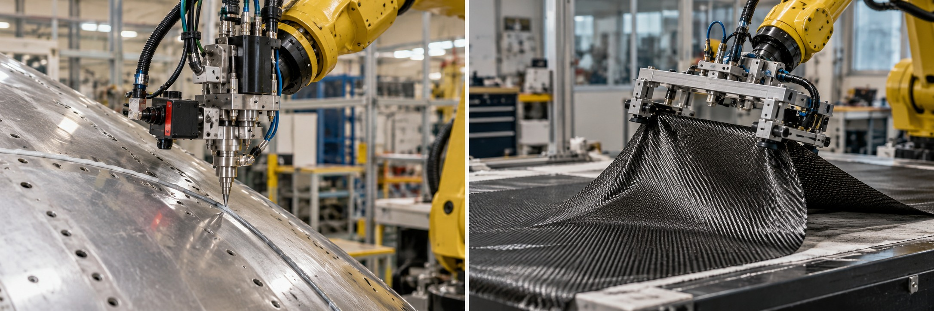
My Airbus journey in motion
Capability progression across my industrial robotics work
REACT
Primer-skin NDT
Intelligent scan plan
Next horizon
Planning how the robot
completes its task
Moving the inspection tool
across the panel
Revisiting only the areas
that need another check
Reusing motion software
that adapts to change
EXPERIENCE
PROPOSED DIRECTION
06
Notes:
This is a progression of capabilities, not a dated project chronology. REACT, Primer-skin NDT and Intelligent scan plan are confirmed areas of work. Next horizon is a proposed direction, shown with a dashed connection. Images are illustrative. No completion dates or maturity levels are implied.
Basis: user-provided career correction, 9 October 2026: flight dynamics and control at DRDO ADE, autopilot work, then ADAS, then robotics. Project and roadmap scope follows the current Airbus motion generation roadmap read in this conversation. Images are conceptual illustrations, not photos of the presenter or actual project evidence. Reference slides informed visual storytelling only; no layouts, personal claims or career details were copied.

Slide 7
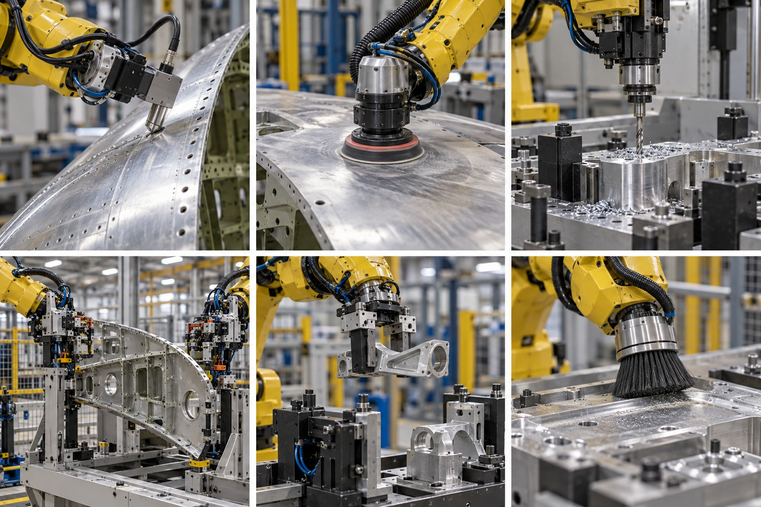
Different jobs need different ways to move
Follow a surface
Reach a precise point
Move between locations
Keep the tool at the right distance.
Position the tool accurately.
Pick up, transfer and place.
My approach: choose and test the method that fits the job.
07
Notes:
My benchmarking discussions compare planning approaches using application requirements. No single framework should be treated as universally best. The roadmap proposes reusing existing capabilities, building adapters and developing algorithms only for confirmed gaps. The visual is conceptual. No performance scores are claimed here.
Basis: user-provided career correction, 9 October 2026: flight dynamics and control at DRDO ADE, autopilot work, then ADAS, then robotics. Project and roadmap scope follows the current Airbus motion generation roadmap read in this conversation. Images are conceptual illustrations, not photos of the presenter or actual project evidence. Reference slides informed visual storytelling only; no layouts, personal claims or career details were copied.

Slide 8
Innovation and knowledge I contribute
PATENTS
IDDs
WHITE PAPER
[Patent title]
[IDD title]
Published white paper
[My contribution]
[Filed / published / granted status]
[My contribution]
[Submitted / accepted status]
[Paper title and publication date]
[My contribution / co-authors]
[Add one sentence on the technical idea and its value to Airbus for each contribution.]
08
Notes:
The user requested inclusion of patents, IDDs and a published white paper. “Parent” has been interpreted as “patent” pending confirmation. Titles, counts, inventorship/authorship and patent/IDD status have not been supplied. The bracketed fields are explicit placeholders and must be completed before presenting. Do not describe a patent as granted without confirmation.
Basis: user-provided career correction, 9 October 2026: flight dynamics and control at DRDO ADE, autopilot work, then ADAS, then robotics. Project and roadmap scope follows the current Airbus motion generation roadmap read in this conversation. Images are conceptual illustrations, not photos of the presenter or actual project evidence. Reference slides informed visual storytelling only; no layouts, personal claims or career details were copied.

Slide 9
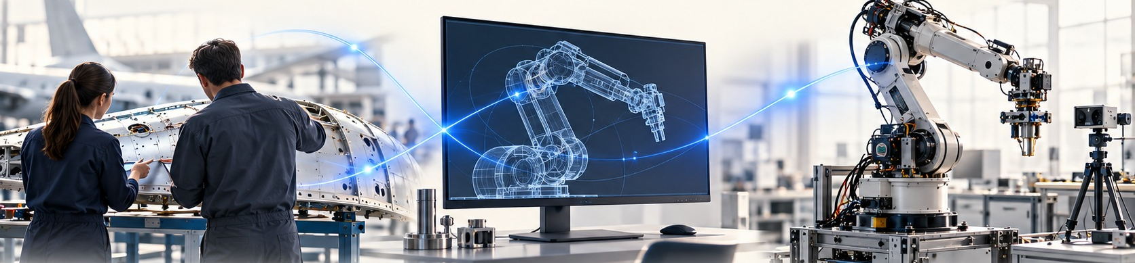
My network connects needs, research and delivery
Application teams
Integration teams
Research partners
Manufacturing and inspection needs
What needs checking and how accurately
Connect software to the robot
Make the components work together
LAAS and IRT Jules Verne
Explore and compare ways to move
How I influence: clarify requirements, compare approaches and share decisions.
09
Notes:
I work at the intersection of application requirements, integration and research approaches. LAAS and IRT Jules Verne are relevant external connections. The IRT collaboration concerns generating motion with their planning approach, not jointly developing a common framework. The lower row describes the way I want to make technical exchanges useful: common requirements, comparable evidence and clear decisions.
Basis: user-provided career correction, 9 October 2026: flight dynamics and control at DRDO ADE, autopilot work, then ADAS, then robotics. Project and roadmap scope follows the current Airbus motion generation roadmap read in this conversation. Images are conceptual illustrations, not photos of the presenter or actual project evidence. Reference slides informed visual storytelling only; no layouts, personal claims or career details were copied.

Slide 10
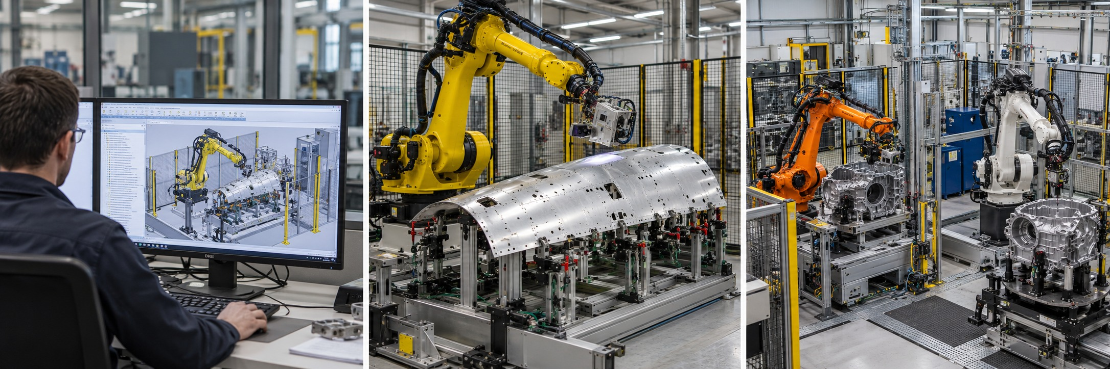
What manufacturing needs from robot motion
Illustrative AI-generated scenes
Less programming
Reliable execution
Reuse across robots
Prepare paths for new parts more easily.
Move smoothly and meet process needs.
Reuse tested software with other robots.
Measure: preparation time and manual effort
Check: tool accuracy and complete coverage
Check: effort needed for the next application
Manufacturing value, measured against agreed application targets.
10
Notes:
These are proposed priorities drawn from the applications discussed, not an official company-wide strategy. Numerical targets should be agreed with application owners after a baseline. The paired measures keep the specialist vision accountable to manufacturing value.
Basis: user-provided career correction, 9 October 2026: flight dynamics and control at DRDO ADE, autopilot work, then ADAS, then robotics. Project and roadmap scope follows the current Airbus motion generation roadmap read in this conversation. Images are conceptual illustrations, not photos of the presenter or actual project evidence. Reference slides informed visual storytelling only; no layouts, personal claims or career details were copied.

Slide 11
How planning automation can evolve
Build on offline-programming expertise as manufacturing needs evolve
Independent tasks
4
Selected jobs within agreed limits
Respond to changes
3 Adaptive
Measure, adjust and recover
Automatic planning
2 Automatic planning
Software prepares the movement
Offline foundation
1 Offline programming
Prepared paths for known processes
Choose the level that delivers value for the application. Validate every step.
11
Notes:
The pyramid is a proposed capability progression, not a maturity score or a claim that the highest level is needed everywhere. Offline programming is a valuable foundation for predictable tasks and prepared cells. As part variants and process variability grow, automation can reduce repeated preparation and support adaptation. Automatic planning still requires verification. Respond to changes adds feedback and recovery within validated limits. More independent tasks is a longer-term option for selected applications and may combine conventional planning with learning. Appropriate autonomy, application validation and cell safety remain essential at each level.
Basis: user-provided career correction, 9 October 2026: flight dynamics and control at DRDO ADE, autopilot work, then ADAS, then robotics. Project and roadmap scope follows the current Airbus motion generation roadmap read in this conversation. Images are conceptual illustrations, not photos of the presenter or actual project evidence. Reference slides informed visual storytelling only; no layouts, personal claims or career details were copied.

Slide 12
More consistent preparation, built on expertise
Manual / OLP / NC programming
Same panel. Preparation time can vary.
Programming time
Capture expertise
Reuse proven methods
Engineer A
Engineer B
Engineer C
Make effort predictable
Illustrative only; not measured hours.
More engineering capacity for new applications and process improvements.
12
Notes:
Manual programming, offline programming (OLP) and numerical-control (NC) programming provide established engineering foundations. The user reports that preparation hours for an aircraft panel vary between people, including differences in experience and familiarity. The three bars are conceptual illustrations only: their heights are arbitrary, there is no hour scale and they are not measured Airbus data, benchmark results or personnel assessments. Programming effort also depends on panel complexity, software, reuse and validation scope. Replace the illustration with comparable measured hours before making a quantitative claim. The proposed opportunity is to capture expert knowledge in reusable planning capabilities, reduce repeated preparation and make engineering effort more predictable. Experts remain important for configuration, process requirements, validation and exceptions. No reduction percentage or autonomous-versus-current time saving is claimed.
Basis: user-provided career correction, 9 October 2026: flight dynamics and control at DRDO ADE, autopilot work, then ADAS, then robotics. Project and roadmap scope follows the current Airbus motion generation roadmap read in this conversation. Images are conceptual illustrations, not photos of the presenter or actual project evidence. Reference slides informed visual storytelling only; no layouts, personal claims or career details were copied.

Slide 13

One platform. Different tasks. Shared capabilities.
ONE PHONE
ONE ROBOTICS PLATFORM
Banking
Shopping
Inspection
Sanding
Drilling
Navigation
Auto-rigging
Pick-and-place
Cleaning
Common services
Choose the right planning method for the task
One foundation
Shared data, validation and execution
13
Notes:
The smartphone analogy communicates a common platform serving different applications. The everyday photographs represent banking/payments, ecommerce and navigation. Robotics photographs illustrate inspection, sanding, drilling, auto-rigging/alignment, pick-and-place and cleaning, not actual project evidence. Different applications can draw on the same framework, and one application can use more than one planning capability. HPP, MoveIt2 and Tesseract are examples, not one-to-one assignments to the pictures. Users select validated task presets, while specialists configure backends through verified adapters. Common data, validation and execution interfaces support reuse. This is a product concept, not an existing user interface.
Basis: user-provided career correction, 9 October 2026: flight dynamics and control at DRDO ADE, autopilot work, then ADAS, then robotics. Project and roadmap scope follows the current Airbus motion generation roadmap read in this conversation. Images are conceptual illustrations, not photos of the presenter or actual project evidence. Reference slides informed visual storytelling only; no layouts, personal claims or career details were copied.

Slide 14
A complete product, from first need to daily use
See the part
Plan the movement
Know its position.
Choose a suitable path.
Move accurately
Work as one system
Measure and correct motion.
Connect equipment and people.
ONE SHARED SOFTWARE PLATFORM
Understand the need
Build together
Test on the robot
Put into use
Support & improve
Reuse the foundation. Adapt it to each manufacturing job.
14
Notes:
My vision is product-oriented industrial robotics: a complete capability integrated with a common software platform and supported across its end-to-end lifecycle. Motion planning is my specialist focus, but its value depends on other components working together. I also have experience beyond planning and bring that wider perspective to interfaces, integration and product decisions. The component groups here describe the proposed product scope, not a claim that I personally delivered every component. The exact examples of my broader component experience should be added when supplied. RXU is the integration context discussed in the roadmap. Product lifecycle includes manufacturing requirements, architecture, verification, deployment, operation, maintenance and controlled updates. The cell safety system remains independently engineered; software integration is not a substitute for safety validation.
Basis: user-provided career correction, 9 October 2026: flight dynamics and control at DRDO ADE, autopilot work, then ADAS, then robotics. Project and roadmap scope follows the current Airbus motion generation roadmap read in this conversation. Images are conceptual illustrations, not photos of the presenter or actual project evidence. Reference slides informed visual storytelling only; no layouts, personal claims or career details were copied.

Slide 15
From a manufacturing task to robot movement
Choose the task
Prepare the path
Check it virtually
Run and monitor
For example: inspect this panel.
Decide where the tool should move.
Check the motion before robot trials.
Measure the result and adjust.
My goal: make a new manufacturing task easier to prepare and deploy.
15
Notes:
The proposed capability starts with a process task and data, produces a toolpath, generates feasible robot motion, validates and executes it, then uses feedback where adaptation is required. The underlying framework can vary by supported capability. RXU integration, control, connectivity and task supervision support the pipeline. This is the architecture I propose to help build, not a claim of an already complete platform. A product line shares maintained components and interfaces while configuring robot, process and application variants. Each variant retains its own acceptance criteria and validation.
Basis: user-provided career correction, 9 October 2026: flight dynamics and control at DRDO ADE, autopilot work, then ADAS, then robotics. Project and roadmap scope follows the current Airbus motion generation roadmap read in this conversation. Images are conceptual illustrations, not photos of the presenter or actual project evidence. Reference slides informed visual storytelling only; no layouts, personal claims or career details were copied.

Slide 16
Vision & Challenges
MY VISION
One robotics platform. The right motion capability for each task.
CHALLENGES TO ADDRESS
Different jobs
One working system
Changing conditions
Select a suitable method
for each manufacturing task.
Connect sensing, planning
and robot control.
Adapt the motion while
maintaining accuracy.
16
Notes:
My vision is a product-oriented robotics capability on a common software platform. Applications should choose validated motion-planning capabilities according to their needs, rather than assume one planner fits every job. The product connects perception, planning, control, supervision and robot connectivity, with support across requirements, validation, deployment and maintenance. Three engineering challenges structure the work: different tasks require different constraints and methods; components and robot interfaces must work together end to end; and changing parts or process conditions require adaptation while retaining accuracy and reliability. These are proposed priorities, not an official Airbus strategy or completed capability. The visuals are conceptual. Benchmarking, common interfaces and application validation provide the route toward this vision. The reference Vision & Challenges slide inspired the use of application examples, without copying its layout or research claims.
Basis: user-provided career correction, 9 October 2026: flight dynamics and control at DRDO ADE, autopilot work, then ADAS, then robotics. Project and roadmap scope follows the current Airbus motion generation roadmap read in this conversation. Images are conceptual illustrations, not photos of the presenter or actual project evidence. Reference slides informed visual storytelling only; no layouts, personal claims or career details were copied.

Slide 17
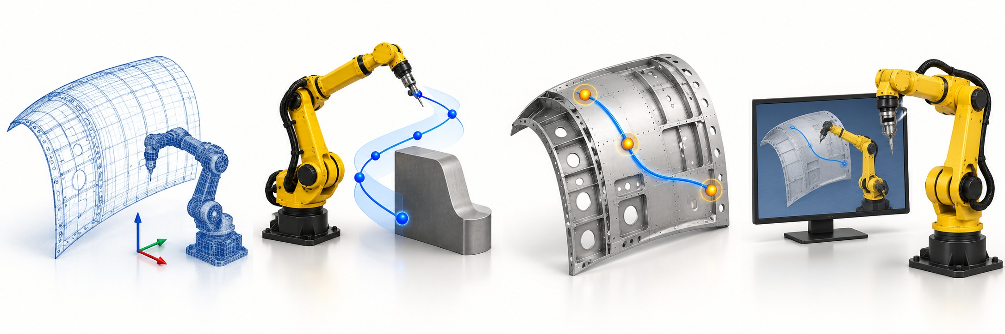
Roadmap 2027: the common motion platform
Q1
Q2
Q3
Q4
Connect the inputs
Generate & check
Improve the motion
Prove it in use
Use the robot and part data.
Produce a usable robot path.
Reduce unnecessary travel and stops.
Test in simulation and on the robot.
Shared software and testing throughout. Proposed dates depend on resources and robot access.
17
Notes:
The sequence follows the latest stepwise framework integration roadmap. These are integration acceptance checkpoints, not eight new algorithms. Start with a thin end-to-end application, then extend capabilities in the numbered order. Integration testing should begin early. The detailed checkpoints are data inputs, toolpath generation, planner integration, validation, sequencing, smoothing and time parameterization, simulation, and execution. Dates depend on resources, capability inventory and robot access.
Basis: user-provided career correction, 9 October 2026: flight dynamics and control at DRDO ADE, autopilot work, then ADAS, then robotics. Project and roadmap scope follows the current Airbus motion generation roadmap read in this conversation. Images are conceptual illustrations, not photos of the presenter or actual project evidence. Reference slides informed visual storytelling only; no layouts, personal claims or career details were copied.

Slide 18
Roadmap 2028–2029+: adaptive robotics
2028 / Adjust during the task
2029+ / Handle more variation
Respond when the part or process changes.
Explore flexible materials and unfamiliar shapes.
Proposed direction: prove reliability before wider use.
18
Notes:
The latest roadmap places dynamic adaptation in 2028 and learning under uncertainty in 2029 and beyond, with data preparation starting in 2027. Candidate research methods include reinforcement learning and vision-language-action models, to be selected only where justified by the application. Evaluate learned policies only for selected tasks where they justify their added complexity. Compare against conventional baselines. These are proposed R&T directions, subject to funding, data and resources.
Basis: user-provided career correction, 9 October 2026: flight dynamics and control at DRDO ADE, autopilot work, then ADAS, then robotics. Project and roadmap scope follows the current Airbus motion generation roadmap read in this conversation. Images are conceptual illustrations, not photos of the presenter or actual project evidence. Reference slides informed visual storytelling only; no layouts, personal claims or career details were copied.

Slide 19
My contribution to industrial robotics
Software
✓
✓
✓
✓
Inspect
Drill
Clean
Less preparation
Reliable motion
Reuse across tasks
Automate repeated
programming steps.
Validate paths against
manufacturing needs.
Integrate planning methods
in one shared platform.
19
Notes:
This closing slide connects my specialist contribution to three proposed manufacturing outcomes. Less preparation: turn repeated programming steps and expert knowledge into reusable planning methods. Reliable motion: validate the path and execution against the needs of the manufacturing process. Reuse across tasks: integrate suitable planning methods into the common robotics software platform so teams can configure capabilities for different applications. These are proposed contributions and expected benefits, not measured savings or claims that all capabilities already exist. My role combines planning and control knowledge, whole-system integration and collaboration with application and research teams.
Basis: user-provided career correction, 9 October 2026: flight dynamics and control at DRDO ADE, autopilot work, then ADAS, then robotics. Project and roadmap scope follows the current Airbus motion generation roadmap read in this conversation. Images are conceptual illustrations, not photos of the presenter or actual project evidence. Reference slides informed visual storytelling only; no layouts, personal claims or career details were copied.

