Slide 1



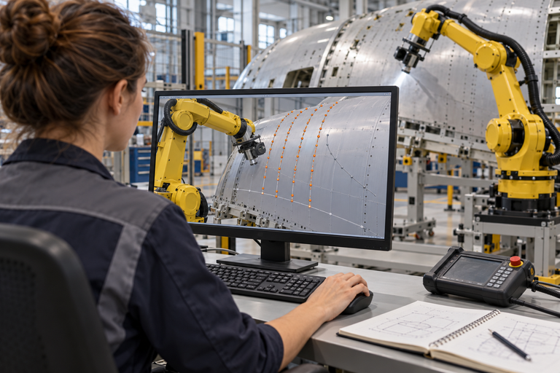

My vision: from one framework to one platform
Start by sharing motion planning, then grow it into a standardised software stack for every application
STEP 1 Share motion planning
STEP 2 Share the whole software stack
Inspection
Inspection
STANDARDISED SOFTWARE STACK
Sealant
Vision
★ Motion planning
Control
Sealant
★ MY FOCUS
Motion planning framework
Auto rigging
Auto rigging
Task orchestrator
Feedback
Simulation
One planner, set up per task
Pick & place
Pick & place
grows
into
Sanding
Simulate
Test
Deploy
Support & improve
Sanding
Common interfaces • shared data • reusable parts
Polishing
Polishing
One shared planner serves every application
One standard platform serves every application
THE VALUE
✓
Reuse proven work
✓
Integrate faster
✓
Share improvements
Build once, configure per task: a foundation for Physical AI.
Notes:
MY VISION: FROM ONE FRAMEWORK TO ONE PLATFORM (about 75 seconds)
(Combines the old slides 14 and 15. Tell it as a journey: left box, arrow, right box.)
[Step 1, left] Step one is where I focus today: a common motion planning framework. Instead of every application building its own robot motion, one shared planner serves all of them: inspection, sealant, auto rigging, pick and place, sanding and polishing. Only the settings change per task.
[Arrow] But motion planning alone cannot complete a task. So the next step is to grow this idea.
[Step 2, right] Step two: we share not only motion planning, but the whole software stack. Vision, motion planning, control, a task orchestrator, feedback and simulation, all on one standardised platform with common interfaces, shared data and reusable parts. The same platform supports the full lifecycle: simulate, test, deploy, and support and improve. And it still serves the same applications.
[Value] The value: we reuse proven work, we integrate new applications faster, and an improvement in one cell helps every cell.
[Message] Build once, configure per task. That is a foundation for Physical AI.
SIMPLE VERSION FOR NON-TECHNICAL LISTENERS: "First we share the robot's 'route planner' across all our robot applications. Then we share the robot's whole 'brain and nervous system', so every new application starts from a proven base instead of from zero."
IF ASKED "Isn't every application too different?": The process is different, but the core problems are the same: seeing the part, planning collision-free motion, executing and correcting. That is what we share. The task-specific part is configuration.
IF ASKED "Why standardise the stack?": Without it, every application builds its own integration. With it, interfaces, data and components are reused, so new applications integrate faster and improvements are shared.

