Slide 1

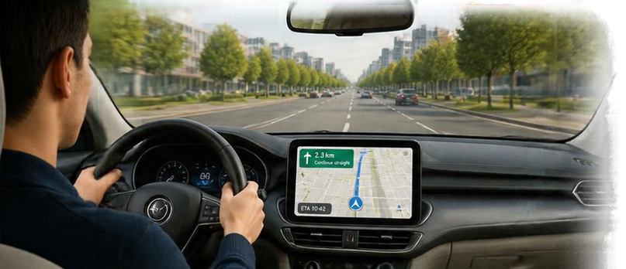
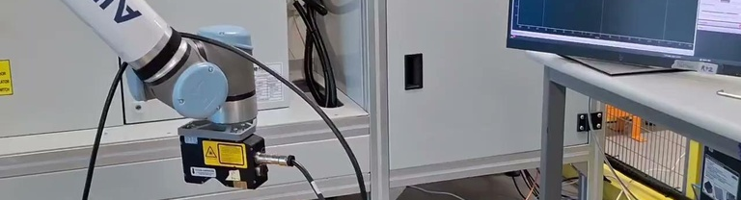
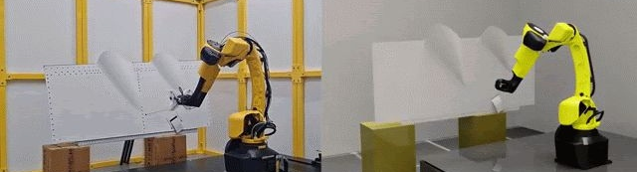


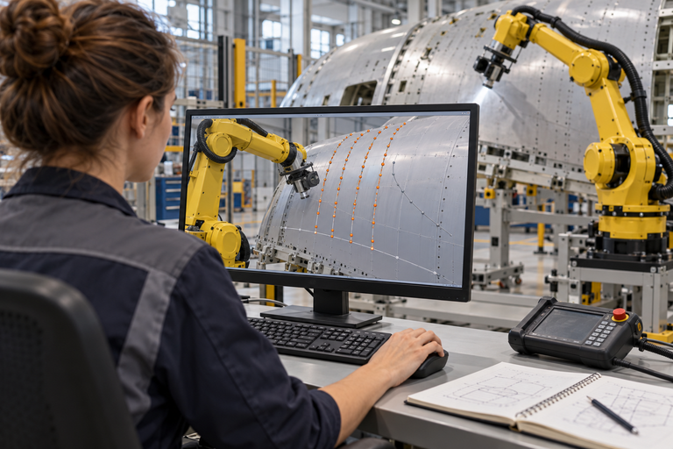

My vision: a complete robotics product
A navigation app alone cannot drive a car; motion planning alone cannot complete a task
LIKE IN A CAR
IN OUR ROBOT CELL
Photos: SAMU sealant cell • Intelligent Scan & Plan
Sees the road
See the panel
Vision
Navigation finds the route
Plan the movement
★ My focus: Motion planning
Steers & brakes
Execute the task
Control
Driver coordinates
Coordinate the whole task
Task orchestrator
Observes & adjusts
Check & correct
Feedback
Driving simulator
Test virtually before the robot moves
Simulation
STANDARDISED SOFTWARE STACK
Simulate
Test
Deploy
Support & improve
Common interfaces • shared data • reusable components
Motion planning is one part. The value comes from the complete system: a foundation for Physical AI.
Notes:
MY VISION: A COMPLETE ROBOTICS PRODUCT (about 60 seconds)
[Subtitle] A navigation app alone cannot drive a car. In the same way, motion planning alone cannot complete a manufacturing task. (Keep the car comparison short: one sentence, then move to the robot cell.)
[Rows] A complete robot cell needs six capabilities working together:
- Vision sees the panel.
- Motion planning plans the movement. This is my focus.
- Control executes the task.
- A task orchestrator coordinates the whole task.
- Feedback checks and corrects during the task.
- Simulation lets us test virtually before the robot moves, so we validate faster and more safely.
[Navy bar] Underneath everything is a standardised software stack: one shared platform with common interfaces, shared data and reusable components. This is what lets us build a capability once and reuse it across applications. [Point to the arrows] And the same stack supports the whole lifecycle: we simulate, test, deploy, and then support and improve.
[Message] So motion planning is one part. The value comes from the complete system, and together these capabilities build a foundation for Physical AI.
IF ASKED "What is the task orchestrator?": The software layer that sequences the steps, connects vision, planning and control, monitors progress, and decides what to do when something changes.
IF ASKED "Why standardise the stack?": Without it, every application builds its own integration. With it, interfaces, data and components are reused, so new applications integrate faster and improvements are shared.

