Slide 1
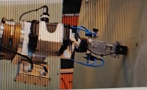
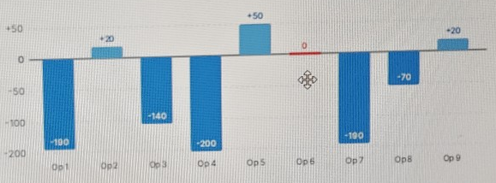
Primer Skin Inspection
Challenges and the automation opportunity
CURRENT CHALLENGES
AUTOMATION OPPORTUNITY
Manual detection, measurement and reporting
NDT cladding / thickness checks and difficult access
Same defect. Different operator measurements.
Vision-guided NDT on flagged regions
More repeatable measurements
Better access and traceability
250 µm range across operators in the supplied example
Less manual effort and lead time
More consistent inspection. Less manual effort. Better traceability.
Automation benefits are targets. Current challenges also include missed-defect risk and limited inspection capacity.
Notes:
Combined from the two user-supplied slides 1000238342.jpg and 1000238343.jpg. The first describes manual visual detection, measurement and reporting, manual NDT cladding and thickness verification, physical access challenges and automation opportunities. It identifies missed-defect risk, inspection effort, lead time, low traceability and the need for systems suited to aerospace. The second shows operator-to-operator measurement variation for an identical rivet pull-in defect and expected benefits of automated inspection. The original operator chart is cropped as source evidence; its readings are -190, +20, -140, -200, +50, 0, -190, -70, +20 micrometres. The range is +50 minus -200 = 250 micrometres. The source annotation of high variance plus/minus 250 micrometres is not repeated because a range is neither a variance nor a plus/minus bound. No automated measurement accuracy or repeatability performance has been supplied, so repeatability, better access and traceability are targets and depend on sensor qualification, calibration, system integration and robot reach. Targeted NDT uses blend-out regions detected by the vision system. The one equipment photograph is a crop of the original NDT sensor setup. This slide describes the broader inspection context, not benefits delivered by path planning alone.

