Slide 1
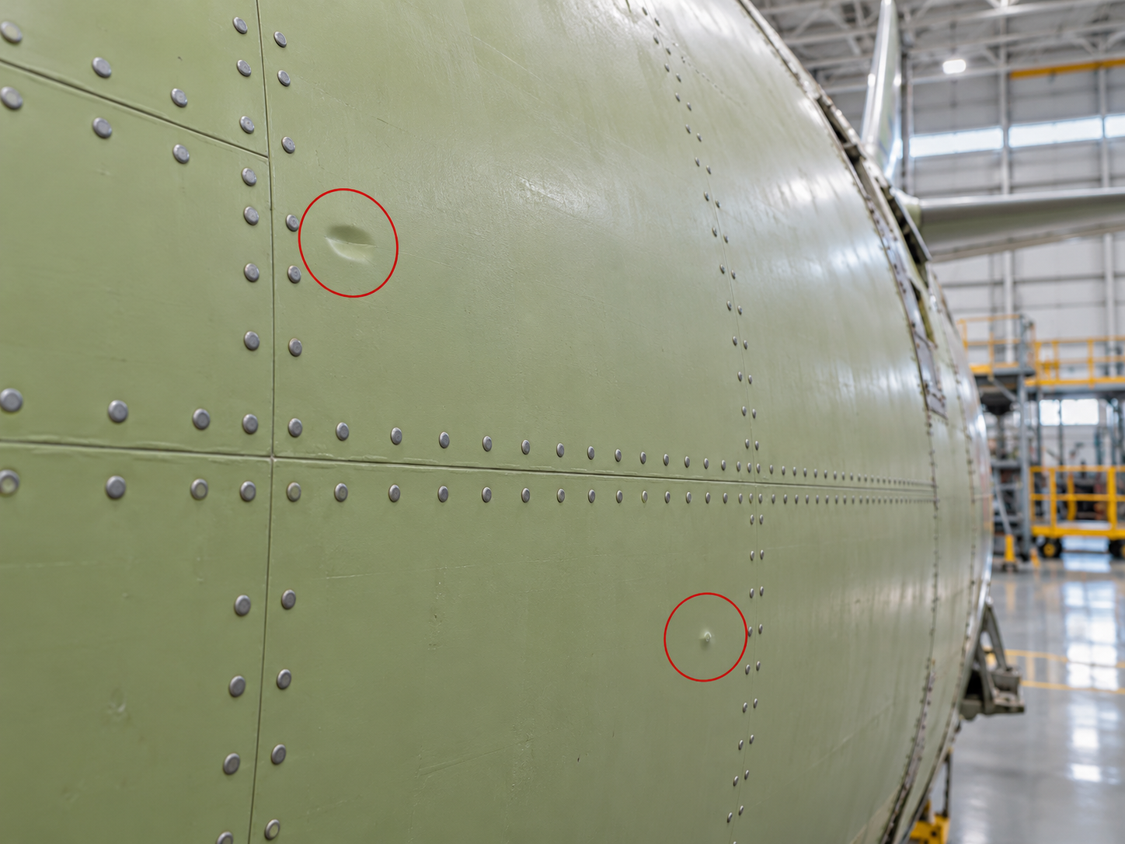
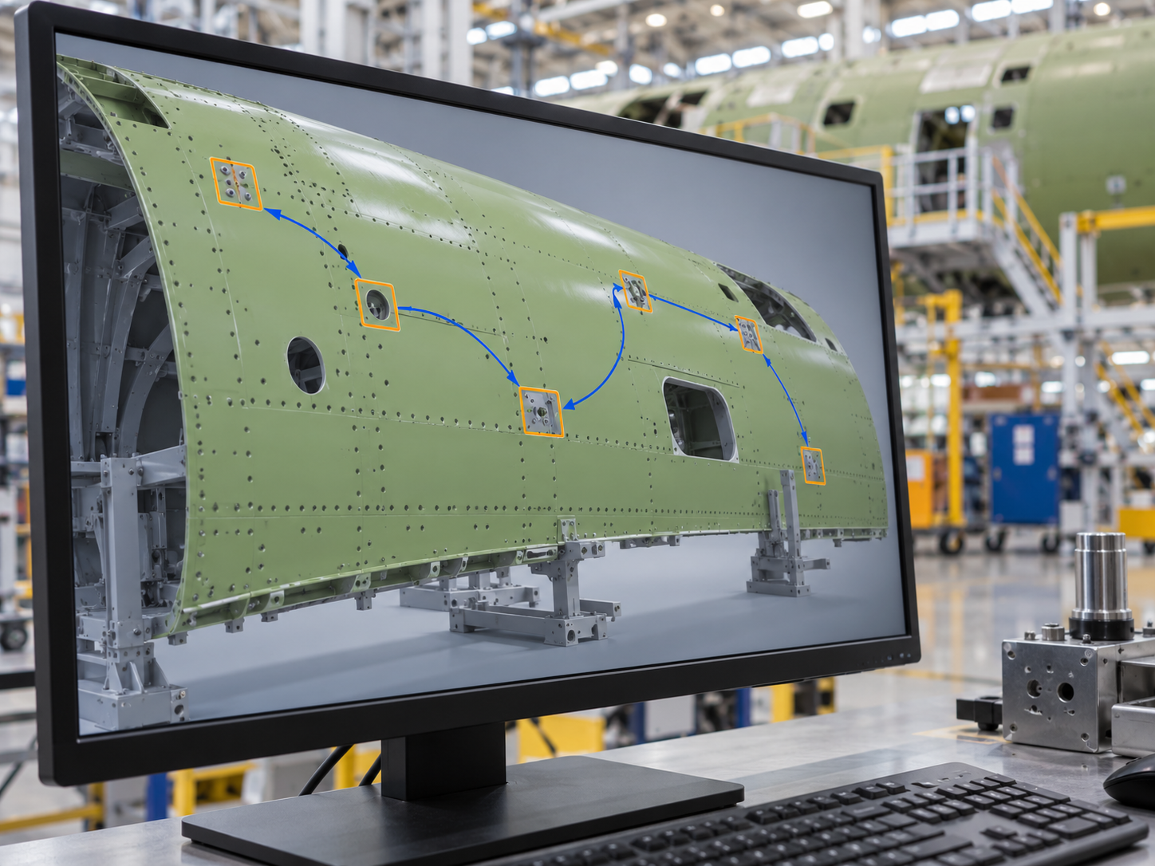
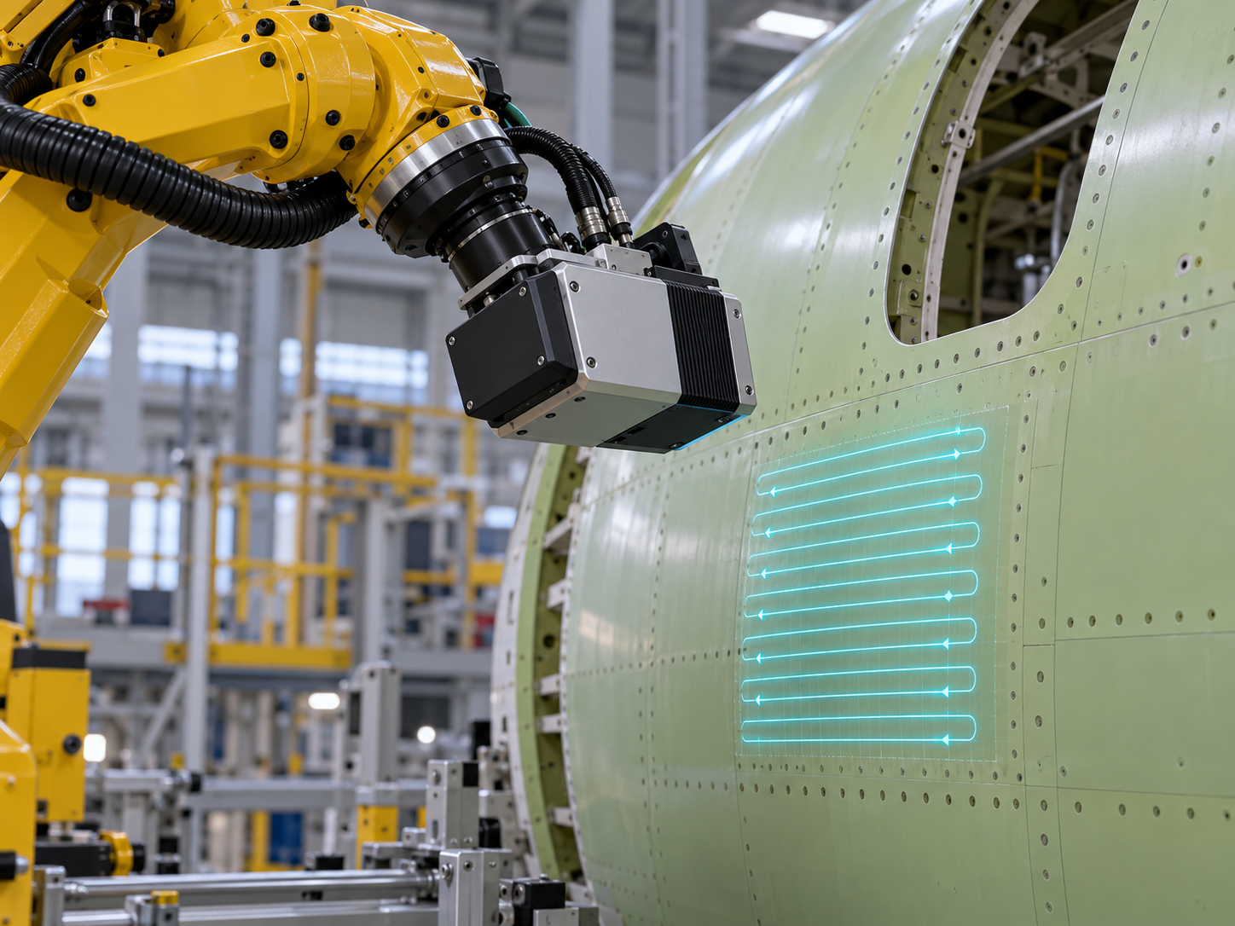
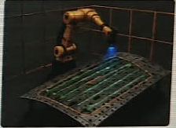
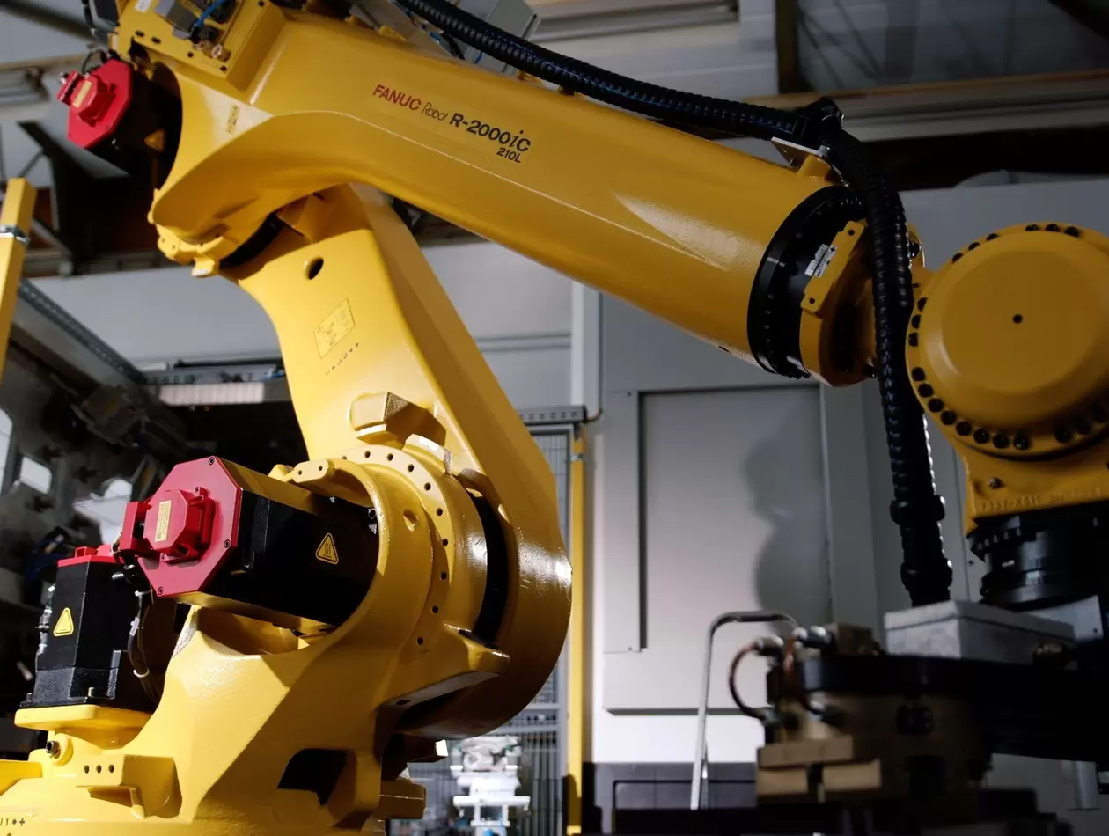
Primer Skin NDT Inspection
Solution Proposal
Defect inputs
Configurable scan pattern
Motion planning inputs
Locations and scan regions
Area, shape and swathe width
Robot/panel models and
process/system constraints
1
2
3
4
5
Use defect
locations
Plan the
visit order
Create scan
paths
Validate in
ROBOGUIDE
Execute on
the robot
Receive flagged areas
from visual inspection
Optimize visit order
and reduce travel
Apply scan settings
and motion constraints
Check the program
before robot execution
Run the validated
inspection program
PATH QUALITY
Singularity avoidance, collision avoidance and optimized, efficient motion
Less programming. Focused scanning. Shorter inspection cycles.
Feasibility depends on models and constraints. Illustrative images. Benefits to validate in trials.
Notes:
Updated scope: configurable scan area, shape and swathe width; process and system constraints supplied to motion generation; planning objectives include singularity avoidance, collision avoidance and optimized efficient motion. These are planning objectives and checks within the supplied model and supported constraints, not a promise that a feasible or globally optimal path always exists. Infeasible requests require revised inputs or constraints. Combined solution proposal based on the attached solution_proposal_inspection.jpeg architecture and the visual workflow slide. The input band retains defect locations and regions, scan area/shape/width, robot and panel models, and movement constraints. Scan width is the plain-language equivalent of swath width. Automatic planning includes defect visit sequencing, local coverage pattern generation and robot motion generation. User-specified sequence: receive defect locations, plan visits, create scan paths and robot movements, validate the generated program in FANUC ROBOGUIDE, then execute that validated program on the robot. Steps 1–3 use AI-generated concept illustrations. Step 4 uses the original project ROBOGUIDE simulation image from Solution_technology.jpeg. Step 5 uses a manufacturer photograph of the FANUC R-2000iC/210L as a robot reference, not a photograph of the actual NDT installation. Manufacturer source: https://www.fanuc.eu/eu-en/case-studies/automating-machining-large-ring-shaped-bearings-robots . The slide depicts the proposed workflow and does not certify physical inspection performance or imply that simulation alone qualifies a production inspection process. Reduced programming and shorter inspection cycles are target benefits; no measured savings are claimed.

