Slide 1
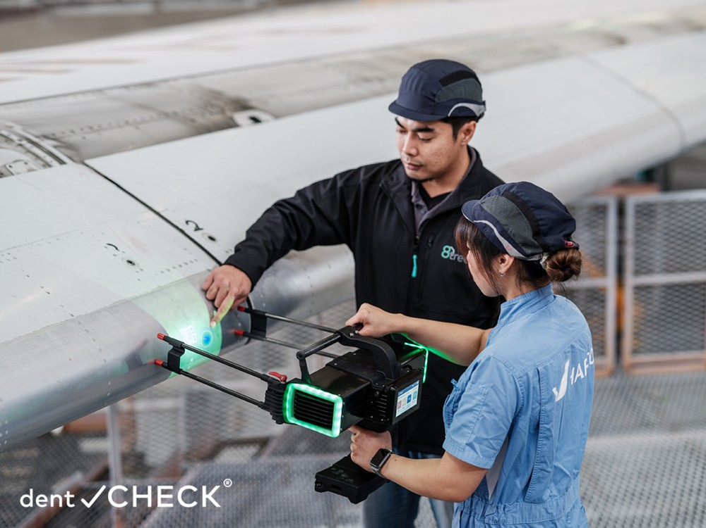
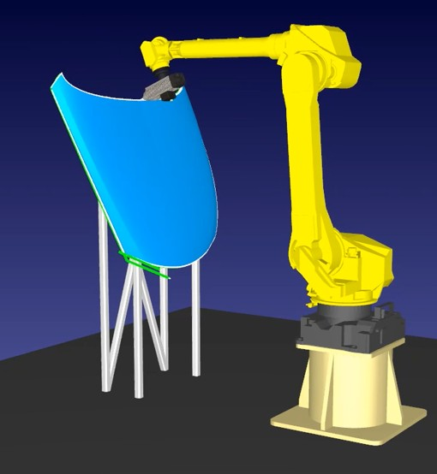
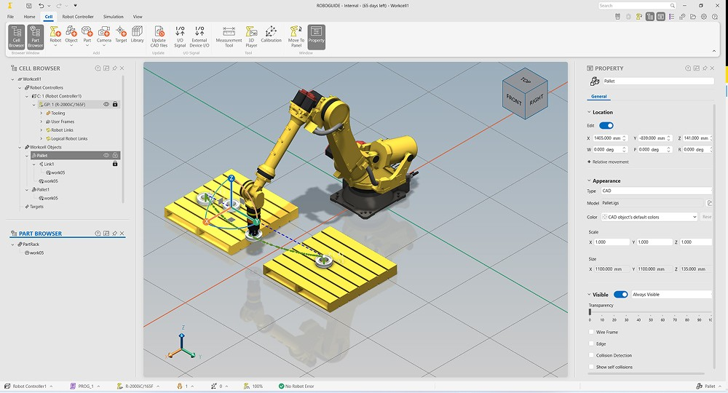

Full-Surface Scanning. Targeted Defect Reinspection.
One reusable framework turns measured surfaces into validated robot motion
Connected to the complete inspection system
Scan data and defect locations in; validated motion and execution status out
COMMON PLANNING FRAMEWORK (IN DEVELOPMENT)
1 Generate scan paths
2 Optimize route and motion
3 Validate in digital twin
4 Inspect with FANUC
Generate scan paths from sensor
point clouds, adapting to the surface.
No complete CAD model required.
GTSP optimizes 100+ defect visits.
Automatically generate robot motion
and local scans for each region.
Simulate and verify coverage,
reachability and collision risks
before running the robot.
Execute approved surface scans.
Revisit only flagged regions
for detailed defect analysis.
IRT JV (planned) / HPP / Future AI: RL, VLA
HPP–IRT JV benchmarking completed
Simulation feedback refines the plan
Less manual programming
Less travel and repeat scanning
Reuse beyond one robot or task
Adapt to new parts using measured geometry
Optimize the route and focus follow-up scans
Common components with selectable planners
Representative images: 8tree, RoboDK and FANUC.
Notes:
Board talk track: We are developing a common motion-generation platform for aircraft inspection. Starting from panel geometry and sensor requirements, we generate the coverage path, choose suitable robot configurations and produce a timed trajectory. We have benchmarked HPP and IRT JV, and plan to use IRT JV for this demonstrator. Common interfaces let us add other planners and support different robots without rebuilding the complete stack. Our roadmap includes reinforcement learning and vision-language-action models, with their outputs connected to the same trajectory verification and digital twin validation process before physical execution. The value proposition is reusable inspection software, consistent validation and an architecture that can evolve. No quantified benefits are claimed without measured evidence. AI roadmap clarification: RL and VLA are future integration targets explicitly requested by the user, not delivered features or benchmarked candidates. They may provide learned policies or action proposals rather than a complete offline trajectory. The future architecture must adapt their outputs to the robot motion and validation interfaces; no specific model, performance, automatic safety guarantee or implementation date is claimed. Inspection motion generation: The path-generation component uses panel CAD or measured geometry and inspection requirements to define coverage passes. Each sensor pose includes position, orientation and required stand-off distance from the surface. The motion-planning component uses the robot model to find joint configurations for the sensor poses (inverse kinematics), select a continuous collision-free sequence, and add timing under inspection-speed and robot-motion constraints. The result is a trajectory of joint positions and velocities over time, which can be checked in the digital twin before execution. Infeasible paths require revision. These are intended responsibilities, not a claim that every step has been delivered. Representative imagery: CAD surface with inspection points from Autodesk Community, https://forums.autodesk.com/t5/fusion-manufacture-forum/surface-inspection-exact-points/td-p/10132375 (image https://forums.autodesk.com/t5/image/serverpage/image-id/889442iA7227BE8053AC087/image-size/large?px=999&v=v2). This represents CAD geometry and inspection positions, not the exact continuous scan path of this demonstrator or an Open3D/Open CASCADE screenshot. Digital twin illustration is a FANUC ROBOGUIDE screenshot from https://www.fanucamerica.com/press-releases/fanuc-introduces-enhanced-next-gen-roboguide-robot-simulation-software (image https://cdn.craft.cloud/6166486b-1eb4-43d5-990c-ea573de4e750/assets/images/roboguide-new-features.jpg). It illustrates virtual robot simulation only; ROBOGUIDE is not asserted to be the selected digital twin software. Purpose: board-level explanation of a common motion planning framework under development. Multiple options are intended within one platform and are selected by use case, not run sequentially. IRT JV is planned for this aircraft-panel inspection demonstrator. HPP/LAAS is shown as an alternative framework option, not as already integrated. A completed benchmarking study compared HPP and IRT JV; this slide does not claim a measured winner. Shared trajectory output feeds pre-execution digital twin validation, then robot-specific execution interfaces. If checks fail, revise motion and validate again. Robot-agnostic reuse is a design objective and still requires robot models, drivers and adapters. Sources: user requirements in the current conversation; IRT_JV_vs_LAAS_HPP_Conversation_QA.docx, Library ID libfile_784d5dbdeadc81918f2f567b5e8e5956, pages 3–6. That conversation record describes IRT MoveIt2/Tesseract and ROS2 execution, and LAAS HPP. Scan-path generation from CAD/point clouds can use Open3D/Open CASCADE before robot motion planning. Within the IRT pipeline, Descartes and TrajOpt are described for Cartesian path planning and optimization. Confirm exact vendor integration before presenting those details as delivered. FANUC photograph/product image source: https://www.fanucamerica.com/products/robot/r-2000ic-210l ; image asset https://cdn.craft.cloud/6166486b-1eb4-43d5-990c-ea573de4e750/assets/products/r-2000ic-210l/R-2000iC_210L-Beauty-Shot-Right.png . The image represents the robot model and is not a photograph of the inspection demonstrator. No AI-generated robot imagery is used.
Latest user scope overrides earlier CAD-centric wording: current application is surface scanning and inspection based on sensor point-cloud geometry, even without a proper CAD model. CAD processing is optional when suitable geometry is available. The inspection system supplies detected defect locations. Initial scanning covers the required surface; follow-up scans cover selected defect regions only. User states GTSP is used to visit 100+ defects efficiently. Distinguish route/task optimization (which defect to visit next) from robot trajectory generation (how to move there) and local coverage generation (how to scan each region). GTSP does not itself detect defects or generate the local scan path. When alternative robot configurations or scan entry states are available per defect, GTSP can select among those alternatives as part of sequencing; do not assert a specific implementation that the user has not supplied. No guarantee of global optimality or measured time saving is claimed. Planning and digital twin validation still check reachability, motion feasibility and the inspection constraints. Existing benchmark material locates GTSP sequencing in the HPP/LAAS approach; do not imply GTSP is already provided by the IRT JV planner. The common framework can integrate sequencing as a reusable component. Reinforcement learning and VLA remain future options. Representative surface acquisition image: https://www.8-tree.com/products/ and https://www.8-tree.com/wp-content/uploads/2025/01/8Tree-7A-1024x768.png . This is a manufacturer example of aircraft surface measurement, not the sensor used in the project. Background reference on GTSP role: https://raaslab.org/projects/GATSBI/ . Management framing: The framework is designed to adapt tool paths to different surface geometries rather than require a separately taught robot program for each part. Do not claim every arbitrary geometry is supported: success depends on valid CAD or point-cloud data, task constraints and robot reach. Open CASCADE and point-cloud processing such as Open3D provide geometry capabilities; application-specific coverage algorithms still need implementation and validation. Automatic robot motion generation converts tool poses to feasible robot joint configurations and timed motion. Benefits on this slide are intended outcomes; no measured percentage or achieved cycle-time reduction is asserted. Proposed integration: the inspection application/supervisor supplies task requirements and geometry and coordinates execution; planning and digital twin exchange scene/trajectory data and feasibility results; approved trajectory goes to robot-specific execution interfaces; progress/status returns to the supervisor. Inspection sensor data and defect analysis remain the inspection system's responsibility. Reuse for other surface processes such as scanning, painting or dispensing requires process-specific parameters and validation. AI RL/VLA are future integration targets, not current proven capabilities. VLA expands to vision-language-action models. Images are representative only. The robot motion image is a FANUC machining example from RoboDK documentation https://robodk.com/doc/fr/Example-5-Axis-Cutting.html, image https://cdn.robodk.com/doc/fr/Example-5-Axis-Cutting_files/img8.png, cropped to robot and workpiece; it is not IRT software or the inspection demonstrator. Talk track: We start from the part geometry and inspection requirements, generate the tool path, and automatically calculate executable robot motion. The digital twin lets us identify infeasible paths before running the cell. Because these components expose common interfaces, the investment can be reused across parts, robots and other surface processes. IRT JV is our planned demonstrator approach after benchmarking against HPP, and the same architecture is intended to accommodate future AI techniques.

