Slide 1
ICCAD-2014 CAD Contest in Design for Manufacturability Flow for Advanced Semiconductor Nodes and Benchmark Suite
11/4/2014
Rasit O. Topaloglu, Ph.D

Slide 2
On Fill Insertion for Manufacturability
One of original methods to improve yield as part of design for manufacturability efforts
Fills not only benefit chemical-mechanical polishing process, but also help reduce device to device variability as well as lithographic printability
Has been utilized for several generations, and will keep on being utilized at least beyond 7nm technology
New technologies such as EUV and DSA will utilize fills also, thereby a contest to teach and improve several aspects of the fill insertion process would be beneficial

Slide 3
Inputs (1/2)
Layout in GDS format with regions identified to fill
Testcase s and testcase b have been available during alpha and beta phases of the contest
An additional hidden testcase is also added in final phase
Density statistics for no-fill are given as ASCII data files
Notes:
Statistics from no-fill case should be used towards the solution, however the non-fillable areas in the testcases could have been used to estimate these statistics before they were available
20um non-overlapping square windows starting from the lower left corner are used for these computations

Slide 4
Inputs (2/2)
Design rules relevant to the problem are given. Minimum metal width and space are 32nm, minimum metal area is 4800nm²
In actual technology implementation, there are many more rules relevant, however we want to keep the rules simple so that teams could focus on the core problem
Space rules apply in rectilinear directions

Slide 5
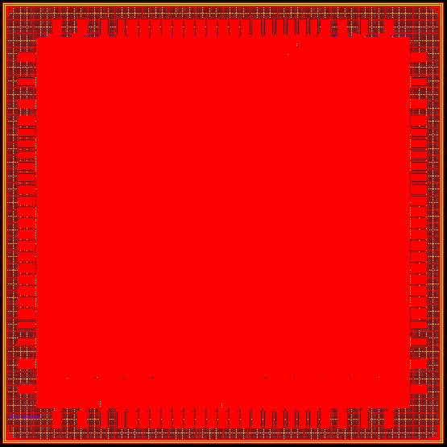
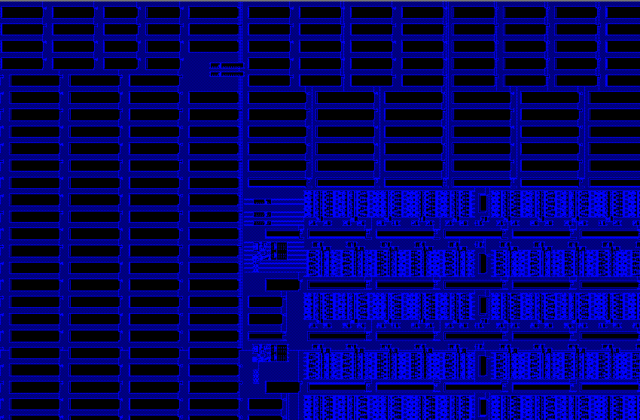
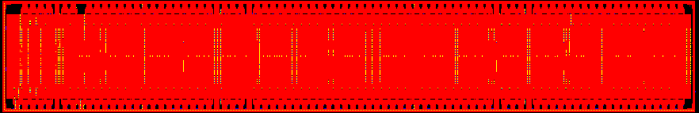
Input Examples
²
testcase b; 2.3x2.3 mm²
zoom within M1 shown
can only fill within colored regions
input file:
0 0 0.22289664 0.501408
0 20 0.24273208 0.501536
0 40 0.322388 0.501751
0 60 0.282762 0.501514
testcase m; 1x6.5 mm²
testcase s is 0.4x0.16 mm²
but vertical instead

Slide 6
Layout Restrictions
Fills use the same design rules as other polygons
Fills can only be rectangles
Fills can abut the fillable region boundaries
Lowest numbered layer is at the bottom of the stack
Layers are ordered by the layer numbers
Layers provided in the layout are neighbors to each other
Fills do not have any direction restrictions, they can be horizontal or vertical
In practice, there are preferred lengths per layer and wrong-way features may be allowed up to a certain length

Slide 7
Output
The output is a layout in GDS format with fills that adhere to the provided design rules.

Slide 8
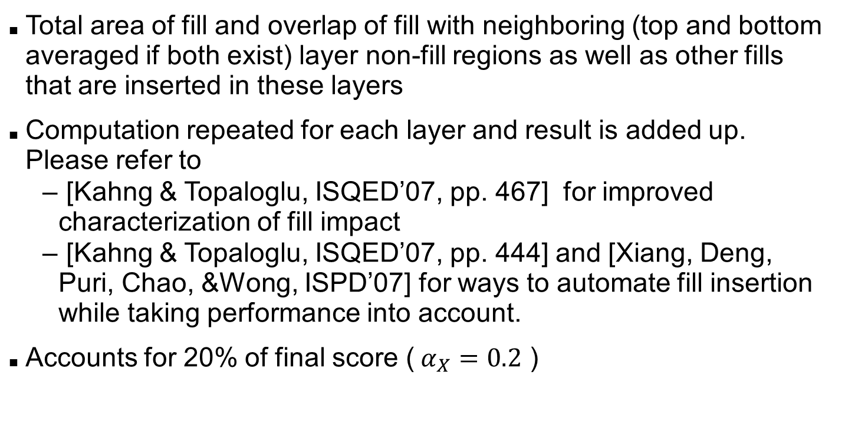
Objectives: Minimize Performance Degradation
Total area of fill and overlap of fill with neighboring (top and bottom averaged if both exist) layer non-fill regions as well as other fills that are inserted in these layers
Computation repeated for each layer and result is added up. Please refer to
[Kahng & Topaloglu, ISQED’07, pp. 467] for improved characterization of fill impact
[Kahng & Topaloglu, ISQED’07, pp. 444] and [Xiang, Deng, Puri, Chao, &Wong, ISPD’07] for ways to automate fill insertion while taking performance into account.
Accounts for 20% of final score ($α_{X}=0.2$ )

Slide 9

Objectives: Minimize Variation
Minimize variation, i.e., chip density standard deviations
Standard deviations of window densities per layer are added up towards the score for this part
Accounts for 20% of final score ($α_{X}=0.2$ )

Slide 10
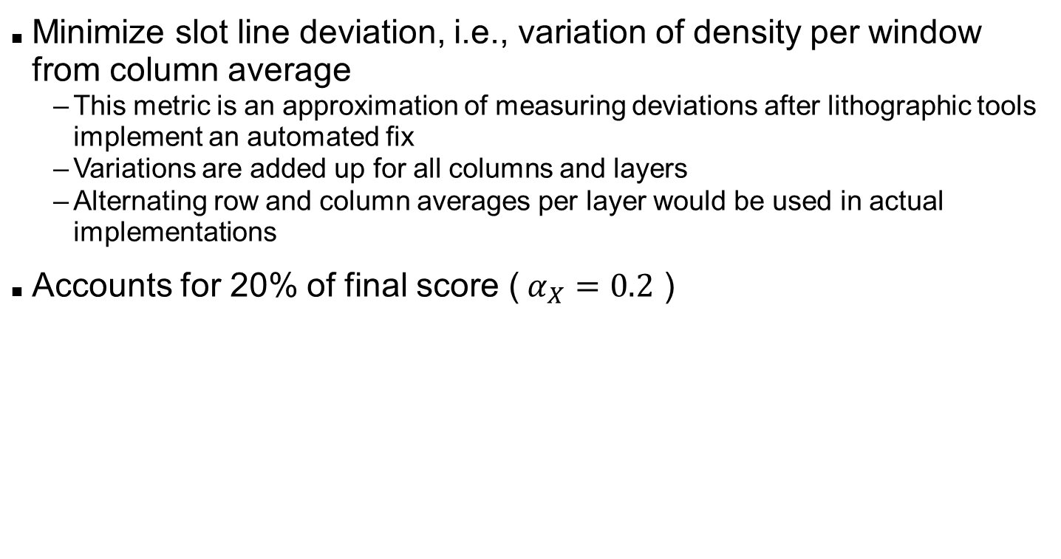
Objectives: Minimize Line Hotspot
Minimize slot line deviation, i.e., variation of density per window from column average
This metric is an approximation of measuring deviations after lithographic tools implement an automated fix
Variations are added up for all columns and layers
Alternating row and column averages per layer would be used in actual implementations
Accounts for 20% of final score ($α_{X}=0.2$ )

Slide 11

Objectives: Minimize Outliers Hotspot
Minimize outliers, i.e., variation of density per window from 3 sigma corners
Variations beyond 3 sigma corners are added up in absolute terms for each window and layer
Accounts for 15% of final score ($α_{X}=0.$15 )

Slide 12
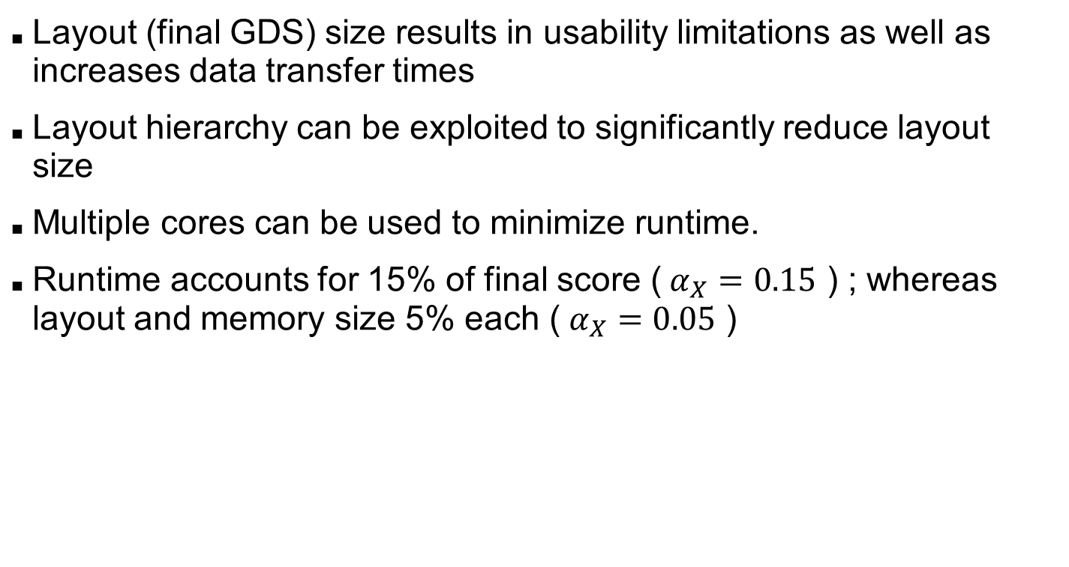
Objectives: Minimize Runtime, Layout, and Memory Sizes
Layout (final GDS) size results in usability limitations as well as increases data transfer times
Layout hierarchy can be exploited to significantly reduce layout size
Multiple cores can be used to minimize runtime.
Runtime accounts for 15% of final score ($α_{X}=0.15$ ) ; whereas layout and memory size 5% each ($α_{X}=0.05$ )

Slide 13
Evaluation System
Only open-source solvers can be used. Stand-alone tools that may require special licenses may not be used
Compiled programs are run on a system with four central processing units (CPU) with eight cores each. Each core has a 256KB L2 cache, and each CPU has a 20MB L3 cache
Core speed is 2.6GHz according to ``/proc/cpuinfo" file. Specifications indicate 2GHz with 2.8GHz at turbo boost for this processor model. The processors run at 95W
Memory of the system is 64GB DDR3-1600

Slide 14

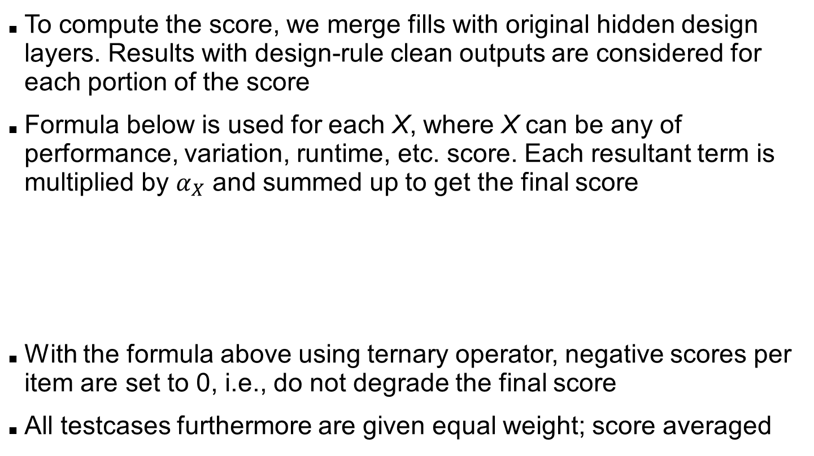
Evaluation
To compute the score, we merge fills with original hidden design layers. Results with design-rule clean outputs are considered for each portion of the score
Formula below is used for each X, where X can be any of performance, variation, runtime, etc. score. Each resultant term is multiplied by $α_{X}$ and summed up to get the final score
With the formula above using ternary operator, negative scores per item are set to 0, i.e., do not degrade the final score
All testcases furthermore are given equal weight; score averaged

Slide 15
Analysis of and Prevention Against Trivial Solutions
We have used both no-fill and max-fill solutions to analyze trivial solutions
These solutions are not DRC-clean, but provide good targets for performance score parameters if carefully used
Outlier score is normalized by multiplying with variation score against max-fill trivial solution
Results with non-zero performance and variation scores only got scored for runtime, size, memory, and line outliers. They are set to 0 otherwise against trivial solutions

Slide 16
Tuning Parameters ($β_{X}$) for Contest
 | Performance Degrade | Variation | Runtime (s) | Size (Mb) | Memory (Mb) | Line Hotspot | Normalized Outlier
s | 79154 | 0.077 | 60 | 32 | 1024 | 11.758 | 0.014319
b | 6111303 | 0.517 | 600 | 2048 | 32768 | 3578 | 22.801251
m | 10276835 | 0.53 | 1200 | 1536 | 32768 | 6052 | 27.56
Runtime, size, and memory picked by checking distribution of results and picking a round number that is close to the maximum
Variation score is picked from no-fill trivial solution
Other scores are picked as maximum of no-fill and maximum fill trivial solutions

Slide 17
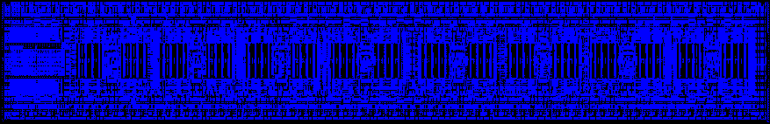
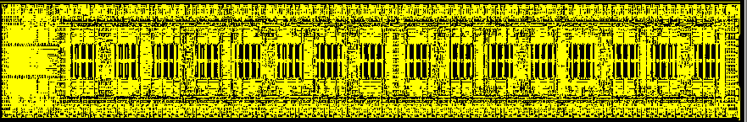
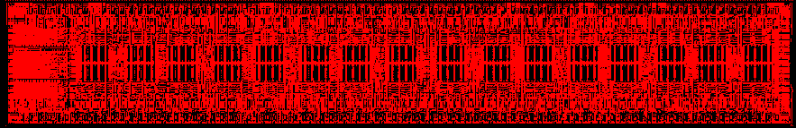
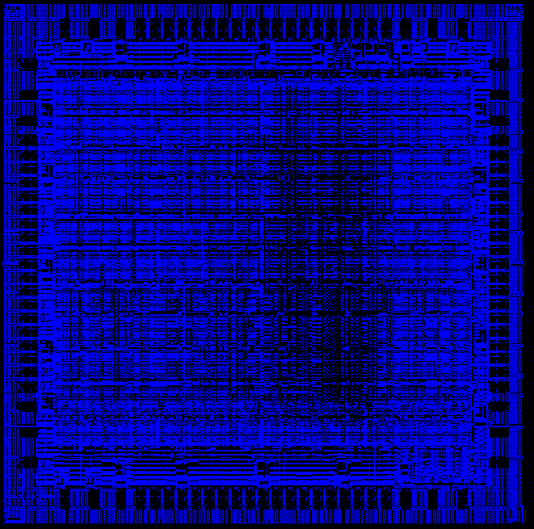
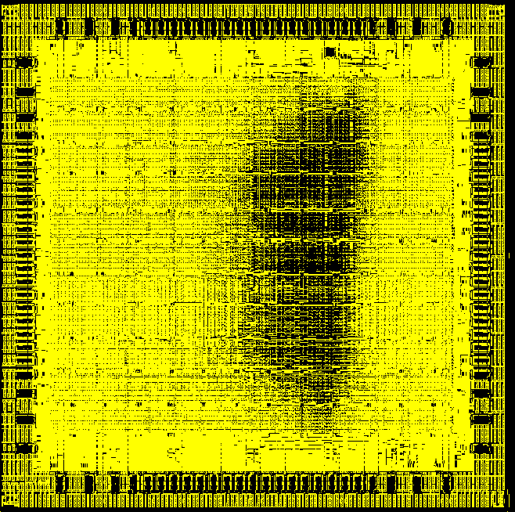
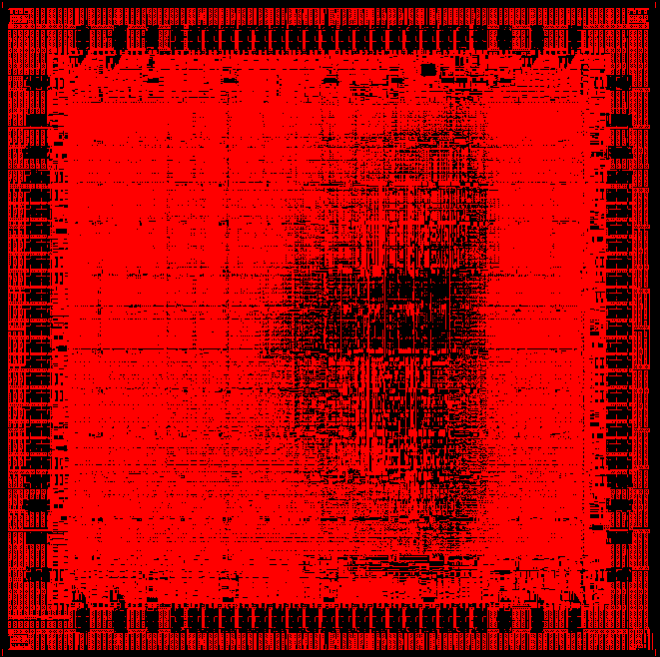
Output Examples
M1
M2
M3
m
b

Slide 18
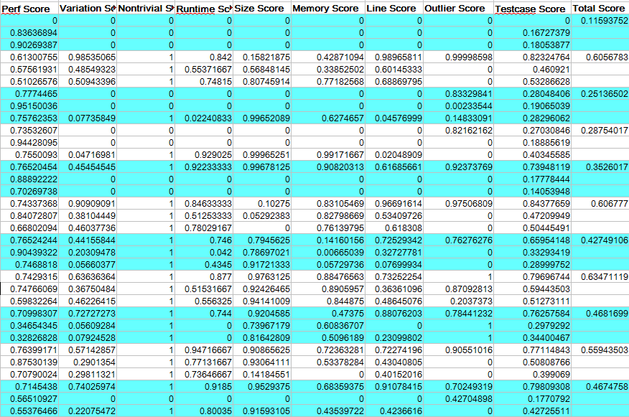
Scores

Slide 19
Acknowledgments
Thanks to
Nick (王煜勛) for compiling and running all testcases and implementing a core and memory utilization characterization script
Tai-Chen Chen (陳泰蓁) of National Central University for pointing out an issue with the hidden testcase
Feedback from participating teams and their advisors

