Slide 1
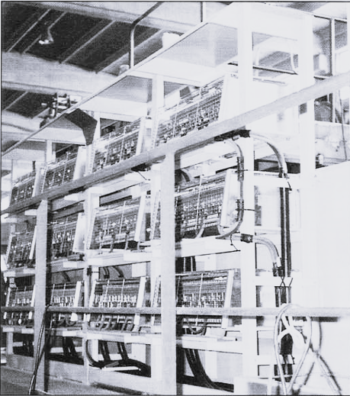

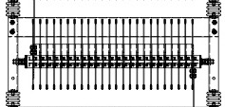
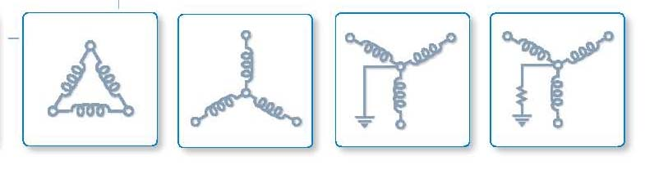
Industrial power resistors
PT GRID Resistor Indonesia
Continually improving our quality management system with the aim of achieving complete customer satisfaction & confidence …….
The CEO Building Level 12
Jl. TB. Simatupang No. 18C
Jakarta Selatan 12430
Phone: +62 21 5091 9498
Mobile: 0852 1189 2728
email: info@gridresistorindonesia.com

Slide 2
about us
PT GRID Resistor Indonesia
Oz Direnc products have been delivered and in operation since 2005 more than 20 years our products have been in service to Indonesia Power Plant Transmission and Distribution not to mention to Industries.
Under PT GRID Resistor Indonesia as sole agent, since 2017, Oz Direnc keep continuing providing and delivering reliable products and in time delivery time.
Its our commitment to the industries delivering our products and achieving complete customer satisfaction and confidence.

Slide 3





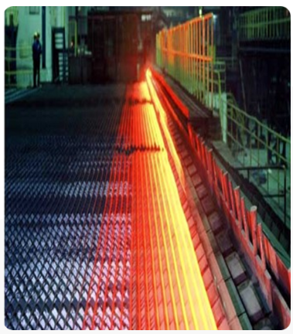

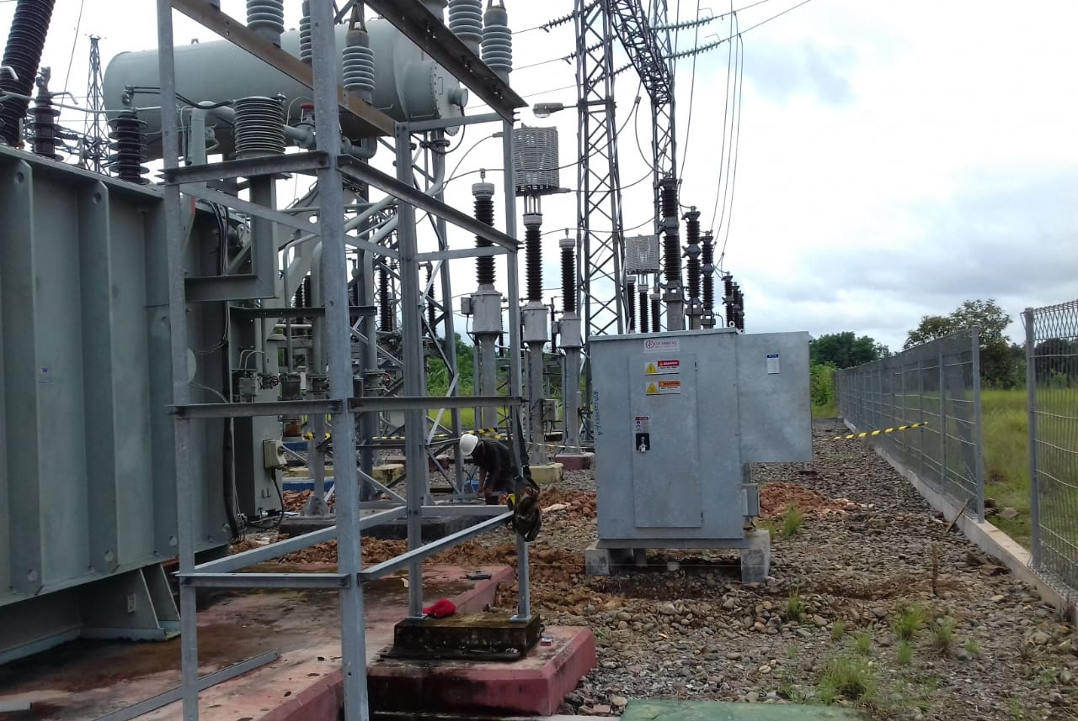


our users….
PT GRID Resistor Indonesia
PETROCHINA

Slide 4
industry coverages…
PT GRID Resistor Indonesia
Power Plants
Steel Industries
Glass Manufacturers
Oil & Gas Industries
Chemicals and Petrochemicals Industries
Shipyards
Aviations
Other related industries

Slide 5
applications…
PT GRID Resistor Indonesia
Loadbanks
Loadbanks are resistors for loading gensets or other power sources so that they can be tested to ensure they can deliver their rated power in actual loading conditions.
Factory testing of Diesel Gensets,
Periodic exercising of stand-by engine Gensets,
UPS System testing​
Battery System testing
Aviation Ground Power Unit (GPU) Testing
Load optimization in prime power applications
Remove and prevent carbon-buildup on piston heads
Neutral Grounding
The neutral of the transformer or generator is connected to ground through a Neutral Grounding Resistor(NGR) to limit phase-to-ground fault currents.The reasons for limiting the current, in case of a line-to ground fault.
Motor Starting
Our resistor units are widely used in motor control applications where electronic drive systems become inadequate due to severe operating conditions having heavy vibration, very high ambient temperatures, dust and humidity as the prime parameter of design.
Start resistors are used in conjunction with switch-starters or contactors for starting and speed regulating of AC slipring motors as well as DC motors. Contrary to popular belief, starting resistors are still used widely in heavy industries such as Iron and Steel Mills, Cement Plants, Mines.
Dynamic Braking
Dynamic braking resistors are used for rheostatic braking of electrical motors. The excess kinetic energy resulting from braking or slowing down the load is dissipated on electrical resistors.
​​
We design powerful braking resistors for applications of centrifuges, cranes and similar applications where DBRs are required.

Slide 6
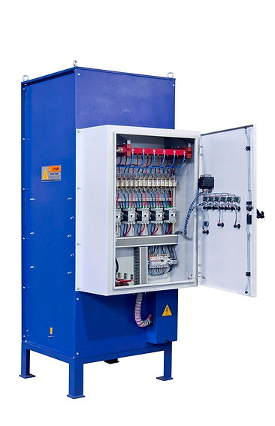
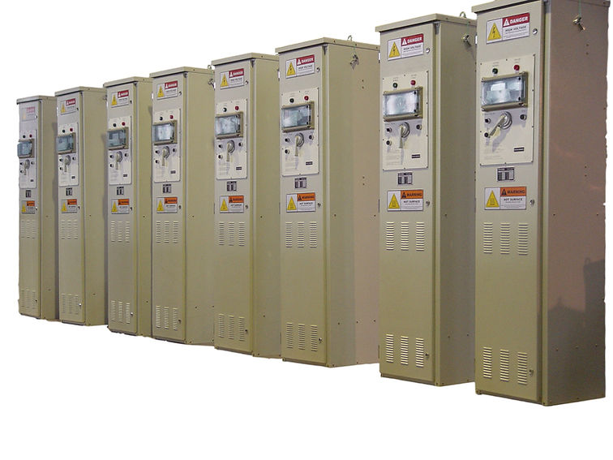
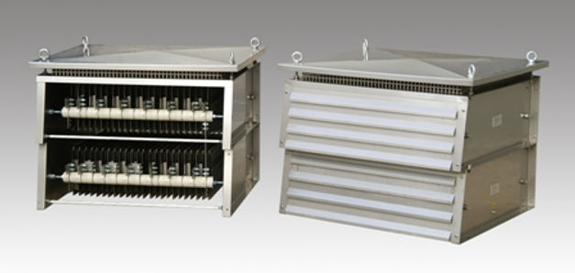
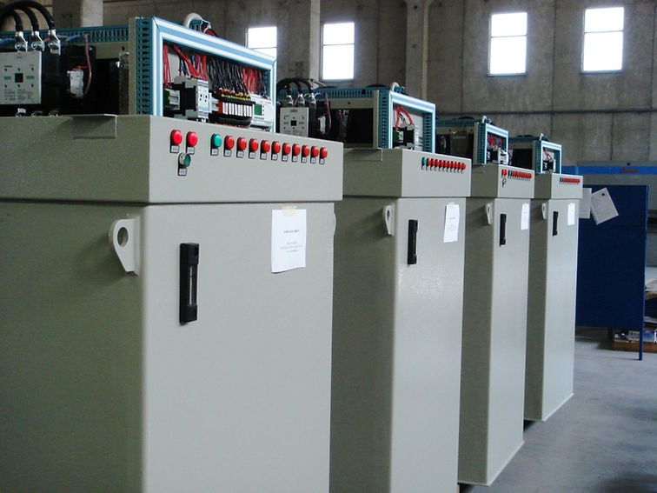
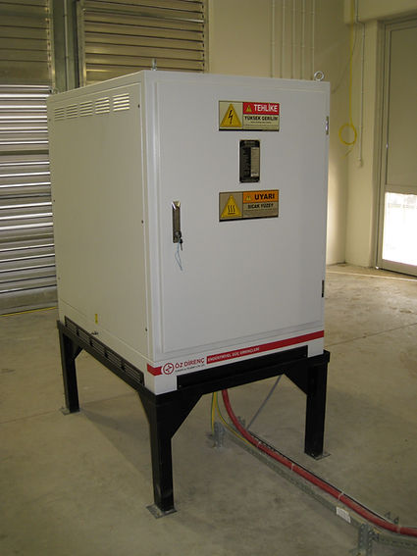
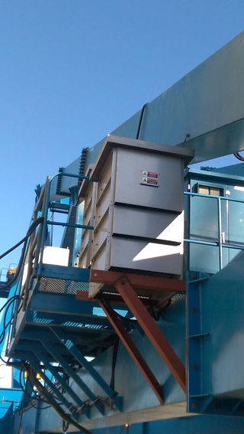
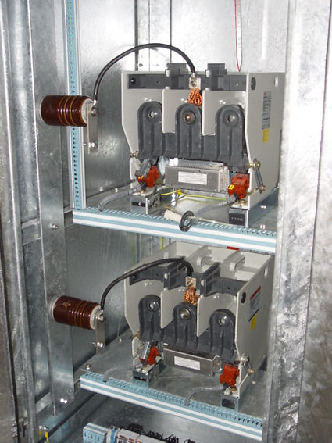
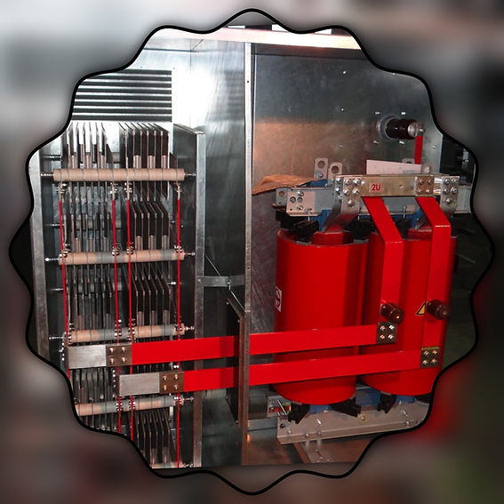
products….
PT GRID Resistor Indonesia
MOTOR STARTING RESISTORS
HRGS
DYNAMIC BREAKING RESISTOR
OIL COOLED STARTER
LOAD BANKS
NGR + SECONDARY RESISTOR
11 KV NEUTRAL GROUNDING RESISTOR
GENSET NGR VACUUM SWITCHES

Slide 7
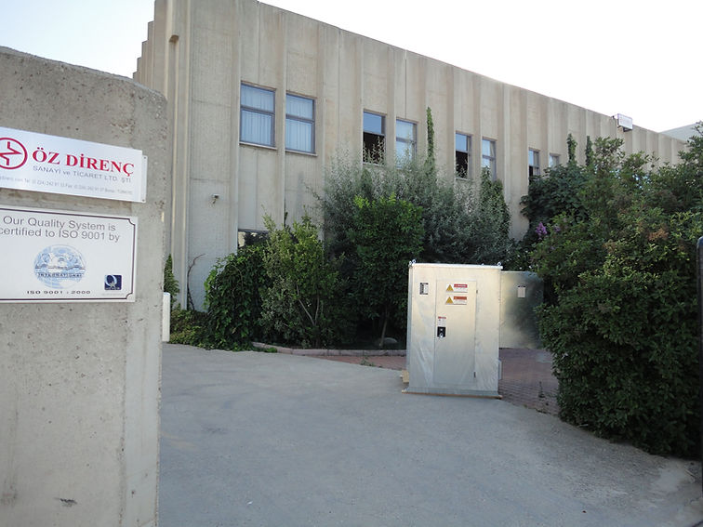

manufacturing facilities
PT GRID Resistor Indonesia
The CEO Building Level 12
Jl. TB. Simatupang No. 18C
Jakarta Selatan 12430
Phone: +62 21 5091 9498
Mobile: 0852 1189 2728
email: info@gridresistorindonesia.com
Organize Sanayi Bolgesi,
Lacivert Cadde No:3 16140 BURSA, Turkey
mail@ozdirenc.com
Tel: ++90-224-242-91-33

