Slide 1

REVERSE MORTGAGE
BASICS
IS A REVERSE MORTGAGE
RIGHT FOR YOU?

Slide 2
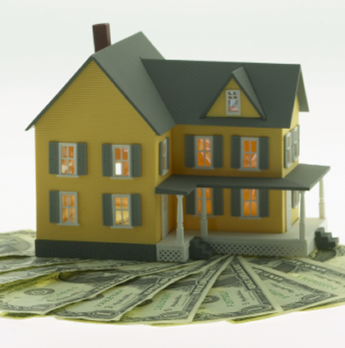
WHAT IS A REVERSE MORTGAGE?
A reverse mortgage is a way to receive cash from the equity in your home.

Slide 3

TRADITIONAL WAYS TO
RECEIVE CASH FROM YOUR HOME:
Sell it
Refinance or take out a home equity loan (requires monthly payments)

Slide 4

HOW IS A REVERSE MORTGAGE DIFFERENT?
A reverse mortgage allows you to remove equity (cash) from your home without paying it back (for as long as you live in the home)

Slide 5
YOU CAN RECEIVE THE CASH
FROM YOUR HOME IN SEVERAL WAYS:
In one lump sum
In a monthly payment
In a “credit line,” which you withdraw from as needed (note: credit lines are not permitted in Texas by state law)
In a combination of the above three forms

Slide 6

WHEN DO YOU PAY BACK THE LOAN?
Typically, only when you:
Pass Away
Sell your home, or
Permanently move out of the home

Slide 7
HOW DOES A REVERSE MORTGAGE WORK?
The debt grows as you continue to take money out, and interest is added to the balance.
Also known as a rising debt, falling equity loan. As the amount you’re borrowing gets bigger, your equity gets smaller.

Slide 8
“EQUITY” IS THE $ VALUE OF YOUR HOME
THAT YOU OWN (AS OPPOSED TO A LENDER)
Example:
You bought your home for $75,000
Because of appreciation over the years, your home is worth $150,000
You owe $10,000
The equity in your home is $140,000

Slide 9
EXAMPLE OF
TRADITIONAL “FORWARD MORTGAGES”:
You buy your home for $75,000
Your Down payment was $15,000
Your debt is $60,000
Over the years, you make monthly payments and your debt decreases as your equity increases.

Slide 10
EXAMPLE OF “A REVERSE MORTGAGE”:
Your home is worth $150,000
You receive a lump sum or monthly payments totaling $120,000
Your debt is $120,000 plus interest
Your equity is $30,000 minus interest
With a reverse mortgage your debt increases and your equity decreases

Slide 11
HOWEVER THERE ARE EXCEPTION TO DEBT INCREASING AND EQUITY DECREASING:
In an appreciating market – Your equity could actually remain the same or increase
If you only get one loan advance – your debt would never change (unless interest were charged on it)

Slide 12
WHO CAN QUALIFY FOR A REVERSE MORTGAGE?
You’re usually required to be at least 62 year old (and any co-owner of the home must also be 62)
You need to own you home
You need to live in the home at least 6 months to a year

Slide 13
WHO CAN QUALIFY FOR A REVERSE MORTGAGE?
Income generally isn’t a factor
Mobile homes usually don’t qualify
Your home must be a single-family unit, two-to-four unit building, or federally approved condominium.

Slide 14
TO QUALIFY, YOU MUST PAY OFF YOUR EXISTING MORTGAGE. YOU CAN DO THIS BY:
Getting a cash advance from the reverse mortgage to pay off the debt, or
Pay off the old mortgage before you get a reverse mortgage

Slide 15

HOW MUCH CAN I QUALIFY FOR?
The amount of cash you can get depends on you;
Age
Your home’s condition
Current interest rates

Slide 16
HOW MUCH CAN I QUALIFY FOR?
Usually the most cash goes to older buyers, with valuable homes, during times of low interest rates
If there is more than one owner, the youngest owner’s age determines the amount of cash available

Slide 17
HOW MUCH CAN I QUALIFY FOR?
The amount also depends on whether you decide to take an immediate cash advance at closing as a lump sum or accept a credit line that allows you to take cash advances up to the full amout

Slide 18
HOW MUCH TOTAL CASH WILL I RECEIVE?
Generally the amount of cash you can receive depends on your age and the value of your home:
The older you are, the more cash you can receive
The more valuable your home, the more cash you can receive

Slide 19
HOW MUCH TOTAL CASH WILL I RECEIVE?
If you take out a credit line account, the cash available depends on whether it’s a flat or growing credit line
Flat credit line – the available cash decreases by the amount of cash you withdraw
Growing credit line – the available cash grows by a certain percentage each year

Slide 20

HOW MUCH TOTAL CASH WILL I RECEIVE?
If you take monthly loan advances, the cash available will depend on whether you take advances for a specific number of years or for the length of time you live in your home

Slide 21
HOW MUCH TOTAL CASH WILL I RECEIVE?
If you use the funds to buy an annuity, the amount will depend on how long you live

Slide 22
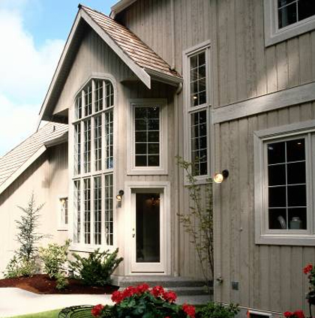
WHEN DO I PAY IT BACK?
When you sell the home
When the final surviving borrower dies, or
When you move away for more that 12 months

Slide 23
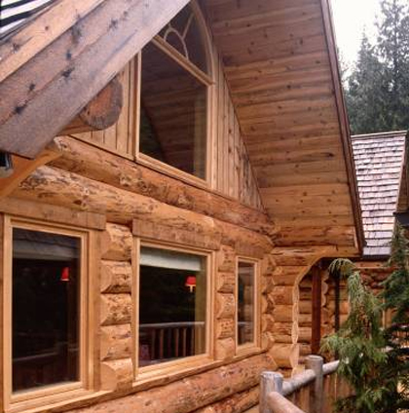
LENDERS CAN ALSO REQUIRE REPAYMENT IF YOU:
Fall behind on property taxes
Let your homeowner’s insurance lapse, or
Let the house fall into major disrepair

Slide 24
A REVERSE MORTGAGE CAN ALSO CONTAIN AN “ACCELERATION CLAUSE,” WHICH MAKES IT PAYABLE IN FULL IF YOU JEOPARDIZE THE SECURITY OF
THE LENDER IN SOME WAY. FOR INSTANCE:
You rent out your home (or a portion of it)
You add another owner to the home’s title
You change the zoning classification of your home
You take out another loan using your home as collateral

Slide 25

HOW MUCH WILL I OWE?
The total amount of all cash advances
Interest on those cash advances

Slide 26
HOW MUCH WILL I OWE?
You will never owe more than the value of the home when the loan is repaid
The lender has no recourse on anything that you or your heirs own except the home on which you took the reverse mortgage

Slide 27
HOW MUCH WILL I OWE?
No matter how long you live, no matter how much your home value declines, - you will never owe more than the actual value of your home

Slide 28

HOW IS IT PAID BACK?
From the proceeds of the sale of your home
Or from other funds if they’re available
If the borrower dies, the loan must be paid back before the title can be transferred to the heirs

Slide 29
WHAT DOES A REVERSE MORTGAGE COST?
Out of pocket costs generally consist of the appraisal and credit check
Other costs are generally financed with the loan
Be aware though that any costs which are financed into the loan will be tacked on to the loan balance on which you will pay interest

Slide 30

OTHER COSTS FOR A REVERSE MORTGAGE:
These costs are generally the same as a forward mortgage, including:
Closing costs
Origination fees
Interest charges
Title search
Insurance
Inspections
Mortgage taxes, etc.

Slide 31

IMPORTANT INFORMATION REGARDING THE COST OF THE LOAN:
All reverse mortgage lenders are required, under The Federal Truth in Lending Law, to disclose the projected annual cost of the loan

Slide 32

REMEMBER YOU ARE STILL A HOMEOWNER AND STILL RESPONSIBLE FOR:
Paying property taxes
Paying homeowner’s insurance
Making property repairs

Slide 33

ARE THERE DIFFERENT TYPES OF REVERSE MORTGAGES?
Yes. But the most popular and available reverse mortgage is the HECM (Home Equity Conversion Mortgage)

Slide 34
ABOUT THE HECM:
It is the only reverse mortgage insured by the federal government (FHA guarantees that the lenders will meet their obligations)
FHA tells HECM lenders how much they can lend to you, according to your age and the value of your home
HECM limits the costs of the mortgage
HECM loans usually provide the largest advances available

Slide 35
HECM IS USUALLY THE LOWEST COST REVERSE MORTGAGE AVAILABLE.
The only less expensive reverse mortgages are government mortgages typically available only:
For specific uses (such as remodeling your home)
To low or moderate income homeowners

Slide 36

IS A REVERSE MORTGAGE RIGHT FOR YOU?
Perhaps – but it is wisest to consult with your mortgage professional and accountant prior to making that decision.

