Slide 1
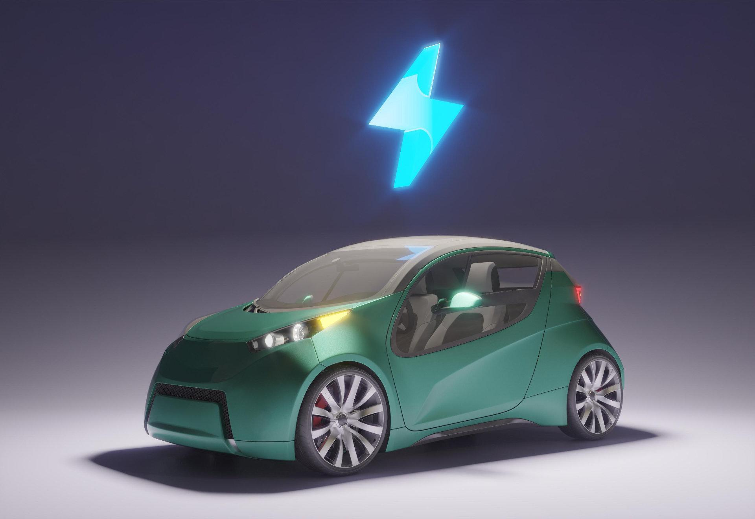
1
Electric car charging station
Welcome to my presentation ^^

Slide 2





2
Réalisé par :
Raslen ferchichi
Fares ben ammar
Alaa bouchakour
EV charging point management
Car management
Maintenance management
Youssef ben arous
Jasser ben yahmadi
Client Management
Employees management

Slide 3
3
01
02
Project presentation :
1.1 Project Idea
1.2 Problem Statement and Existing System Analysis
1.3 Competitor Analysis
1.4 Proposed Solution
2. Requirements Specification:
2.1 Functional Requirements
2.2 Non-Functional Requirements
2.3 Graphic/User Interface Design

Slide 4
4
Project Presentation
01

Slide 5
5
1.1
Project idea

Slide 6
6
1.1
Project Idea
Our project focuses on electric charging stations.
The application will use IoT (Internet of Things) principles to monitor and manage the stations in real time.
Our application simplifies and organizes the work at the charging stations.

Slide 7
7
1.2
Problem Statement and Existing System Analysis

Slide 8
8
1.2
Problématique et étude de l’existant
Problems with data loss between employees (messages, statistics, information, etc.).
Poor management of waiting times, with risks of overload and mishandling maintenance reservations.
Lack of interaction with clients, leading to difficulties in providing bonuses and offers to them.

Slide 9
9
1.3
Competitor Analysis

Slide 10
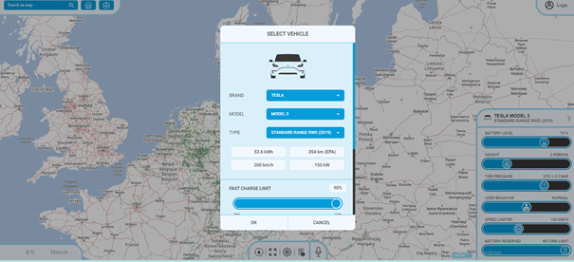
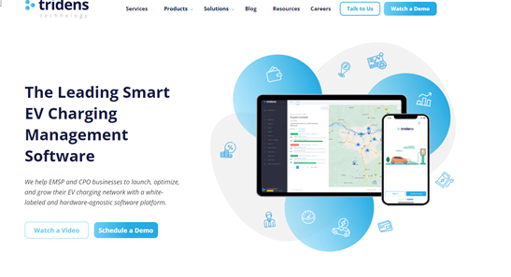
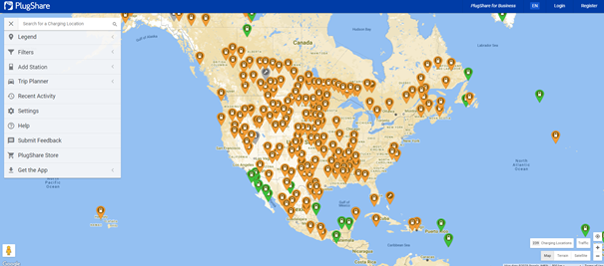
10
1.3
Competitor Analysis
There are several competing companies and projects, such as:
.Ev Station Manager which allows managing electric vehicle charging stations.
.Ev Charger Locator which provides information about the locations of electric vehicle charging stations.
.Ev Trip Planner which helps plan trips for electric vehicles..

Slide 11
11
1.4
Proposed Solution

Slide 12
12
1.4
Proposed Solution
Une application « Desktop »
Permettant la gestion des stations de recharge:
Elle permettra aux utilisateurs de gérer les informations sur
clients
véhicules
Maintenance workshops
Charging sessions
Employees

Slide 13
13
Requirements Specification :
02

Slide 14
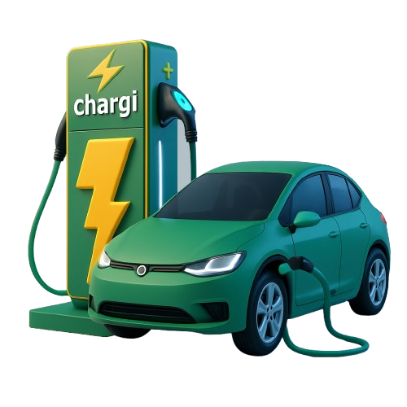
14
2.1
Functional requirements

Slide 15
Car Management :
15
Entity
Cars
Users
Employee
Admin
-Add a car
-Delete car
-Edit car
-View car
CRUD:
-Génération Pdf personnalisée
-Search and sorting
-Statistical calculations
+ Needle update during charging
+ Vehicle history
Features :

Slide 16
Employee management
16
Entity
Employee
Users
Employee
Admin
CRUD:
-Add Employee
-Delete Employee
- Edit Employee
-View Employee
Métiers:
-Generate personalized Pdf
-sorting/searching
-Authentification
-Prime membership

Slide 17
Client Management
17
Entity
Client
Users
Employee
Admin
-Add client
-Delete client
-Edit client
-View clients
CRUD:
-Generate personalized Pdf
-sorting/searching
-Calcul du statistique
-Offrire une carte de fidélité
-Prévenir le Happy-Hour
Métiers:

Slide 18
Maintenance Management :
18
Entity
Maintenances
Users :
Employee
Admin
-Add maintenance
-Delete maintenance
-Edit maintenance
-View maintenance
CRUD :
-Generate personalized Pdf
-Search and sorting
-Statistical calculations
-Reservation
-Notifications (when the car finish charging )
Métiers:

Slide 19
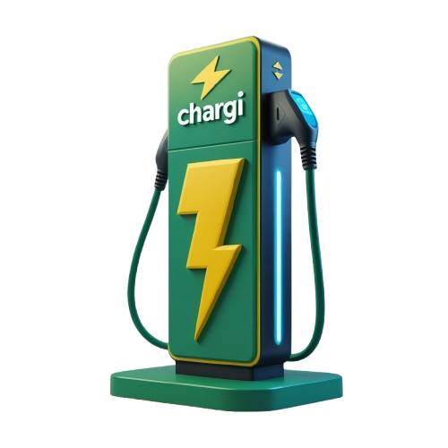
Ev charging point management
19
Entité
Ev charging point
Utilisateurs
Employé
Admin
-Add EV charging point
-Delete EV charging point
-Edit EV charging point
-View EV charging point
CRUD:
-Generate personalized Pdf
-Search and sorting
-Statistical calculations
- Happy-hour
- Ev Low Battery Model 🔋( recharge with solar panels )
Métiers:

Slide 20
20
2.2
Non functional requirements

Slide 21
21
2.2
Non functional requirements
Reliability : The charging station must be reliable and consistently functional to ensure customer satisfaction.
Safety : The charging station must be secure to prevent accidents or vehicle theft
Cost : The cost of the application will be affordable.

Slide 22
22
2.3
Graphic design

Slide 23

23
2.3
Graphic design
CONFORTA
( normal )
#81e54f
#d3d3d3
LOGO
POLICE
COULEUR

Slide 24
24
Thank you for your time and attention ^^

