Slide 1

JHipster

Slide 2
What is Jhipster?
JHipster is a high level code generator.
With just small amount of shell commands, it creates a full-fledged Java web project with a friendly, responsive front-end, documented REST API, comprehensive test coverage, basic security and database integration!

Slide 3
Components
Yeoman, a front-end scaffolding tool
Good old Spring Boot
AngularJS, the prominent Javascript framework. JHipster also works with AngularJS 2

Slide 4
Other technologies leveraged
Swagger, for API documentation
Maven, Npm, Yarn, Gulp and Bower as dependency managers and build tools
Jasmine, Protractor, Cucumber and Gatling as test frameworks
Liquibase for database versioning

Slide 5
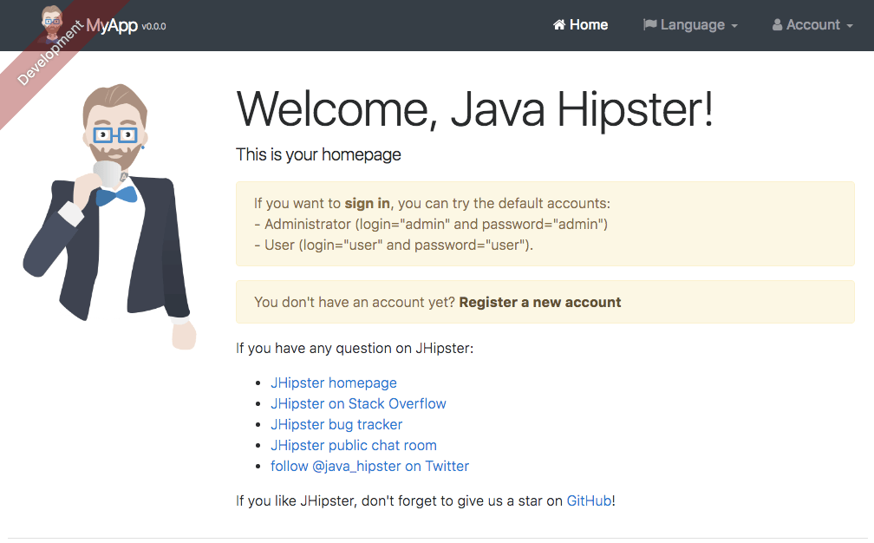

Slide 6
Installation ,creation commands
Softwares needed
Commands to start
Next steps
Java – release 8 recommended
Git – the version control system
NodeJS
Yeoman
Yarn
yarn global add generator-jhipster
mkdir rasminewapp
cd rasminewapp
yo jhipster
The process involves 15 steps

Slide 7
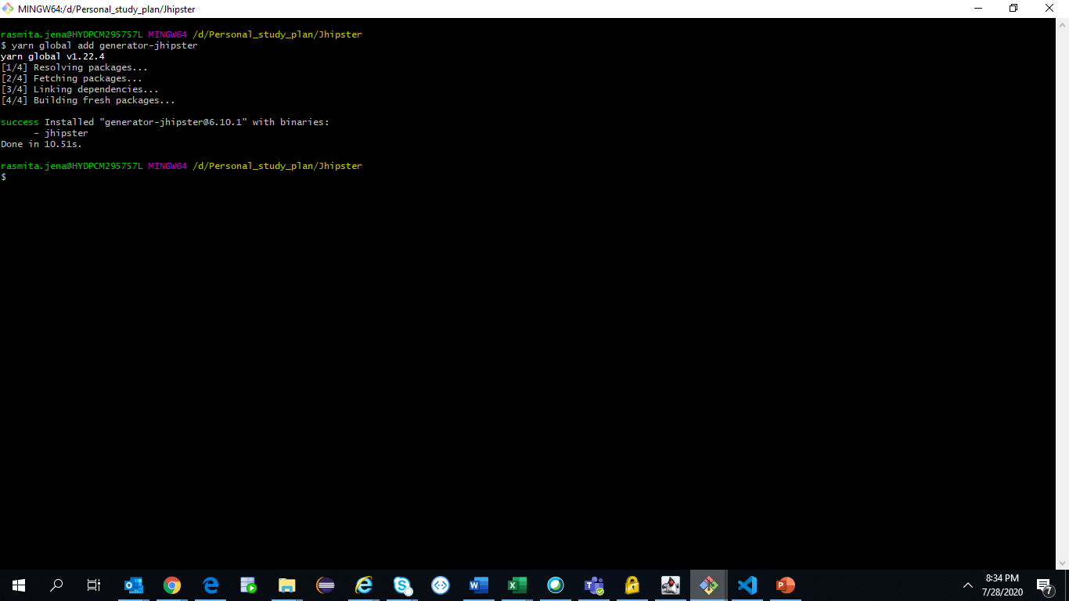

Slide 8
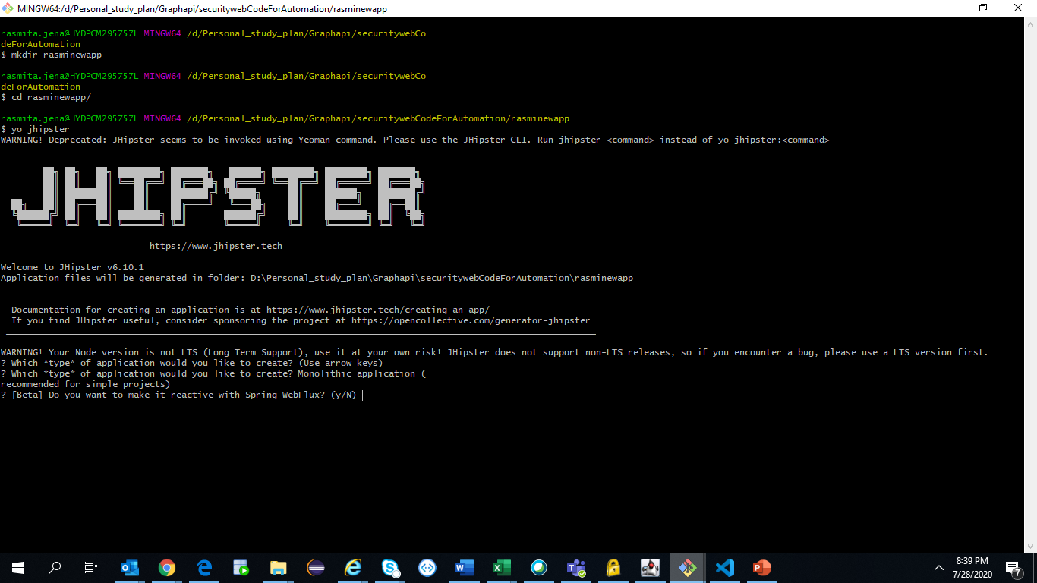

Slide 9
Significant steps while creating project
Type of application – Choose Monolithic application (recommended for simple projects)
Installation of other generators from the JHipster Marketplace – Type N. In this step we could want to install cool add-ons. Some popular ones are entity-audit that enables data tracing; bootstrap-material-design, that uses the trendy Material Design components, and angular-datatables
Maven or Gradle – Choose Maven
Other technologies – Do not select any options, just press Enter to move to the next step. Here we can choose to plug in Social login with Google, Facebook, and Twitter, which is a very nice feature.
Client framework – Choose [BETA] Angular 2.x. We could also go with AngularJS 1
Enable internationalization – Type Y, then choose English as the native language. We can

Slide 10
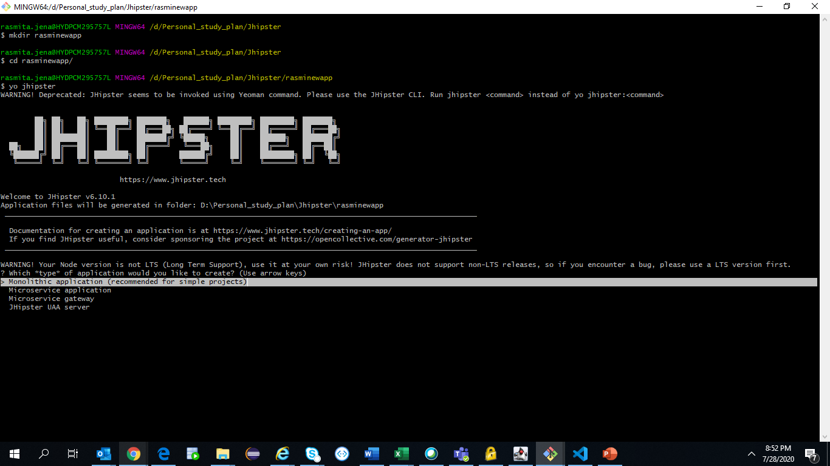

Slide 11
https://dzone.com/articles/getting-started-with-jhipster-part-i

Slide 12
https://www.baeldung.com/jhipster

